Slide 1
Chapter 5: Indications for Mechanical Ventilation

Slide 2
Chapter Objectives
Explain the primary function of a mechanical ventilator.
Define respiratory failure and explain the differences between hypoxemic and hypercapnic respiratory failure.
Define acute ventilatory failure.
Describe each of the components of ventilation including the relationship between tidal volume, respiratory rate, minute volume, physiologic dead space and alveolar ventilation.
Define ventilatory capacity and describe factors which affect ventilatory capacity.

Slide 3
Chapter Objectives (cont’d)
Define ventilatory requirements (aka ventilatory demand or load) and describe factors which affect ventilatory requirements.
Explain the relationship between ventilatory capacity and ventilatory requirements in terms of adequacy of ventilation and development of acute ventilatory failure.
Describe clinical conditions which may reduce or eliminate respiratory drive.
Describe factors that may impair lung function and explain how they may reduce ventilatory capacity.

Slide 4
Chapter Objectives (cont’d)
Describe clinical conditions which increase ventilatory workload and may lead to ventilatory muscle fatigue and ventilatory failure.
Explain how changes in ventilatory muscle strength affect ventilatory capacity.
Describe the disease states or conditions which cause ventilatory muscle weakness or dysfunction and predispose patients to the development of respiratory failure, hypoventilation and/or apnea.

Slide 5
Chapter Objectives (cont’d)
Explain the relationship between alveolar ventilation (𝑉 ̇A), arterial carbon dioxide tension (PaCO2), metabolic rate and carbon dioxide production (𝑉 ̇CO2).
Describe the normal ventilatory response to hypoxemia.
Describe the effects of increased physiologic dead space on ventilatory requirements.
Explain how metabolic acidosis may affect ventilatory requirements.
List common causes of acute respiratory failure requiring mechanical ventilation.

Slide 6
Chapter Objectives (cont’d)
Explain the seven primary goals of mechanical ventilatory support.
Provide examples of clinical causes of each of the four primary indications for institution of mechanical ventilation.
List values for bedside measures of pulmonary function which suggest the need for mechanical ventilatory support.
Explain why certain neuromuscular disorders may progress to ventilatory failure requiring mechanical ventilation.
Recognize the presence of severe oxygenation problems including refractory hypoxemia.

Slide 7
Chapter Objectives (cont’d)
Explain how PEEP and CPAP may improve oxygenation in certain patients.
Recognize patients for which institution of mechanical ventilatory support is indicated.
Describe the major complications, hazards and contraindications of mechanical ventilation.
Overview the initial ventilator settings for patients requiring mechanical ventilatory support.
Describe the clinical manifestations of acute respiratory failure associated with the need for mechanical ventilatory support.

Slide 8
Chapter Overview
Indications for mechanical ventilatory support
Functions of mechanical ventilation
Causes of hypoventilation and apnea
Types of respiratory failure
Goals of mechanical ventilation
Contraindications, hazards, and complications of mechanical ventilation
Patient assessment for determining the need for mechanical ventilation

Slide 9
Ventilation
Ventilation can be defined as the bulk movement of gas into and out of the lungs.
Adequate spontaneous ventilation requires a sufficient tidal volume, respiratory rate, and minute volume to support oxygenation and CO₂ removal, while maintaining acid-base homeostasis
Tidal volume (Vt) = the volume of gas passively exhaled after a normal inspiration
Respiratory rate (f) = the number of breaths taken per minute
Minute volume ($\dot{V}$E) = Vt x f

Slide 10
Ventilation (cont’d)
The single best clinical index of ventilation is the measurement of arterial carbon dioxide tension (PaCO₂)
Normal ventilation: PaCO₂ = 35-45 mmHg
Hypoventilation: PaCO₂ >45 mmHg
Hyperventilation: PaCO₂ < 35 mmHg
Venous blood gases are frequently utilized to assess pH, and a PvCO₂ > 50mm Hg suggests possible hypercapnia

Slide 11
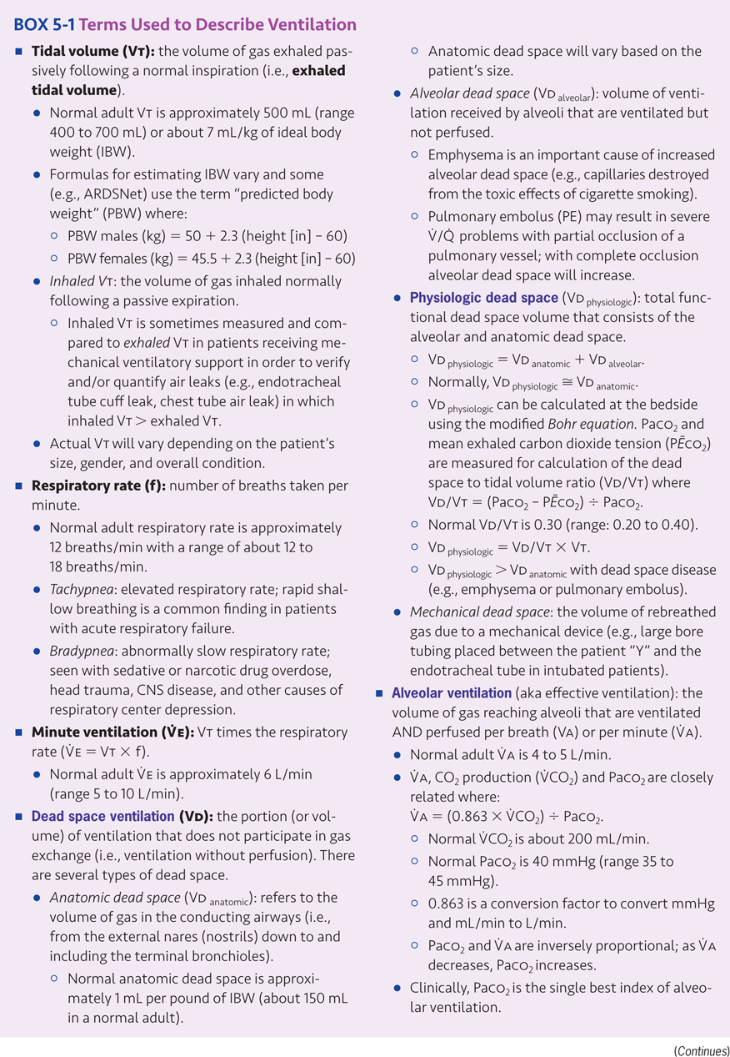

Slide 12
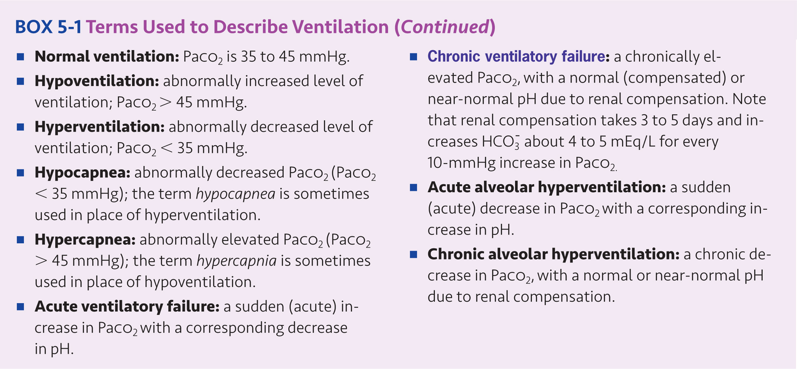

Slide 13
Ventilatory Capacity and Ventilatory Requirements
Ventilatory capacity is a general term indicating the amount of air that can be moved into and out of the lungs by the ventilatory pump (how much the patient can breathe).
If ventilatory capacity is insufficient to provide the level of ventilation required to maintain adequate tissue oxygenation and CO₂ removal, mechanical ventilatory support may be necessary.
Affected by many factors, including respiratory drive, lung function, ventilatory workload, and ventilatory muscle strength

Slide 14
Ventilatory Capacity and Ventilatory Requirements (cont’d)
Ventilatory requirements (aka ventilatory demand or load) refers to the volume of ventilation required to achieve adequate oxygenation and carbon dioxide removal (how much the patient must breathe).
Determined by the patient’s oxygenation status, carbon dioxide production, lung function, circulatory status, and acid-base status
The difference between ventilatory capacity and ventilatory requirements is the ventilatory reserve
When ventilatory requirements > ventilatory capacity, hypercapnic respiratory failure may occur

Slide 15
Factors Affecting Ventilatory Capacity
Respiratory drive (aka ventilatory drive)
Resides primarily in the central respiratory centers, which respond to input from the central chemoreceptors in the medulla of the brainstem and the peripheral chemoreceptors of the carotid and aortic bodies
Respiratory centers are stimulated by hypoxemia, hypercarbia, and acidosis.
May result in rapid shallow breathing
Respiratory drive can be reduced or abolished by administration of narcotics, sedatives, tranquilizers or anesthetic gases.
May result in hypoventilation or apnea, and may lead to the need for mechanical ventilation, shock, trauma or myocardial infarction may lead to respiratory and cardiac arrest

Slide 16
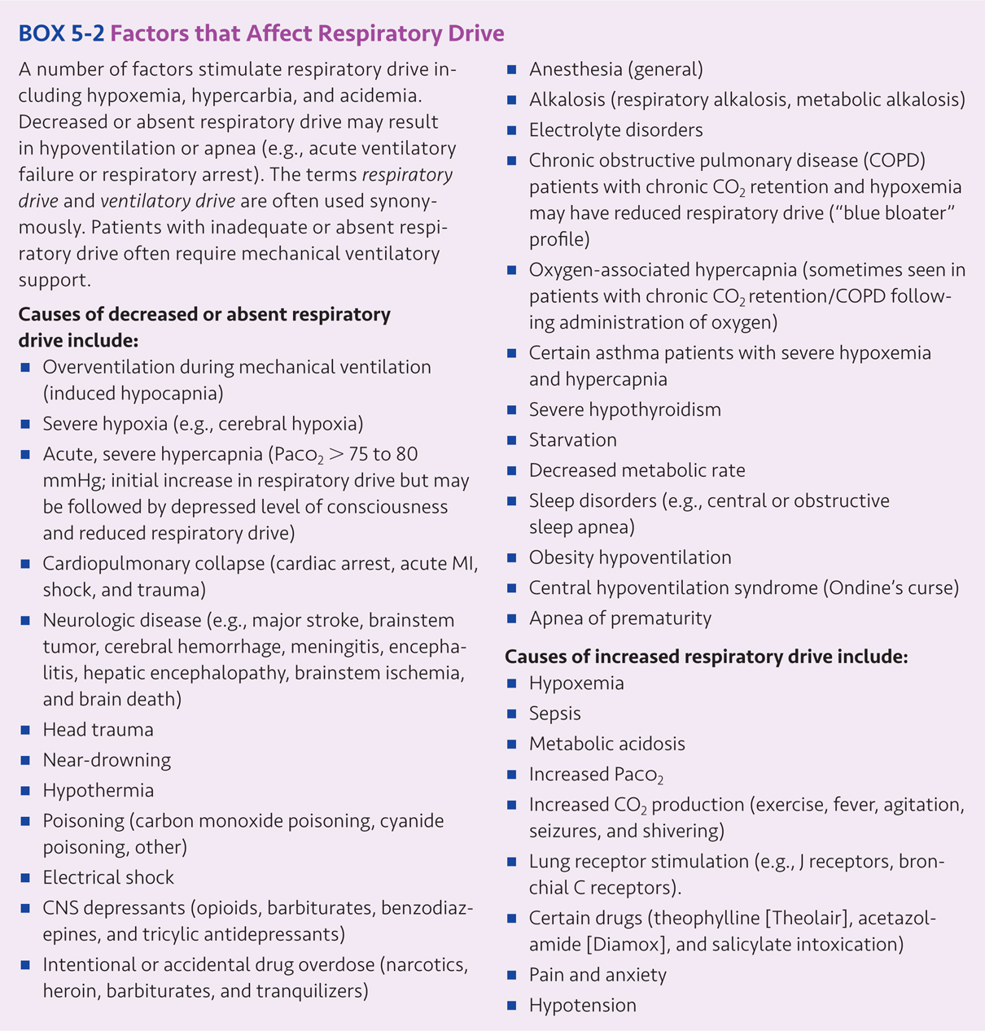

Slide 17
Factors Affecting Ventilatory Capacity (cont’d)
Lung Function
Factors that may reduce vital capacity
Upper airway obstruction (e.g., bronchospasm, mucosal edema, or secretions)
Decreased lung compliance (e.g., pneumonia, pulmonary edema, fibrotic lung disease)
Decreased thoracic compliance (e.g., chest wall deformity, obesity, ascites)
Alveolar filling (e.g., consolidative pneumonia, pulmonary edema)
Atelectasis
Alveolar wall destruction (e.g., emphysema)
Interstitial fibrosis

Slide 18
Factors Affecting Ventilatory Capacity (cont’d)
Workload (aka work of breathing/ WOB)
The amount of work performed by the respiratory muscles to provide adequate ventilation
Determined by compliance of the lungs and thorax, or resistance to gas flow
Reduced compliance or increased resistance cause an increase in ventilatory workload
May cause ventilatory muscle fatigue, ventilatory muscle weakness, reduced ventilatory capacity, and may result in respiratory failure

Slide 19
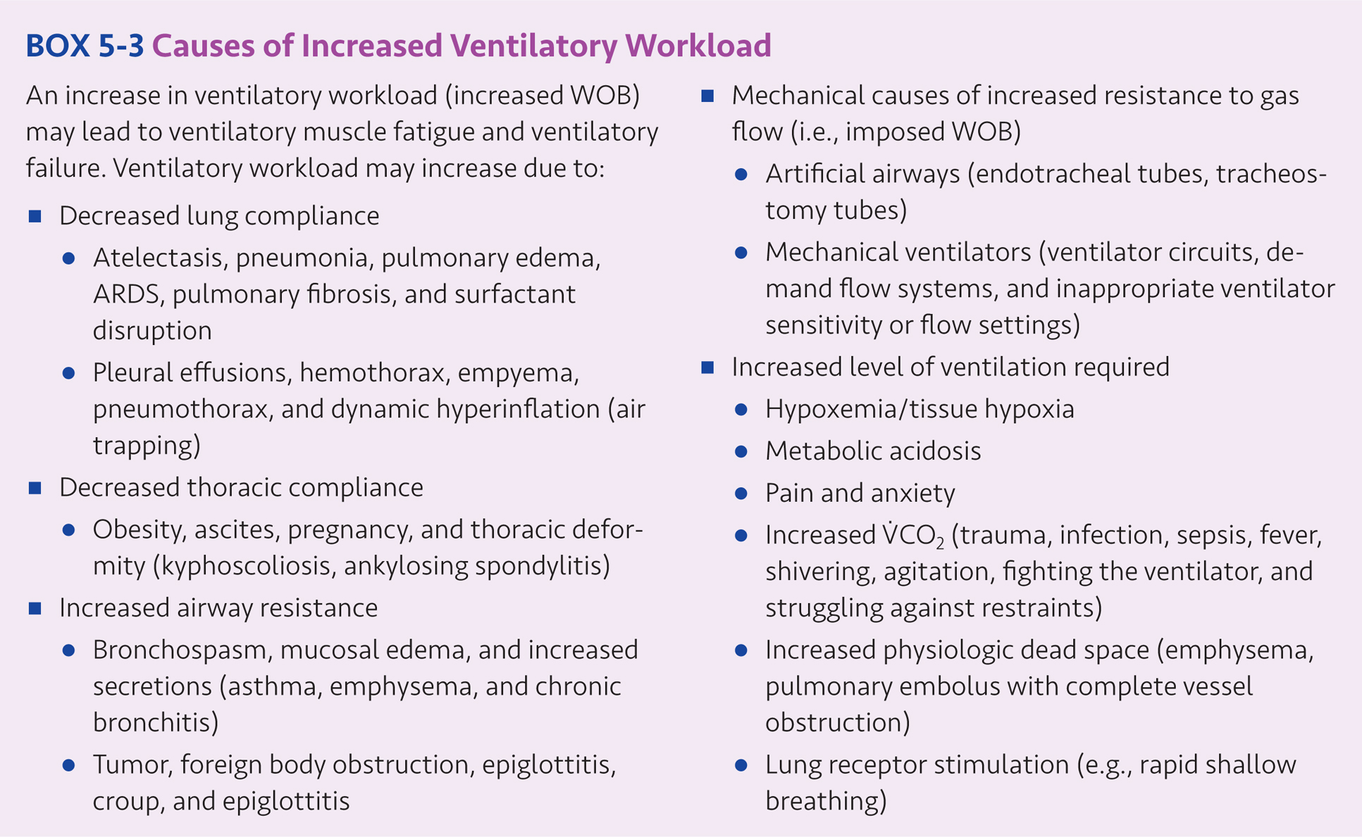

Slide 20
Factors Affecting Ventilatory Capacity (cont’d)
Ventilatory Muscles
Reduced ventilatory muscle strength or endurance reduces ventilatory capacity
Disease states causing muscle weakness or dysfunction which may lead to respiratory failure, hypoventilation, and/or apnea:
Amyotrophic lateral sclerosis (ALS): Chronic and relentless motor neuron disease resulting in progressive voluntary muscle weakness which eventually leads to respiratory failure. Patients with end stage disease require mechanical ventilatory support in order to survive.

Slide 21
Factors Affecting Ventilatory Capacity (cont’d)
Disease states continued:
Botulism: Caused by ingestion of food contaminated with Clostridium botulinum which produces a nerve toxin that affects the neuromuscular junction and may cause skeletal muscle paralysis and respiratory failure.
Critical illness myopathy and polyneuropathy: Associated with corticosteroid administration, neuromuscular blocking agents, systemic inflammatory response and other conditions sometimes seen in critically ill patients (e.g., sepsis). Causes generalized muscle weakness, including ventilatory muscle weakness which may cause difficulty in weaning from mechanical ventilatory support.

Slide 22
Factors Affecting Ventilatory Capacity (cont’d)
Disease states continued:
Duchenne muscular dystrophy: A genetic disorder resulting in muscle weakness which progressively worsens with age. As the patient’s condition declines, nocturnal noninvasive ventilation may be needed. Eventually, tracheostomy and invasive ventilation may be required.
Guillian Barré syndrome: A motor neuron disease which causes progressive weakness and flaccid paralysis of the arms and legs. Involvement of the diaphragm requiring mechanical ventilation occurs in up to 30% of cases, however, generally resolves in about four weeks.
Malnutrition: Causes generalized skeletal muscle weakness, which may predispose patients to the development of respiratory failure

Slide 23
Factors Affecting Ventilatory Capacity (cont’d)
Disease states continued:
Multiple sclerosis (MS): A central nervous system disease which damages the myelin sheath of nerves and disrupts nerve transmission from the brain to other parts of the body. In advanced cases, patients may require tracheostomy and intermittent or continuous mechanical ventilatory support.
Myasthenia gravis: An autoimmune disease which affects the neuromuscular junction and may cause relapsing, chronic respiratory muscle weakness

Slide 24
Factors Affecting Ventilatory Capacity (cont’d)
Disease states continued:
Neuromuscular blocking agents: Neuromuscular blocking agents (e.g., pancuronium, vercuronium, atracurium, cistracurium) block nerve transmission at the myoneural junction and cause ventilatory muscle paralysis.
Poliomyelitis: Polio virus infection causes loss of motor neurons and results in varying degrees of muscle weakness and paralysis. Post-polio syndrome may cause a syndrome of new or progressive disability.

Slide 25
Factors Affecting Ventilatory Capacity (cont’d)
Disease states continued:
Tetanus: Caused by infection with Clostridium tetani spores which produce a toxin that produces uncontrolled skeletal muscle contractions.
Tick paralysis: Although this disease is rare in humans, certain ticks produce a toxin which may be transmitted following a tick bite and cause life threatening paralysis.

Slide 26
Ventilatory Requirements
Ventilatory requirements (aka ventilatory demand or ventilatory load) are determined by the patient’s oxygenation needs, CO₂ production, lung function, and acid-base status.
The level of ventilation required to remove CO₂ is determined by metabolic rate, diet and associated CO₂ production ($\dot{V}$CO₂)
Factors that increase metabolic rate, $\dot{V}$CO₂ and $\dot{V}$O₂: fever, shivering, agitation, trauma, sepsis, and other hypermetabolic states

Slide 27
Ventilatory Requirements (cont’d)
Causes of hypoxemia: hypoventilation, V/Q mismatch, and diffusion limitations
Causes of decreased tissue oxygen delivery: problems with hemoglobin and reduced cardiac output or tissue perfusion
Hyperventilation is caused by metabolic acidosis, which is caused by lactic acidosis, renal failure, ketoacidosis, poisoning, loss of bicarbonate, carbonic anhydrase inhibitors, and renal tubular acidosis

Slide 28
Calculating Ventilatory Requirements
Example:
At rest, normal $\dot{V}$CO₂ = 200 mL/min, oxygen consumption ($\dot{V}$O₂) = 250 mL/min, requiring an alveolar ventilation ($\dot{V}$A) = 4-5 L/min in order to maintain a normal PaCO₂ of 40 mm Hg.
$\dot{V}$A = (0.863 x $\dot{V}$CO₂) ÷ PaCO₂
$\dot{V}$A = (0.863 x 200 mL/min) ÷ 40 mm Hg = 4.3 L/min
If $\dot{V}$CO₂ increased to 300 mL/min, the required $\dot{V}$A to achieve a normal PaCO₂ of 40 mm Hg would be:
$\dot{V}$A = (0.863 x 300 mL/min) ÷ 40 mm Hg = 6.47 L/min
This example illustrates that with increases in $\dot{V}$CO₂, alveolar ventilation must increase in order to maintain a normal PaCO₂.

Slide 29
Assessment of Ventilation
Assessment of ventilation determines a patient’s need for mechanical ventilation.
Assessment includes: patient history, patient examination, measurement of oxygen saturation, and arterial blood gas analysis
The most effective measurement of ventilation is PaCO₂.
Pulmonary function is measured by respiratory rate, tidal volume, minute volume, vital capacity, and maximum inspiratory pressure.
Calculating rapid shallow breathing index (RSBI) may also be useful to determine the ability to maintain spontaneous breathing.

Slide 31
Clinical Manifestations of Respiratory Failure
The most common reason for initiating mechanical ventilatory support: acute respiratory failure
Causes of acute respiratory failure requiring mechanical ventilation include: pneumonia, ARDS, trauma, sepsis, postoperative respiratory failure, COPD exacerbation, heart failure, coma, neuromuscular disease, sedative or narcotic drug overdose, and pulmonary aspiration
Early manifestations include: tachycardia, tachypnea, diaphoresis, anxiety, and respiratory distress followed by depressed mental status, confusion, solemnness, and coma

Slide 32
Clinical Manifestations of Respiratory Failure (cont’d)
The most common reason for initiating mechanical ventilatory support: acute respiratory failure (cont’d)
Physical findings: accessory muscle use, intercostal retractions, and asynchrony chest wall/diaphragmatic movement
Altered ventilation includes increased respiratory rate and rapid shallow breathing leading to irregular breathing, apneic periods, or respiratory arrest.
Blood gases reveal hypoxemia, hyperventilation, and alkalosis, followed by hypoventilation, hypercapnia, and respiratory acidosis.

Slide 33
Goals of Mechanical Ventilatory Support
The primary goals of mechanical ventilation:
Provide adequate alveolar ventilation
Ensure adequate tissue oxygenation
Restore and maintain acid-base homeostasis
Reduce the work of breathing
Ensure patient safety and comfort
Minimize harmful side effects and complications
Promote liberation of the patient from the ventilator

Slide 34
Goals of Mechanical Ventilatory Support (cont’d)
Other goals of mechanical ventilation:
Normalize alveolar ventilation and PaCO₂
Correct respiratory and metabolic acidosis
Revere hypoxemia
Relieve respiratory distress
Reduce cardiac work
Restore or maintain lung volumes
Prevent/treat atelectasis
Internal stabilization of the chest wall in the case of severe chest trauma

Slide 35
Indications for Mechanical Ventilation
Apnea
Definition: Complete cessation of breathing and failure to institute mechanical ventilatory support
Acute ventilatory failure
Definition: A sudden increase in PaCO₂ with a corresponding decrease in pH
Impending ventilatory failure
Definition: When ventilatory failure is likely to occur in the immediate future
Severe/refractory oxygenation problems (refractory hypoxemia)
Definition: When PaO₂ < 60 mm Hg and SaO₂ < 90% while receiving conventional oxygen therapy

Slide 36
Indications for Mechanical Ventilation (cont’d)
Apnea
May lead to cardiac arrest
Airway obstruction can block airflow into the lungs.
Possible causes: upper airway foreign body aspiration, upper airway swelling from anaphylaxis, epiglottitis, airway trauma, laryngospasm post-extubation
Treatment includes securing the airway with an oral pharyngeal airway and providing positive pressure ventilatory support
If spontaneous breathing does not occur, intubation should be performed and mechanical ventilation support should be provided.
Upper airway obstruction or acute laryngospasm occasionally requires emergent tracheostomy.

Slide 37
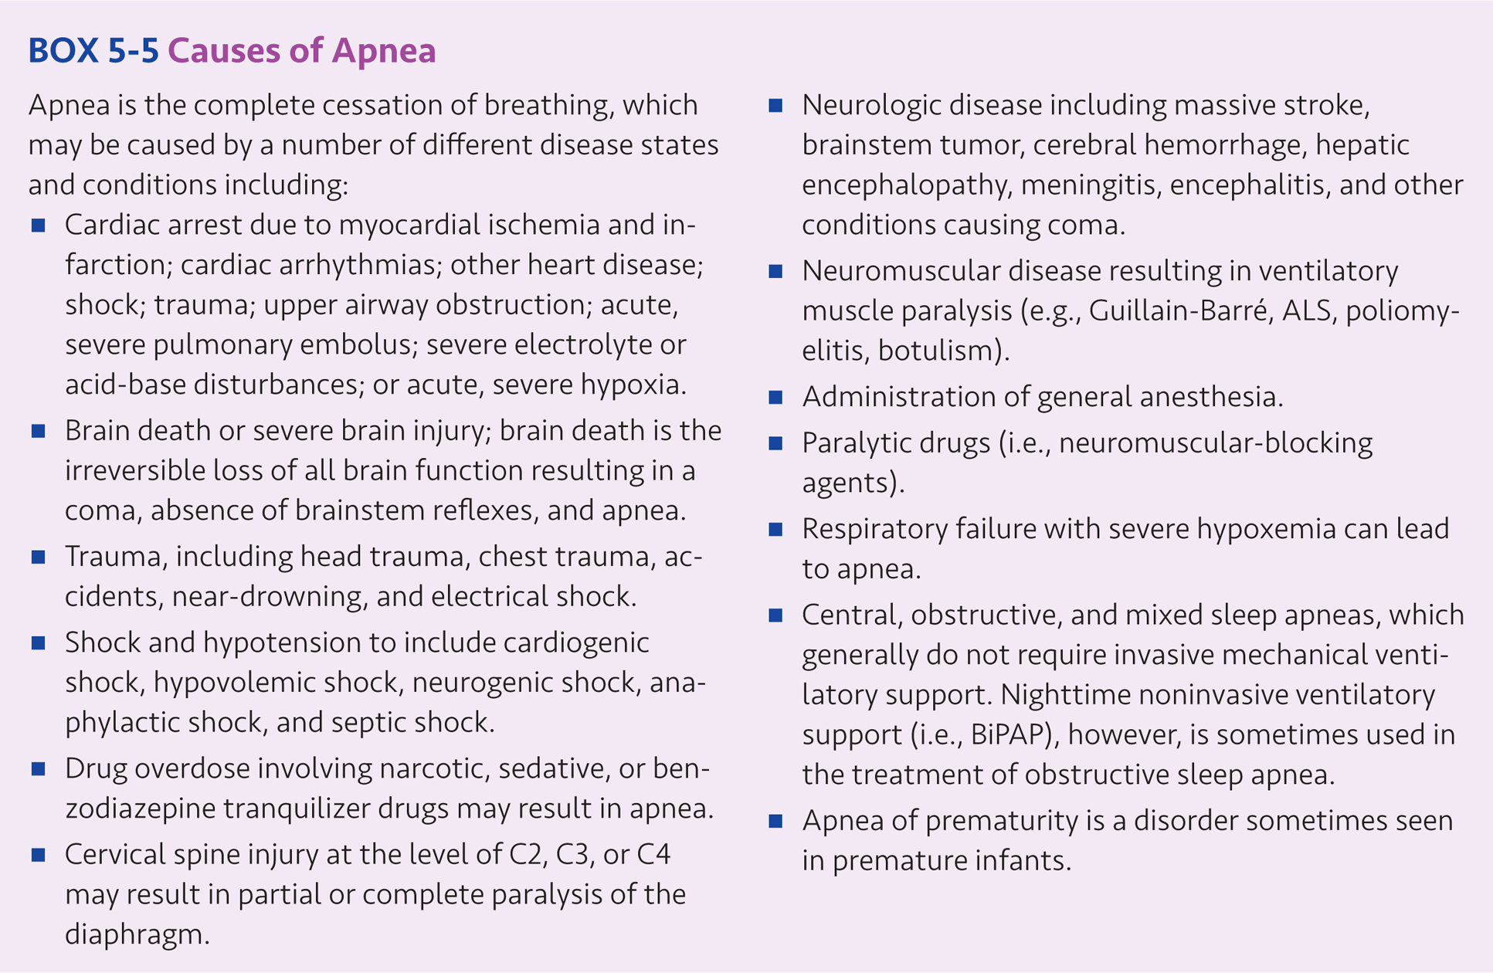

Slide 38
Indications for Mechanical Ventilation (cont’d)
Acute Ventilatory Failure (AVF)
Also known as acute hypercapnic respiratory failure
AVF initially results in an uncompensated respiratory acidosis.
Generally speaking, an acute increase in PaCO₂ resulting in a decrease in pH to ≤ 7.25 provides a clear indication for mechanical ventilation.
Acute ventilatory failure should not be confused with chronic ventilatory failure.
Chronic ventilatory failure: PaCO₂ is chronically elevated and pH is normal or near normal due to metabolic compensation.
Chronic ventilatory failure may lead to acute ventilatory failure superimposed on chronic ventilatory failure, which may lead to the need for mechanical ventilation.

Slide 39
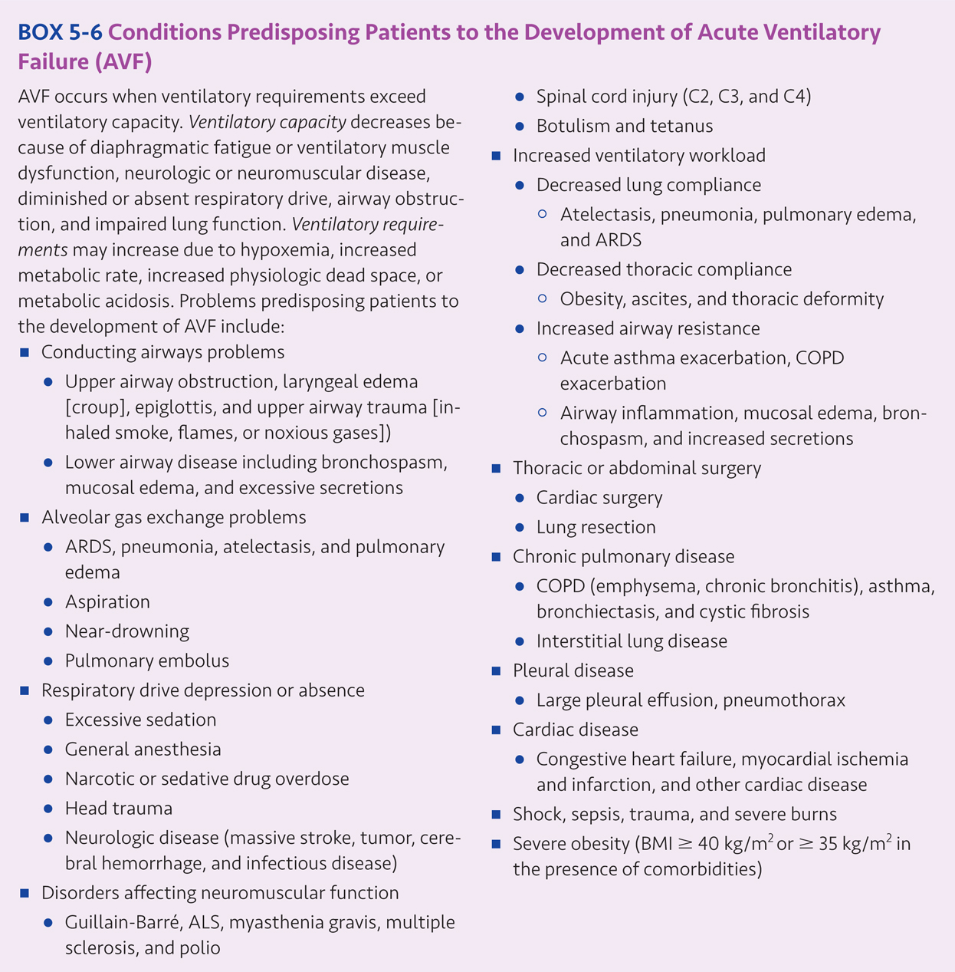

Slide 40
Indications for Mechanical Ventilation (cont’d)
Impending Ventilatory Failure
Ventilatory support may be initiated prior to the development of an acute, severe respiratory acidosis.
The decision to begin ventilatory support is based on patient assessment, knowledge of the typical progression of the patient’s disease state or condition and the clinical judgement that the patient will progress to acute ventilatory failure in the near future.
Clinical presentation: extreme tachypnea (f > 35), severe dyspnea, accessory muscle use, intercostal retractions, significant diaphoresis, dusky skin, and altered mental status

Slide 41
Indications for Mechanical Ventilation (cont’d)
Impending Ventilatory Failure (cont’d)
Treatment includes noninvasive ventilation may be attempted for 30-120 minutes or high flow heated/humidified nasal cannulas before using mechanical ventilation
Certain neuromuscular diseases may progress to ventilatory failure, including Guillian Barré syndrome, myasthenia gravis, severe muscular dystrophy, and amyotrophic lateral sclerosis (ALS)

Slide 42
Indications for Mechanical Ventilation (cont’d)
Refractory hypoxemia
PaO₂/Fio₂ ratio (P/F ratio): measures the effectiveness of oxygen transfer across the lung.
Normal P/F ratio= 380 - 476 mm Hg
P/F ratios ≤ 300 mm Hg are associated with oxygenation problems.
Mild ARDS: P/F 200-300 mmHg (while receiving 5 cm H₂O PEEP)
Moderate ARDS: P/F 100-200 mmHg (while receiving 5 cm H₂O PEEP)
Severe ARDS: P/F ≤ 100 mm Hg (while receiving 5 cm H₂O PEEP)

Slide 43
Indications for Mechanical Ventilation (cont’d)
Treatment includes positive end-expiratory pressure (PEEP), continuous positive airway pressure (CPAP), or other techniques.
Patients with ARDS have severe oxygenation problems due to increased intrapulmonary right-to-left shunt.
Patients with large intrapulmonary shunts experience significant hypoxemia, which does not respond well to low-moderate concentrations of oxygen therapy.
Increased work of breathing due to decreased lung compliance is common in patients with acute, restrictive lung disease (e.g., pneumonia, ARDS).

Slide 44
Complications, Hazards, and Contraindications
Complications and hazards
Barotrauma, airway injury, infection, ventilator-associated pneumonia, pulmonary embolus, gastrointestinal bleeding, and ventilatory muscle atrophy and dysfunction
Also, positive pressure to the airways reduces venous return to the right side of the heart, causing hypovolemia and initiation of mechanical ventilation may result in hypotension, and may result in life threatening complications, including death.

Slide 45
Complications, Hazards, and Contraindications (cont’d)
Contraindications
Untreated pneumothorax, lack of indication for mechanical ventilation, rapid resolution of the underlying condition, life support interventions are futile and when mechanical ventilation is contrary to the patient’s wishes.

Slide 46
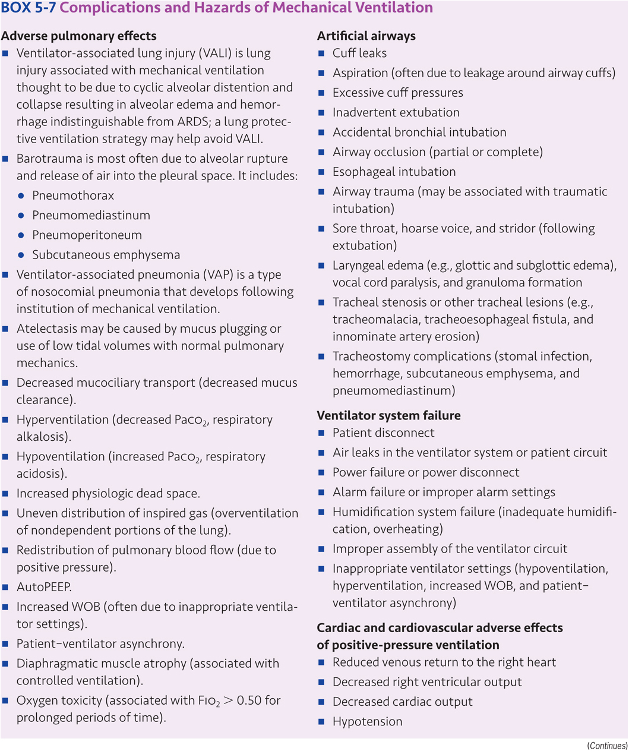

Slide 48
Patient Assessment for Ventilator Initiation
The decision to initiate mechanical ventilatory support should be based on a thorough patient assessment, sound clinical judgment, and understanding of the indications and associated contraindications, complications and hazards of mechanical ventilation.
Assessment of the patient’s oxygenation and ventilatory status, acid-base balance, cardiac and cardiovascular function, and CNS and mental status
The most common reason for initiating mechanical ventilation is acute respiratory failure (aka hypoxemic respiratory failure).

Slide 49
Initial Ventilator Settings
Many ventilators allow the clinician to choose between providing partial and full ventilatory support.
Apneic patients require full ventilatory support.
Spontaneously breathing patients may require partial ventilatory support using some form of synchronized intermittent mandatory ventilation (SIMV).
Available modes include:
Continuous mandatory ventilation (CMV)
Intermittent mandatory ventilation (IMV)
Continuous spontaneous ventilation (CSV)
Manufacturers use an array of different terms to describe the modes available on their ventilators.
For example, the Covidien Puritan-Bennett 840 and Maquet Servo-i have modes with the same function but are named differently, such as volume control + (VC+) and pressure regulated volume control (PRVC), respectively.

Slide 50
Initial Ventilator Settings (cont’d)
Volume control- continuous mandatory ventilation (VC-CMV)
Control variable: volume
Both volume and flow are preset prior to inspiration and volume delivery is not affected by changes in lung compliance or airway resistance.
CMV with an “s” subscript (CMVs) indicates that all breaths are mandatory, but may be patient or machine (i.e., time) triggered to inspiration.
If the ventilator is setup to allow for a patient triggered or machine triggered, volume-targeted mandatory breath, the mode is commonly referred to as assist – control (A/C) volume ventilation (aka patient triggered or time triggered CMV).
If only machine triggered, volume-targeted breaths are allowed, the ventilator is in the control mode (aka time triggered CMV).

Slide 51
Initial Ventilator Settings (cont’d)
Volume control- intermittent mandatory ventilation (VC-IMV)
Control variable: volume
During mandatory breaths volume delivery remains constant. IMV and synchronized intermittent mandatory ventilation (SIMV) may be used to provide partial or full ventilatory support.
IMV indicates that patients may breathe spontaneously between machine triggered mandatory breaths.
SIMV is the most common form of IMV in which the mandatory breaths are patient triggered.
SIMV also allows patients to breathe spontaneously between mandatory breaths and the machine breaths are “synchronized” to the end of the patient’s exhalation.

Slide 52
Initial Ventilator Settings (cont’d)
Pressure control- continuous mandatory ventilation (PC-CMV)
Control variable: pressure
Inspiratory pressure is preset as either a constant value or proportional to the patient’s inspiratory effort.
Inspiration is pressure limited and time cycled.
CMV indicates that all breaths are mandatory and breaths may be machine or patient triggered.
A commonly used form of this mode delivers a predetermined minimum mandatory rate and allows the patient to trigger the ventilator at a higher rate (i.e., assist-control mode)

Slide 53
Initial Ventilator Settings (cont’d)
Pressure control- intermittent mandatory ventilation (PC-IMV)
Control variable: Pressure
IMV indicates that the patient may breathe spontaneously in between mandatory breaths
Pressure control- continuous spontaneous ventilation (PC-CSV)
Control variable: Pressure
CSV indicates all breaths are spontaneous.
A commonly used form of this mode is referred to as pressure support ventilation (PSV) in which each breath is patient triggered
Inspiratory pressure is preset and inspiration is flow cycled to expiration

Slide 54
Initial Ventilator Settings (cont’d)
Other important settings include:
Tidal volume: based on the patient’s condition and clinical goals. Large tidal volumes may result in high airway pressures which may cause ventilator-induced lung injury.
Respiratory rate: when combined with tidal volume, minute ventilation and PaCO₂ can be determined. An approximate minute volume goal to achieve full ventilatory support for most adult patients is about 100 mL/kg IBW.
Sensitivity: must be set at a level where patient triggering requires minimal patient effort without auto-cycling

Slide 55
Initial Ventilator Settings (cont’d)
Inspiratory flow rate: should be sufficient to meet or exceed patients’ inspiratory demand and expiratory time should be sufficient to avoid the development of auto PEEP
Inspiratory flow pattern: may have an impact on inspiratory time as well as peak and mean airway pressures and distribution of the inspired gas
Oxygen concentration: generally set at the lowest level required to correct hypoxemia and avoid oxygen toxicity
PEEP/CPAP: often added to prevent end-expiratory alveolar collapse and improve $\dot{V}$/$\dot{Q}$ and arterial oxygenation while allowing for reduction in Fio₂

Slide 56
Initial Ventilator Settings (cont’d)
Once the decision has been made to institute mechanical ventilatory support, the respiratory care clinician must adjust the level of support provided to achieve adequate alveolar ventilation, maintain acid-base homeostasis, and insure adequate tissue oxygenation.
Ventilator settings should be selected that reduce the patient’s work of breathing, ensure patient comfort and avoid patient-ventilator breathing asynchrony.
Patient safety must be ensured and avoidance of the complications and hazards of mechanical ventilation, wherever possible, must occur.
Last, but not least, patient management should promote liberation of the patient from the ventilator as soon as reasonably prudent.

Slide 57
Key Points
The primary function of the mechanical ventilator is to augment or replace normal ventilation.
Respiratory failure is the inability of the heart and lungs to maintain adequate tissue oxygenation and/or carbon dioxide removal; hypoxemic respiratory failure (aka lung failure) is a problem with oxygenation while hypercapneic ventilatory failure (aka pump failure) is a problem with ventilation resulting in an abnormal increase in PaCO₂.
Mechanical ventilation may be required when spontaneous breathing is insufficient or absent.

Slide 58
Key Points (cont’d)
Respiratory failure is the most common reason for initiating mechanical ventilatory support.
Acute ventilatory failure (aka acute hypercapnic respiratory failure) is a sudden rise in PaCO₂ with a corresponding decrease in pH.
The major components of ventilation are tidal volume, respiratory rate and minute volume.
Alveolar ventilation is determined by tidal volume, respiratory rate, and physiologic dead space.

Slide 59
Key Points (cont’d)
Ventilatory capacity refers to the amount of air that can be moved into and out of the lungs by the ventilatory pump.
Ventilatory requirements (aka ventilatory demand) is the volume of ventilation required in order to achieve adequate oxygenation and carbon dioxide removal.
Ventilatory capacity may be reduced due to absent or decreased respiratory drive, increased work of breathing resulting in ventilatory muscle fatigue, neuromuscular disease and impaired lung function.
Ventilatory requirements may increase due to hypoxia, increased metabolic rate, metabolic acidosis or increased physiologic dead space.
When ventilatory requirements exceed ventilatory capacity, mechanical ventilatory support may be necessary.

Slide 60
Key Points (cont’d)
Respiratory drive may be reduced or absent in the presence of severe hypoxemia, severe hypercapnia, cardiac arrest, neurologic disease, head trauma, near drowning, poisoning, severe electrical shock, drug overdose (e.g., narcotics, barbiturates, tranquilizers), general anesthesia, alkalosis, electrolyte disorders, severe hypothyroidism, and certain other disease states and conditions.
Ventilatory capacity may be reduced due to upper airway obstruction; lower airway bronchospasm, mucosal edema, or secretions; reductions in lung or thoracic compliance; alveolar filling or collapse; interstitial pulmonary fibrosis; or increased physiologic dead space.

Slide 61
Key Points (cont’d)
Increased ventilatory workload may result in ventilatory muscle fatigue, reduced ventilatory capacity and the development of acute ventilatory failure.
Causes of increased ventilatory workload include decreased lung compliance, decreased thoracic compliance, increased airway resistance, and increased level of ventilation required.

Slide 62
Key Points (cont’d)
Causes of ventilatory muscle weakness or dysfunction include amyotrophic lateral sclerosis, botulism, critical illness myopathy and polyneuropathy, muscular dystrophy, Guillain-Barré syndrome, multiple sclerosis, malnutrition, myasthenia gravis, poliomyelitis, tetanus, and tick paralysis.
Neuromuscular blocking agents block nerve transmission at the myoneural junction (aka neuromuscular junction) and cause ventilatory muscle paralysis.
Arterial carbon dioxide tension (PaCO₂) is inversely proportional to alveolar ventilation ($\dot{V}$A) and directly proportional to carbon dioxide production ($\dot{V}$CO₂).
The single best index of alveolar ventilation is measurement of PaCO₂.

Slide 63
Key Points (cont’d)
Clinical manifestations of acute respiratory failure include tachycardia, tachypnea, diaphoresis, anxiety, respiratory distress, accessory muscle use, and intercostal retractions. Manifestations of severe respiratory failure may include markedly increased respiratory rate, rapid shallow breathing, slowed or irregular breathing, periods of apnea, asynchronous chest wall to diaphragm movement, confusion, somnolence, and coma.
Goals of mechanical ventilation include providing adequate alveolar ventilation and oxygenation, restoring and maintaining acid-base homeostasis, producing the work of breathing, ensuring patient safety and comfort, minimizing harmful side effects and complications, and promoting liberation of the patient from the ventilator.

Slide 64
Key Points (cont’d)
The primary indications for institution of mechanical ventilation are apnea, acute ventilatory failure, impending ventilatory failure, and severe oxygenation problems.
Apnea is the complete cessation of breathing and failure to provide mechanical ventilatory support in the presence of prolonged apnea will lead to cardiac arrest and brain death in minutes.
Acute ventilatory failure in which an acute increase in PaCO₂ results in a pH ≤ 7.25 provides an indication for mechanical ventilation.
Impending ventilatory failure refers to situations where ventilatory failure is likely to occur in the immediate future.

Slide 65
Key Points (cont’d)
Refractory hypoxemia refers to an oxygenation problem which does not respond conventional oxygen therapy.
Patients with refractory hypoxemia may require the use of PEEP or CPAP.
Complications of mechanical ventilation include barotrauma, ventilator associated lung injury, airway injury, infection, ventilator associated pneumonia, pulmonary embolus, hypotension, and stress ulcers (gastrointestinal bleeding).

Slide 66
Key Points (cont’d)
Contraindications to mechanical ventilation include pneumothorax without chest tubes, absence of clear indications, rapid resolution of apnea or ventilatory failure, futility of intervention, or mechanical ventilation is against the patient’s wishes.
The decision to initiate mechanical ventilatory support should be based on a thorough patient assessment, sound clinical judgment, and an understanding of the indications, contraindications, complications and hazards of mechanical ventilation.
Decisions regarding initial ventilator setup include use of invasive or noninvasive ventilation, use of full or partial ventilatory support, choice of mode, and selection of initial ventilator settings.

