Slide 1
Chapter 4: Mechanical Ventilators

Slide 2
Section I Chapter 4
Representative Critical Care Ventilators:
HAMILTON-G5
Getinge Servo-u
Covidien Puritan Bennett 980 Ventilator
Vyaire AVEA
Dräger Evita Infinity V500
Philips Respironics V60 Ventilator

Slide 3
Chapter Objectives
Define key terms related to mechanical ventilation.
Describe the five “basic” modes of mechanical ventilation possible.
Summarize each critical care ventilator in terms of a brief description, manufacturer’s specifications, and controls.
Describe each of the critical care ventilators to include modes of ventilation available and the main operator controls.
Explain the special features and accessories available on each ventilator.

Slide 4
Chapter Objectives (cont’d)
List the monitored parameters, manufacturer’s specifications, and alarms for each critical care ventilator.
Describe the clinical application of each of the critical care ventilators.
Explain the uses and application of the high-frequency ventilators.
Describe the function and operation of the portable ventilators.
Overview the use and operation of the neonatal ventilators

Slide 5
Key Terms
adaptive pressure ventilation
apnea backup
breath
continuous positive airway pressure (CPAP)
cycle
flow
inspiratory flow
inspiratory pressure
inspiratory time
mechanical ventilator
nebulizer
parameters

Slide 6
Key Terms
positive end-expiratory pressure (PEEP)
pressure assist
pressure assist/control
pressure support
respiratory mechanics
respiratory rate
sensitivity
synchronized, intermittent mandatory ventilation (SIMV)
spontaneous ventilation
tidal volume
trigger
volume assist
volume assist/control

Slide 7
Introduction
Mechanical ventilators incorporate sophisticated life support technology support oxygenation and ventilation.
Chapter 4 provides detailed information on over 35 different ventilators on the market.
This section will describe six representative critical care ventilators.
Most modern ventilators offer a very large number of features and modes.
For the purposes of this chapter the following basic terminology will be used to refer to the different modes:
Volume assist/control (VAC)
Volume-synchronized, intermittent mandatory ventilation (V-SIMV)
Pressure assist/control (PAC)
Pressure-synchronized, intermittent mandatory ventilation (P-SIMV)
Pressure support (PS)

Slide 8
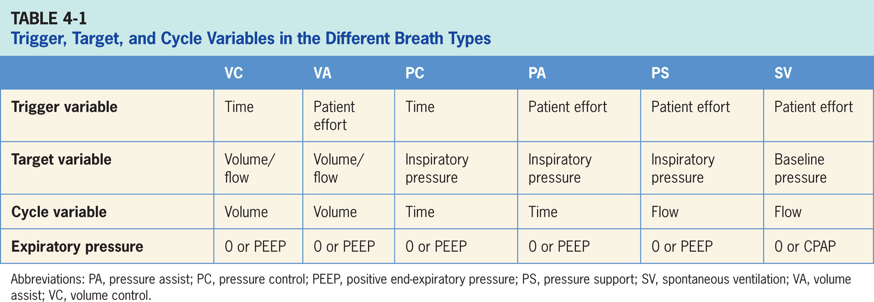

Slide 9
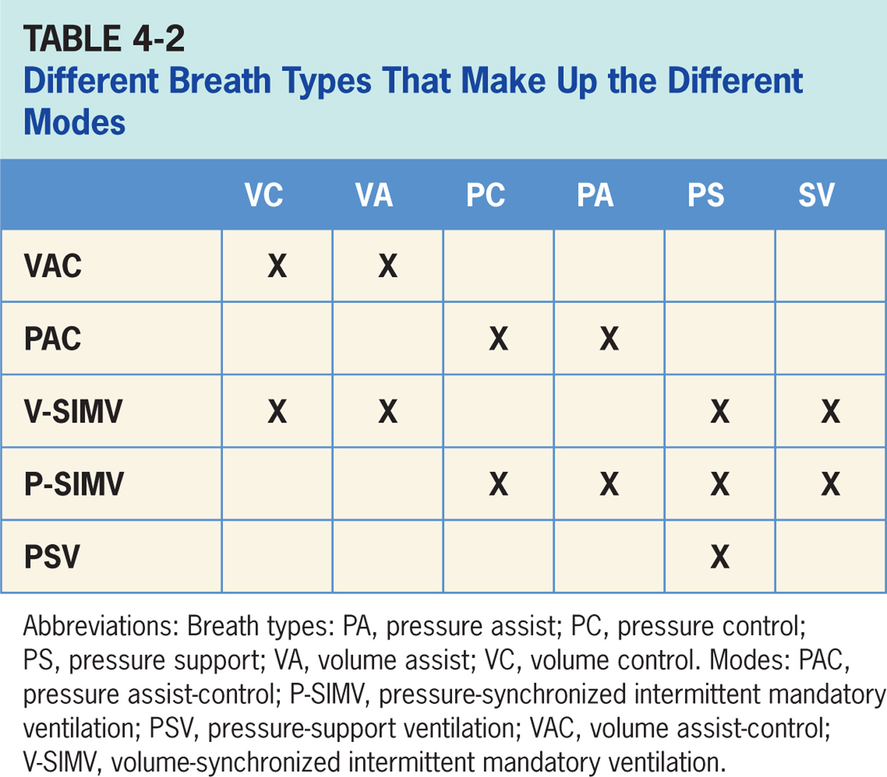

Slide 10
Critical Care Ventilators
Specific ventilators differ on features and modes available, monitoring and graphic displays provided and cost.
Ventilator choice should be based on patient's needs, specific clinical goals, and the clinician’s familiarity with the ventilator.
Ventilators features, modes, pressure and flow capabilities, and integrated alarms and monitoring systems should be considered.
The ventilator chosen should adequately and safely ventilate patients under changing conditions and provide the features and modes required.

Slide 11
Hamilton-G5
Key features:
For hospital use by healthcare professionals trained in optimizing mechanical ventilation
Can ventilate adult and pediatric patients with an option for infant and neonatal patients
Employs a disposable proximal flow sensor, which is a requirement, and it works in conjunction with other internal sensors to adjust gas delivery to the patient. (The HAMILTON-G5 operator interface is displayed in Figure 4-2).
Consists of a touch screen, some keys, and a turn-and-press knob. Turning the knob changes the values of the parameter chosen, and pressing the knob confirms the selection.

Slide 12
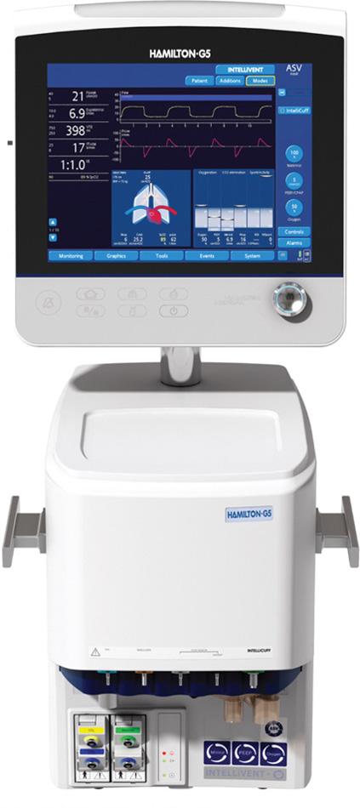
Figure 4.1

Slide 13
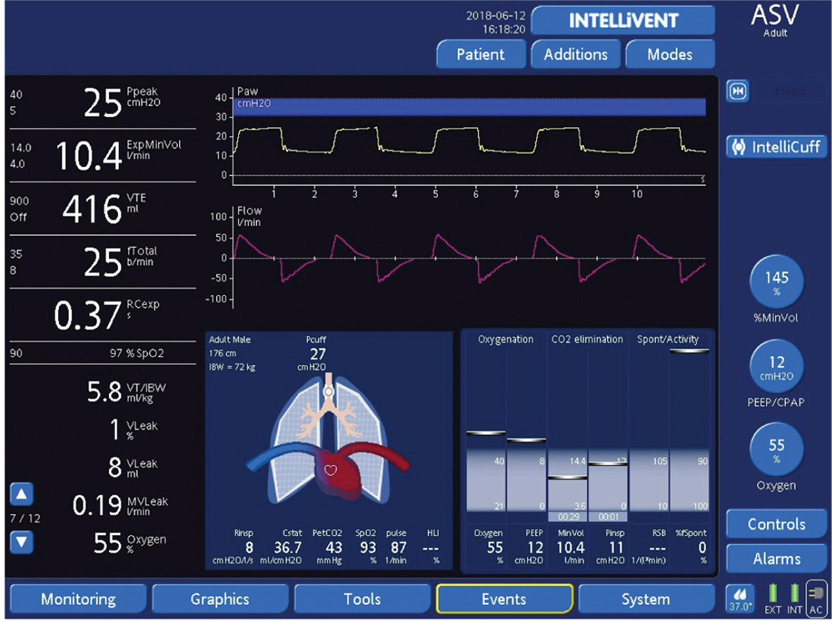
Figure 4.2

Slide 14
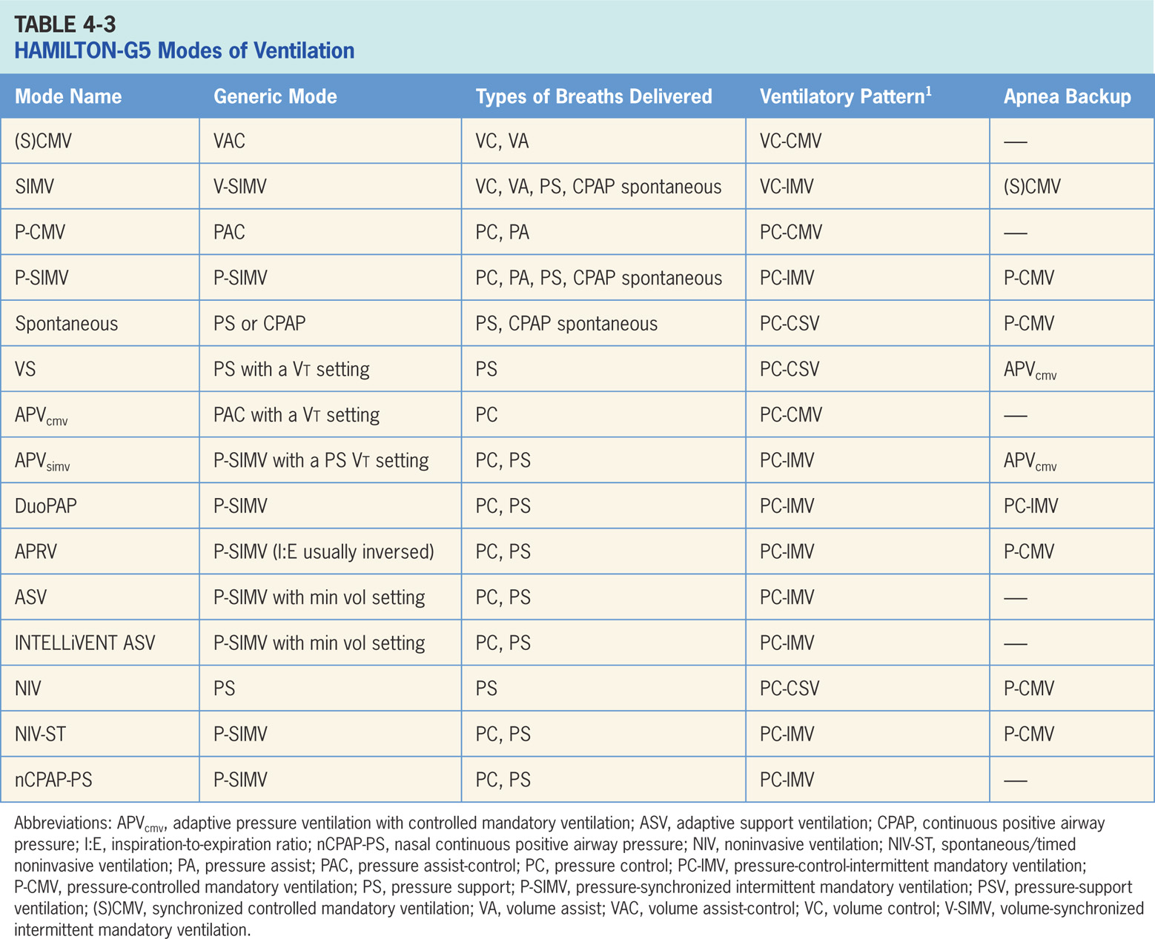

Slide 15
Synchronized, Controlled Mandatory Ventilation [(S)CMV]
Volume-targeted mode of ventilation (VAC) allows mandatory, time-triggered breaths or patient-assisted breaths.⁴
Spontaneous breaths not allowed.
Breath cycles to exhalation once tidal volume (Vt) has been delivered.

Slide 16
Main Operator Controls Include:
Fio₂
PEEP
Vt
Flow
Respiratory rate (RR)
Inspiratory time
I:E
Pressure created is variable and depends on Vt, flow, and respiratory system mechanics.⁴

Slide 17
Synchronized, Intermittent Mandatory Ventilation (SIMV)
Combines two breath types, VAC and either PS or spontaneous breathing, while on continuous positive airway pressure (CPAP).⁴ Permits mandatory, time-triggered breaths, patient-assisted breaths, or spontaneous breaths.
Ventilator prevents “breath stacking” (a VAC breath compounded by a PS breath) through use of a “timing window.”
If patient attempts to trigger a breath in timing window, then ventilator will deliver a patient-assisted VAC breath.
If patient attempts to trigger a breath outside window, then a spontaneous breath will occur.

Slide 18
Main Operator Controls Include:
Fio₂
PEEP
Vt
Flow
RR
I:E
Inspiratory time
Pressure support level
Cycle sensitivity
During VAC breaths, resulting pressure is variable and depends on Vt, flow, and patient mechanics.⁴
During PS breaths, volume will be variable depending on PS level, patient effort, and respiratory system mechanics. ⁴

Slide 19
Pressure-controlled Mandatory Ventilation (P-CMV)
Pressure-targeted mode of ventilation allows for mandatory, time-triggered breaths or patient-assisted breaths. ⁴
Spontaneous breaths are not allowed.
The breath cycles to exhalation once inspiratory time has been reached.

Slide 20
Main Operator Controls Include:
Fio₂
PEEP
Inspiratory pressure level
Inspiratory time
RR
I:E
Pressure will be consistently delivered breath to breath; Vt and flow are variable and will depend on the inspiratory pressure level, patient effort, and respiratory system mechanics.⁴

Slide 21
Pressure-synchronized, Intermittent Mandatory Ventilation (P-SIMV)
Similar to SIMV except target is now pressure instead of volume.
Combines two breath types, PAC and either PS or spontaneous breathing, while on CPAP.⁴
Combination of mandatory, time-triggered breaths, patient-assisted breaths, and spontaneous breaths.
Ventilator prevents “breath stacking” (a PAC breath compounded by a PS breath) through the use of a “timing window.”
If patient attempts to trigger a breath in timing window, ventilator will deliver a PAC breath.
If patient attempts to trigger a breath outside window, then a spontaneous breath will occur.

Slide 22
Main Operator Controls Include:
Fio₂
PEEP
Inspiratory pressure level
Inspiratory time
I:E
RR
Pressure support level
Cycle sensitivity
During PAC breaths, resulting Vt is variable and depending on inspiratory pressure level, patient effort, and respiratory system mechanics.⁴
During PS breaths, volume will be variable and depend on the PS level, patient effort, and respiratory system mechanics. ⁴

Slide 23
Spontaneous
Patient triggers all of the breaths and will receive either PS or CPAP (if the PS is set at 0). ⁴
If the PS is set at 0, then patient must contribute all of the work of breathing.
Sometimes used for a spontaneous breathing trial (SBT) to assess for liberation from ventilator.
During PS, patient regulates respiratory rate and Vt with support from the ventilator.
Patient triggers all breaths and will receive the clinician-set PS level
The breath cycles to expiration when the inspiratory flow decreases below a preset percentage of the inspiratory peak flow.

Slide 24
Main Operator Controls Include:
Fio₂
PEEP
Pressure support level
Cycle sensitivity
The Vt will be variable and depend on PS level, patient effort, and patient respiratory system mechanics. ⁴

Slide 25
Volume Support
Ventilator delivers a variable (from breath to breath) PS level in order to reach a clinician-set Vt.⁴
Ventilator changes PS level as needed to reach the Vt.
Ventilator has potential to drop the level of support as patient effort increases and conversely may increase PS level when patient effort is too low.

Slide 26
Main Operator Controls Include:
Fio₂
PEEP
Vt target
Cycle sensitivity
Vt may not match operator setting because ventilator using PS to target Vt as to VAC and relies on previous breaths to make calculation.⁴ Any change in patient effort from previous breath may result in deviation from Vt setting.⁴

Slide 27
Adaptive Pressure Ventilation with Controlled Mandatory Ventilation (APVCMV)
A Vt-targeted pressure-regulated mode.
Clinician sets the desired Vt and ventilator uses varying levels of inspiratory pressure to achieve the target.⁴
Similar to VS, ventilator relies on calculations from previous breaths to deliver inspiratory pressure level needs to be to achieve the Vt.
Different from VS; the ventilator now uses PAC breaths as to PS breaths.
Ventilator may reduce inspiratory pressure level as patient effort increases and increase inspiratory pressure level when patient effort too low. The breaths may be time-triggered or patient-triggered.

Slide 28
Adaptive Pressure Ventilation with Synchronized, Intermittent Mandatory Ventilation (APV_{simv})
(APV_{simv}) combines Vt-targeted PAC breath with spontaneous PS breaths in between.⁴
Type of breaths delivered are same as P-SIMV.
Difference is inspiratory pressure level is controlled by the ventilator (variable) in APV_{simv} as to being clinician-set (P-SIMV).

Slide 29
Duo Positive-pressure Ventilation (DuoPAP)
Pressure-targeted mode of ventilation that allows for spontaneous breathing at two pressure levels.⁴
Ventilator switches between two clinician-set pressure levels (the lower of which can be CPAP).
Pressure levels are referred to as P_{high} and P_{low}. T_{high} is length of time at P_{high} and T_{low} is length of time spent at T_{low}.
Difference from the pressure-targeted modes the P_{high} level referenced to atmosphere to positive end-expiratory pressure (PEEP) level.
Increases in P_{low} will decrease the distending pressure.
Additional ventilator support can also be added in the form of PS at both pressure levels to augment the patient effort.

Slide 30
Airway Pressure-release Ventilation (APRV)
Similar to DuoPAP allowing for spontaneous breathing at two pressure levels.⁴
Ventilator switches between two clinician-set pressure levels (the lower of which can be CPAP).
Pressure levels are referred to as P_{high} and P_{low}. T_{high} is length of time at P_{high} and T_{low} is length of time spent at T_{low}.
APRV is used in an inverse ratio fashion. Most of time is spent at P_{high} with periodic releases to P_{low}.
Difference from pressure-targeted modes is P_{high} level referenced to atmosphere as to PEEP level.
Important: increases in P_{low} will decrease distending pressure. Additional ventilator support can be added in form of PS at both pressure levels to augment patient effort.

Slide 31
Adaptive Support Ventilation (ASV)
“Feedback” mode that adjusts inspiratory pressure and RR to meet minimum-minute volume set by clinician.⁴
Result in variable form of P-SIMV. The machine-timed breaths are PAC, while generated breaths are PS.
Amount of breathing patient does determines how many machine-generated breaths will be delivered.

Slide 32
Noninvasive Ventilation (NIV)
Patient triggers all of breaths, will receive PS breaths.
NIV designed for use with mask or other noninvasive patient interface.⁴

Slide 33
Spontaneous/Timed Noninvasive Ventilation (NIV-ST)
Designed for use with mask or other noninvasive patient interface.⁴
Essentially P-SIMV without an endotracheal tube. NIV-ST combines two breath types, PAC and either PS or spontaneous breathing, while on CPAP.
Combination of mandatory, time-triggered breaths, patient-assisted breaths, and spontaneous breaths.
Ventilator prevents “breath stacking” (a PAC breath compounded by a PS breath) through use of “timing window.”
Patient attempts to trigger a breath in timing window, then ventilator will deliver a PAC breath.
Patient attempts to trigger a breath outside the window, spontaneous breath will occur.

Slide 34
Nasal Continuous Positive Airway Pressure (nCPAP-PS)
Available in neonatal mode, designed for use with noninvasive interface.⁴
P-SIMV without an endotracheal tube. NIV-ST combines two breath types, PAC and either PS or spontaneous breathing, while on CPAP.
Different from P-SIMV, if patient triggers regularly, all breaths are patient-triggered spontaneous breaths, i.e., no time-triggered mandatory breaths. Only when patient trigger not detected during defined breath cycle time (or total breath time) does the ventilator deliver time-triggered mandatory breaths.

Slide 35
Nasal Continuous Positive Airway Pressure (nCPAP-PS) (cont’d)
Combination of mandatory, time-triggered breaths, patient-assisted breaths, and spontaneous breaths. The ventilator prevents “breath stacking” (a PAC breath compounded by a PS breath) through the use of a “timing window.”
Patient attempts to trigger breath in timing window, then ventilator will deliver a PAC breath.
Patient attempts to trigger breath outside window, then spontaneous breath will occur.

Slide 37
Clinical Focus 4-2
You go into a patient’s room to monitor the ventilator and note that the patients appears agitated and uncomfortable. She is on PRVC with the following settings: Vt 450 mL, Fio₂ 0.35, PEEP 5, inspiratory time 0.80 seconds. You note that the inspiratory pressure has dropped from 20 to about 6 cm H₂O while the tidal volume has remained close to 450 mL.

Slide 38
Clinical Focus 4-2 (cont’d)
Question 1. What is the primary problem or issue to be addressed?

Slide 39
Clinical Focus 4-2 (cont’d)
Question 1 Answer:
The patient is experiencing difficulty due to the fact that the ventilator cannot distinguish between what it perceives as an increase in compliance and the increase in patient effort (due to things like anxiety or inadequate pain management). Because of the excessive patient effort, the tidal volume may temporarily rise, causing the ventilator to drop the inspiratory pressure to get back to the target tidal volume. This, in turn, may cause patient further agitation and tidal volume fluctuations and has been termed “runaway.”

Slide 40
Clinical Focus 4-2 (cont’d)
Question 2. What can you do with the ventilator to help calm the patient and improve patient-ventilator synchrony?

Slide 41
Clinical Focus 4-2 (cont’d)
Question 2 Answer:
Option 1: Switch the mode to PAC or PS with a set inspiratory pressure. This may result in an increased tidal volume initially, but since the patient is now receiving the support she was trying to get on PRVC, she should eventually calm down and the tidal volume should reset to a safer value. Careful assessment and minor adjustments may still be needed until the patient is completely comfortable.
Option 2: Switch to VAC with a set tidal volume. This may not be the optimal solution, since the flow is also set; given that the patient has such an active respiratory drive, it likely will not satisfy the patient’s flow requirements.

Slide 42
Pressure/Volume Tool (PV) Special Features
Respiratory mechanics maneuver that performs quasi-static P/V curve on the ventilator (Figure 4-3).⁴
During maneuver, G5 slowly increases pressure to clinician-set upper level then slowly decreases pressure either back to baseline or to elevated PEEP level, ultimately producing an inflation and deflation limb and will only work on passive patients because any effort by the patient will terminate maneuver.
Allows for a breath hold at the top of the curve (recruitment maneuver, in essence).
Can be set to terminate the maneuver at higher-than-baseline PEEP level to maintain gained recruitment.

Slide 43
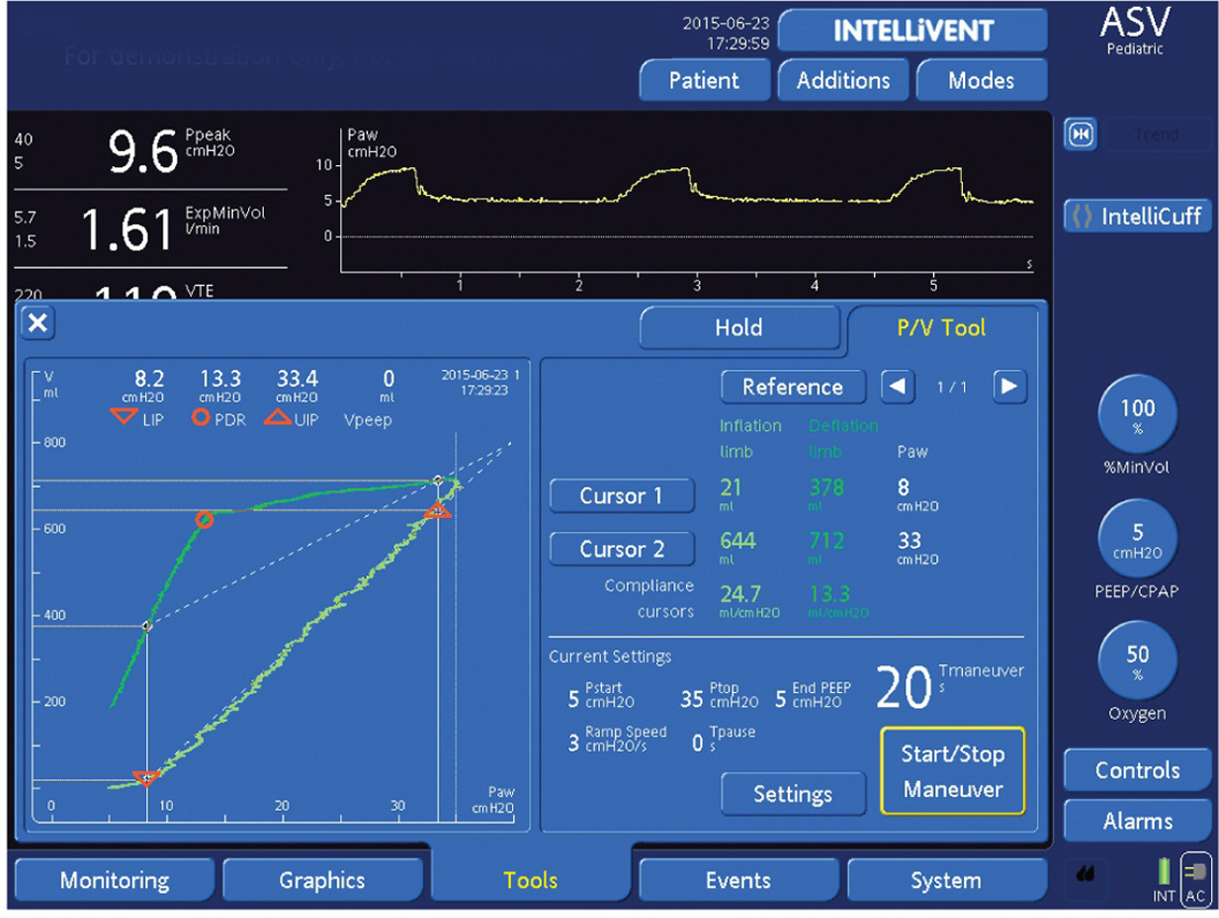
Figure 4.3

Slide 44
Apnea Backup Ventilation
Ventilator will go into apnea backup ventilation if no breaths are detected in clinician-set interval.⁴
Mode of apnea backup ventilation depends on mode that patient is in (Table 4-3).
G5’s apnea backup is bidirectional, i.e., if no patient triggering is detected within defined apnea time, ventilator switches to defined backup mode
Patient breaths resume, device switches back to previous support mode. The back-and-forth switching is fully automatic.

Slide 45
Intellicuff®
Intellicuff® is an integrate automated endotracheal tube cuff pressure controller that is used to both monitor and maintain cuffs pressure.⁴

Slide 46
Dynamic Heart/Lung Panel
Pictorial representation of the heart and lungs.⁴
Displays Vt, interaction with the heart, patient triggering and resistance in real time.

Slide 47
INTELLiVENT (ASV)
(Not available in the United States at this time) closed loop mode of ventilation.⁴
Uses ASV to adjust the inspiratory pressure and RR to achieve a minute ventilation target.
Passive patients, the target minute volume is adjusted according to exhaled partial pressure of end-tidal CO₂.
INTELLiVENT controls the oxygenation. PEEP and Fio₂ are adjusted according to Spo₂ (finger or ear probe) and are based on table derived from the ARDSNet publications.^{2,3}
Clinicians can opt for INTELLiVENT to wean the patient (if tolerated) and do spontaneous breathing trials.

Slide 48
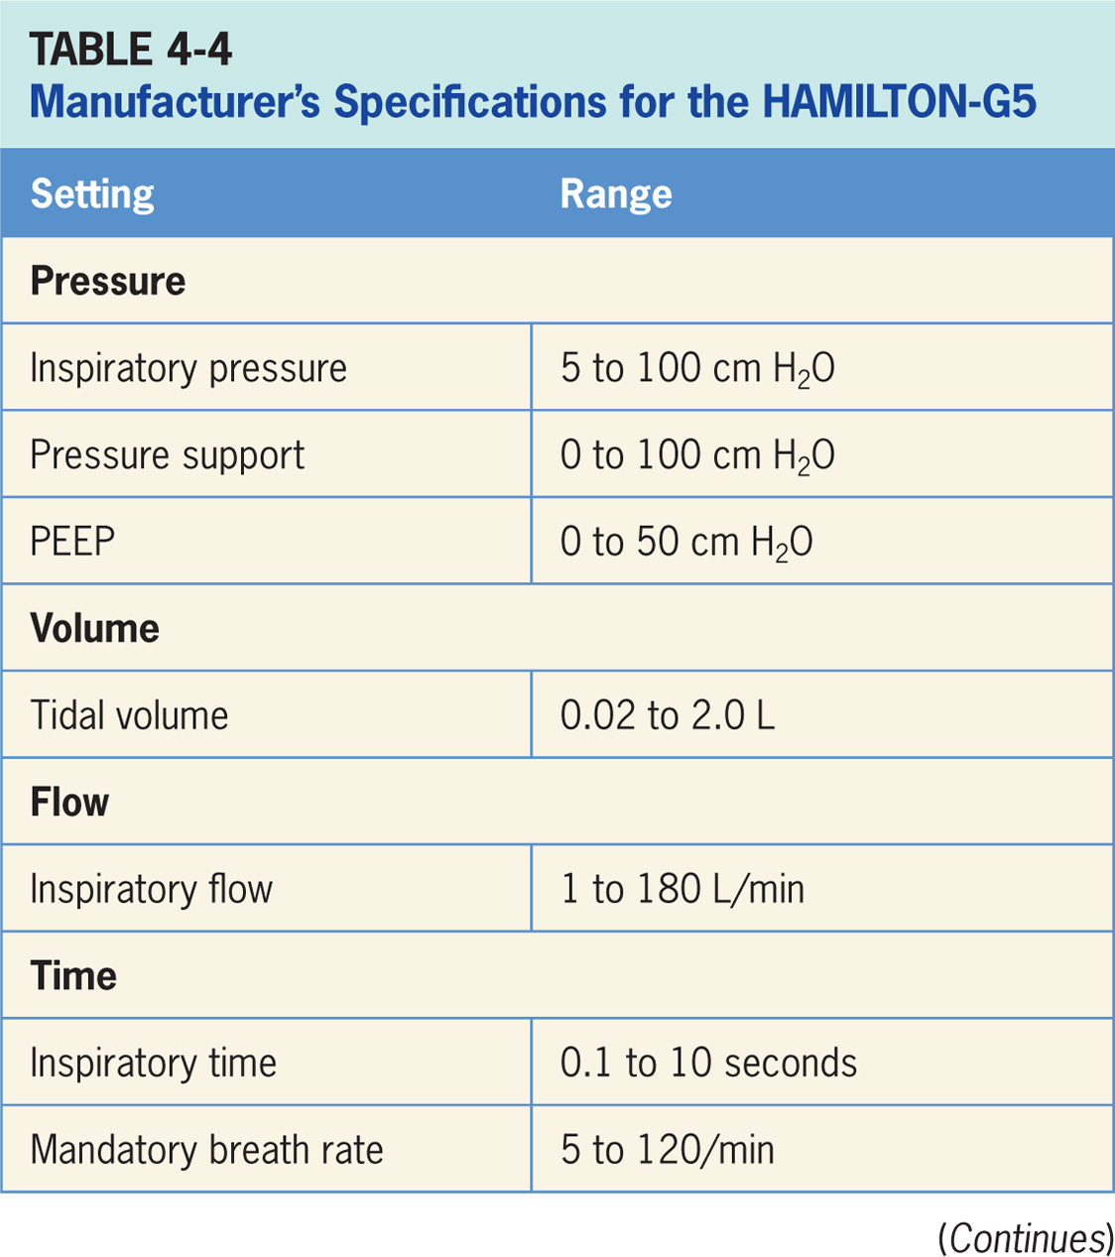

Slide 49
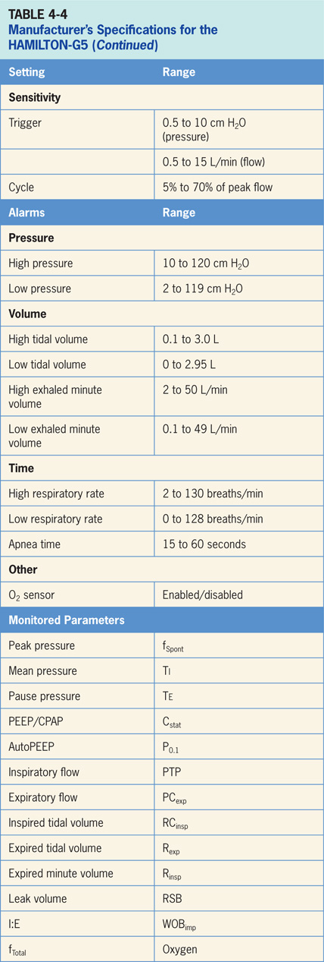

Slide 50
Hamilton-G5 Accessories
End-tidal CO₂ (ETco₂) measurement, pulse oximetry and an integrated vibrating mesh Aerogen® nebulizer for aerosolized medication delivery and esophageal manometry.⁴
ETco₂ can be mainstream or side stream and can be used for volumetric capnography and airway dead space calculations.
Pulse oximetry parameter can be displayed on the ventilator.
Compatible with Masimo and Nihon Kohden cables. Both ETco₂ and pulse oximetry measurements require special modules that attach to the ventilator.
Integrated Aerogen® system consists of the Aerogen nebulizer and the Aerogen module of the HAMILTON-G5.

Slide 51
Hamilton-G5 Accessories
End-tidal CO₂ (ETco₂) measurement, pulse oximetry and an integrated vibrating mesh Aerogen® nebulizer for aerosolized medication delivery.⁵
ETco₂ can be mainstream or sidestream and can be used for volumetric capnography and airway dead space calculations.
Pulse oximetry, parameter that can be displayed on the ventilator.
C3 is compatible with Masimo and Nihon Kohden cables.
ETco₂ and pulse oximetry measurements require special modules attach to ventilator.
Integrated Aerogen® system consists of Aerogen nebulizer and Aerogen module of HAMILTON-G5.

Slide 52
Getinge Servo-u
Critical care ventilator intended for treatment and monitoring of neonates, infants, and adults with respiratory failure or respiratory insufficiency.⁸
Pictured in figure 4-10, Servo-u is electrically powered from an AC outlet with an internal battery backup and designed to be used by healthcare providers in hospitals or healthcare facilities and for in-hospital transport.
Getinge Servo-u operator interface is displayed in Figure 4-11 which operates through the use of a touch screen, that is used to make changes to ventilation parameters, navigate through different screen display, and manage alarm settings.

Slide 53
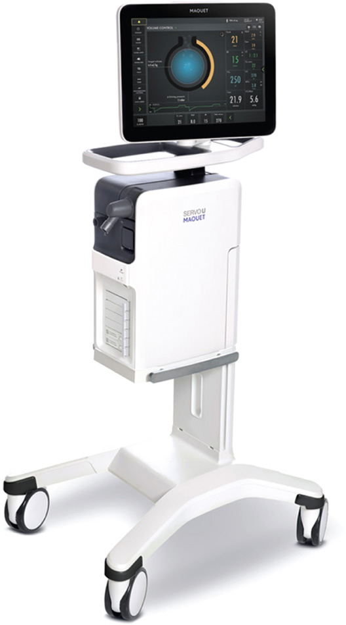
Figure 4.10

Slide 54
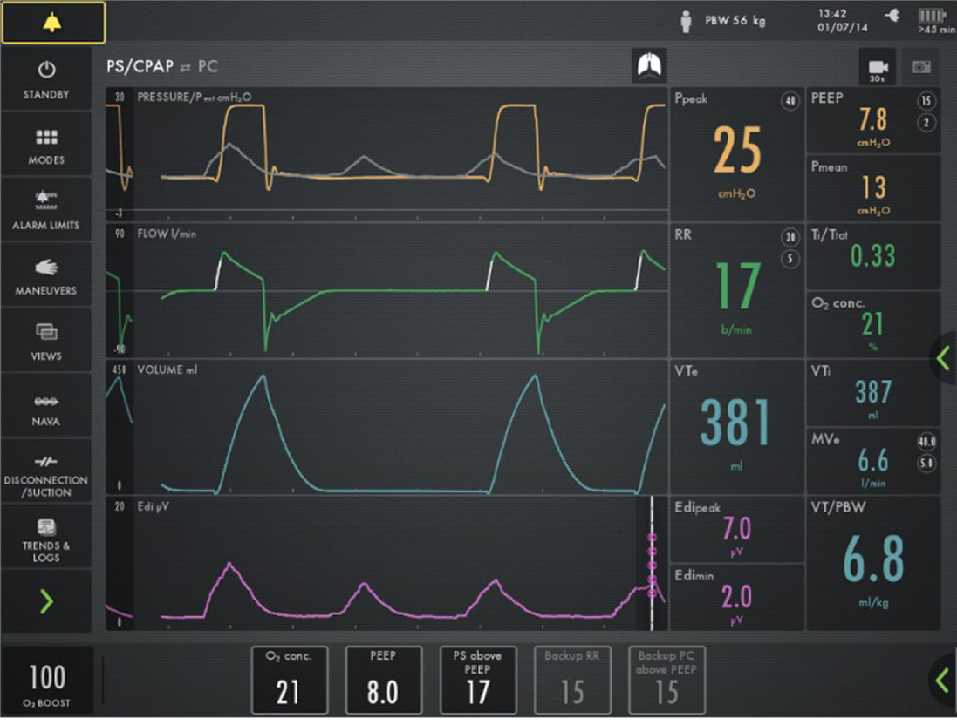
Figure 4.11

Slide 55
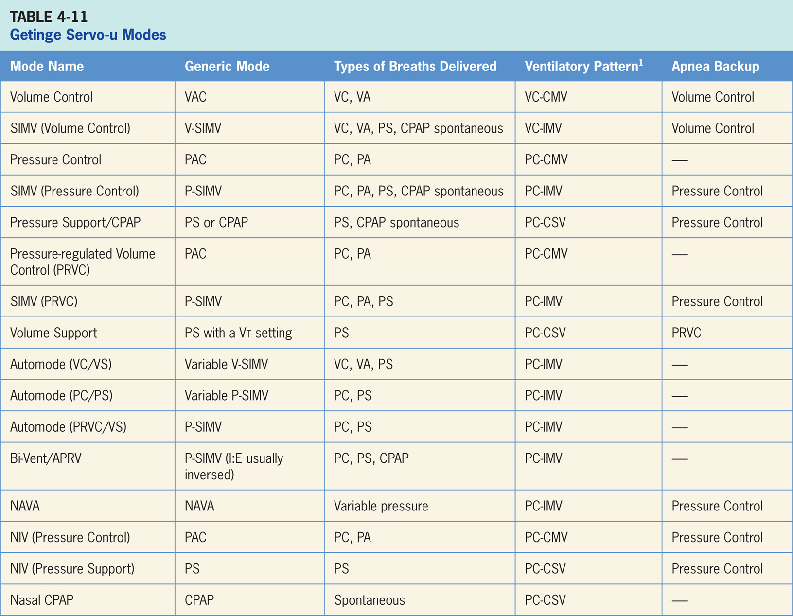

Slide 56
Volume Control
Volume-targeted mode of ventilation (VAC) allows for mandatory, time-triggered breaths or patient-assisted breaths.⁸
Spontaneous breathing not allowed.
The breath cycles to exhalation once the Vt has been delivered.
Volume control incorporates flow adaptation, if patient’s inspiratory effort is large enough, inspiration will switch from volume control to pressure support with flow cycling.

Slide 57
Main Operator Controls Include:
Fio₂
PEEP
Vt or MV
RR
Inspiratory time or I:E
Resulting pressure created is variable, depends on Vt, flow, and patient respiratory system mechanics.⁸

Slide 58
SIMV (Volume Control)
SIMV (Volume Control) combines two breath types, VAC and PS or spontaneous breathing, while on CPAP.⁸
Mandatory, time-triggered breaths, patient-assisted breaths, and spontaneous breaths are all provided.
The ventilator prevents “breath stacking” (a VAC breath compounded by a PS breath) through the use of a “timing window.”
If patient attempts to trigger a breath in timing window, then ventilator will deliver a VAC breath.
If patient attempts to trigger a breath outside window, then a spontaneous breath will occur.
Volume control breaths also use dual targeting so, if patient’s inspiratory effort is large enough, inspiration will switch from volume control to pressure control with flow cycling.

Slide 59
Main Operator Controls Include:
Fio₂
PEEP
Vt or MV
SIMV rate
Inspiratory time or I:E
Pressure support level
Cycle sensitivity for PS breaths
During VAC breaths, resulting pressure created is variable, depends on Vt, flow, and patient mechanics.⁸
During PS breaths, volume will be variable and depend on PS level, patient effort, and patient respiratory system mechanics.⁸

Slide 60
Pressure Control
Pressure-targeted mode of ventilation allowing for mandatory, time-triggered breaths or patient-assisted breaths.⁸
Spontaneous breaths not allowed.
Breath cycles to exhalation once inspiratory time has been reached or when high-pressure alarm is tripped.

Slide 61
Main Operator Controls Include:
Fio₂
PEEP
Inspiratory pressure level
Inspiratory time or I:E
RR
Pressure will be consistently delivered from breath to breath; Vt and flow are variable and will depend on the inspiratory pressure level, patient effort, and patient respiratory system mechanics.⁸

Slide 62
SIMV (Pressure Control)
Similar to SIMV (Volume Control) described above except target is now pressure instead of volume.⁸
Combines two breath types, PAC and either PS or spontaneous breathing, while on CPAP.
Combination of mandatory, time-triggered breaths, patient-assisted breaths, and spontaneous breaths.
Ventilator prevents “breath stacking” (PAC breath compounded by a PS breath) through use of “timing window.”
If patient attempts to trigger a breath in timing window, then ventilator will deliver a PAC breath.
If the patient attempts to trigger a breath outside window, then spontaneous breath will occur.

Slide 63
Main Operator Controls Include:
Fio₂
PEEP
Inspiratory pressure level
Inspiratory time or I:E
SIMV rate
Pressure support level
Cycle sensitivity for the PS breaths
During PAC breaths, resulting Vt created is variable, depends on inspiratory pressure level, patient effort, and patient respiratory system mechanics.⁸
During PS breaths, volume will be variable and depend on PS level, patient effort, and patient respiratory system mechanics.⁸

Slide 64
Pressure Support /CPAP
Patient regulates the respiratory rate and the Vt.⁸
Patient triggers all breaths and will receive either no additional support (CPAP) or the clinician-set PS level.
With pressure support, the breath cycles to expiration when inspiratory flow decreases below a preset percentage of inspiratory peak flow.
CPAP is sometimes used for spontaneous breathing trials.

Slide 65
Main Operator Controls Include:
Fio₂
PEEP/CPAP
Pressure support level
Cycle sensitivity
Vt will be variable and depend on PS level (if any), patient effort, and patient respiratory system mechanics.⁸

Slide 66
Automode
Feedback mechanism whereby ventilator switches between an A/C mode and supported mode depending on patient’s spontaneous breathing activity.⁷
If number of spontaneous efforts is low majority of breaths will be controlled.
If number of spontaneous efforts is high ventilator will stay in supported mode and allow for longer pauses in effort before switching back to controlled mode.
Three mode combinations that clinician can set up using automode:
Volume Control–Volume Support
PRVC–Volume Support
Pressure Control–Pressure Support
All of these modes have been described in detail above.

Slide 67
Main Operator Controls Include:
Volume Control/ Volume Support:
Fio₂
PEEP
Vt or MV
RR
Inspiratory time or I:E
Vt target for Volume Support breaths
Cycle sensitivity
PRVC/Volume Support:
Fio₂
PEEP
RR
Vt target
Inspiratory time or I:E
Vt target for Volume Support breaths
Cycle sensitivity
Pressure Control/Pressure Support:
Fio₂
PEEP
RR
Inspiratory pressure level – Pressure Control
Inspiratory pressure level – Pressure Support
Inspiratory time or I:E ratio
Cycle sensitivity
Automode is not available in noninvasive mode.

Slide 68
Bi-Vent/APRV
Mode of ventilation allowing for spontaneous breathing at two different clinician-set pressure levels.⁸
Ventilator switches between two different clinician-set pressure levels (the lower of which can be CPAP).
Pressure levels referred to P_{high} and P_{peep}. T_{high} is length of time at P_{high} and T_{low} is length of time spent at T_{peep}.
Mainly used in an inverse I:E ratios; difference from pressure-target modes is P_{high} level is now referenced to atmosphere as to PEEP level.
Increase in P_{peep} will decrease distending pressure.
Additional ventilator support can be added in form of PS at both pressure levels to augment the patient effort.

Slide 69
Main Operator Controls Include:
Fio₂
PEEP
P_{high}
P_{peep}
T_{high}
T_{peep}
PS above P_{high}
PS above P_{peep}
Cycle sensitivity
Vt will be variable and depend on the P_{high}, P_{low}, PS level (if set > 0), patient effort, and patient respiratory system mechanics.⁸

Slide 70
Neurally Adjusted Ventilatory Assist NAVA
Spontaneous mode of ventilation delivers ventilatory assist in proportion to patient’s Edi (electrical activity of diaphragm) i.e., ventilator will delivery assist synchronized with timing and effort of patients own diaphragmatic breathing.⁸
Requires a separate module on the ventilator and special catheter. Edi signal is obtained through use of specialized nasogastric catheter that has a series of transducers designed to detect electrical activity of diaphragm.
Breath trigger is also based on Edi. If Edi signal is lost ventilator switches over to traditional pressure support.
NAVA is available both for invasive and noninvasive ventilation and can be used with any patient population (adult, pediatrics and neonates).
Monitoring of Edi is available in all ventilation modes as well as in standby.

Slide 71
Main Operator Controls Include:
Fio₂
PEEP
NAVA level
Edi trigger threshold
PS and PC backup
Cycle sensitivity
Vt, flow, and pressure are all variable, depending on NAVA support level, patient effort, and patient respiratory system mechanics.⁸

Slide 72
Noninvasive Ventilation
Modes available are PC, PS, and NAVA.⁸
Designed to be used with a variety of masks, infant nasal prongs and neonatal uncuffed endotracheal tubes.
Servo-u automatically adapts to variation of leakage in order to maintain required pressure and PEEP level.
If leakage is excessive, ventilator will issue a high-priority alarm and deliver a flow according to settings.

Slide 73
Nasal CPAP
Involves delivering CPAP through a nasal cannula.
Only available for infants.⁸
During NIV, the ventilator automatically adapts to variation of leakage in order to maintain required pressure.
If leakage is excessive, ventilator will issue a high-priority alarm, deliver a continuous flow and pause breath cycling.

Slide 74
Apnea Backup Ventilation Special Features
Ventilator will go into apnea backup ventilation if no breaths are detected in the clinician-set interval.⁸
Mode of apnea backup ventilation depends on mode that patient is in.

Slide 75
Leak Compensation
Comes into play in neonatal patient category in invasive ventilation, and for all patient categories with noninvasive ventilation.⁸
Automatically adapts to any inherent leaks in system and maintain pressure level.

Slide 76
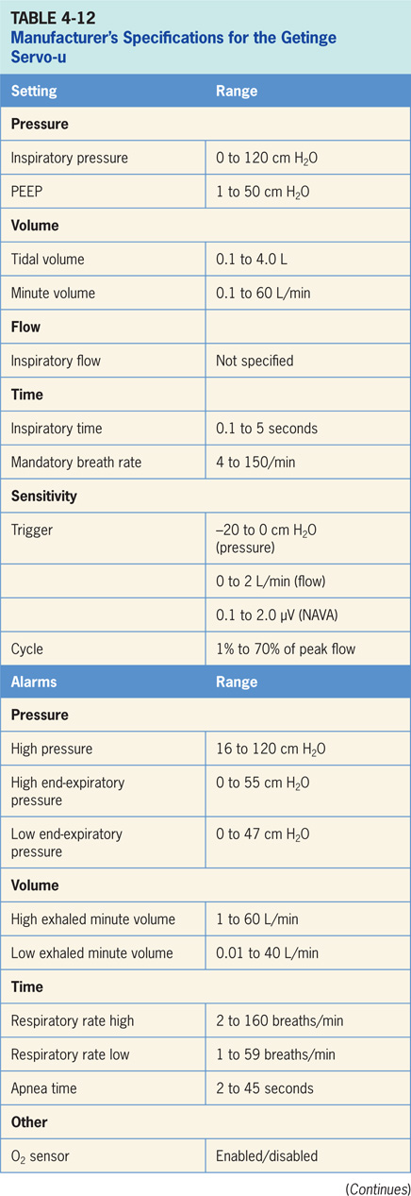

Slide 77
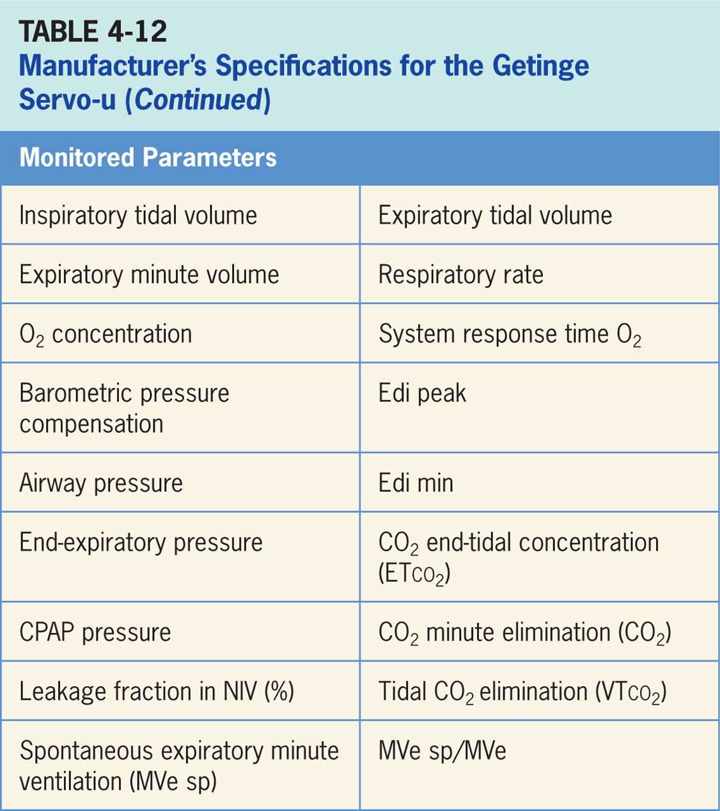

Slide 78
Accessories
Servo-u has available an optional CO₂ analyzer providing continuous monitoring of: CO₂ concentration vs. time (waveform), end tidal CO₂ concentration (ETco₂), CO₂ minute elimination, CO₂ tidal elimination, and alarm limits for high and low ETco₂.⁸
For aerosolized medication delivery, the Aerogen Micropump vibrating mesh nebulizer can be employed.
Has the advantage of not adding any flow to the circuit.
There is an optional Y sensor providing proximal flow and pressure measurement as well as triggering in invasive ventilation. This is recommended for Vt < 10 mL.

Slide 79
Covidien Puritan Bennett 980 Ventilator
Critical care ventilator designed for use in adult, pediatric, and neonatal patients in both acute and subacute clinical locations.¹⁰
Is electrically controlled and pneumatically powered. (Pictured in Figure 4-14)
If there is no piped compressed air, an external compressor would be required.

Slide 80
Covidien Puritan Bennett 980 Ventilator (cont’d)
Operator interface on the PB 980 employs a combination of a touch screen, buttons (real and virtual) and a control knob (Figure 4-15).
Three-step process to make a change to a setting. Clinician first touches a virtual button on the touch screen. Second, the control knob is used to change the value of setting. Last, the “accept” button must be pressed to confirm. Screen displays change depending on the operation being carried out.
The alarm screen looks different than the monitoring. There are a number of different screens.

Slide 81
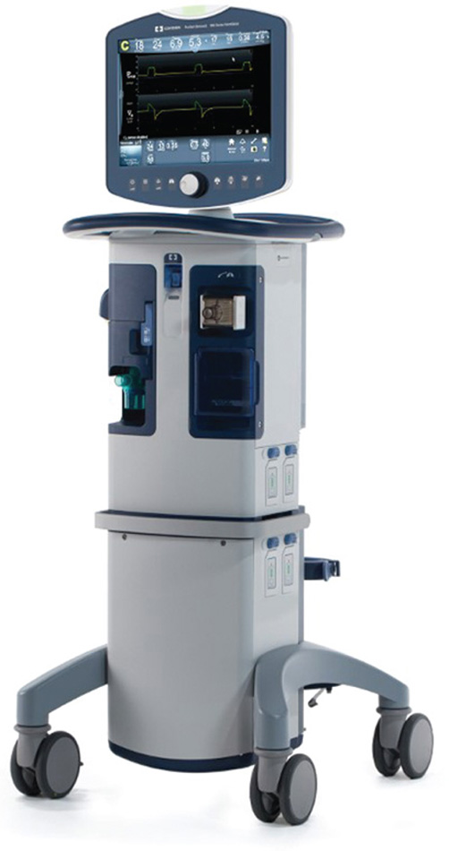
Figure 4.14

Slide 82
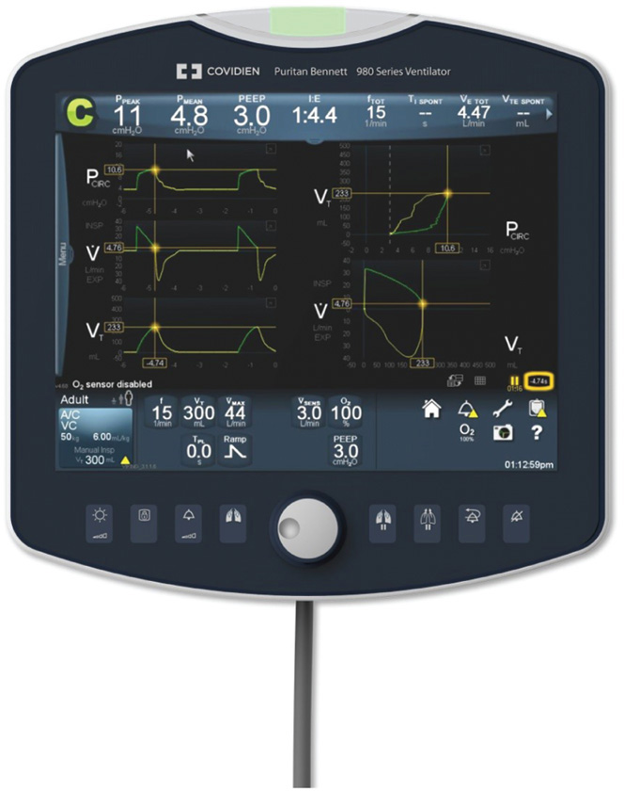
Figure 4.15

Slide 83
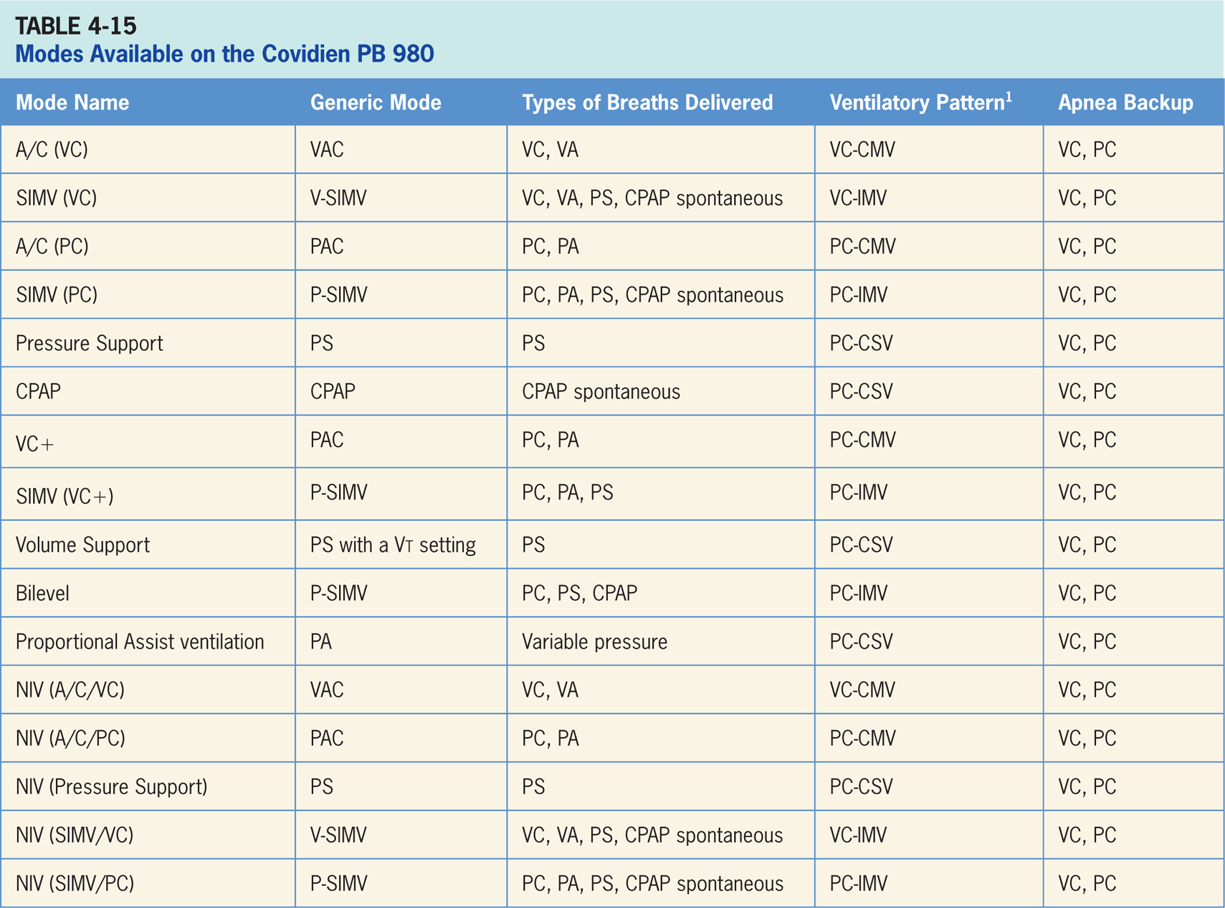

Slide 84
Assist/Control (Volume Control) A/C (VC)
Volume-targeted mode of ventilation (VAC) allowing for mandatory, time-triggered breaths or patient-assisted breaths.¹⁰
Spontaneous breathing not allowed.
Breath cycles to exhalation once the tidal volume (Vt) has been delivered.

Slide 85
Main Operator Controls Include:
Fio₂
PEEP
Vt
Inspiratory flow
RR
Resulting pressure created is variable; depending on Vt, flow, and patient respiratory system mechanics.¹⁰

Slide 86
SIMV Volume Control
Combines two breath types, VAC and PS or spontaneous breathing, while on CPAP.¹⁰
Mandatory, time-triggered breaths, patient-assisted breaths, and spontaneous breaths are all provided.
The ventilator prevents “breath stacking” (a VAC breath compounded by a PS breath) through the use of a “timing window.”
If patient attempts to trigger a breath in timing window, then ventilator will deliver a VAC breath.
If patient attempts to trigger a breath outside window, then a spontaneous breath will occur.

Slide 87
Main Operator Controls Include:
Fio₂
PEEP
Vt
Inspiratory flow
SIMV rate
Pressure support level
Cycle sensitivity
During VAC breaths, the resulting pressure created is variable, depending on Vt, flow, and patient mechanics.¹⁰ During PS breaths, the volume will be variable, depending on the PS level, patient effort, and patient respiratory system mechanics.¹⁰

Slide 88
Assist/Control Pressure Control A/C/PC
Mode of ventilation that allows for mandatory, time-triggered breaths or patient-assisted breaths.¹⁰
Spontaneous breaths not allowed.
Breath cycles to exhalation once the inspiratory time has been reached or when high-pressure alarm is tripped.

Slide 89
Main Operator Controls Include:
Fio₂
PEEP
Inspiratory pressure level
Inspiratory time or I:E
RR
Pressure will be consistently delivered from breath to breath; Vt and flow are variable and will depend on the inspiratory pressure level, patient effort, and patient respiratory system mechanics.¹⁰

Slide 90
SIMV Pressure Control (SIMV PC)
Similar to SIMV volume control except the target is now pressure instead of volume.¹⁰
SIMV PC also combines two breath types, PAC and PS or spontaneous breathing, while on CPAP.
Combination of mandatory, time-triggered breaths, patient-assisted breaths, and spontaneous breaths.
Ventilator prevents “breath stacking” (a PAC breath compounded by a PS breath) through use of a “timing window.”
If patient attempts to trigger a breath in this timing window, then ventilator will deliver a PAC breath.
If patient attempts to trigger a breath outside window, then a spontaneous breath will occur.

Slide 91
Main Operator Controls Include:
Fio₂
PEEP
Inspiratory pressure level
Inspiratory time
SIMV rate
Pressure support level
Cycle sensitivity
During PAC breaths, resulting Vt created is variable, depending on inspiratory pressure level, patient effort, and patient respiratory system mechanics.¹⁰
During PS breaths, the volume will be variable, depending on the PS level, patient effort, and patient respiratory system mechanics.¹⁰

Slide 92
Spontaneous Pressure Support
Patient regulates the respiratory rate and the Vt with support from the ventilator.¹⁰
Patient triggers all breaths and will receive clinician-set PS level.
If pressure support level > 0 cm H₂O is set, breath cycles to expiration when the inspiratory flow decreases below a preset percentage of the inspiratory peak flow.

Slide 93
Main Operator Controls Include:
Fio₂
PEEP
Pressure support level
Cycle sensitivity
Vt will be variable, depending on PS level, patient effort, and patient respiratory system mechanics.¹⁰ If PS level is set to 0, all breaths will be unsupported.

Slide 94
Volume Control + (VC+)
Pressure-targeted mode uses pressure breaths (either PC or PA breaths) to achieve a clinician-set Vt.¹⁰
Inspiratory pressure level, is now adjusted by the ventilator instead of clinician.
Since ventilator relies a previous breath sequence to deliver ensuing breath Vt tends to be somewhat variable, especially in patients with inconsistent efforts.
No spontaneous breaths.

Slide 95
SIMV Volume Control+ SIMV-VC+
Combines two breath types, PAC (ventilator-controlled inspiratory pressure) and either PS or spontaneous breathing, while on CPAP.¹⁰
Combination of mandatory, time-triggered breaths, patient-assisted breaths, and spontaneous breaths.
Ventilator prevents “breath stacking” (a PAC breath compounded by a PS breath) through the use of a “timing window.”
If patient attempts to trigger a breath in timing window, then ventilator will deliver a PAC breath.
If patient attempts to trigger a breath outside window, then a spontaneous breath will occur.

Slide 96
Main Operator Controls Include:
Fio₂
PEEP
SIMV rate
Vt
Inspiratory time
Pressure support level
Cycle sensitivity
During the control breath the amount of pressure and flow delivered will be variable and depend on the Vt setting, patient effort, and patient respiratory system.¹⁰
During PS breath flow, Vt will be variable, depending on PS level, patient effort, and patient respiratory system mechanics. If CPAP is used, spontaneous breath Vt will be variable, depending on patient effort, and patient respiratory system mechanics.

Slide 97
Spontaneous Volume Support
Ventilator delivers a variable (from breath to breath) PS level in order to reach a clinician-set Vt.¹⁰
Ventilator changes the PS level as needed to reach Vt.
Ventilator drops level of support as patient effort increases and conversely increases PS level when patient effort is too low.

Slide 98
Bilevel
Mode of ventilation allowing for spontaneous breathing at two different clinician-set pressure levels.⁹
Ventilator switches between two different clinician-set pressure levels (the lower of which can be CPAP).
These pressure levels referred to as PEEP_{H} and PEEP_{L}. T_{H} is length of time at PEEP_{H} and T_{L} is length of time spent at PEEP_{L}.
Bilevel is used mainly in an inverse I:E ratio; difference from pressure-targeted modes is the PEEP_{H} level is now referenced to atmosphere as to the PEEP_{L}.
Increase in PEEP_{L} will decrease distending pressure.
Additional ventilator support can be added in form of PS at both pressure levels to augment patient effort.

Slide 99
Proportional Assist Ventilation
PAV optional mode on the PB 980.¹⁰
Spontaneous mode that delivers variable flow, pressure and volume to patient.
PB 980 calculates the work of breathing on an intra-breath basis and responds with the clinician-set variable support.
Instead of setting a pressure or volume target, the target is work of breathing.
Clinician sets how much of the work of breathing (in % - a direct setting) that the ventilator will contribute.
Balance is picked up by patient. For example, if the clinician sets the ventilator to do 60%, the patient does the other 40%.

Slide 100
Noninvasive Ventilation
Most modes are available for use in NIV except for Bilevel, VC+, PAV+ and VS.¹⁰
Designed to be used with a variety of masks, infant nasal prongs and neonatal uncuffed endotracheal tubes.
The PB 980 automatically adapts to variation of leakage in order to maintain the required pressure and PEEP level .

Slide 101
Apnea Backup Ventilation Special Features
Ventilator engages apnea backup ventilation when no breath has been delivered by the time clinician selected apnea interval elapses.¹⁰
Can be set in either A/C/VC, A/C/PC.

Slide 102
Tube Compensation (TC)
PB 980 increases pressure during inspiration to overcome the extra resistance created by the artificial airway.¹⁰
Available in SIMV, SPONT and BiLevel modes.
Clinician must set the following parameters: % of the resistive load, artificial airway tube type, artificial airway tube diameter and type of humidification.

Slide 103
Neomode 2.0
Intended to provide respiratory support to neonatal patients with predicted body weights down to 0.3 kg.¹⁰
Supports delivered tidal volumes as low as two (2) mL.

Slide 104
Leak Sync
Designed to compensate for leaks in the circuit.¹⁰
Maintains the PEEP level and optimizes synchrony between patient and the ventilator by preventing auto-triggering.
Works in both invasive and noninvasive ventilation modes.
Leak Sync allows the ventilator to determine leak level and allows the operator to set the flow trigger and peak flow sensitivities to a selected threshold.

Slide 105
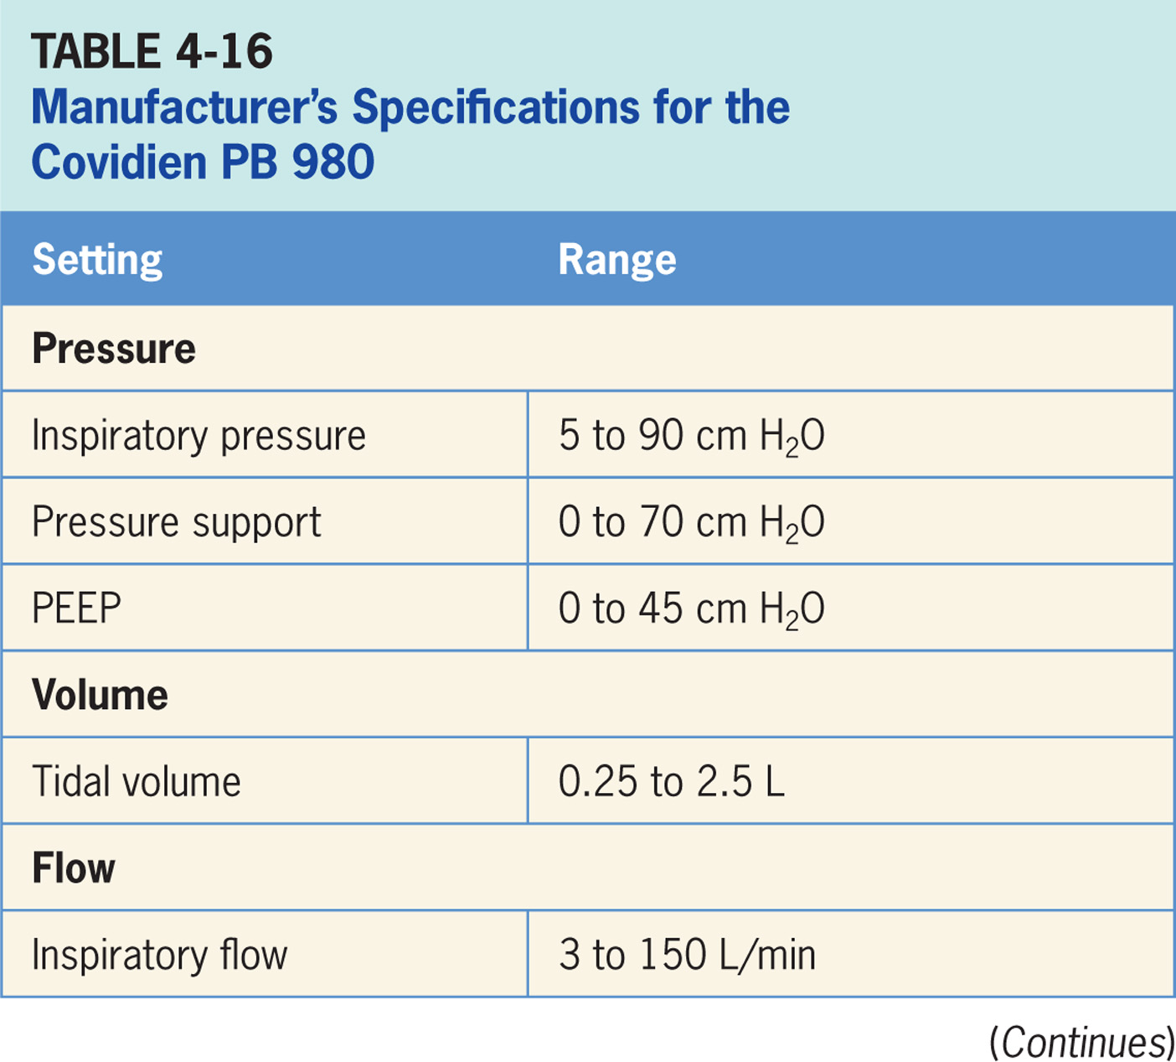

Slide 106
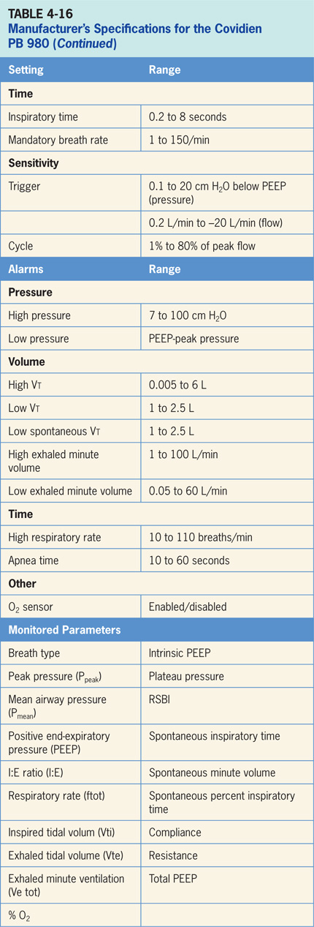

Slide 107
Accessories
An optional Aerogen Aeroneb vibrating mesh nebulizer can be used with PB 980.¹⁰
Unlike the many available jet nebulizers; Aerogen nebulizer does not add any flow to circuit (which ultimately would increase the delivered volume).
An optional proximal flow sensor is available to measure flow, volumes and pressures at patient wye.
ETco² measurement is an additional option.

Slide 108
Vyaire AVEA
The Vyaire AVEA ventilator is a critical care ventilator designed for use in adult, pediatric, and neonatal patients in both acute and subacute clinical locations.¹²
It The AVEA is a fourth generation, servo-controlled, software-driven ventilator.
The Vyaire AVEA operator interface consists of a flat panel color LCD screen with real time graphic displays and digital monitoring capabilities, a touch screen, membrane keys and a dial for changing settings and operating parameters. (pictured in Figure 4-18)

Slide 109
Vyaire AVEA
Settings are entered by pressing a virtual button to select parameter to be changed, then control dial is turned to select the new value, and finally the “ACCEPT” button is pressed. (pictured in Figure 4-19)
Alternatively virtual button can be pressed again to confirm the setting; real buttons provide various features related to menu navigation, access to alarm settings, and alarm silence among other things.

Slide 110
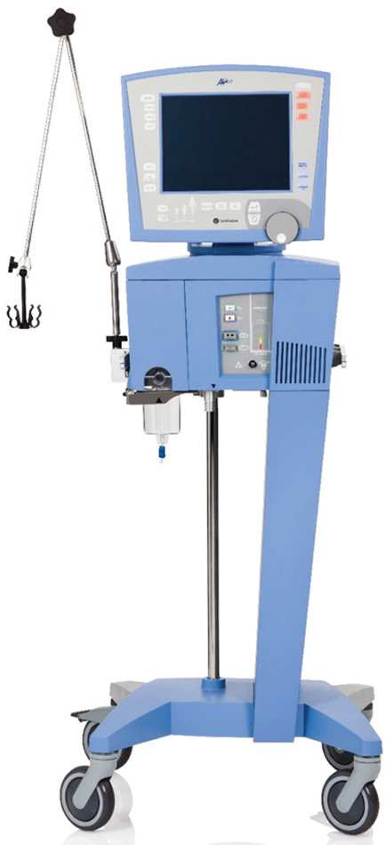
Figure 4.18

Slide 111
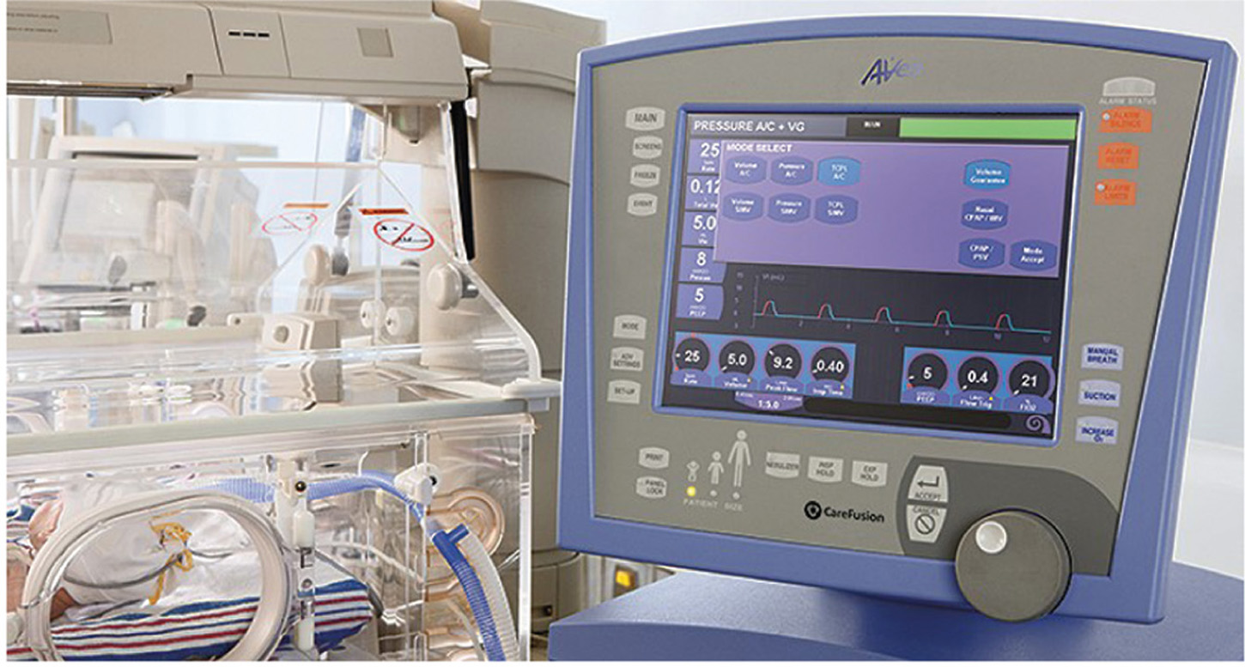
Figure 4.19

Slide 112
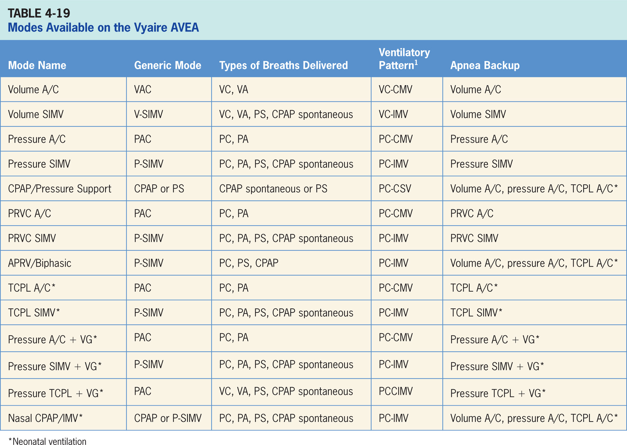

Slide 113
Volume A/C
Volume-targeted mode of ventilation (VAC) allowing for mandatory, time-triggered breaths or patient-assisted breaths.¹²
Spontaneous breathing not allowed.
Breath cycles to exhalation once tidal volume (Vt) has been delivered.

Slide 114
Main Operator Controls Include:
Fio₂
PEEP
Vt
Inspiratory flow
RR
The resulting pressure created is variable; depending on Vt, flow, and patient respiratory system mechanics.¹²

Slide 115
Volume SIMV
Combines two breath types, VAC and PS or spontaneous breathing, while on CPAP.¹²
Mandatory, time-triggered breaths, patient-assisted breaths, and spontaneous breaths are all provided.
Ventilator prevents “breath stacking” (a VAC breath compounded by a PS breath) through the use of “timing window.”
If patient attempts to trigger a breath in this timing window, then ventilator will deliver a VAC breath.
If the patient attempts to trigger a breath outside window, then spontaneous breath will occur.

Slide 116
Main Operator Controls Include:
Fio₂
PEEP
Vt
Flow
SIMV rate
Pressure support level
Cycle sensitivity
During VAC breaths, resulting pressure created is variable and depends on Vt, flow, and patient mechanics.¹²
During PS breaths, volume will be variable, depending on PS level, patient effort, and patient respiratory system mechanics.¹²

Slide 117
Pressure A/C
Pressure-targeted mode of ventilation allowing for mandatory, time-triggered breaths or patient-assisted breaths.¹²
Spontaneous breaths not allowed.
Breath cycles to exhalation once the inspiratory time has been reached.

Slide 118
Main Operator Controls Include:
Fio₂
PEEP
Inspiratory pressure level
Inspiratory time
RR
The pressure will be consistently delivered from breath to breath; Vt and flow are variable and will depend on the inspiratory pressure level, patient effort, and patient respiratory system mechanics.¹²

Slide 119
Pressure SIMV
Similar to SIMV (Volume A/C) except the target is now pressure instead of volume.¹²
SIMV (Pressure Control) also combines two breath types, PAC and PS or spontaneous breathing, while on CPAP.
Combination of mandatory, time-triggered breaths, patient-assisted breaths, and spontaneous breaths.
Ventilator prevents “breath stacking” (a PAC breath compounded by a PS breath) through the use of “timing window.”
If patient attempts to trigger a breath in timing window, then ventilator will deliver a PAC breath.
If patient attempts to trigger a breath outside the window, then a spontaneous breath will occur.

Slide 120
Main Operator Controls Include:
Fio₂
PEEP
Inspiratory pressure level
Inspiratory time
SIMV rate
Pressure support level
Cycle sensitivity
During PAC breaths, resulting Vt created is variable depending on inspiratory pressure level, patient effort, and patient respiratory system mechanics.¹² During PS breaths, the volume will be variable, depending on the PS level, patient effort, and patient respiratory system mechanics.

Slide 121
CPAP/Pressure Support (CPAP/PSV)
Patient regulates respiratory rate and Vt with support from the ventilator.¹²
The patient triggers all breaths and will receive the clinician-set PS level.
If pressure support level > 0 cm H₂O is set, breath cycles to expiration when inspiratory flow decreases below a preset percentage of inspiratory peak flow.

Slide 122
Pressure-regulated Volume Control (Assist/Control)
Pressure-targeted (either PC or PA breaths) mode uses its pressure breaths to achieve a clinician-set Vt.¹²
Inspiratory pressure level; is now adjusted by the ventilator instead of clinician.
Ventilator relies a previous breath sequence to deliver the ensuing breath Vt tends to be somewhat variable, especially in patients with inconsistent efforts.
No spontaneous breaths.

Slide 123
PRVC SIMV
Combines two breath types, PAC (ventilator-controlled inspiratory pressure) and either PS or spontaneous breathing, while on CPAP.¹²
Combination of mandatory, time-triggered breaths, patient-assisted breaths, and spontaneous breaths.
Ventilator prevents “breath stacking” (a PAC breath compounded by a PS breath) through the use of “timing window.”
If patient attempts to trigger a breath in timing window, then ventilator will deliver a PAC breath.
If patient attempts to trigger a breath outside window, then spontaneous breath will occur.

Slide 124
Airway Pressure Release Ventilation/Biphasic (APRV/Biphasic)
Mode of ventilation allowing for spontaneous breathing at two different clinician-set pressure levels.¹²
Ventilator switches between two different clinician-set pressure levels (the lower of which can be CPAP).
These pressure levels are referred to as P_{high} and P_{low}. T_{high} is length of time at P_{high} and T_{low} is length of time spent at P_{low}.
Mainly used in an inverse I:E ratio.
Difference from the pressure-targeted modes is the P_{high} level is now referenced to atmosphere as opposed to the P_{low}.
Increases in P_{low} will decrease distending pressure. Additional ventilator support can also be added in form of PS at both pressure levels to augment the patient effort.

Slide 125
Time Cycled Pressure Limited A/C (TCPL A/C)
Only available for neonates.¹²
Pressure-targeted mode of ventilation similar to Pressure A/C in adults.
Pressure is held in lungs for a clinician-specified period of time (inspiratory time).
Difference is the clinician sets the inspiratory flow, which is variable in Pressure A/C (there is no setting for flow).
Inspiratory flow is used to achieve a set inspiratory pressure.
Spontaneous breathing not allowed.

Slide 126
Time Cycled Pressure Limited SIMV (TCPL SIMV)
Only available for neonates.¹²
Combines two breath types, the TCPL breath and PS.
Combination of mandatory, time-triggered breaths, patient-assisted breaths, and spontaneous breaths.
Ventilator prevents “breath stacking” (a TCPL breath compounded by a PS breath) through the use of “timing window.”
If patient attempts to trigger a breath in this timing window, then ventilator will deliver a TCPL breath.
If patient attempts to trigger a breath outside window, then spontaneous breath will occur.

Slide 127
Pressure A/C with Volume Guarantee (Pressure A/C + VG)
Pressure-targeted (either PC or PA breaths) mode that uses pressure breaths to achieve a clinician-set Vt.¹²
The inspiratory pressure level is now adjusted by ventilator instead of the clinician.
No spontaneous breaths.

Slide 128
Pressure SIMV with Volume Guarantee (Pressure SIMV + VG)
Only available for neonates.¹²
Combines two breath types, PAC (ventilator-controlled inspiratory pressure) and either PS or CPAP.
Combination of mandatory, time-triggered breaths, patient-assisted breaths, and spontaneous breaths.
Ventilator prevents “breath stacking” (a PAC breath compounded by a PS breath) through the use of a “timing window.”
If patient attempts to trigger a breath in timing window, then ventilator will deliver a PAC breath.
If patient attempts to trigger a breath outside window, then spontaneous breath will occur.

Slide 129
Time Cycled Pressure Limited with Volume Guarantee (TCPL + VG)
Only available for neonates.¹²
Pressure-targeted (either PC or PA breaths) mode that uses its pressure breaths to achieve a clinician-set Vt.
Inspiratory pressure level is now adjusted by the ventilator instead of the clinician.
Inspiratory flow stops when the pressure target is reached.
Spontaneous breathing not allowed.

Slide 130
Nasal Continuous Positive Airway Pressure/Intermittent Mandatory Ventilation
Continuous positive airway pressure (purely spontaneous) is provided with or without intermittent mandatory ventilation (mix of control and spontaneous breaths).

Slide 131
CLINICAL FOCUS 4-2 Ventilator Adjustments: PRVC
You go into a patient’s room to monitor the ventilator and note that the patients appears agitated and uncomfortable. She is on PRVC with the following settings: Vt 450 mL, Fio₂ 0.35, PEEP 5, inspiratory time 0.80 seconds. You note that the inspiratory pressure has dropped from 20 to about 6 cm H₂O while the tidal volume has remained close to 450 mL.

Slide 132
CLINICAL FOCUS 4-2 Ventilator Adjustments: PRVC (cont’d)
Question 1. What is the primary problem or issue to be addressed?

Slide 133
CLINICAL FOCUS 4-2 Ventilator Adjustments: PRVC (cont’d)
Question 1 Answer:
The patient is experiencing difficulty due to the fact that the ventilator cannot distinguish between what it perceives as an increase in compliance and the increase in patient effort (due to things like anxiety or inadequate pain management). Because of the excessive patient effort, the tidal volume may temporarily rise, causing the ventilator to drop the inspiratory pressure to get back to the target tidal volume. This, in turn, may cause patient further agitation and tidal volume fluctuations and has been termed “runaway.”

Slide 134
CLINICAL FOCUS 4-2 Ventilator Adjustments: PRVC (cont’d)
Question 2. What can you do with the ventilator to help calm the patient and improve patient-ventilator synchrony?

Slide 135
CLINICAL FOCUS 4-2 Ventilator Adjustments: PRVC (cont’d)
Question 2 Answer:
Option 1: Switch the mode to PAC or PS with a set inspiratory pressure. This may result in an increased tidal volume initially, but since the patient is now receiving the support she was trying to get on PRVC, she should eventually calm down and the tidal volume should reset to a safer value. Careful assessment and minor adjustments may still be needed until the patient is completely comfortable.
Option 2: Switch to VAC with a set tidal volume. This may not be the optimal solution, since the flow is also set; given that the patient has such an active respiratory drive, it likely will not satisfy the patient’s flow requirements.

Slide 136
Apnea Backup Ventilation Special Features
Ventilator engages apnea backup ventilation when no breath has been delivered by the time the clinician-selected apnea interval elapses.¹²
Can be adjusted in either volume A/C, pressure A/C, or TCPL A/C (Table 4-20).
Apnea backup ventilation is available in CPAP/PS and APRV/Biphasic.
When in A/C or SIMV modes, apnea backup rate is determined by operator-set mandatory breath rate or the apnea interval setting (whichever provides the highest respiratory rate).
When apnea interval setting (found in the alarm limits window) determines the backup rate, ventilator will continue to ventilate at this rate until apnea has been resolved.
All other controls for apnea ventilation in A/C and SIMV are set when the primary control values for these modes are selected.

Slide 137
Artificial Airway Compensation
When artificial airway compensation is activated, ventilator calculates the pressure drop from the proximal to the distal end of ETT and applies sufficient pressure to counter balance this drop.¹²
Clinician has to input ETT diameter and length.

Slide 138
Advanced Settings
The advanced settings and the modes in which they are available are depicted in Table 4-20. These advance settings serve to give the clinician modes options and possibly more control of the delivered breaths.
Volume limit: sets the volume limit for a pressure-targeted breath.
Machine volume (Mach Vol): sets the minimum tidal volume delivered from the ventilator.
Insp Rise: controls the slope of the pressure rise during a mandatory breath.
Flow Cycle: sets the percentage of the peak inspiratory flow (Peak Flow), at which the inspiratory phase of a breath is terminated.
Waveform: square or decelerating flow pattern

Slide 139
Advanced Settings
Demand Flow: offers additional flow in volume controlled ventilation when the set flow is not enough for the patient.
Sigh: when activated the ventilator delivers a sigh volume breath (1 and half times the Vt) every 100th breath.
Bias Flow: sets the background flow available between breaths as well as establishing the base flow that is used for flow triggering.
Pres Trig: sets the level below PEEP at which the inspiratory trigger mechanism is activated
Vsync: changes the target from volume to pressure with a set Vt.
Vsync Rise: sets the slope of the pressure rise during the volume breath.

Slide 140
Advanced Settings
PSV Rise: sets the slope of the pressure rise during a pressure-support breath.
PSV Cycle: sets the percentage of peak inspiratory flow at which a pressure support breath will cycle to exhalation.
PSV Tmax: sets the maximum inspiratory time for a pressure support breath.
T_{high} Sync: establishes the length of trigger (Sync) window while in T_{high}.
T_{high} PSV: makes pressure support breaths available during T_{high} in APRV/BiPhasic.
T_{low} Sync: establishes the length of trigger (Sync) window while in T_{low}.

Slide 141
Leak Compensation
Option is designed to compensate for leaks in the circuit.¹²
PEEP is maintained through a cooperation between the flow control valve and the exhalation valve.
If circuit pressure drops, the flow control valve supplies flow up to a maximum flow rate for the patient’s size.
It is not active during breath delivery.

Slide 142
Maneuvers
The Vyaire AVEA has a number of maneuvers available including: Esophageal manometry, MIP P100, P_{flex}, AutoPEEP detection and capnometry (optional).¹²

Slide 143
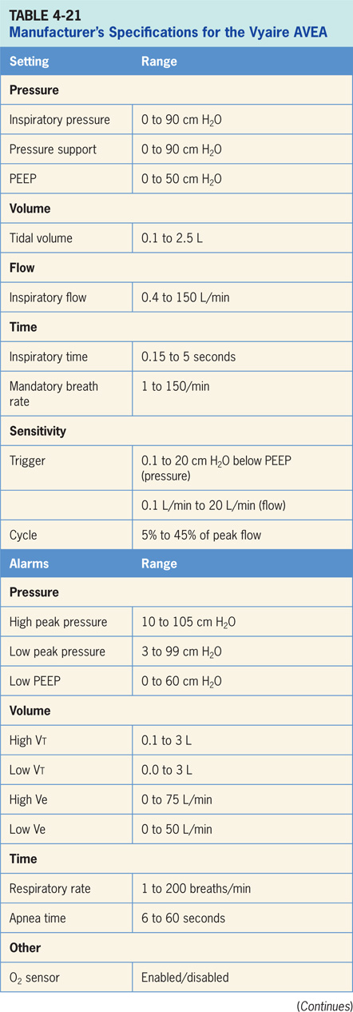

Slide 144
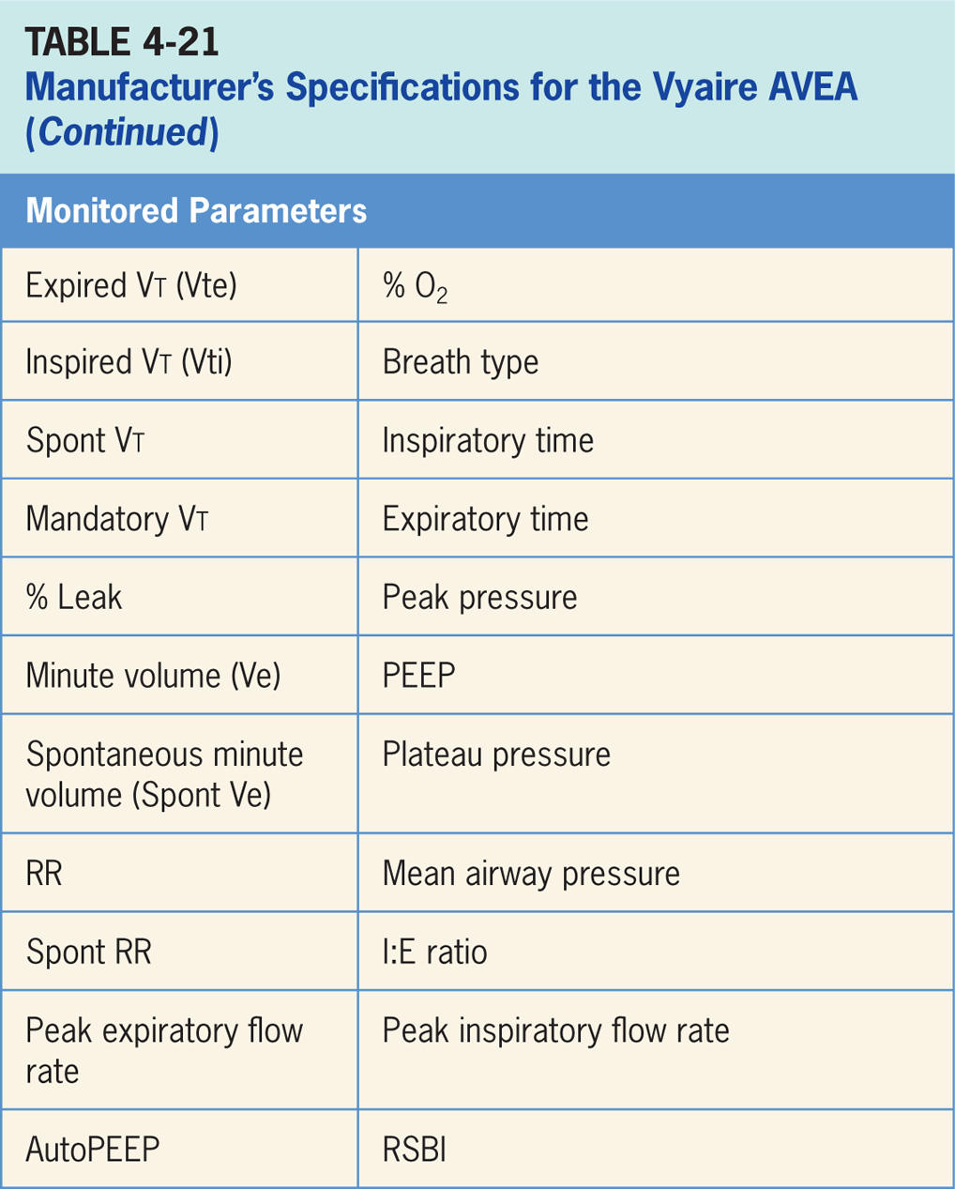

Slide 145
Accessories
AVEA supplies blended gas to power a jet nebulizer (not provided) which is synchronized with inspiration.¹²
Ventilator has a port that can facilitate independent lung ventilation.¹²
Accessories include the following:
Volumetric capnometry (optional).¹²
Esophageal manometry.¹²
The Avea can deliver Heliox through the use of a special adaptor.¹²

Slide 146
Dräger Evita Infinity V500
Critical care ventilator designed for use in adult, pediatric, and neonatal patients in both acute and subacute clinical locations.¹⁴
The Evita Infinity is electrically powered and controlled. It is designed to be used in acute and subacute clinical settings. (pictured in Figure 4-22)
Requires an external compressor if piped air is not available.
It consists of a flat panel touch screen, buttons and a control dial to change and confirm settings. Settings are entered by pressing a button on the touch screen to select the parameter to be changed, then the control dial is turned to select the new value, and then the control dial is pressed to confirm. (Infinity V500 operator interface is depicted in Figure 4-23)

Slide 147
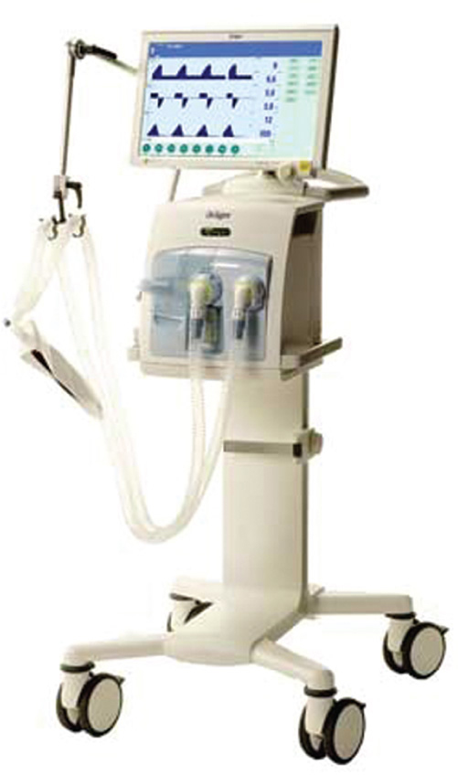
Figure 4.22

Slide 148
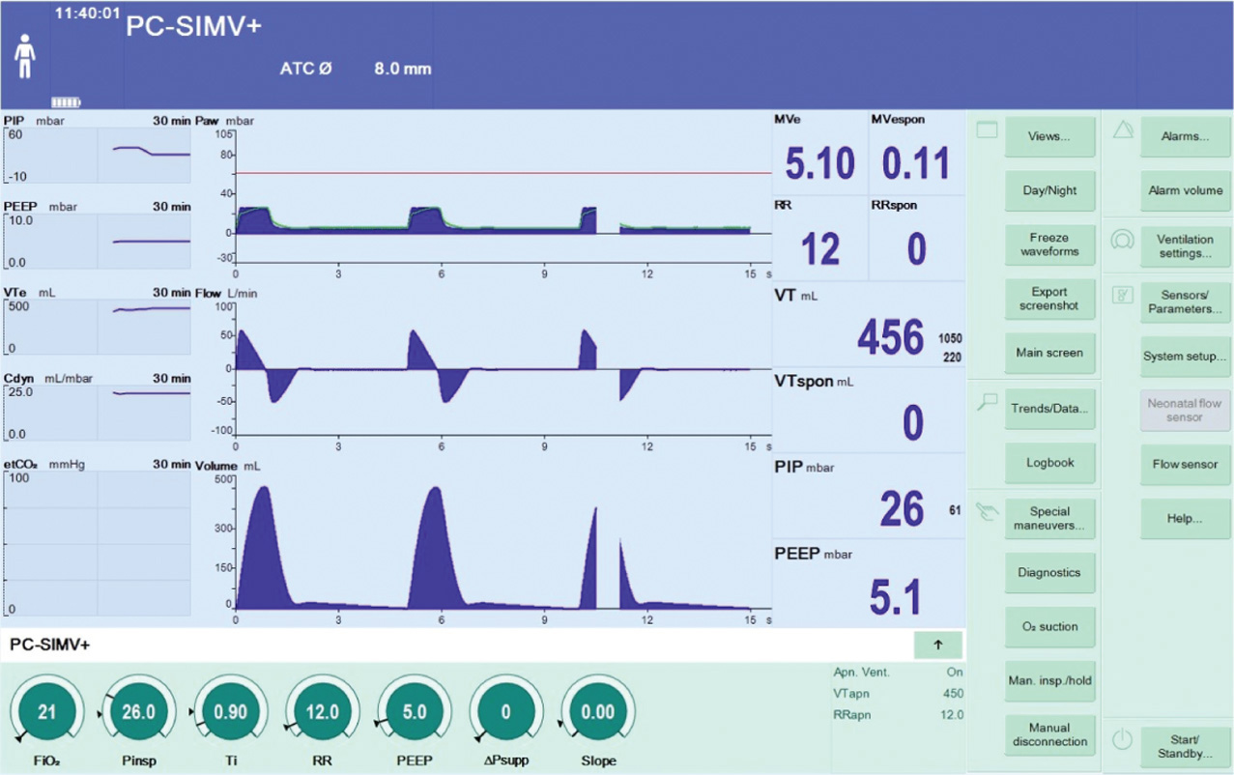
Figure 4.23

Slide 149
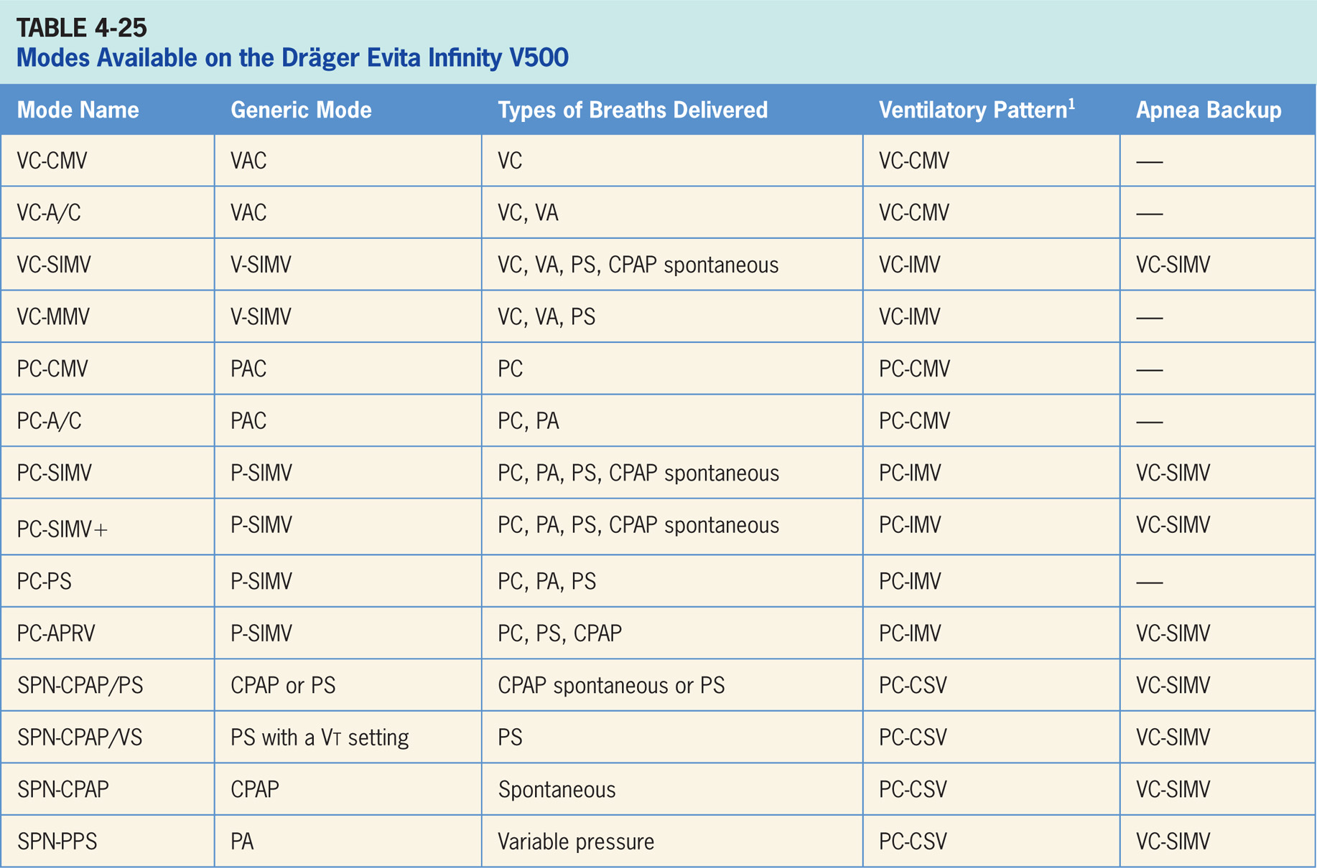

Slide 150
Volume Control–continuous Mandatory Ventilation (VC-CMV)
Volume-targeted mode of ventilation (VAC) allowing for mandatory, time-triggered breaths only.¹⁴
Patient assisted breaths, and spontaneous breathing is not allowed.
Breath cycles to exhalation once the tidal volume (Vt) has been delivered.

Slide 151
Main Operator Controls Include:
Fio₂
PEEP
Vt
Inspiratory flow
RR
Inspiratory time
The resulting pressure created is variable and depends on Vt, flow, and patient respiratory system mechanics.¹⁴

Slide 152
Volume Control–A/C (VC)–A/C
Volume-targeted mode of ventilation (VAC) allowing for mandatory, time-triggered breaths or patient-assisted breaths.¹⁴
Spontaneous breathing not allowed.
Breath cycles to exhalation once tidal volume (Vt) has been delivered.

Slide 153
Main Operator Controls Include:
Fio₂
PEEP
Vt
Inspiratory flow
RR
Inspiratory time
Resulting pressure created is variable and depends on Vt, flow, and patient respiratory system mechanics.¹⁴

Slide 154
Volume Control–synchronized, Intermittent Mandatory Ventilation VC-SIMV
Combines two breath types, VAC and PS or spontaneous breathing, while on CPAP.¹⁴
Thus, mandatory, time-triggered breaths, patient-assisted breaths, and spontaneous breaths are all provided.
The ventilator prevents “breath stacking” (a VAC breath compounded by a PS breath) through the use of a “timing window.”
If patient attempts to trigger a breath in timing window, then ventilator will deliver a VAC breath.
If patient attempts to trigger a breath outside window, then spontaneous breath will occur.

Slide 155
Main Operator Controls Include:
Fio₂
PEEP
Vt
Inspiratory flow
SIMV rate
Inspiratory time
Pressure support level
Cycle sensitivity
During VAC breaths, the resulting pressure created is variable and depends on Vt, flow, and patient mechanics.¹⁴
During PS breaths, the volume will be variable and depend on the PS level, patient effort, and patient respiratory system mechanics.¹⁴

Slide 156
Volume Control-mandatory Minute Volume Ventilation (VC-MMV)
Guarantees that the patient always receives at least the set minute volume MV.¹⁴
Patient can always breathe spontaneously at PEEP level (with or without pressure support).
If spontaneous breathing of patient is insufficient to achieve the set minute ventilation, VAC breaths are applied.
These mandatory breaths are synchronized with patient’s own breathing attempts.

Slide 157
Pressure Control-continuous Mandatory Ventilation (PC-CMV)
Pressure-targeted mode of ventilation allowing for mandatory, time-triggered breaths only (patient-assisted breaths are not allowed).¹⁴
Spontaneous breathing is permitted during entire breathing cycle.
Mandatory breaths cycle to exhalation once the inspiratory time has been reached.

Slide 158
Main Operator Controls Include:
Fio₂
PEEP
I:E/Inspiratory pressure level
Inspiratory time
RR
Pressure will be consistently delivered from breath to breath; Vt and flow are variable and will depend on the inspiratory pressure level, patient effort, and patient respiratory system mechanics.¹⁴
For PC-CMV, pressure control settings are not automatically adjusted for PEEP but are referenced to atmospheric pressure; an increase in PEEP will decrease delta P (ΔP) and tidal volume, if pressure control is not also adjusted.

Slide 159
Pressure Control-A/C (PC-A/C)
Pressure-targeted mode of ventilation allowing for mandatory, time-triggered breaths or patient-assisted breaths.¹⁴
Spontaneous breaths not allowed.
Breath cycles to exhalation once the inspiratory time has been reached or when the high-pressure alarm is tripped.

Slide 160
Main Operator Controls Include:
Fio₂
PEEP
Inspiratory pressure level
I:E /Inspiratory time
RR
The pressure will be consistently delivered from breath to breath; Vt and flow are variable and will depend on the inspiratory pressure level, patient effort, and patient respiratory system mechanics.¹⁴
For PC-A/C, pressure control settings are not automatically adjusted for PEEP but are referenced to atmospheric pressure; an increase in PEEP will decrease delta P (ΔP) and tidal volume, if pressure control is not also adjusted.

Slide 161
Pressure Control-synchronized, Intermittent Mandatory Ventilation (PC-SIMV)
Similar to VC-SIMV except the target is now pressure instead of volume.¹⁴
PC-SIMV also combines two breath types, PAC and either PS or spontaneous breathing, while on CPAP.
Combination of mandatory, time-triggered breaths, patient-assisted breaths, and spontaneous breaths.
Ventilator prevents “breath stacking” (a PAC breath compounded by a PS breath) through the use of “timing window.”
If patient attempts to trigger a breath in timing window, then ventilator will deliver a PAC breath.
If patient attempts to trigger a breath outside the window, then spontaneous breath will occur.
Spontaneous breathing is allowed throughout entire breath cycle.

Slide 162
Main Operator Controls Include:
Fio₂
PEEP
Inspiratory pressure level
Inspiratory time
SIMV rate
Pressure support level
Cycle sensitivity
During PAC breaths, the resulting Vt created is variable and depends on inspiratory pressure level, patient effort, and patient respiratory system mechanics.¹⁴ For PC-SIMV, pressure control settings are not automatically adjusted for PEEP and an increase in PEEP will decrease delta P (ΔP) and tidal volume, if pressure control is not also adjusted.
During PS breaths, the volume will be variable and depend on the PS level, patient effort, and patient respiratory system mechanics.¹⁴

Slide 163
Pressure Control-synchronized, Intermittent Mandatory Ventilation+ (PC-SIMV+)
PC-SIMV+ is essentially PC-SIMV with an added synchronization feature.¹⁴
Synchronization of mandatory breaths reduces the expiratory time.
Evita V500 extends subsequent expiratory time or spontaneous breathing time by the missing time.

Slide 164
Pressure Control-pressure Support Ventilation (PC-PSV)
PC-PSV similar to PC-SIMV, it combines two breath types, PAC and PS.¹⁴
Inspiratory pressure level is referenced to atmosphere as to the PEEP level.
Changes in PEEP will affect the distending pressure.
Combination of mandatory, time-triggered breaths, patient-assisted breaths, and spontaneous breaths.
Ventilator prevents “breath stacking” (a PAC breath compounded by a PS breath) through the use of “timing window.”
If patient attempts to trigger a breath in this timing window, then ventilator will deliver a PAC breath.
If patient attempts to trigger a breath outside window, then a spontaneous breath will occur.
Spontaneous breathing is allowed throughout entire breath cycle.

Slide 165
Pressure Control-airway Pressure Release Ventilation (PC-APRV)
Mode of ventilation allowing for spontaneous breathing at two different clinician-set pressure levels.¹⁴
Ventilator switches between two different clinician-set pressure levels (the lower of which can be CPAP).
Pressure levels are referred to as P_{high} and P_{low}. T_{high} is length of time at P_{high} and T_{low} is length of time spent at P_{low}.
Mainly used in an inverse I:E ratio. P_{high} level is referenced to atmosphere as to the P_{low}.
Important: increases in P_{low} will decrease ΔP.

Slide 166
Spontaneous-continuous Positive Pressure/Pressure Support (SPN-CPAP/PS)
Patient regulates the respiratory rate and the Vt with support from ventilator.¹⁴
Patient triggers all breaths and will receive the clinician-set PS level.
If a pressure support level > 0 cm H₂O is set, the breath cycles to expiration when the inspiratory flow decreases below a preset percentage of the inspiratory peak flow.

Slide 167
Spontaneous-continuous Positive Airway Pressure/Volume Support (SPN-CPAP/VS)
In SPN-CPAP/VS the ventilator delivers a variable (from breath to breath) PS level in order to reach a clinician-set Vt.¹⁴
Ventilator changes the PS level as needed to reach the Vt.
Ventilator drops the level of support as patient effort increases and conversely increases the PS level when patient effort is too low.

Slide 168
Spontaneous-continuous Positive Airway Pressure (SPN-CPAP)
Only available in noninvasive ventilation and is designed only for neonatal population.¹⁴
During SPN-CPAP, patient regulates the respiratory rate and the Vt with support from ventilator.

Slide 169
Spontaneous-proportional Pressure Support (SPN-PPS)
In ventilation mode SPN-PPS, the Evita V500 supports patient's spontaneous breathing in proportion to the inspiratory effort.¹⁴
If patient breathes strongly, ventilator will support this effort with high-pressure support.
If patient has shallow breathing, the ventilator responds with low-pressure support.
Mechanical support is omitted altogether if there is no spontaneous breathing.

Slide 170
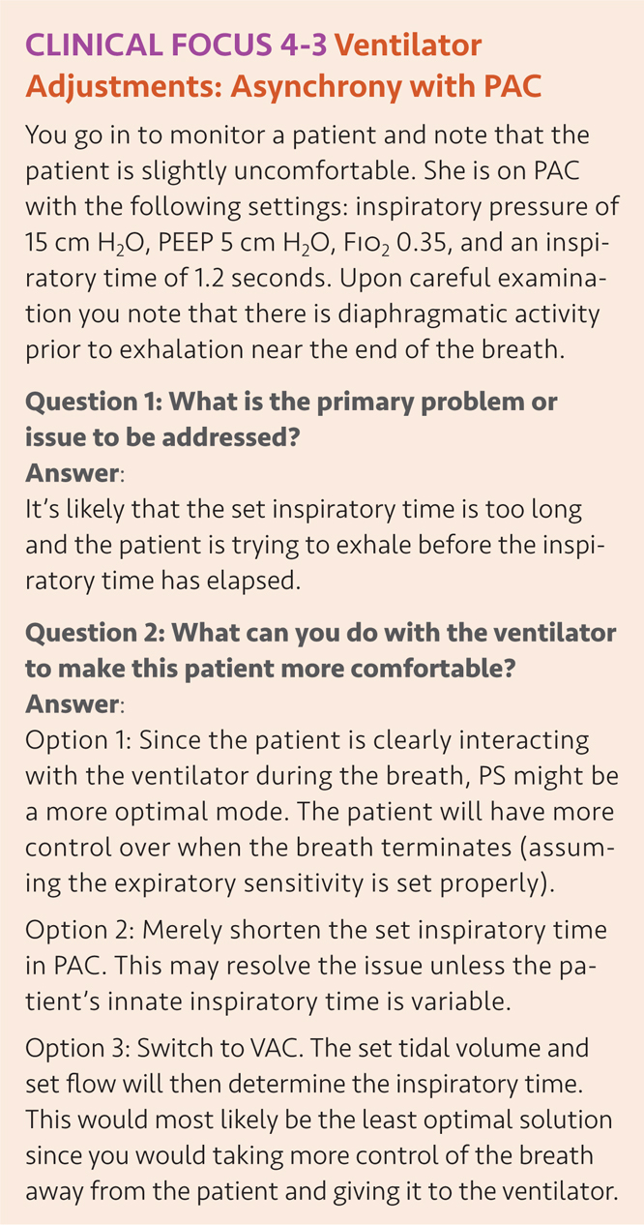

Slide 171
CLINICAL FOCUS 4-3
You go in to monitor a patient and note that the patient is slightly uncomfortable. She is on PAC with the following settings: inspiratory pressure of 15 cm H₂O, PEEP 5 cm H₂O, Fio₂ 0.35, and an inspiratory time of 1.2 seconds. Upon careful examination you note that there is diaphragmatic activity prior to exhalation near the end of the breath.

Slide 172
CLINICAL FOCUS 4-3 (cont’d)
Question 1. What is the primary problem or issue to be addressed?

Slide 173
CLINICAL FOCUS 4-3 (cont’d)
Question 1 Answer:
It’s likely that the set inspiratory time is too long and the patient is trying to exhale before the inspiratory time has elapsed.

Slide 174
CLINICAL FOCUS 4-3 (cont’d)
Question 2. What can you do with the ventilator to make this patient more comfortable?

Slide 175
CLINICAL FOCUS 4-3 (cont’d)
Question 2 Answer:
Option 1: Since the patient is clearly interacting with the ventilator during the breath, PS might be a more optimal mode. The patient will have more control over when the breath terminates (assuming the expiratory sensitivity is set properly).
Option 2: Merely shorten the set inspiratory time in PAC. This may resolve the issue unless the patient’s innate inspiratory time is variable.
Option 3: Switch to VAC. The set tidal volume and set flow will then determine the inspiratory time. This would most likely be the least optimal solution since you would taking more control of the breath away from the patient and giving it to the ventilator.

Slide 176
Apnea Backup Ventilation Special Features
Ventilator engages apnea backup ventilation when no breath has been delivered by the time apnea interval elapses.¹⁴
If patient is in a volume control mode without AutoFlow (see description of AutoFlow below) they will receive apnea backup ventilation in VC-SIMV without AutoFlow with the preset apnea respiratory rate and tidal volume.
Apnea backup ventilation will be VC-SIMV with AutoFlow.

Slide 177
Autoflow
When AutoFlow is activated the ensuing breaths become pressure-targeted with a volume guarantee.¹⁴
Ventilator determines what pressure to use in order to achieve the set tidal volume.
AutoFlow is only available in volume-targeted modes.

Slide 178
RC Insight
On the Dräger ventilators when “AutoFlow” is enabled the inspiratory pressure now becomes referenced to atmosphere as opposed to the PEEP level. So switching on AutoFlow will reduce the distending pressure. Regardless of the mode patients need to be assessed for patient ventilator synchrony, even (or perhaps especially) in the “closed loop modes.”

Slide 179
Automatic Tube Compensation
When Automatic Tube Compensation is activated ventilator calculates the pressure drop from proximal to the distal end of the ETT and ventilation pressure in the breathing circuit is increased during inspiration or decreased during expiration.¹⁴
Airway pressure is adjusted to the tracheal level if 100 % compensation of the tube resistance has been selected.
Clinician has to input ETT diameter and length.

Slide 180
Low-flow PV Loop
Low-flow PV loop measuring procedure records a static pressure-volume curve, which can be used to assess mechanical properties of the lungs.¹⁴

Slide 181
Variable Pressure Support (PS) Ventilation
Variable Pressure Support Ventilation is optional on the V500.¹⁴
Functions by generating random variation values in pressure support levels and then applies those values to the pressure support delivered to patient.
Regardless of patient’s spontaneous breathing effort, Variable PS increases and decreases the tidal volume variation.

Slide 182
Nebulizer
The Evita V500 incorporates an internal pneumatic nebulizer.¹⁴
In adults, nebulizer synchronizes with inspiratory phase and adds no additional flow and the Fio₂ is constant.
For pediatrics and neonates; nebulizer operates continuously.

Slide 183
Noninvasive Ventilation
NIV is available for adults in all ventilator modes.¹⁴
For neonates, ventilator supplies NIV in SPN-CPAP and PC-CMV.

Slide 184
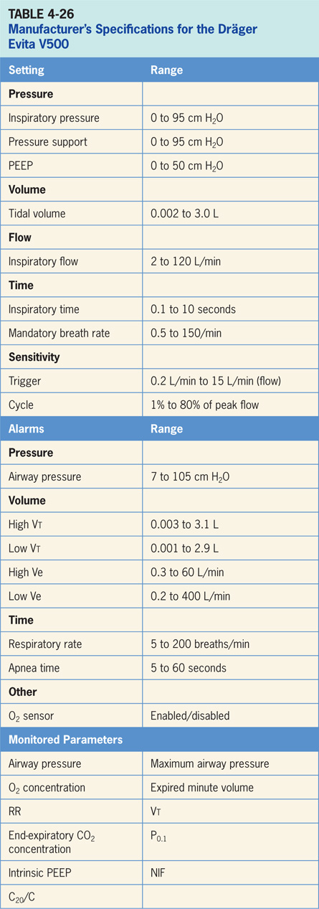

Slide 185
Accessories
Accessories include optional CO₂ monitoring with CapnoPlus.¹⁴
The neonatal mode, a neonatal sensor provides flow measurement at the wye.¹⁴
SmartCare is an optional weaning mode that gradually reduces PS level based on inputs from ETco₂, RR and Vt.¹⁴

Slide 186
Philips Respironics V60 Ventilator
Philips Respironics V60 is a microprocessor-controlled ventilator designed for use in adult and pediatric patients > 20 kg.¹⁷
Delivers bilevel positive airway pressure (BiPAP) during both invasive and noninvasive ventilation. It is pictured in (Figure 4-28).
The operator interface on the V60 employs a combination of a touch screen, buttons and a control knob (Figure 4-29).
A three-step process to make a change to a setting. The clinician first touches a virtual button on the touch screen. Second, the control knob is used to change the value of the setting. Last, the control button must be pressed to confirm.

Slide 187
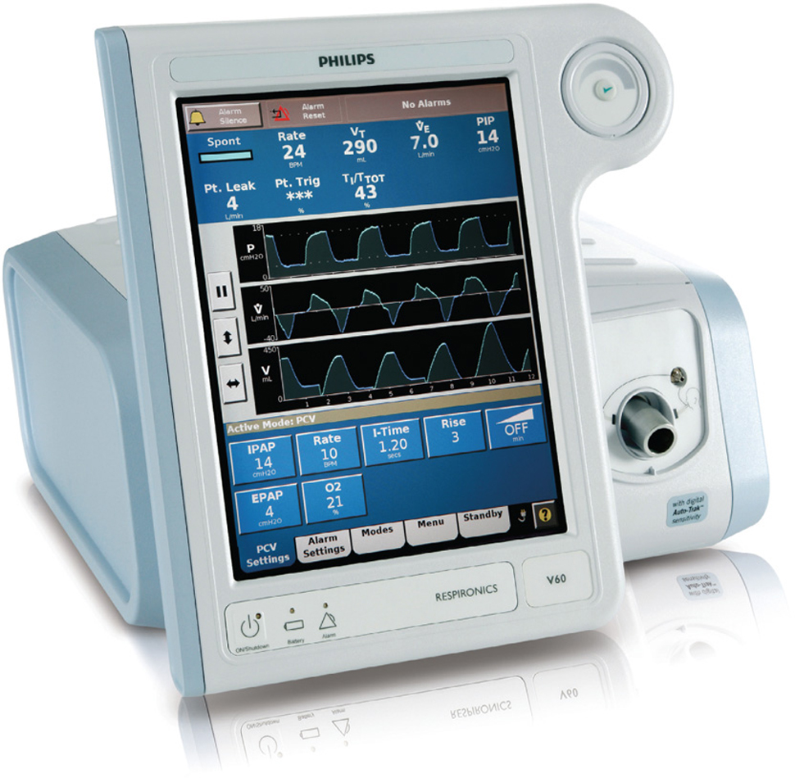
Figure 4.28

Slide 188
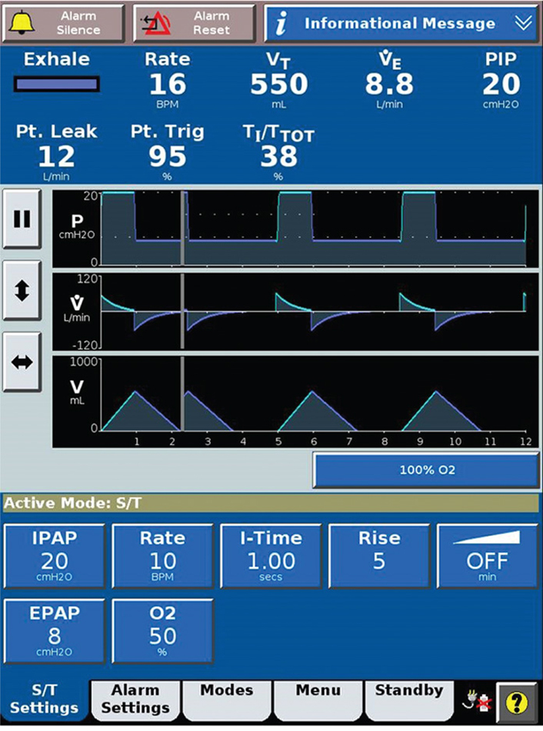
Figure 4.29

Slide 189
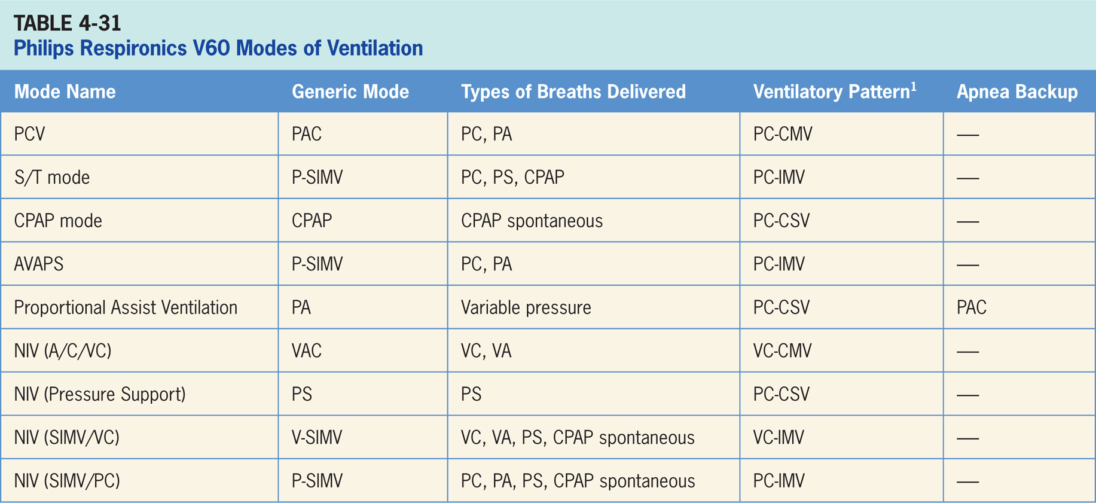

Slide 190
Pressure-control Ventilation (PCV)
Pressure-targeted mode of ventilation allowing for mandatory, time-triggered breaths or patient-assisted breaths.¹⁷
Spontaneous breaths not allowed.
Breath cycles to exhalation once the inspiratory time has been reached.
Triggering and cycling sensitivities are not set by the clinician to the ventilator uses its Auto-Trak Sensitivity algorithms (discussed in more detail in the “Special Features” section).

Slide 191
Spontaneous/Timed Mode (S/T)
(S/T) mode delivers pressure-controlled, time-cycled mandatory and pressure supported spontaneous breaths.¹⁷
If patient fails to trigger a breath within the interval determined by the Rate setting, ventilator triggers a mandatory breath with the set I-Time.
Triggering and cycling sensitivities are not set by the clinician; the ventilator uses its Auto-Trak Sensitivity algorithms (discussed in more detail in the “Special Features” section).

Slide 192
Continuous Positive Airway Pressure Mode (CPAP Mode)
In CPAP mode, ventilator functions as a demand flow system, with the patient triggering all breaths and determining their timing, pressure, and size.¹⁷
Triggering and cycling sensitivities are not set by the clinician; the ventilator uses its Auto-Trak Sensitivity algorithms (discussed in more detail in the “Special Features” section).

Slide 193
Average Volume-assured Pressure Support (AVAPS)
AVAPS mode delivers PAC mandatory breaths and pressure-supported spontaneous breaths.¹⁷
If patient does not trigger a breath within the interval determined by the rate control, ventilator delivers a PAC breath with the set I-Time.
If patient triggers a breath within the interval, ventilator delivers a PS breath.
PAC and PS inspiratory pressure levels are continually adjusted over a period of time to achieve the volume target.
Triggering and cycling sensitivities are not set by the clinician; the ventilator uses its Auto-Trak Sensitivity algorithms (discussed in more detail in the “Special Features” section).

Slide 194
Proportional Pressure Ventilation (PPV)
An optional mode that provides patient-triggered breaths that deliver pressure in proportion to patient effort.¹⁷
Accomplished by setting a percentage of the maximum elastance (Max E) and the maximal resistance (Max R).
Patient effort determines the pressure, flow, and tidal volume delivered by ventilator as well as when to start and end a breath.
There is a user-settable backup rate activates PAC breaths if patient becomes apneic.

Slide 195
Noninvasive Ventilation Special Features
V60 is primarily designed for noninvasive ventilation and all modes can be set up for this purpose.¹⁷

Slide 196
Apnea Backup Ventilation
There is no backup mode if apnea occurs except in PPV where backup PAC breaths are delivered in the event of apnea.¹⁷

Slide 197
Leak Adaptation
To maintain prescribed pressures in presence of leakage, ventilator adjusts its baseline flow.¹⁷
The V60 uses two main mechanisms to update its baseline flow: expiratory flow adjustment and tidal volume adjustment.

Slide 198
Auto-Trak Sensitivity
With Auto-Trak Sensitivity the V60 automatically adjust its triggering and cycling algorithms to maintain optimum performance in the presence of leaks.¹⁷
V60 does this by using an algorithm called the shape signal method.
The shape signal or “shadow trigger” method uses a mathematical model derived from the flow signal to achieve optimal triggering and cycling.

Slide 199
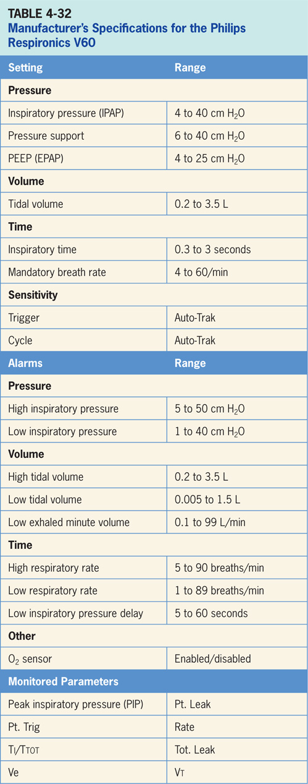

Slide 200
Key Points
It is important to understand what triggers a breath (trigger setting or time mandate), what set point is (pressure or volume), and what ends breath (VT delivery, time, cycle sensitivity).
Breath sequence can be (1) continuous mandatory ventilation (CMV), in which all breaths are controlled by machine but can be triggered by patient in most cases, (2) intermittent mandatory ventilation (IMV), in which the patient can take spontaneous breaths between mandatory breaths, and (3) continuous spontaneous ventilation (CSV), in which all breaths are spontaneous.
In volume ventilation, the VT and inspiratory flow are set (and indirectly the Ti) while resulting pressure is dependent variable.
Worsening lung mechanics in volume assist/control will manifest as increases in ventilatory pressure.

Slide 201
Key Points (cont’d)
In pressure targeted ventilation, the inspiratory pressure and inspiratory time are set, while VT and inspiratory flow are the dependent variables.
Worsening lung mechanics in pressure A/C will manifest as decreases in VT.
Volume support (VS) is a feedback mode in which the ventilator delivers a variable (from breath to breath) PSV level in order to reach a clinician-set VT. ventilator drops level of support as patient effort increases and conversely increases the PSV level when patient activity is too low.
PRVC (also referred to as VC+, AutoFlow, A/C PRVC, VTPC) is pressure control but clinician set a target VT and the ventilator adjusts inspiratory pressure level to achieve the desired VT.

Slide 202
Key Points (cont’d)
ASV (available on the Hamilton ventilators) is an automatic mode in which ventilator targets a selected MV using a combination of inspiratory pressure (to achieve a specific VT) and RR. In a passive patient, most if not all breaths are PAC. In a spontaneously breathing patient, there may be a combination of PS and PAC, or most of the breaths may be PS if the patient generates enough MV himself.
SmartCare (available on the Drager ventilators) is designed to be an automated weaning tool where by ventilator automatically adjusts the PS level based on certain monitored parameters (RR, ETco₂, and Vt).
Automode (available on the Servo ventilators) is a feedback feature that switches between a control mode of ventilation (either PC, PRVC or VC) and a supported mode (either volume support or PS) depending on patients spontaneous breathing activity.

Slide 203
Key Points (cont’d)
MMV is designed to assure that patient receives a clinician set MV. If patient’s spontaneous efforts are not sufficient the ventilator will deliver VAC breaths to maintain the target MV.
PAV (available on Covidien PB ventilators) is a purely spontaneous mode that delivers variable flow, pressure and volume to the patient. clinician sets WOB that ventilator will do on an intra-breath basis and remainder of total WOB is assumed by the patient.
NAVA (available on the Servo ventilators) is a purely spontaneous mode of ventilation that delivers ventilatory assistance in proportion to the electrical activity of the patient’s diaphragm. With this mode, clinician sets inspiratory pressure (cm H₂O) per diaphragm microvolt activity.
It is important to realize that newer models and other feedback modes are unproven in terms of a mortality benefit, also can be difficult to optimize for patient if the clinician is unfamiliar with the mode.

