Slide 1
Chapter 4: Section II Additional Critical Care Ventilators HAMILTON-C3 HAMILTON-C1 Getinge Servo-i Covidien Puritan Bennett 840 Ventilator Newport E360 Ventilator Vyaire AVEA Dräger Evita XL GE Healthcare CARESCAPE R860

Slide 2
HAMILTON-C3
Ventilator is intended to provide positive pressure ventilatory support to adults and pediatrics, and optionally infants and neonates.⁵ (pictured in Figure 4-4)
Electrically powered and pneumatically driven and also incorporates an air compressor and internal battery backup which facilitate intrahospital transport.
C3 also incorporates a proximal flow sensor that facilitates measurement at patient wye.
Consists of touch screen, some keys, and a turn-and-press knob. Turning the knob changes the values of the parameter chosen and pressing the knob confirms the selection. (depicted in Figure 4-5)

Slide 3
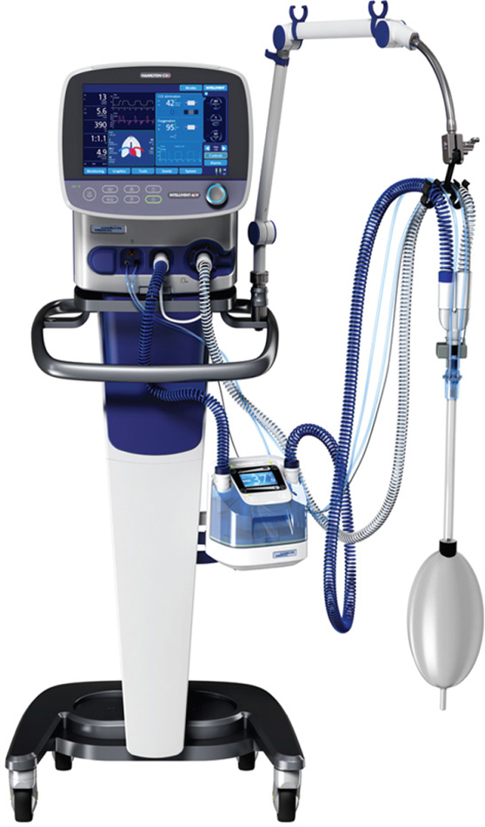
Figure 4.4

Slide 4
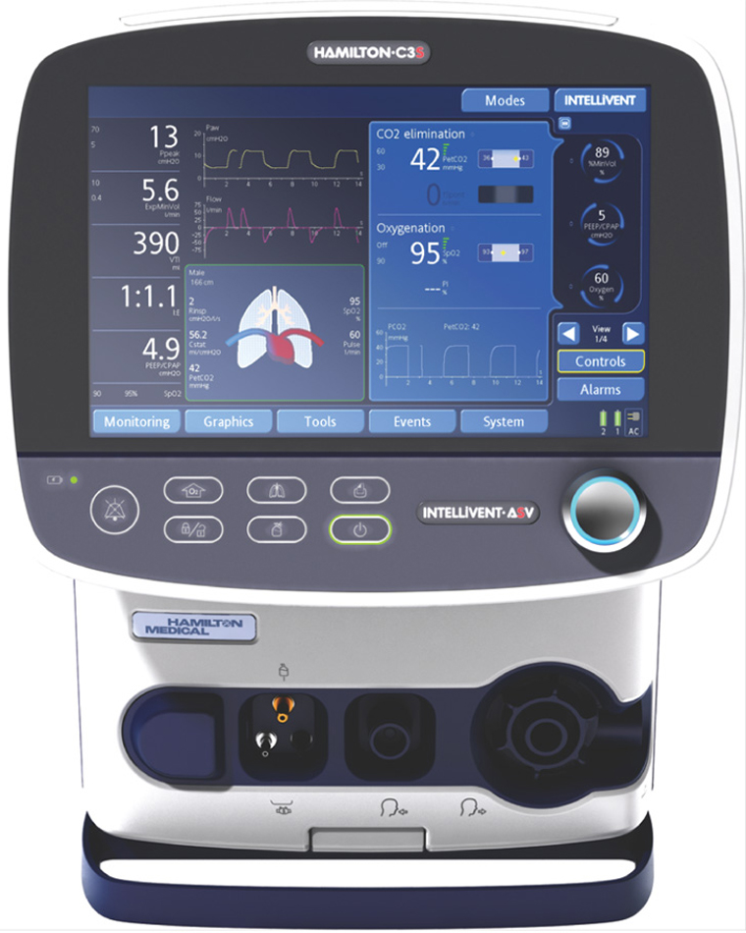
Figure 4.5

Slide 5
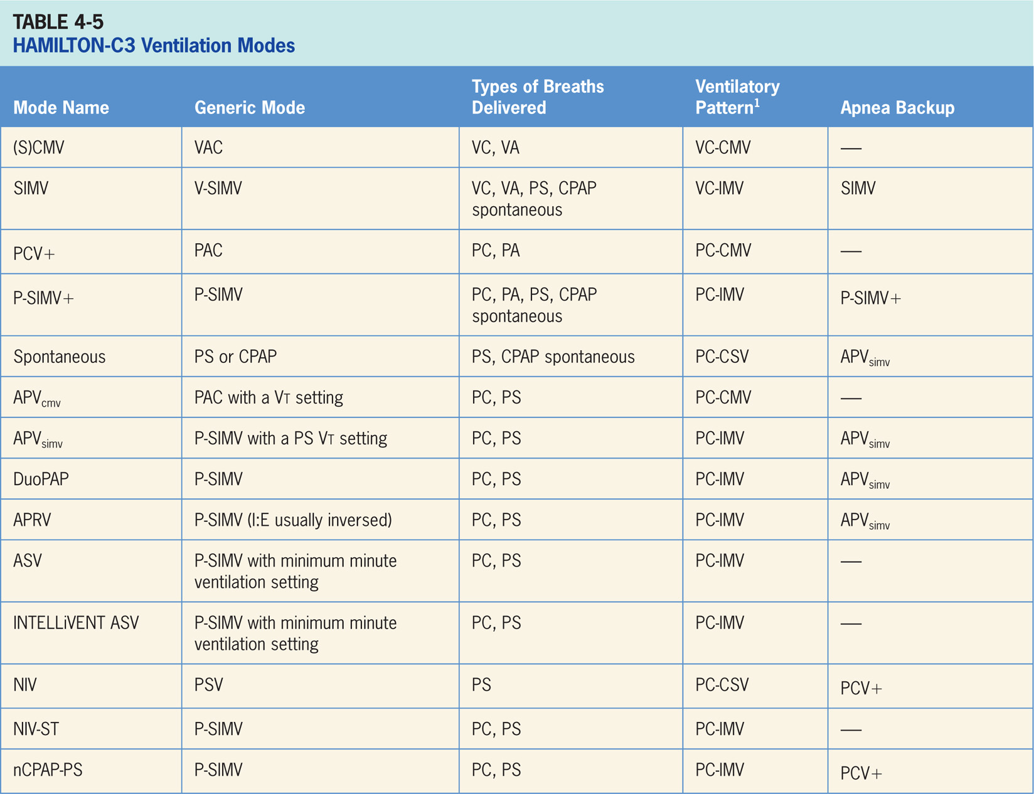

Slide 6
Synchronized Controlled Mandatory Ventilation[(S)CMV]
Volume-targeted mode of ventilation (VAC) allows mandatory, time-triggered breaths or patient-assisted breaths.⁵
Spontaneous breaths not allowed.
Breath cycles to exhalation once tidal volume (Vt) has been delivered.

Slide 7
Main Operator Controls Include:
Fio₂
PEEP
Vt
Flow
RR
I:E
Resulting pressure created is variable and depends on Vt, flow, and patient respiratory system mechanics.⁵

Slide 8
Synchronized, Intermittent Mandatory Ventilation (SIMV)
Combines two breath types, VAC and PS or spontaneous breathing, while on CPAP.⁵
Mandatory, time-triggered breaths, patient-assisted breaths, and spontaneous breaths provided.
Ventilator prevents “breath stacking” (a VAC breath compounded by a PS breath) through use of “timing window.”
Patient attempts to trigger a breath in timing window, ventilator will deliver VAC breath.
Patient attempts to trigger a breath outside the window, then a spontaneous breath will occur.

Slide 9
Main Operator Controls Include:
Fio₂
PEEP
Vt
Flow
RR
Pressure support level
Cycle sensitivity
During VAC breaths, resulting pressure created is variable and depends on Vt, flow, and patient mechanics.⁵
During PS breaths, volume will be variable and depend on PS level, patient effort, and patient respiratory system mechanics.⁵

Slide 10
Pressure Controlled Ventilation+ (PCV+)
Pressure-targeted mode of ventilation allowing for mandatory, time-triggered breaths or patient-assisted PAC breaths.⁵
Spontaneous breaths not allowed.
Breath cycles to exhalation once inspiratory time has been reached.

Slide 11
Main Operator Controls Include:
Fio₂
PEEP
Inspiratory pressure level
Inspiratory time
I:E
RR
Pressure will be consistently delivered from breath to breath. Vt and flow are variable and will depend on the inspiratory pressure level, patient effort, and patient respiratory system mechanics.⁵

Slide 12
Pressure Synchronized, Intermittent Mandatory Ventilation+ (P-SIMV+)
Similar to SIMV except the target is pressure instead of volume.⁵
P-SIMV+ combines two breath types, PAC and PS or spontaneous breathing, while on CPAP.
Combination of mandatory, time-triggered breaths, patient-assisted breaths, and spontaneous breaths.
Ventilator prevents “breath stacking” (a PAC breath compounded by a PS breath) through the use of a “timing window.”
Patient attempts to trigger a breath in timing window, then ventilator will deliver a PAC breath.
Patient attempts to trigger breath outside window, spontaneous breath will occur.

Slide 13
Main Operator Controls Include:
Fio₂
PEEP
Inspiratory pressure level
Inspiratory time
RR
Pressure support level
Cycle sensitivity
During PAC breaths, resulting Vt created is variable and depends on inspiratory pressure level, patient effort, and patient respiratory system mechanics.⁵
During PS breaths, the volume will be variable and depend on PS level, patient effort, and patient respiratory system mechanics.⁵

Slide 14
Spontaneous Mode
Patient triggers all breaths and will receive PS or CPAP (if the PS is set at 0).⁵
If PS set at 0, patient must contribute all work of breathing. This is sometimes used for a spontaneous breathing trial to assess the potential for liberation from the ventilator.
During PS, patient regulates respiratory rate and Vt with support from ventilator.
Patient triggers all breaths and will receive clinician-set PS level.
Breath cycles to expiration when the inspiratory flow decreases below a preset percentage of inspiratory peak flow.

Slide 15
Main Operator Controls Include:
Fio₂
PEEP
Pressure support level
Cycle sensitivity
Vt will be variable and depend on PS level, patient effort, and patient respiratory system mechanics.⁵

Slide 16
Adaptive Pressure Ventilation with Controlled Mandatory Ventilation (APV_{cmv})
Referred to as (S)CMV+.⁵
Vt-targeted pressure-regulated mode, clinician sets Vt that is wanted, ventilator uses varying levels of PAC to achieve target.
Similar to VS, ventilator relies on calculations from previous breaths to deliver what calculates the inspiratory pressure level needs to be to achieve the Vt.
Differs from volume in ventilator now uses PAC breaths as to PS breaths.
The ventilator drops inspiratory pressure level as patient effort increases and conversely increases inspiratory pressure level when patient effort is too low.

Slide 17
Adaptive Pressure Ventilation with Synchronized, Intermittent Mandatory Ventilation (APV_{simv})
Referred to as SIMV+.⁵
Combines a Vt targeted PAC breath with spontaneous PS breaths in between.
Type of breaths delivered are same as P-SIMV; difference is inspiratory pressure level is controlled by ventilator (variable) in APV_{simv} as to clinician-set (P-SIMV).

Slide 18
Duo Positive Airway Pressure
Pressure-targeted mode of ventilation allows for spontaneous breathing at two different pressure levels.⁵
Ventilator switches between different clinician-set pressure levels (the lower of which can be CPAP).
Pressure levels referred to as P_{high} and P_{low}. T_{high} is length of time at P_{high} and T_{low} is length of time spent at T_{low}.
Difference is the P_{high} level is now referenced to atmosphere as to PEEP level.
Increases in P_{low} will decrease distending pressure.
Additional ventilator support can be added in form of PS at both pressure levels to augment patient effort.

Slide 19
Airway Pressure-release Ventilation (APRV)
Mode of ventilation that is similar to DuoPAP, allows for spontaneous breathing at two different pressure levels.⁵
Ventilator switches between two different clinician-set pressure levels (the lower of which can be CPAP).
Pressure levels referred to as P_{high} and P_{low}. T_{high} is length of time at P_{high} and T_{low} is length of time spent at T_{low}. Unlike DuoPAP, APRV used in inverse ratio fashion. Most of time spent at P_{high} with brief, periodic releases to P_{low}.
P_{high} level is now referenced to atmosphere as to PEEP level.
Increases in P_{low} will decrease distending pressure.
Additional ventilator support can be added in form of PS at both pressure levels to augment patient effort.

Slide 20
Adaptive Support Ventilation (ASV)
Adjusts inspiratory pressure and RR to meet minimum minute volume set by clinician.⁵
This results in variable form of P-SIMV.
Machine-timed breaths are PAC while spontaneously generated breaths are PS.
Amount of breathing that patient does determines how many machine-generated breaths will be delivered.
Algorithm for ASV is centered around lung protection.

Slide 21
Noninvasive Ventilation (NIV)
Patient triggers all breaths and may receive PS with/without CPAP or CPAP alone.⁵
NIV is designed for use with mask or other noninvasive patient interface.

Slide 22
Spontaneous/Timed Noninvasive Ventilation (NIV-ST)
Designed for use with mask or other noninvasive patient interface.⁵
P-SIMV without an endotracheal tube. NIV-ST combines two breath types, PAC and PS or spontaneous breathing, while on CPAP.
Combination of mandatory, time-triggered breaths, patient-assisted breaths, and spontaneous breaths.
Patient triggers regularly, all breaths are patient-triggered spontaneous breaths, i.e., no time-triggered mandatory breath.

Slide 23
Spontaneous/Timed Noninvasive Ventilation (NIV-ST) (cont’d)
Only when patient trigger not detected during defined breath cycle time (or total breath time), ventilator delivers time-triggered mandatory breath.
Ventilator prevents “breath stacking” (a PAC breath compounded by a PS breath) through use of “timing window.” If patient attempts to trigger a breath in timing window, then ventilator will deliver a PAC breath.
Patient attempts to trigger a breath outside window, then spontaneous breath will occur.

Slide 24
Nasal Continuous Positive Airway Pressure (nCPAP-PS)
Available only in neonatal mode; designed for use with noninvasive interface.⁵
P-SIMV without an endotracheal tube. NIV-ST combines two breath types, PAC either PS or spontaneous breathing, while on CPAP.
Combination of mandatory, time-triggered breaths, patient-assisted breaths, and spontaneous breaths.
Different from P-SIMV, the patient triggers regularly, all breaths are patient-triggered spontaneous breaths, i.e., no time-triggered mandatory breath.

Slide 25
Nasal Continuous Positive Airway Pressure (nCPAP-PS) (cont’d)
Only when patient trigger not detected during defined breath cycle time (or total breath time) does ventilator deliver time-triggered mandatory breaths.
Ventilator prevents “breath stacking” (a PAC breath compounded by PS breath) through use of “timing window.”
Patient attempts to trigger a breath in timing window, then ventilator will deliver PAC breath.
Patient attempts to trigger a breath outside window, then spontaneous breath will occur.

Slide 26
Pressure/Volume Tool (PV) Special Features
Respiratory mechanics maneuver that performs quasi-static P/V curve on ventilator (Figure 4-3).⁵
During maneuver, C3 slowly increases pressure to clinician-set upper level then slowly decrease pressure either back to baseline or elevated PEEP level ultimately producing an inflation and deflation limb.
Only work on passive patients, any effort will terminate the maneuver.
Allows for breath hold at top of curve (recruitment maneuver, in essence) can be set to terminate maneuver at higher than baseline PEEP level to maintain gained recruitment.

Slide 27
Apnea Backup Ventilation
Ventilator will go into apnea backup ventilation if no breaths detected in clinician-set interval.⁵
Mode of apnea backup ventilation depends on mode that patient is in.

Slide 28
Nebulizer
Pneumatic nebulization function powers standard inline nebulizer for delivery of prescribed medications in ventilator circuit.⁵
When nebulization is active, nebulizer flow is synchronized with inspiratory phase of each breath for 30 minutes.
Nebulization can be activated in all modes of ventilation.

Slide 29
High-flow Oxygen Therapy
Therapy in which continuous flow of heated and humidified air and oxygen is delivered to patient.⁵
Level of oxygen and flow are preset by operator.
High-flow oxygen therapy can be delivered using single- or double-limb breathing circuits.

Slide 30
Dynamic Heart/Lung Panel
Pictorial representation of the heart and lungs.⁵
Displays Vt, interaction with heart, patient triggering and resistance in real time.

Slide 31
INTELLiVENT (ASV)
(Not available in the United States at this time) closed loop mode of ventilation.⁴
Uses ASV (see above) to adjust the inspiratory pressure and RR to achieve a minute ventilation target.
Passive patients, the target minute volume is adjusted according to exhaled partial pressure of end-tidal CO₂.
INTELLiVENT controls the oxygenation. PEEP and Fio₂ are adjusted according to Spo₂ (finger or ear probe) and are based on table derived from the ARDSNet publications.^{2,3}
Clinicians can opt for INTELLiVENT to wean the patient (if tolerated) and do spontaneous breathing trials.

Slide 32
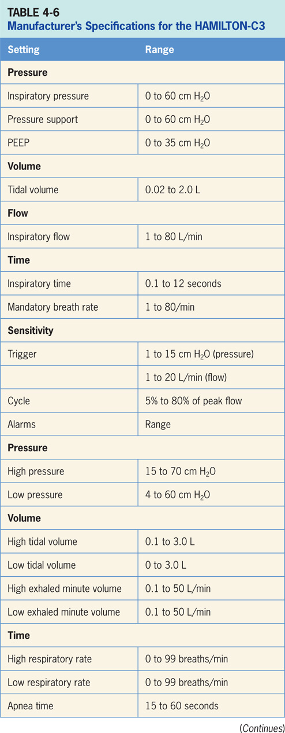

Slide 33
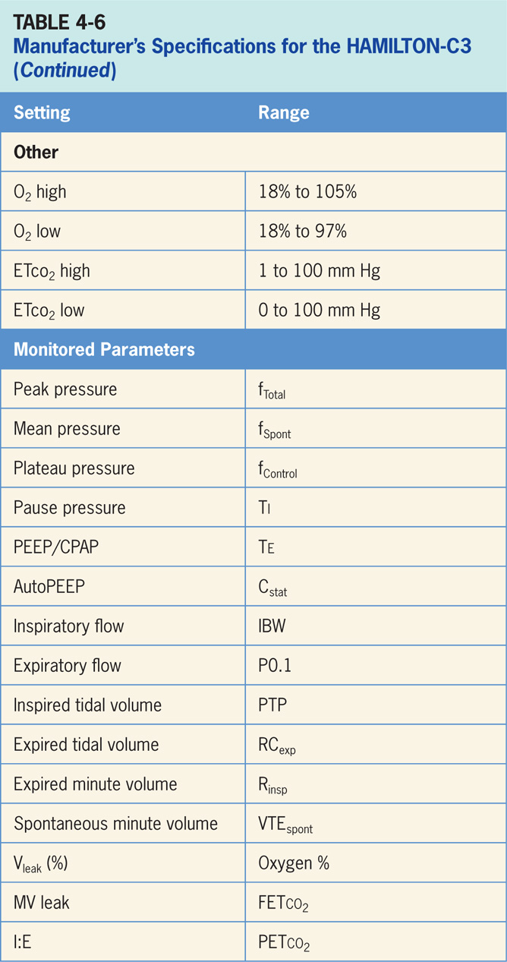

Slide 34
HAMILTON-C3 Accessories
End-tidal CO₂ (ETco₂) measurement, pulse oximetry and an integrated vibrating mesh Aerogen® nebulizer for aerosolized medication delivery.⁵
ETco₂ can be mainstream or sidestream and can be used for volumetric capnography and airway dead space calculations.
Pulse oximetry, parameter that can be displayed on the ventilator.
C3 is compatible with Masimo and Nihon Kohden cables.
ETco₂ and pulse oximetry measurements require special modules attach to ventilator.
Integrated Aerogen® system consists of Aerogen nebulizer and Aerogen module of HAMILTON-G5.

Slide 35
HAMILTON–C1
HAMILTON-C1 ventilator intended to provide positive pressure ventilatory support to adults, pediatrics, infants and neonates⁶
Intended to be used in intensive care ward, intermediate care ward, emergency ward, long-term acute care hospital, or in recovery room. (Pictured in Figure S4-S6)
Electronically controlled pneumatic system with integrated air compressor.
Runs on AC power with battery backup to protect, facilitate intra-hospital transport.
Pneumatics deliver gas, and its electrical systems control pneumatics, monitor alarms, and distribute power.
C1 also incorporates a proximal flow sensor that facilitates measurement at the patient wye. (C1 operator interface is depicted in Figure S4-S7).
Consists of a touch screen, some keys, and a turn-and-press knob. Turning knob changes the values of the parameter chosen and pressing knob confirms selection.

Slide 36
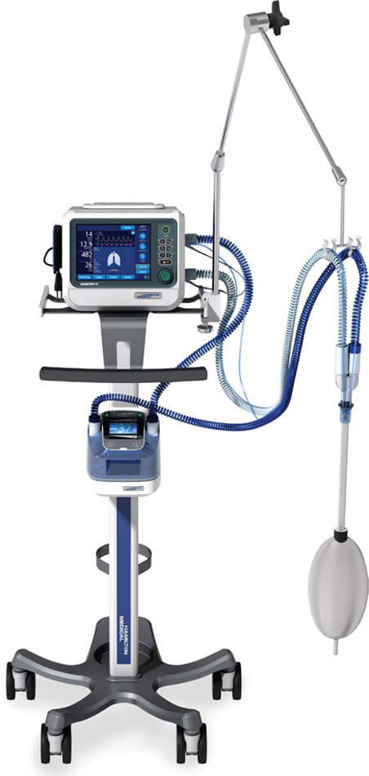
Figure 4.6

Slide 37
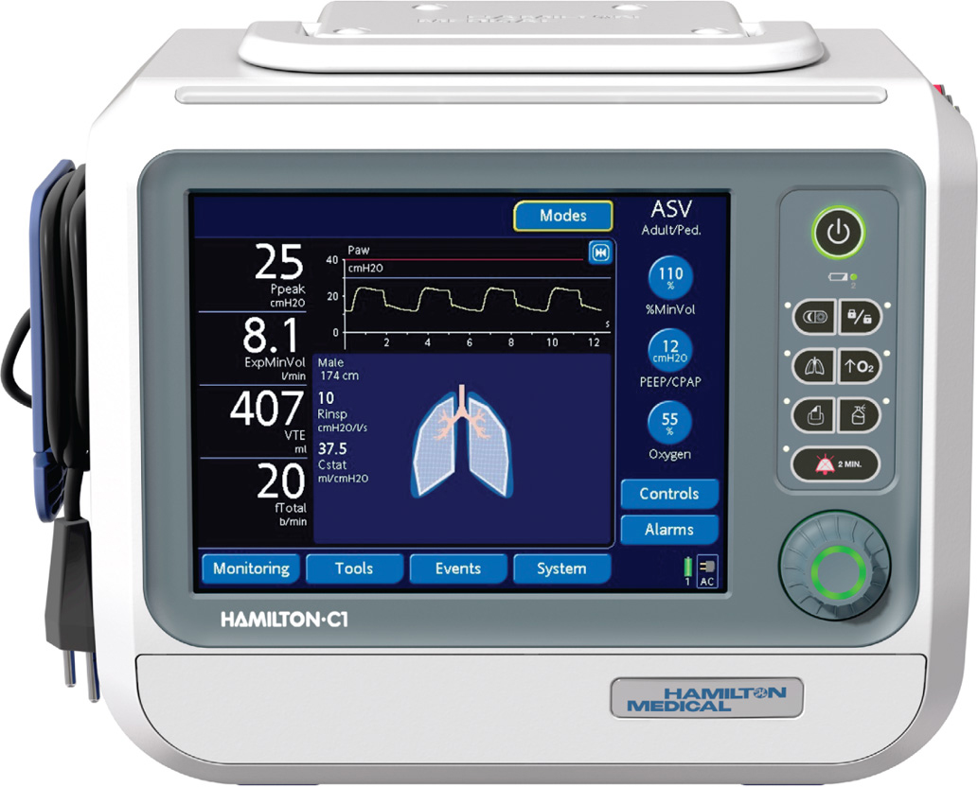
Figure 4.7

Slide 38
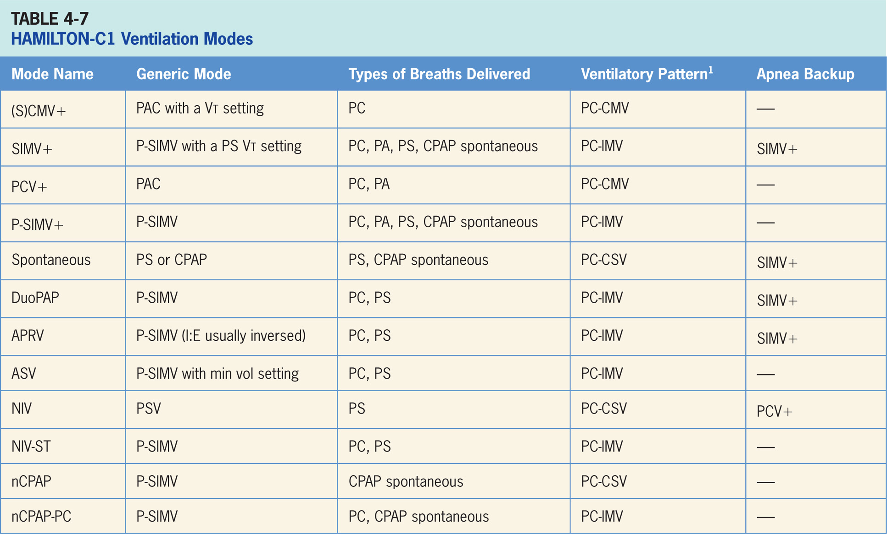

Slide 39
Synchronized, Controlled Mandatory Ventilation Plus [(S)CMV+]
Vt targeted, pressure-regulated mode.⁶
Clinician sets Vt that ventilator uses varying levels of PAC to achieve target.
Ventilator relies on calculations from previous breaths to deliver what calculates inspiratory pressure level needed to achieve Vt.
In this mode, ventilator has potential to drop inspiratory pressure level as patient effort increases and conversely may increase inspiratory pressure level when patient effort is too low.

Slide 40
Main Operator Controls Include:
Fio₂
PEEP
Vt target
I:E
RR
Vt may not match operator setting due to the ventilator is using inspiratory pressure to target Vt as to VAC and relies on previous breaths to make calculation.⁶ Change in patient effort from previous breath may result in deviation from Vt setting.

Slide 41
Synchronized, Intermittent Mandatory Ventilation Plus (SIMV+)
Vt-targeted PAC breath with spontaneous PS breaths in between.⁶
Type of breaths delivered are same as P-SIMV.
Difference; inspiratory pressure level is controlled by ventilator (variable) in SIMV+.

Slide 42
Main Operator Controls Include:
Fio₂
PEEP
Vt target
Inspiratory time
RR
PS level
Cycle sensitivity
Vt may not match operator setting for PAC breaths due to ventilator is using inspiratory pressure to target the Vt as to VAC and relies on previous breaths to make calculation.⁶ Change in patient effort from previous breath may result in a deviation from the Vt setting. During PS breaths, the Vt will be variable, depend on PS level, patient effort, and patient respiratory system mechanics.

Slide 43
Pressure-controlled Ventilation+ (PCV+)
Pressure-targeted mode of ventilation allows for mandatory, time-triggered breaths or patient-assisted breaths.⁶
Spontaneous breaths are not allowed.
Breath cycles to exhalation once inspiratory time has been reached.

Slide 44
Main Operator Controls Include:
Fio₂
PEEP
Inspiratory pressure level
I:E
RR
Pressure will be consistently delivered from breath to breath; Vt and flow are variable, will depend on inspiratory pressure level, patient effort, and patient respiratory system mechanics.⁶

Slide 45
Pressure-synchronized, Intermittent Mandatory Ventilation+ (PSIMV+)
Similar to SIMV except target is now pressure instead of volume.⁶
P-SIMV combines two breath types, PAC and PS or spontaneous breathing, while on CPAP.
Combination of mandatory, time-triggered breaths, patient-assisted breaths, and spontaneous breaths.
Ventilator prevents “breath stacking” (a PAC breath compounded by a PS breath) through use of “timing window.”
If patient attempts to trigger a breath in timing window, then ventilator will deliver PAC breath.
If patient attempts to trigger a breath outside the window, then spontaneous breath will occur.

Slide 46
Main Operator Controls Include:
Fio₂
PEEP
Inspiratory pressure level
Inspiratory time
RR
Pressure support level
Cycle sensitivity
During PAC breaths, resulting Vt created is variable, depends on inspiratory pressure level, patient effort, and patient respiratory system mechanics.⁶ During PS breaths, the volume will be variable, depend on PS level, patient effort, and patient respiratory system mechanics.⁶

Slide 47
Spontaneous/CPAP
Spontaneous/CPAP, patient regulates respiratory rate and Vt.⁶
Patient triggers all breaths and will receive no additional support (CPAP) or the clinician-set PS level.
With pressure support, breath cycles to expiration when inspiratory flow decreases below preset percentage of the inspiratory peak flow.
CPAP sometimes used for spontaneous breathing trials.

Slide 48
Duo Positive Airway Pressure
Pressure-targeted mode of ventilation allows for spontaneous breathing at two different pressure levels.⁵
Ventilator switches between different clinician-set pressure levels (the lower of which can be CPAP).
Pressure levels referred to as P_{high} and P_{low}. T_{high} is length of time at P_{high} and T_{low} is length of time spent at T_{low}.
Difference is the P_{high} level is now referenced to atmosphere as to PEEP level.
Increases in P_{low} will decrease distending pressure.
Additional ventilator support can be added in form of PS at both pressure levels to augment patient effort.

Slide 49
Airway Pressure-release Ventilation (APRV)
Ventilation similar to DuoPAP allowing for spontaneous breathing at two pressure levels.⁴
Ventilator switches between two clinician-set pressure levels (the lower of which can be CPAP).
Pressure levels are referred to as P_{high} and P_{low}. T_{high} is length of time at P_{high} and T_{low} is length of time spent at T_{low}.
APRV is used in an inverse ratio fashion. Most of time is spent at P_{high} with periodic releases to P_{low}.
Difference from pressure-targeted modes is P_{high} level referenced to atmosphere as to PEEP level. This is important because increases in P_{low} will decrease distending pressure.
Additional ventilator support can be added in form of PS at both pressure levels to augment patient effort.

Slide 50
Adaptive Support Ventilation (ASV)
“Feedback” mode that adjusts inspiratory pressure and RR to meet minimum-minute volume set by clinician.⁴
Result in variable form of P-SIMV. The machine-timed breaths are PAC, while generated breaths are PS.
Amount of breathing patient does determines how many machine-generated breaths will be delivered.

Slide 51
Noninvasive Ventilation
The patient triggers all of breaths and receive either PS or CPAP (if the pressure is set to 0).
NIV is designed for use with a mask or other noninvasive patient interface.

Slide 52
Spontaneous/Timed Noninvasive Ventilation
Designed for use with mask or other noninvasive patient interface. P-SIMV without an endotracheal tube.⁶
NIV-ST combines two breath types, PAC and PS or spontaneous breathing, while on CPAP.
Combination of mandatory, time-triggered breaths, patient-assisted breaths, and spontaneous breaths.
If patient triggers regularly, all breaths are patient-triggered spontaneous breaths, i.e., no time-triggered mandatory breath.

Slide 53
Spontaneous/Timed Noninvasive Ventilation (cont’d)
Only when patient trigger is not detected during defined breath cycle time (or total breath time), ventilator delivers time-triggered mandatory breath.
Ventilator prevents “breath stacking” (a PAC breath compounded by a PS breath) through the use of “timing window.”
If patient attempts to trigger a breath in timing window, then ventilator will deliver PAC breath.
If patient attempts to trigger a breath outside window, then a spontaneous breath will occur.

Slide 54
Nasal Continuous Positive Airway Pressure (nCPAP)
Available only in neonatal mode and is designed for use with a noninvasive interface.⁶
Purely spontaneous mode with CPAP as baseline pressure with no additional pressure added on inspiration.

Slide 55
Nasal Continuous Positive Airway Pressure-pressure Control (nCPAP-PC)
Noninvasive, pressure-targeted mode of ventilation that allows for mandatory, time-triggered breaths or patient-assisted breaths.⁶
Breath cycles to exhalation once inspiratory time has been reached.

Slide 56
Apnea Backup Ventilation Special Features
Ventilator will go into apnea backup ventilation if no breaths are detected in clinician-set interval.6
Mode of apnea backup ventilation depends on the mode that patient is in.

Slide 57
Nebulizer
Pneumatic nebulization function powers a standard inline nebulizer for delivery of prescribed medications in the ventilator circuit.⁶
When nebulization is active, nebulizer flow is synchronized with inspiratory phase of each breath for 30 minutes.
Nebulization can be activated in all modes of ventilation.

Slide 58
Dynamic Lung Panel
Visualizes tidal volume, lung compliance, patient triggering, and resistance in real time.⁶
Lungs expand and contract in synchrony with actual breaths. Numeric values for resistance (R_{insp}) and compliance (C_{stat}) are displayed.
Shape of lungs and the bronchial tree are also related to compliance and resistance values.
If all values are in a normal range, panel is framed in green.

Slide 59
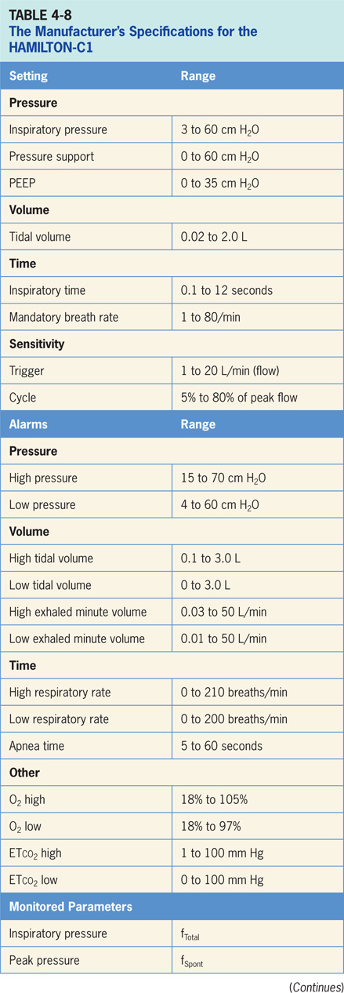

Slide 60
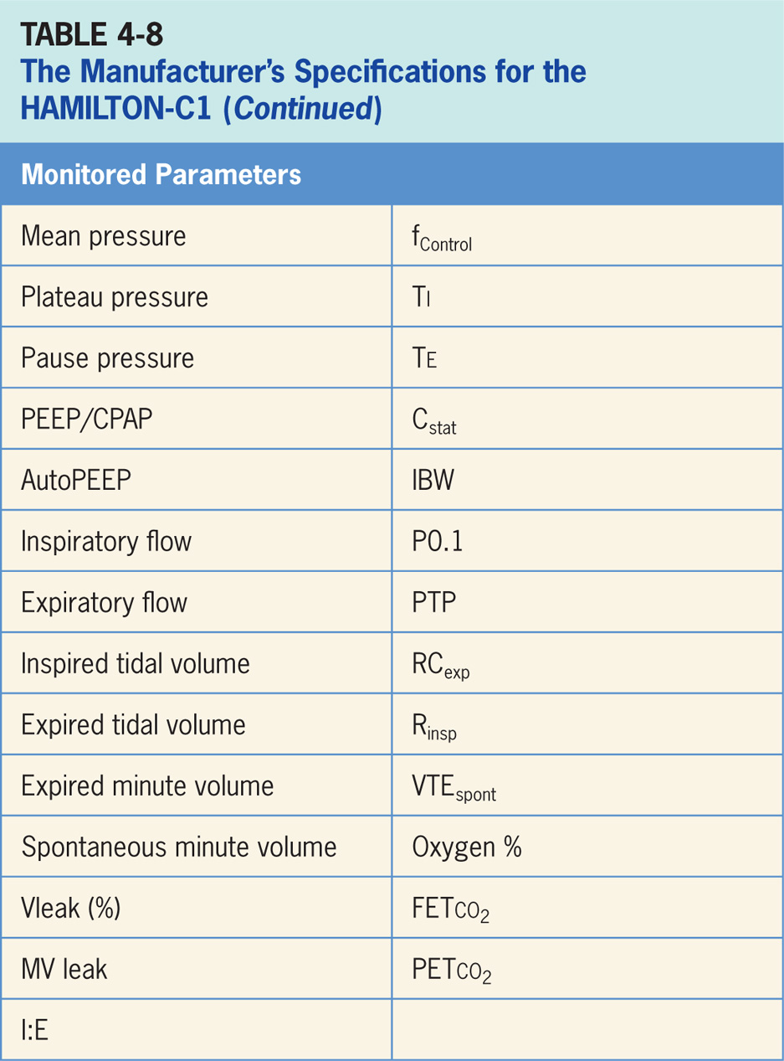

Slide 61
HAMILTON-C1 Accessories
End-tidal CO₂ (ETco₂) measurement, pulse oximetry and an integrated vibrating mesh Aerogen® nebulizer for aerosolized medication delivery.⁶

Slide 62
Getinge Servo-i
Critical care ventilator intended for treatment and monitoring of neonates, infants, and adults with respiratory failure or respiratory insufficiency.⁷ As pictured in Figure 4-8, the Servo-i is electrically powered from an AC outlet with an internal battery backup and is designed to be used by healthcare providers in hospitals or healthcare facilities and for in-hospital transport.
Controls consist of a touch screen, buttons, and knobs. largest knob is the main control knob (Figure 4-9).

Slide 63
Getinge Servo-I (cont’d)
Touch screen is used to select variable to be changed, main control knob adjusts the settings by turning and is pressed to confirm settings.
Supplemental control knobs allow clinician to make quick, direct setting adjustments of Fio₂, tidal volume, inspiratory pressure, depending on the mode, respiratory rate and PEEP (Figure 4-9).
Buttons on bottom provide for manual breath trigger, O₂ breaths (100% O₂ for 1 min), inspiratory and expiratory holds. Buttons up the right side of operator interface are related to alarm settings, system information, and navigation.

Slide 64
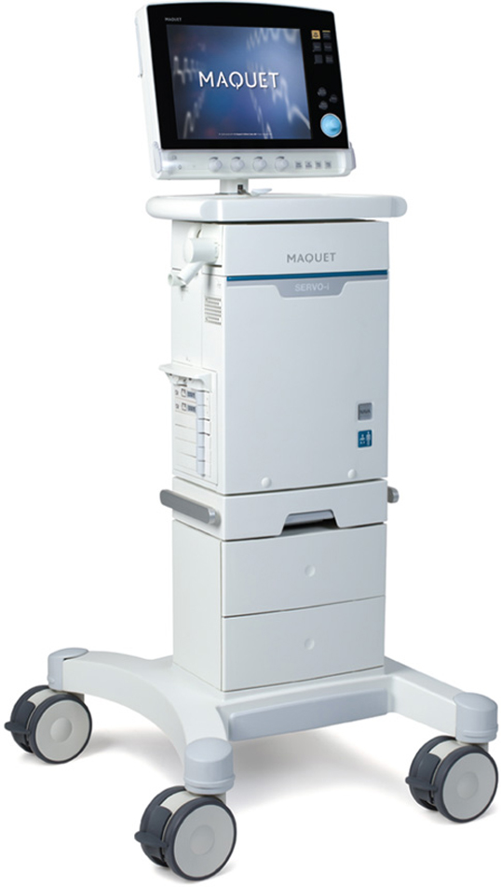
Figure 4.8

Slide 65
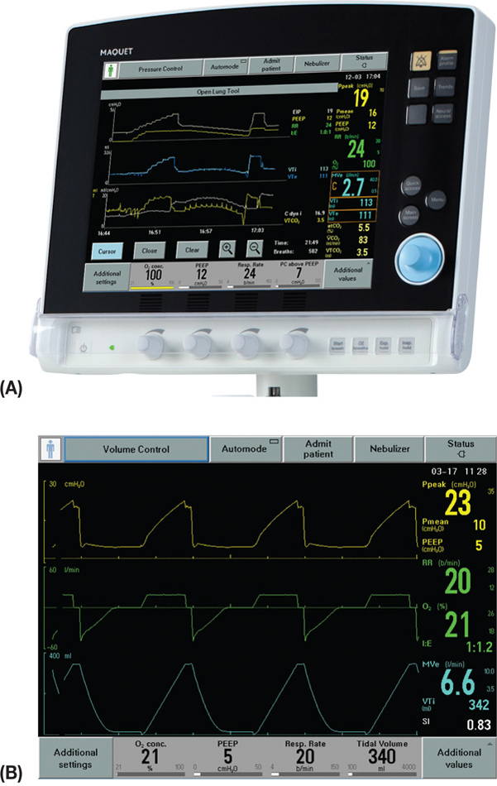
Figure 4.9A & B

Slide 66
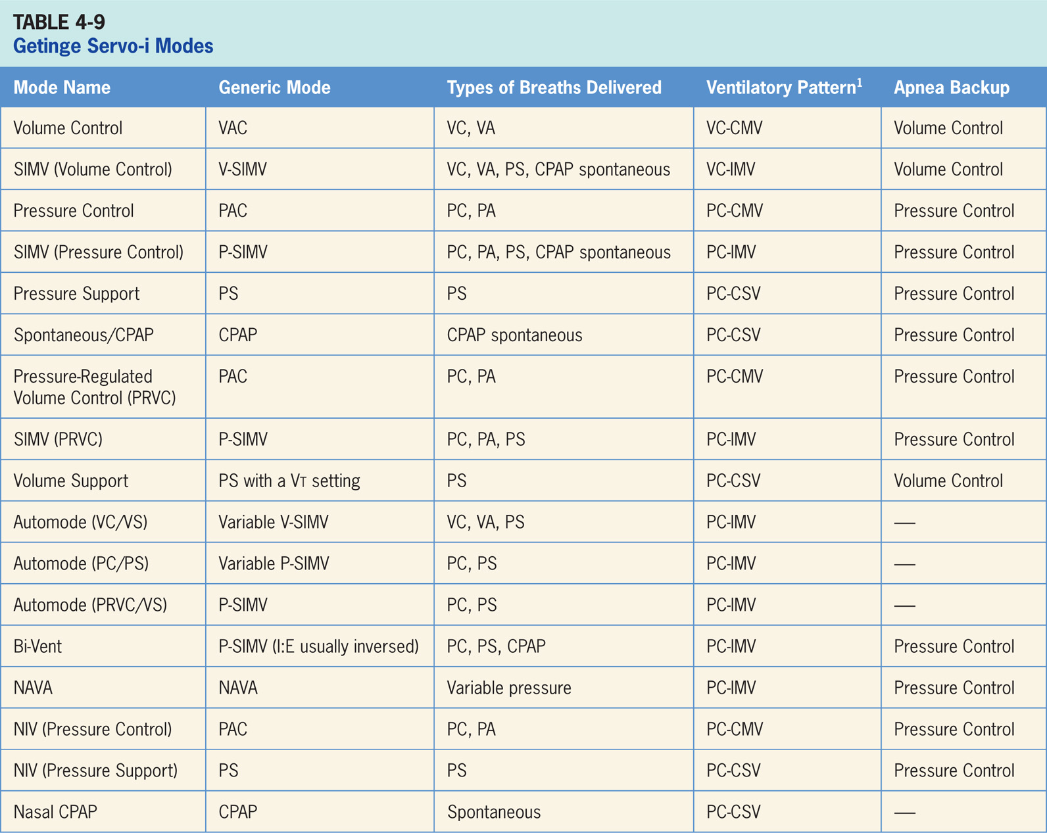

Slide 67
Volume Control
Volume-targeted mode of ventilation (VAC) allows for mandatory, time-triggered breaths or patient-assisted breaths.⁷
Spontaneous breathing not allowed. The breath cycles to exhalation once the tidal volume (Vt) has been delivered.
Volume control also incorporates flow adaptation, if patient’s inspiratory effort is large enough, inspiration will switch from volume control to pressure support with flow cycling.
Breaths can be delivered by a decelerating or fixed flow.

Slide 68
Main Operator Controls Include:
Fio₂
PEEP
Vt or MV
RR
Inspiratory time or I:E
Resulting pressure created is variable, depends on Vt, flow, patient effort, and patient respiratory system mechanics.⁷

Slide 69
SIMV (Volume Control)
Combines two breath types, VAC and PS or spontaneous breathing, while on CPAP.⁷
Ventilator provides mandatory, time-triggered breaths, patient-assisted breaths, and spontaneous breaths.
Ventilator prevents “breath stacking” (a VAC breath compounded by a PS breath) through the use of a “timing window.”
If patient attempts to trigger a breath in timing window, then ventilator will deliver a VAC breath.
If patient attempts to trigger breath outside the window, then spontaneous breath will occur.
Volume control breaths also incorporate flow adaptation so that if patient’s inspiratory effort is large enough, inspiration will switch from volume control to pressure support with flow cycling.

Slide 70
Main Operator Controls Include:
Fio₂
PEEP
Vt or MV
SIMV rate
Inspiratory time or I:E
Pressure support level
Cycle sensitivity
During VAC breaths, resulting pressure created is variable, depends on Vt, flow, patient effort, and patient mechanics.⁷
During PS breaths, volume will be variable, depend on PS level, patient effort, and patient respiratory system mechanics.⁷

Slide 71
Pressure Control
Pressure-targeted mode of ventilation allowing for mandatory, time-triggered breaths or patient-assisted breaths.⁷
Spontaneous breaths not allowed.
Breath cycles to exhalation once the inspiratory time has been reached.

Slide 72
Main Operator Controls Include:
Fio₂
PEEP
Inspiratory pressure level
Inspiratory time or I:E
RR
Pressure will be consistently delivered from breath to breath; Vt and flow are variable and will depend on inspiratory pressure level, patient effort, and patient respiratory system mechanics.⁷

Slide 73
SIMV (Pressure Control)
Similar to SIMV (Volume Control) except the target is now pressure instead of volume.⁷
SIMV (Pressure Control) also combines two breath types, PAC and PS or spontaneous breathing, while on CPAP.
Combination of mandatory, time-triggered breaths, patient-assisted breaths, and spontaneous breaths.
Ventilator prevents “breath stacking” (a PAC breath compounded by a PS breath) through the use of “timing window.”
If patient attempts to trigger a breath in timing window, then ventilator will deliver PAC breath.
If patient attempts to trigger a breath outside window, then spontaneous breath will occur.

Slide 74
Main Operator Controls Include:
Fio₂
PEEP
Inspiratory pressure level
Inspiratory time or I:E
SIMV rate
Pressure support level
Cycle sensitivity
During PAC breaths, the resulting Vt created is variable, depends on inspiratory pressure level, patient effort, and patient respiratory system mechanics.⁷
During PS breaths, volume will be variable and depend on the PS level, patient effort, and patient respiratory system mechanics.⁷

Slide 75
Pressure Support (PS)
Patient regulates respiratory rate and the Vt with support from ventilator.⁷
Patient triggers all of breaths and will receive clinician-set PS level.
Breath cycles to expiration when inspiratory flow decreases below a preset percentage of inspiratory peak flow.

Slide 76
Main Operator Controls Include:
Fio₂
PEEP
Pressure support level
Cycle sensitivity
The Vt will be variable, depend on PS level, patient effort, and patient respiratory system mechanics.⁷

Slide 77
Spontaneous/CPAP
Spontaneous breathing on CPAP occurs when inspiratory pressure level is set to zero in Pressure Support.⁷
Patient triggers all the breaths and does all work of breathing.
Sometimes used for a spontaneous breathing trial to assess potential for liberation from ventilator.

Slide 78
Pressure-regulated Volume Control (PRVC)
Pressure-targeted (either PC or PA breaths) mode that uses pressure breaths to achieve a clinician-set Vt.⁷
Inspiratory pressure level now adjusted by ventilator instead of clinician.
Since ventilator relies a previous breath sequence to deliver ensuing breath Vt tends to be variable, in patients with inconsistent efforts.
Pressure change between breaths is up to 3 cm H₂O.
Maximum pressure used depends on set upper pressure limit alarm, always staying 5 cm H₂O below this limit.
No spontaneous breaths.

Slide 79
SIMV (PRVC)
Combines two breath types, PAC (ventilator-controlled inspiratory pressure) and PS or spontaneous breathing, while on CPAP.⁷
Combination of mandatory, time-triggered breaths, patient-assisted breaths, and spontaneous breaths.
Ventilator prevents “breath stacking” (a PAC breath compounded by a PS breath) through use of “timing window.”
If patient attempts to trigger a breath in timing window, then ventilator will deliver a PAC breath.
If patient attempts to trigger a breath outside window, then spontaneous breath will occur.

Slide 80
Volume Support (VS)
Ventilator delivers a variable (from breath to breath) PS level in order to reach clinician-set Vt.⁷
Ventilator changes PS level as needed to reach set Vt.
Ventilator may drop level of support as patient effort increases and conversely may increase PS level when patient effort is too low.

Slide 81
Automode
Feedback mechanism whereby ventilator switches between an A/C mode and supported mode depending on patient’s spontaneous breathing activity.⁷
If number of spontaneous efforts is low majority of breaths will be controlled.
If number of spontaneous efforts is high ventilator will stay in supported mode and allow for longer pauses in effort before switching back to controlled mode.
Three mode combinations that clinician can set up using automode:
Volume Control–Volume Support
PRVC–Volume Support
Pressure Control–Pressure Support
All of these modes have been described in detail above.

Slide 82
Bi-Vent
Mode of ventilation allowing for spontaneous breathing at two different clinician-set pressure levels can be used for APRV.⁷
Ventilator switches between two different clinician-set pressure levels (the lower of which can be CPAP).
These pressure levels are referred to as P_{high} and PEEP. T_{high} is length of time at P_{high} and T_{PEEP} is length of time spent at PEEP.
Bi-Vent is mainly used in an inverse I:E fashion, difference from pressure-targeted modes is the P_{high} level is now referenced to atmosphere as to PEEP level.
Increase in PEEP will decrease distending pressure. Additional ventilator support can be added in form of PS at both pressure levels to augment patient effort.

Slide 83
Neurally Adjusted Ventilatory Assist (NAVA)
Spontaneous mode of ventilation that delivers ventilatory assist in proportion to electrical activity of patient’s diaphragm (Edi); i.e., ventilator will delivery assist synchronized with timing and effort of patient’s own diaphragmatic breathing.⁷
Requires a separate module on ventilator and a special catheter.
Edi signal is obtained through use of specialized nasogastric catheter that has a series of transducers designed to detect electrical activity of diaphragm.
Breath trigger is also based on Edi.

Slide 84
Neurally Adjusted Ventilatory Assist (NAVA) (cont’d)
If Edi signal is lost, ventilator switches over to traditional pressure support.
NAVA is available both for invasive and noninvasive ventilation and can be used with any patient population (adult, pediatrics, and neonates).
Monitoring of Edi is available in all ventilation modes as well as in standby.

Slide 85
Noninvasive Ventilation
Modes available during noninvasive ventilation: pressure control, pressure support, and NAVA.⁷
Noninvasive ventilation designed to be used with a variety of masks and infant nasal prongs.
Servo-I automatically adapts to variation of leakage in order to maintain required pressure and PEEP level.
If leakage is excessive, ventilator will issue a high-priority alarm and deliver a flow according to settings.

Slide 86
Nasal CPAP
Involves delivering CPAP through a nasal cannula.
Only available for infants⁷
During NIV, ventilator automatically adapts to variation of leakage to maintain required pressure.
If leakage is excessive, ventilator will issue a high-priority alarm, deliver a continuous flow and pause breath cycling.

Slide 87
Open Lung Tool Special Features
Special display allowing clinician to examine end inspiratory pressure, PEEP, VT, dynamic compliance tidal CO₂ elimination (with CO₂ analyzer option; see below) on a breath-to-breath basis.⁷
There is an adjustable cursor allowing clinician to see values at specific points in time.

Slide 88
Apnea Backup Ventilation
Ventilator will go into apnea backup ventilation if no breaths are detected in clinician-set interval.
Mode of apnea backup ventilation depends on mode that patient is in (Table 4-5).⁷

Slide 89
Leak Compensation
Leak compensation comes into play with noninvasive ventilation as it automatically adapts to any inherent leaks in the system and maintain the pressure level and trigger and cycle sensitivity.⁷

Slide 90
Stress Index
Designed to assist clinician in identifying potentially harmful ventilatory patterns by analyzing changes in inspiratory pressure waveform during the constant flow of volume control breaths.⁷
Continually calculated while ventilating in volume control mode or SIMV(VC) + PS.
Intended for adults only.
Stress index is measured within a range of 0.5 to 1.5. A smaller range of 0.8 to 1.2 is displayed in graph in the stress index window.

Slide 91
Heliox
Possible through a Heliox enabled SERVO-i Ventilator System.⁷
Specialized system compensates monitoring and flow delivery when HeO₂ is used.
HeO₂ gas is connected to SERVO-i Ventilator System via a Heliox adapter, which is connected to the Air/HeO₂ inlet.
Servo-i automatically detects if air or HeO₂ is connected and compensates accordingly.

Slide 92
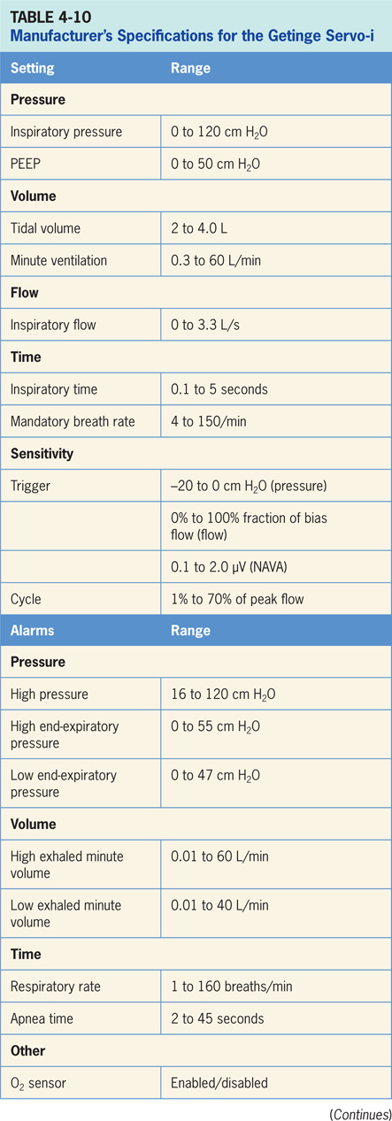

Slide 93
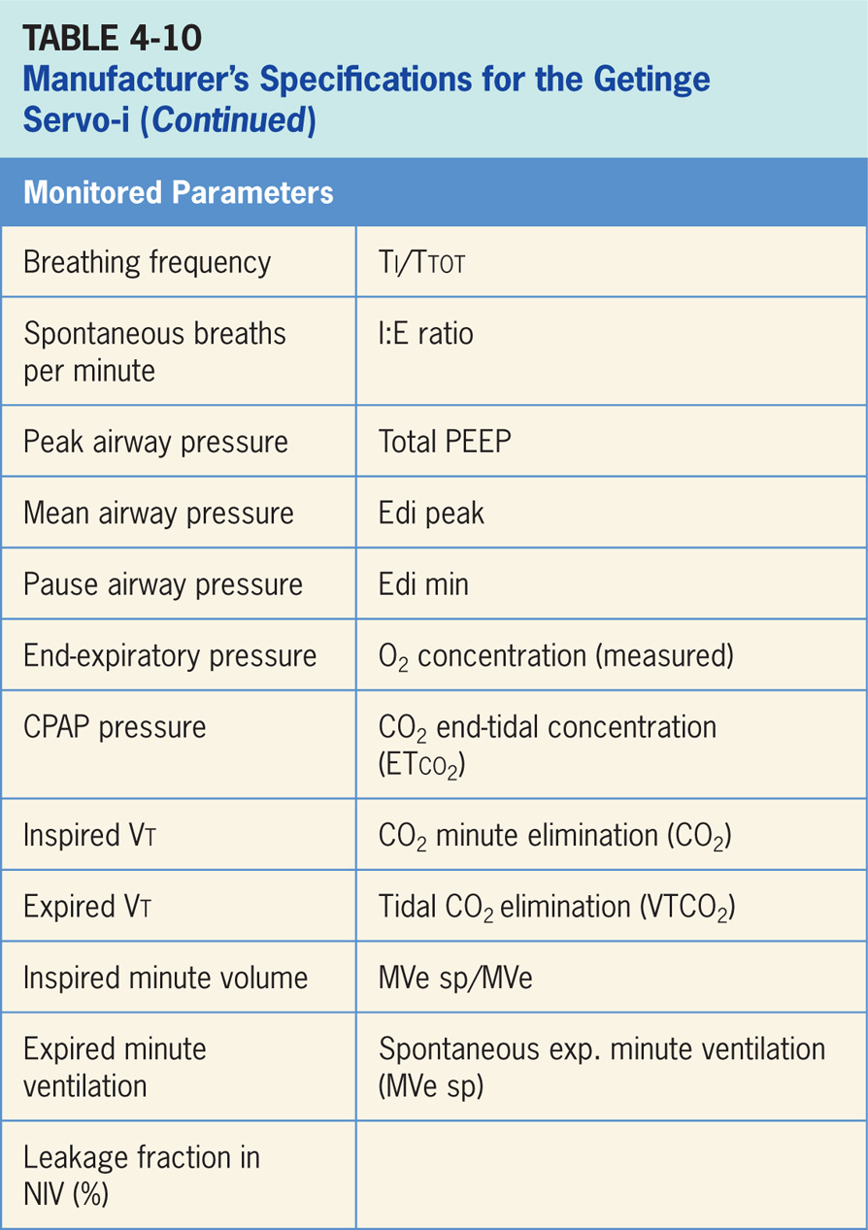

Slide 94
Accessories
Servo-i has available an optional CO₂ analyzer that provides continuous monitoring of: CO₂ concentration vs. time (waveform), end-tidal CO₂ concentration (ETco₂), CO₂ minute elimination, CO₂ tidal elimination and alarm limits for high and low ETco₂.⁷
For aerosolized medications, Aerogen Micropump vibrating mesh nebulizer can be integrated and has the advantage of not adding any flow to the circuit.

Slide 95
Covidien Puritan Bennett 840 Ventilator
Covidien Puritan Bennett 840 ventilator is a critical care ventilator designed for use in adult, pediatric, and neonatal patients in both acute and subacute clinical locations. (Pictured in Figure 4-12.)⁹
Electrically controlled and pneumatically powered. If there is no piped compressed air an external compressor would be required.
Operator interface on PB 840 employs a combination of a touch screen, buttons (real and virtual) and a control knob (Figure 4-13).

Slide 96
Covidien Puritan Bennett 840 Ventilator (cont’d)
It is a three-step process to make a change to a setting. The clinician first touches a virtual button on the touch screen. Second, the control knob is used to change value of the setting. Last, the “accept” button must be pressed to confirm.
Screen displays change depending on operation being carried out. For instance, alarm screen looks different than the monitoring screen and so forth. There are a number of different screens.

Slide 97
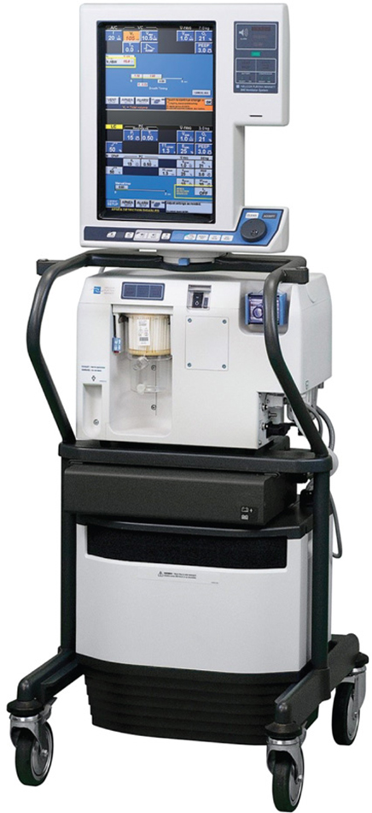
Figure 4.12

Slide 98
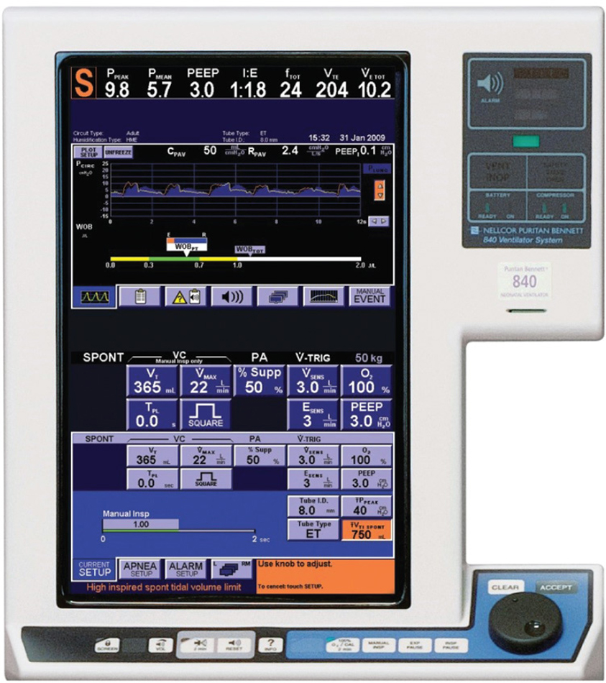
Figure 4.13

Slide 99
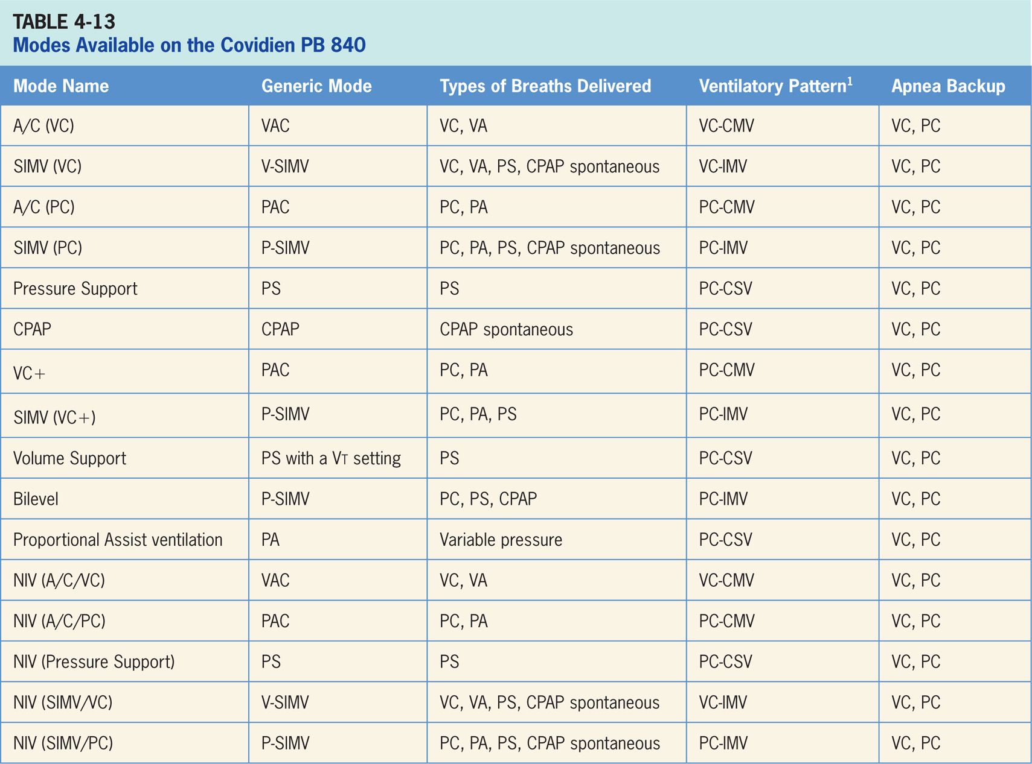

Slide 100
Assist/Control (Volume Control) [A/C (VC)]
Volume-targeted mode of ventilation (VAC) allowing for mandatory, time-triggered breaths or patient-assisted breaths.⁹
Spontaneous breathing not allowed.
Breath cycles to exhalation once tidal volume (Vt) has been delivered.

Slide 101
Main Operator Controls Include:
Fio₂
PEEP
Vt
Inspiratory flow
RR
Resulting pressure created is variable and depends on Vt, flow, and patient respiratory system mechanics.⁹

Slide 102
RC Insight
If patient with a very strong inspiratory demand flow is starved in VAC, options to meet this increased demand include simply increasing the set flow (however, this will reduce the Ti), switching to PAC, or perhaps switching to PS (in both of these cases, the Vt will be variable).

Slide 103
SIMV Volume Control
SIMV (Volume Control) combines two breath types, VAC and PS or spontaneous breathing, while on CPAP.⁹
Mandatory, time-triggered breaths, patient-assisted breaths, and spontaneous breaths are all provided.
Ventilator prevents “breath stacking” (a VAC breath compounded by a PS breath) through use of “timing window.”
If patient attempts to trigger a breath in this timing window, then ventilator will deliver a VAC breath.
If patient attempts to trigger a breath outside window, then a spontaneous breath will occur.

Slide 104
Main Operator Controls Include:
Fio₂
PEEP
Vt
Inspiratory flow
SIMV rate
Pressure support level
Cycle sensitivity
During VAC breaths, resulting pressure created is variable and depends on Vt, flow, and patient mechanics.⁹
During PS breaths, volume will be variable and depend on PS level, patient effort, and patient respiratory system mechanics.⁹

Slide 105
Assist/Control Pressure Control (A/C/PC)
Pressure-targeted mode of ventilation allowing for mandatory, time-triggered breaths or patient-assisted breaths.⁹
Spontaneous breaths not allowed.
Breath cycles to exhalation once inspiratory time has been reached or when high-pressure alarm is tripped.

Slide 106
Main Operator Controls Include:
Fio₂
PEEP
Inspiratory pressure level
Inspiratory time or I:E
RR
Pressure will be consistently delivered from breath to breath; Vt and flow are variable, depending on inspiratory pressure level, patient effort, and patient respiratory system mechanics.⁹

Slide 107
SIMV Pressure Control
Similar to SIMV (Volume Control) except that target is now pressure instead of volume.⁹
SIMV (Pressure Control) also combines two breath types, PAC and either PS or spontaneous breathing, while on CPAP.
Combination of mandatory, time-triggered breaths, patient-assisted breaths, and spontaneous breaths.
Ventilator prevents “breath stacking” (a PAC breath compounded by a PS breath) through the use of “timing window.”
If patient attempts to trigger a breath in this timing window, then ventilator will deliver a PAC breath.
If patient attempts to trigger a breath outside the window, then a spontaneous breath will occur.

Slide 108
Main Operator Controls Include:
Fio₂
PEEP
Inspiratory pressure level
Inspiratory time
SIMV rate
Pressure support level
Cycle sensitivity
During PAC breaths, resulting Vt created is variable, depending on inspiratory pressure level, patient effort, and patient respiratory system mechanics.⁹
During PS breaths, volume will be variable and depend on PS level, patient effort, and patient respiratory system mechanics.⁹

Slide 109
Spontaneous Pressure Support
Patient regulates respiratory rate and Vt with support from ventilator.⁹
The patient triggers all breaths and will receive clinician-set PS level.
If pressure support level > 0 cm H₂O is set, breath cycles to expiration when inspiratory flow decreases below a preset percentage of the inspiratory peak flow.

Slide 110
Main Operator Controls Include:
Fio₂
PEEP
Pressure support level
Cycle sensitivity
Vt will be variable, depending on PS level, patient effort, and patient respiratory system mechanics.⁹ If the PS level is set to 0, all breaths will be unsupported.

Slide 111
Volume Control + (VC+)
Pressure-targeted (either PC or PAC breaths) mode that uses pressure breaths to achieve a clinician-set Vt.⁹
Inspiratory pressure level however, is now adjusted by ventilator instead of the clinician.
Since ventilator relies a previous breath sequence to deliver ensuing breath the Vt tends to be somewhat variable, especially in patients with inconsistent efforts.
No spontaneous breaths.

Slide 112
Main Operator Controls Include:
Fio₂
PEEP
RR
Vt target
Inspiratory time
The amount of pressure and flow delivered will be variable depending on Vt setting, patient effort, and patient respiratory system mechanics.⁹

Slide 113
SIMV Volume Control+ (SIMV-VC+)
Combines two breath types, PAC (ventilator-controlled inspiratory pressure) and either PS or spontaneous breathing, while on CPAP.⁹
Combination of mandatory, time-triggered breaths, patient-assisted breaths, and spontaneous breaths.
Ventilator prevents “breath stacking” (a PAC breath compounded by a PS breath) through use of a “timing window.”
If patient attempts to trigger a breath in timing window, then ventilator will deliver a PAC breath.
If patient attempts to trigger a breath outside window, then a spontaneous breath will occur.

Slide 114
Main Operator Controls Include:
Fio₂
PEEP
SIMV rate
Vt
Inspiratory time
Pressure support level
Cycle sensitivity
During the control breath the amount of pressure and flow delivered will be variable, depending on Vt setting, patient effort, and patient respiratory system.⁹ During the PS breath flow, the Vt will be variable depending on PS level, patient effort, and patient respiratory system mechanics.
If CPAP is used, spontaneous breath Vt will be variable depending on the patient effort and patient respiratory system mechanics.

Slide 115
Spontaneous Volume Support
Ventilator delivers a variable (from breath to breath) PS level in order to reach a clinician-set Vt.⁹
Ventilator changes PS level as needed to reach Vt.
Ventilator drops level of support as patient effort increases and conversely increases PS level when patient effort is too low.

Slide 116
Main Operator Controls Include:
Fio₂
PEEP
Vt target
Cycle sensitivity
Vt may not match operator setting due to ventilator is using PS to target the Vt as to VAC and relies on previous breaths to make calculation.⁹
Change in patient effort from previous breath may result in a deviation from Vt setting.
Inspiratory pressure will be variable, depending on target Vt, patient effort, and patient respiratory system mechanics.⁹

Slide 117
Bilevel
Mode of ventilation allowing for spontaneous breathing at two different clinician-set pressure levels.⁹
Ventilator switches between two different clinician-set pressure levels (the lower of which can be CPAP).
These pressure levels referred to as PEEP_{H} and PEEP_{L}. T_{H} is length of time at PEEP_{H} and T_{L} is length of time spent at PEEP_{L}.
Bilevel is used mainly in an inverse I:E ratio; difference from pressure-targeted modes is the PEEP_{H} level is now referenced to atmosphere as to the PEEP_{L}.
Increase in PEEP_{L} will decrease distending pressure.
Additional ventilator support can be added in form of PS at both pressure levels to augment patient effort.

Slide 118
Main Operator Controls Include:
Fio₂
PEEP_{H}
PEEP_{L}
T_{H}
T_{L}
Pressure support (can be left at 0 if no additional pressure is needed)
Cycle sensitivity
Vt will be variable, depending on the PEEP_{H}, PEEP_{L}, PS level (if set > 0), patient effort, and patient respiratory system mechanics.⁹

Slide 119
Proportional Assist Ventilation (PAV)
Optional mode on the PB 840.⁹
Spontaneous mode that delivers variable flow, pressure and volume to patient.
PB 840 calculates work of breathing on an intra-breath basis and responds with the clinician-set variable support.
Instead of setting a pressure or volume target, target is work of breathing (WOB).
Clinician sets as a percentage (a direct setting) how much of the WOB that the ventilator will contribute.
Balance is picked up by patient. For example, if clinician sets ventilator to do 60%, then the patient does the other 40%.

Slide 120
Noninvasive Ventilation
Most modes are available for use in NIV with the exception of Bilevel, VC+, PAV, and VS.⁹
Designed to be used with a variety of masks, infant nasal prongs and neonatal uncuffed endotracheal tubes.
PB 840 automatically adapts to variation of leakage in order to maintain required pressure and PEEP level.

Slide 121
Apnea Backup Ventilation Special Features
Ventilator engages apnea backup ventilation when no breath has been delivered by the time clinician selected apnea interval elapses.⁹
Can be set in either A/C/VC, A/C/PC.

Slide 122
Tube Compensation
PB 840 increases pressure during inspiration to overcome the extra resistance created by the artificial airway.⁹
Clinician must set the following parameters: % of the resistive load, artificial airway tube type, artificial airway tube diameter and type of humidification.

Slide 123
Neomode
Neomode is optional on PB 840, allowing clinicians to set smaller Vt and flow parameters in order to ventilate neonates.⁹

Slide 124
Leak Compensation
Designed to compensate for leaks in circuit.⁹
Maintains PEEP level and optimizes synchrony between patient and the ventilator by preventing auto-triggering.
Works in both invasive and noninvasive ventilation modes.
Works in all three patient populations and available for A/C/PC, pressure support, bilevel and CPAP.

Slide 125
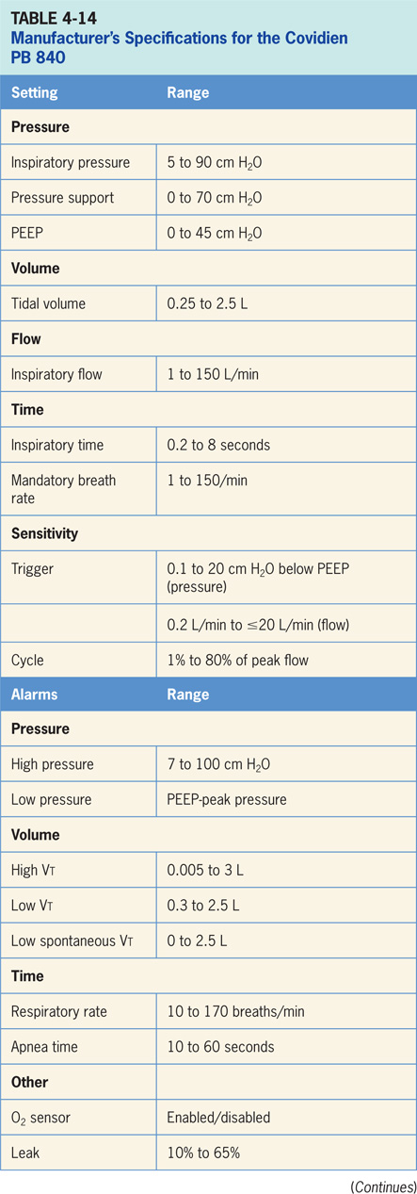

Slide 126
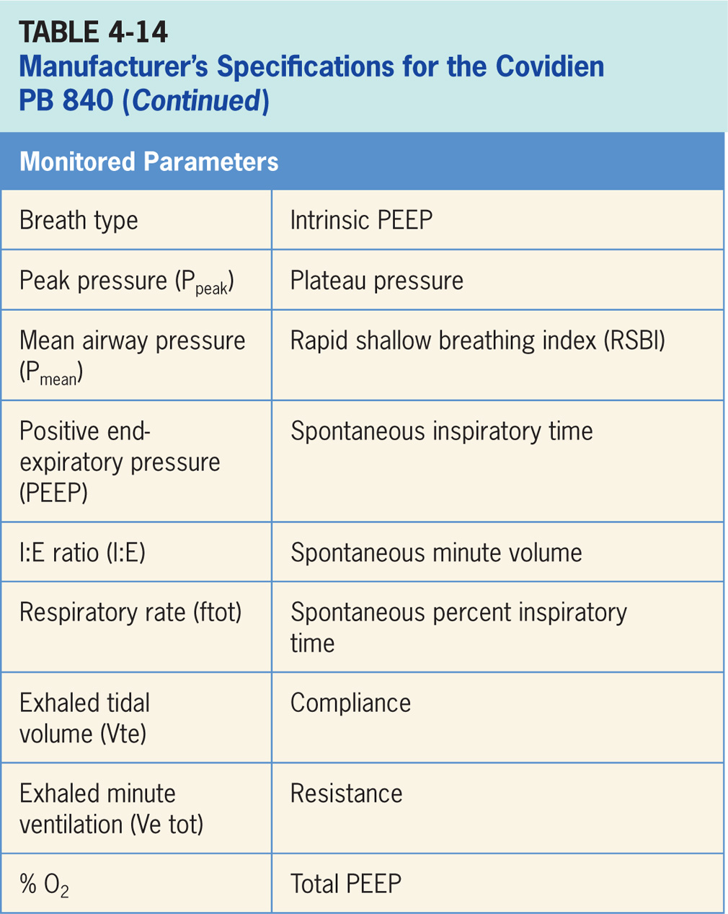

Slide 127
Accessories
Optional Aerogen Aeroneb vibrating mesh nebulizer, can be used with the PB 840.⁹
Unlike the many available jet nebulizers, Aerogen nebulizer does not add any flow to the circuit (which ultimately would increase the delivered volume).

Slide 128
Newport E360 Ventilator
Newport e360 features a dual servo gas delivery system, a servo controlled active exhalation valve, a user interface and a touch screen graphics monitor.¹¹
Is designed for use in adult, pediatric, and neonatal patients in both acute and subacute clinical locations (depicted in Figure 4-16).
Operator interface on the e360 employs a combination of a touch screen, buttons (real and virtual) and a control knob (Figure 4-17).

Slide 129
Newport E360 Ventilator (cont’d)
Is a three-step process to make a change to a setting. The clinician first touches a panel button or virtual button on the touch screen. Second, the control knob is used to change the value of the setting. Last, the “accept” button must be pressed to confirm. Screen displays change depending on the operation being carried out.
The alarm screen looks different than the monitoring screen. There are a number of different screens available for viewing.

Slide 130
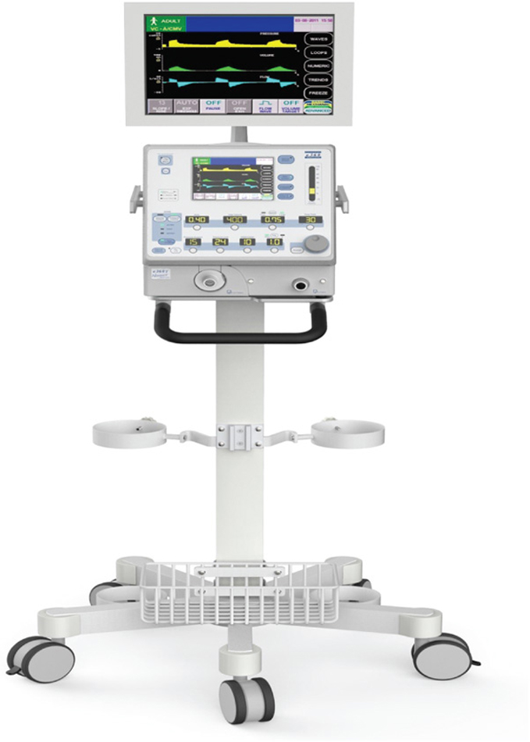
Figure 4.16

Slide 131
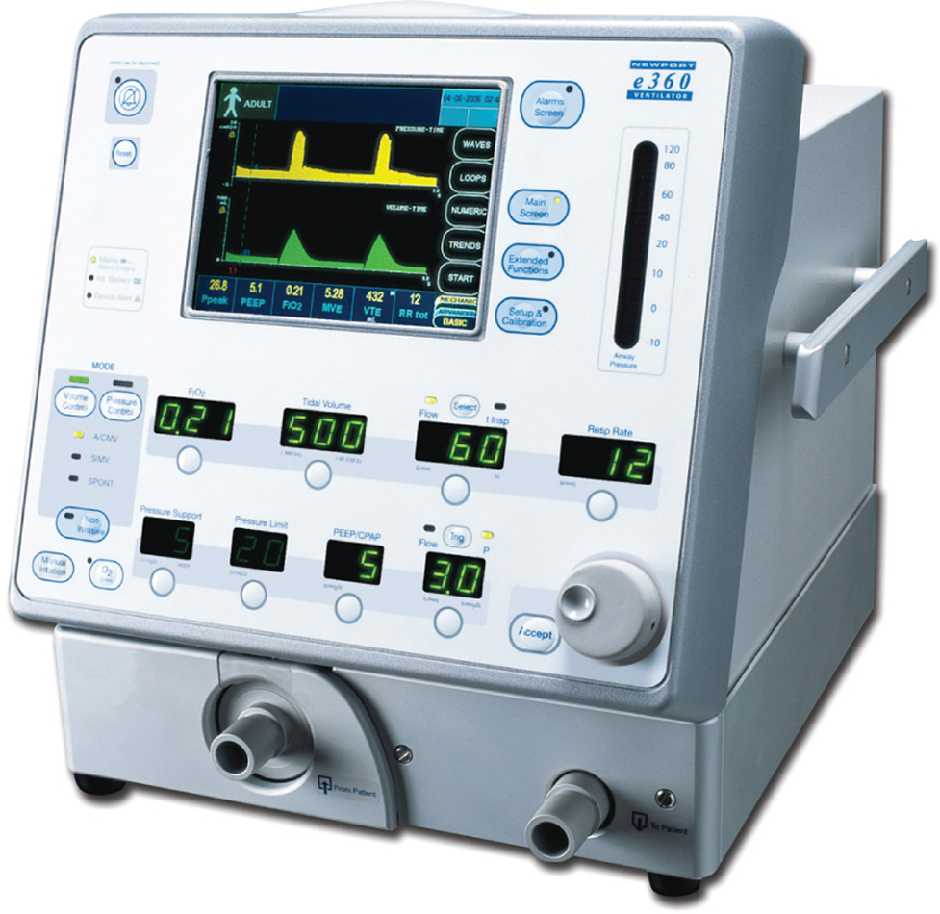
Figure 4.17

Slide 132
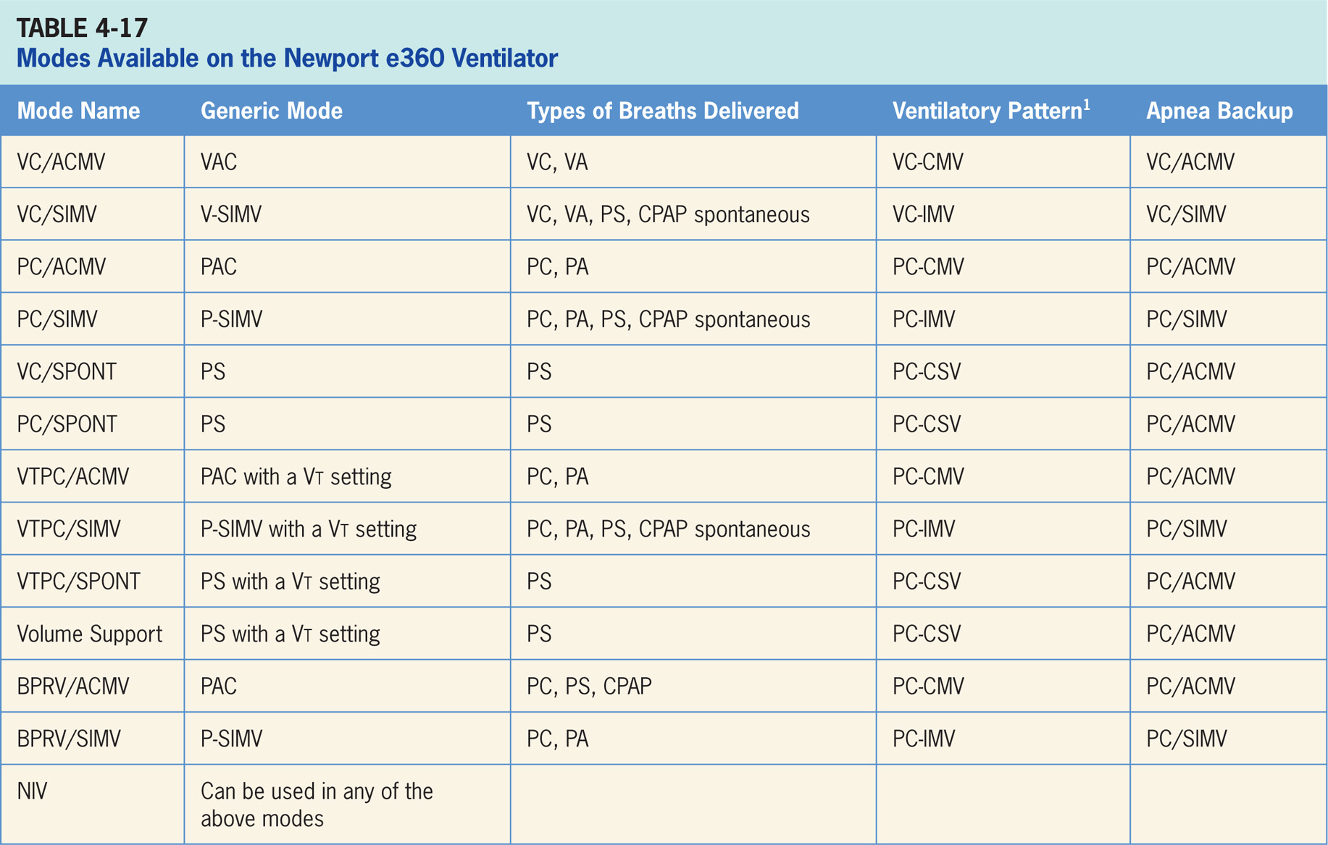

Slide 133
Volume Control/Assist/Control Mandatory Ventilation
Volume-targeted mode of ventilation (VAC) allowing for mandatory, time-triggered breaths or patient-assisted breaths.¹¹
Spontaneous breathing not allowed.
Breath cycles to exhalation once the tidal volume (Vt) has been delivered.

Slide 134
Main Operator Controls Include:
Fio₂
PEEP
Vt
Inspiratory flow
Inspiratory time (T_{insp})
RR
Resulting pressure created is variable; depends on Vt, flow, and patient respiratory system mechanics.¹¹

Slide 135
Volume Control SIMV VC/SIMV
Combines two breath types, VAC and PS or spontaneous breathing, while on CPAP.¹¹
Mandatory, time-triggered breaths, patient-assisted breaths, and spontaneous breaths are all provided.
Ventilator prevents “breath stacking” (a VAC breath compounded by a PS breath) through the use of “timing window.”
If patient attempts to trigger a breath in this timing window, then ventilator will deliver a VAC breath.
If patient attempts to trigger a breath outside the window, then spontaneous breath will occur.

Slide 136
Main Operator Controls Include:
Fio₂
PEEP
Vt
Inspiratory flow
Inspiratory time
SIMV rate
Pressure support level
Cycle sensitivity
During VAC breaths, resulting pressure created is variable; depending on Vt, flow, and patient mechanics.¹¹
During PS breaths, volume will be variable; depending on PS level, patient effort, and patient respiratory system mechanics.¹¹

Slide 137
Pressure Control Assist/Control Mandatory Ventilation – (PC/ACMV)
Pressure-targeted mode of ventilation allowing for mandatory, time-triggered breaths or patient-assisted breaths.¹¹
Spontaneous breaths not allowed.
Breath cycles to exhalation once the inspiratory time has been reached.

Slide 138
Main Operator Controls Include:
Fio₂
PEEP
Inspiratory pressure level (Pressure Limit)
Inspiratory time
RR
Pressure will be consistently delivered from breath to breath; Vt and flow are variable; depending on the inspiratory pressure level, patient effort, and patient respiratory system mechanics.¹¹

Slide 139
Pressure Control SIMV (PC/SIMV)
Similar to VC/SIMV except the target is now pressure instead of volume.¹¹
PC/SIMV also combines two breath types, PAC and PS or spontaneous breathing, while on CPAP.
Combination of mandatory, time-triggered breaths, patient-assisted breaths, and spontaneous breaths.
Ventilator prevents “breath stacking” (a PAC breath compounded by a PS breath) through the use of a “timing window.”
If patient attempts to trigger a breath in timing window, then ventilator will deliver a PAC breath.
If patient attempts to trigger a breath outside the window, then spontaneous breath will occur.

Slide 140
Main Operator Controls Include:
Fio₂
PEEP
Inspiratory pressure level
Inspiratory time
SIMV rate
Pressure support level
Cycle sensitivity
During PAC breaths, resulting Vt created is variable; depending on inspiratory pressure level, patient effort, and patient respiratory system mechanics.¹¹
During the PS breaths, the volume will be variable; depending on PS level, patient effort, and patient respiratory system mechanics.¹¹

Slide 141
Volume Control/Spontaneous
During VC/SPONT, patient regulates the respiratory rate and Vt with support from the ventilator.¹¹
Patient triggers all of the breaths and will receive clinician-set PS level. If a pressure support level > 0 cm H₂O is set, the breath cycles to expiration when the inspiratory flow decreases below a preset percentage of the inspiratory peak flow.

Slide 142
Main Operator Controls Include:
Fio₂
PEEP
Pressure support level
Cycle sensitivity
Vt will be variable; depending on PS level, patient effort, and patient respiratory system mechanics.¹¹ If the PS level is set to 0, all breaths will be unsupported.

Slide 143
Pressure Control/Spontaneous
During PC/SPONT, patient regulates the respiratory rate and the Vt with support from the ventilator.¹¹
Patient triggers all of breaths and will receive clinician-set PS level. If a pressure support level > 0 cm H₂O is set, breath cycles to expiration when the inspiratory flow decreases below a preset percentage of the inspiratory peak flow.

Slide 144
Main Operator Controls Include:
Fio₂
PEEP
Pressure support level
Cycle sensitivity
The Vt will be variable and depend on the PS level, patient effort, and patient respiratory system mechanics. If the PS level is set to 0, all breaths will be unsupported.¹¹

Slide 145
Volume Target Pressure Control/Assist/Control Mandatory Ventilation (VTPC/ACMV)
Pressure-targeted (either PC or PA breaths) mode that uses pressure breaths to achieve a clinician-set Vt.¹¹
The inspiratory pressure level, is now adjusted by ventilator instead of the clinician.
Since ventilator relies a previous breath sequence to deliver the ensuing breath the Vt tends to be somewhat variable, especially in patients with inconsistent efforts.
No spontaneous breaths.

Slide 146
Volume Target Pressure Control/Synchronized, Intermittent Mandatory Ventilation (VTPC/SIMV)
Combines two breath types, PAC (ventilator-controlled inspiratory pressure) and either PS or spontaneous breathing, while on CPAP.¹¹
There is a combination of mandatory, time-triggered breaths, patient-assisted breaths, and spontaneous breaths.
Ventilator prevents “breath stacking” (a PAC breath compounded by a PS breath) through the use of a “timing window.”
If patient attempts to trigger a breath in timing window, then ventilator will deliver a PAC breath.
If patient attempts to trigger a breath outside window, then spontaneous breath will occur.

Slide 147
Volume-target Pressure Control/Spontaneous (VTPC/SPONT)
Ventilator delivers a variable (from breath to breath) PS level in order to reach a clinician-set Vt.¹¹
The ventilator changes the PS level as needed to reach the Vt.
Ventilator drops the level of support as patient effort increases and conversely increases the PS level when patient effort is too low.

Slide 148
Biphasic Pressure Release Ventilation/Assist/Control Mandatory Ventilation (BPRV/ACMV)
Mode of ventilation allowing for spontaneous breathing at two different clinician-set pressure levels.¹¹
Ventilator switches between two different clinician-set pressure levels (the lower of which can be CPAP).
These pressure levels are referred to as PEEP_{H} and PEEP_{L}. T_{H} is length of time at PEEP_{H} and T_{L} is length of time spent at PEEP_{L}.
Bilevel is mainly used in an inverse I:E ratios.
Difference from pressure-targeted modes is that the PEEP_{H} level is now referenced to atmosphere as to the PEEP_{L}.
Increases in PEEP_{L} will decrease the distending pressure. Additional ventilator support can also be added in the form of PS at both pressure levels to augment patient effort.

Slide 149
Biphasic Pressure-release Ventilation/Synchronized, Intermittent Mandatory Ventilation (BPRV/SIMV)
Mode of ventilation allowing for spontaneous breathing at two different clinician-set pressure levels.¹¹
The ventilator switches between two different clinician-set pressure levels (the lower of which can be CPAP).
These pressure levels are referred to as PEEP_{H} and PEEP_{L}. T_{H} is length of time at PEEP_{H} and T_{L} is length of time spent at PEEP_{L}.
Bilevel is mainly used in an inverse I:E ratios.
Difference from pressure-targeted modes is that PEEP_{H} level is now referenced to atmosphere as to the PEEP_{L}.
Increases in PEEP_{L} will decrease the distending pressure. Additional ventilator support can also be added in the form of PS at both pressure levels to augment the patient effort.

Slide 150
Noninvasive Ventilation
All modes are available for use in NIV.
NIV is activated by pressing a button on the front panel.

Slide 151
Backup Ventilation Special Features
Activated when the low expired minute volume (MVE) alarm is violated.¹¹
If current mode is A/CMV or SIMV, the current settings are used with a respiratory rate of 1.5 times the current setting.
If current mode is SPONT, the ventilator delivers pressure control mandatory breaths (Ti 0.6 sec for ped/inf and 1.0 sec for adults, RR 20 for ped/inf and 12 for adults, pressure limit of 15 above PEEP).

Slide 152
Leak Compensation
The e360 provides 3 L/min of bias flow through circuit during exhalation to facilitate both flow triggering and the stabilization of baseline pressure and flow in order to minimize auto-triggering of breaths.¹¹
When The Leak Comp button is pressed the ventilator automatically adjusts the bias flow 3 to 8 L/min for Ped/Infants and 3 to 15 L/min for Adults in order to maintain an end expiratory base flow of 3 L/min.
Leak Comp automatically comes on when NIV is selected.

Slide 153
Flex Cycle
When Flex Cycle option is selected the ventilator automatically adjusts the expiratory threshold setting on a breath-by-breath basis.¹¹
Ventilator now controls when the breaths cycle to exhalation in pressure support.

Slide 154
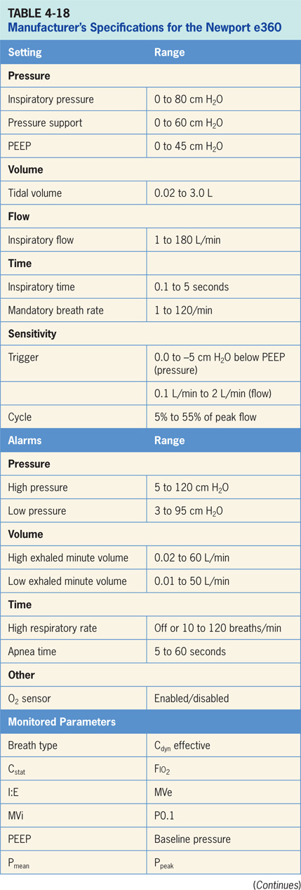

Slide 155
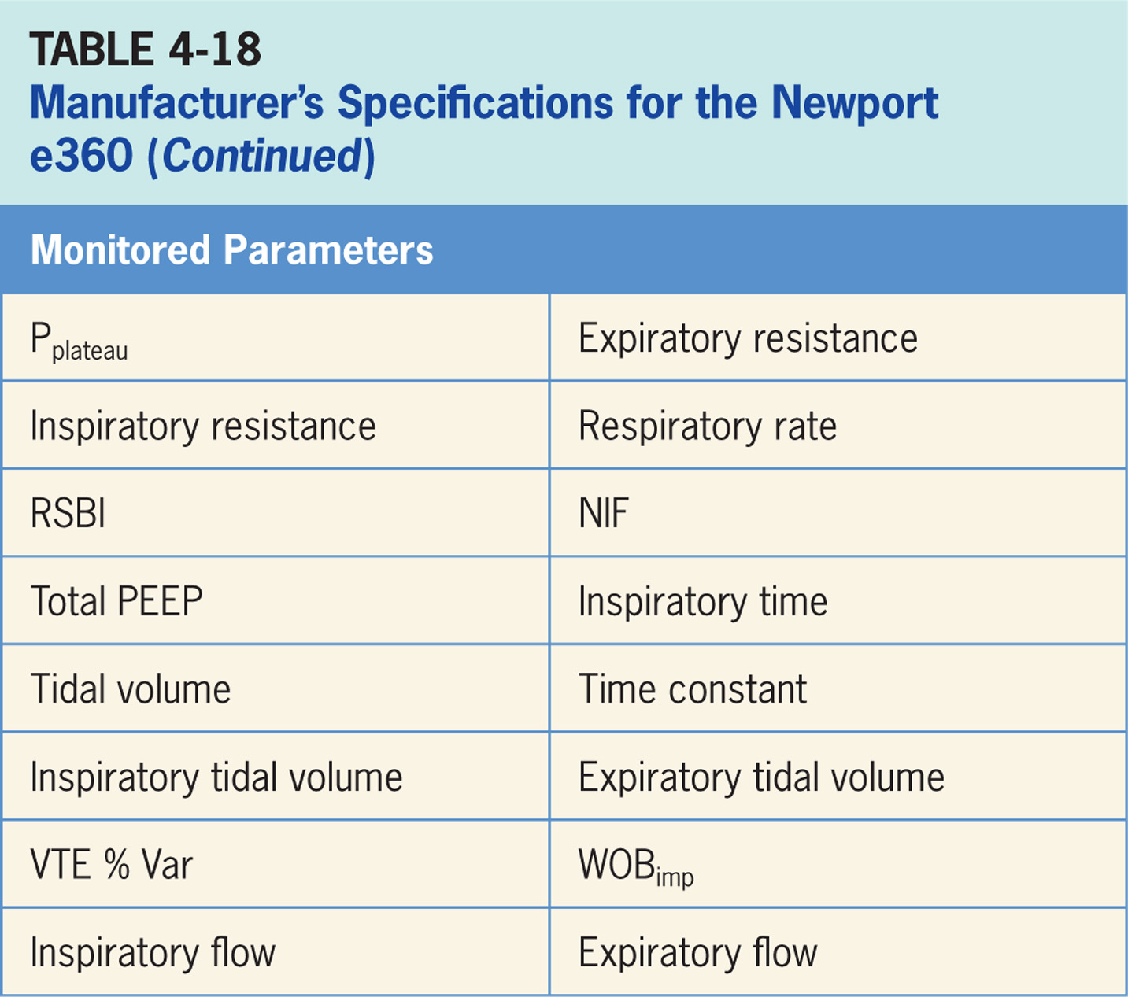

Slide 156
Vyaire VELA
The ventilator is a critical care ventilator designed for use in adult and pediatric patients in both acute and subacute clinical locations.¹³
It is pictured in Figure 4-20. It can ventilate critically ill patients and can be used for intrahospital transports.
The Vyaire Vela operator interface consists of a flat panel color LCD screen with real time graphic displays and digital monitoring capabilities, a touch screen, membrane keys and a dial for changing settings and operating parameters. It is pictured in Figure 4-21.
Settings are entered by pressing a virtual button to select the parameter to be changed, then the control dial is turned to select the new value, and finally the “ACCEPT” button is pressed. Alternatively, the virtual button can be pressed again to confirm the setting. The real buttons provide various features related to menu navigation, access to alarm settings, and alarm silence among other things.

Slide 157
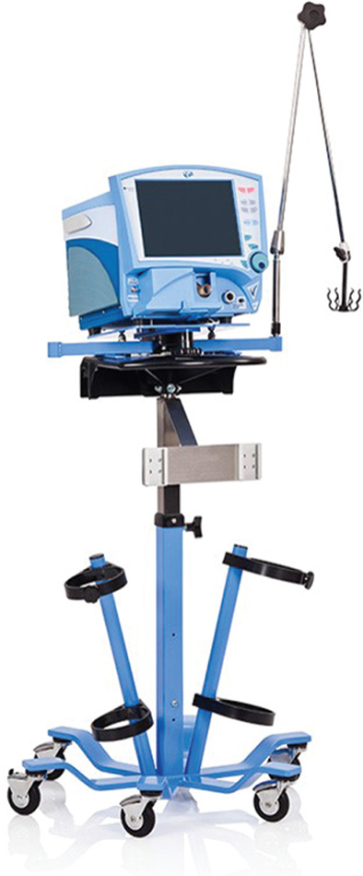
Figure 4.20

Slide 158
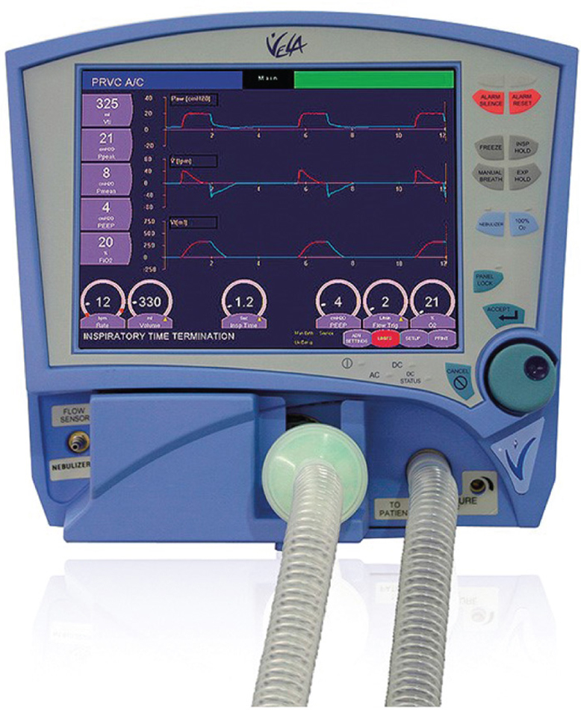
Figure 4.21

Slide 159
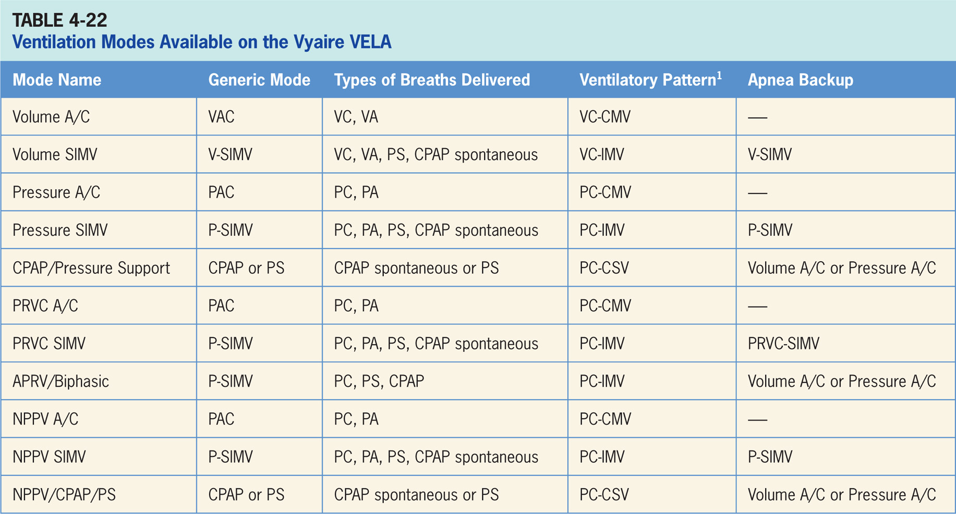

Slide 160
Volume A/C
Volume-targeted mode of ventilation (VAC) allowing for mandatory, time-triggered breaths or patient-assisted breaths.¹³
Spontaneous breathing not allowed.
The breath cycles to exhalation once the tidal volume (Vt) has been delivered.

Slide 161
Main Operator Controls Include:
Fio₂
PEEP
Vt
Inspiratory flow
RR
Resulting pressure created is variable, depending on Vt, flow, and patient respiratory system mechanics.¹³

Slide 162
Volume SIMV
Combines two breath types, VAC and either PS or spontaneous breathing, while on CPAP.¹³
Mandatory, time-triggered breaths, patient-assisted breaths, and spontaneous breaths are all provided.
The ventilator prevents “breath stacking” (a VAC breath compounded by a PS breath) through the use of “timing window.”
If patient attempts to trigger a breath in this timing window, then ventilator will deliver a VAC breath.
If patient attempts to trigger a breath outside the window, then spontaneous breath will occur.

Slide 163
Main Operator Controls Include:
Fio₂
PEEP
Vt
Flow
SIMV rate
Pressure support level
Cycle sensitivity
During VAC breaths, resulting pressure created is variable and depends on Vt, flow, and patient mechanics.¹³
During PS breaths, the volume will be variable and depend on PS level, patient effort, and patient respiratory system mechanics.¹³

Slide 164
Pressure A/C
Pressure-targeted mode of ventilation that allows for mandatory, time-triggered breaths or patient-assisted breaths.¹³
Spontaneous breaths not allowed.
Breath cycles to exhalation once inspiratory time has been reached.

Slide 165
Main Operator Controls Include:
Fio₂
PEEP
Inspiratory pressure level
Inspiratory time
RR
Pressure will be consistently delivered from breath to breath; Vt and flow are variable and will depend on the inspiratory pressure level, patient effort, and patient respiratory system mechanics.¹³

Slide 166
Pressure SIMV
Similar to SIMV (Volume A/C) described above except that the target is now pressure instead of volume.¹³
Pressure SIMV also combines two breath types, PAC and either PS or spontaneous breathing, while on CPAP.
Combination of mandatory, time-triggered breaths, patient-assisted breaths, and spontaneous breaths.
Ventilator prevents “breath stacking” (a PAC breath compounded by a PS breath) through the use of “timing window.”
If patient attempts to trigger a breath in this timing window, then ventilator will deliver a PAC breath.
If patient attempts to trigger a breath outside the window, then spontaneous breath will occur.

Slide 167
Main Operator Controls Include:
Fio₂
PEEP
Inspiratory pressure level
Inspiratory time
SIMV rate
Pressure support level
Cycle sensitivity
During PAC breaths, resulting Vt created is variable and depends on inspiratory pressure level, patient effort, and patient respiratory system mechanics. ¹³
During PS breaths, the volume will be variable and depend on the PS level, patient effort, and patient respiratory system mechanics. ¹³

Slide 168
CPAP/Pressure Support (CPAP/PSV)
Patient regulates the respiratory rate and the Vt with support from the ventilator.¹³
Patient triggers all of the breaths and will receive the clinician-set PS level.
If a pressure support level > 0 cm H₂O is set, the breath cycles to expiration when the inspiratory flow decreases below a preset percentage of the inspiratory peak flow.

Slide 169
Pressure-regulated Volume Control (A/C) PRVC A/C
Pressure-targeted (either PC or PA breaths) mode that uses its pressure breaths to achieve a clinician-set Vt.¹³
Inspiratory pressure level however, is now adjusted by the ventilator instead of the clinician.
Since ventilator relies on a previous breath sequence to deliver the ensuing breath the Vt tends to be somewhat variable, especially in patients with inconsistent efforts.
No spontaneous breaths.

Slide 170
PRVC SIMV
Combines two breath types, PAC (ventilator-controlled inspiratory pressure) and either PS or spontaneous breathing, while on CPAP.¹³
Combination of mandatory, time-triggered breaths, patient-assisted breaths, and spontaneous breaths.
Ventilator prevents “breath stacking” (a PAC breath compounded by a PS breath) through the use of “timing window.”
If patient attempts to trigger a breath in timing window, then ventilator will deliver a PAC breath.
If patient attempts to trigger a breath outside window, then spontaneous breath will occur.

Slide 171
Airway Pressure Release Ventilation/Biphasic APRV/Biphasic
Mode of ventilation allowing for spontaneous breathing at two different clinician-set pressure levels.¹³
Ventilator switches between two different clinician-set pressure levels (the lower of which can be CPAP).
These pressure levels are referred as P_{high} and P_{low}. T_{high} is length of time at P_{high} and T_{low} is length of time spent at P_{low}.
Mainly used in an inverse I:E ratio.
Difference from pressure-targeted modes is that the P_{high} level is now referenced to atmosphere as to the P_{low}.
Increases in P_{low} will decrease distending pressure. Additional ventilator support can also be added in form of PS at both pressure levels to augment the patient effort.

Slide 172
Noninvasive Positive Pressure Ventilation A/C (NPPV A/C)
Pressure A/C delivered through a mask instead of an endotracheal tube.¹³
Pressure-targeted mode of ventilation that allows for mandatory, time-triggered breaths or patient-assisted breaths.
Spontaneous breaths not allowed.
Breath cycles to exhalation once the inspiratory time has been reached or when the high-pressure alarm is tripped.

Slide 173
Noninvasive Positive Pressure Ventilation/SIMV (NPPV/SIMV)
Pressure SIMV delivered through a mask instead of an endotracheal tube.¹³
NPPV/SIMV combines two breath types, PAC and either PS or spontaneous breathing, while on CPAP.
Combination of mandatory, time-triggered breaths, patient-assisted breaths, and spontaneous breaths.
Ventilator prevents “breath stacking” (a PAC breath compounded by a PS breath) through the use of “timing window.”
If patient attempts to trigger a breath in this timing window, then the ventilator will deliver a PAC breath.
If patient attempts to trigger a breath outside window, then spontaneous breath will occur.

Slide 174
Noninvasive Positive Pressure Ventilation/CPAP/Pressure Support (NPPV/CPAP/PS)
NPPV/CPAP/PS is CPAP/PS delivered through a mask instead of an endotracheal tube.¹³
During NPPV/CPAP/PSV the patient regulates the respiratory rate and the Vt with support from the ventilator.
Patient triggers all of the breaths and will receive the clinician-set PS level.
If a pressure support level > 0 cm H₂O is set, the breath cycles to expiration when the inspiratory flow decreases below a preset percentage of the inspiratory peak flow.

Slide 175
Apnea Backup Ventilation Special Features
The ventilator engages apnea backup ventilation when no breath has been delivered by the time the clinician-selected apnea interval elapses.¹³
It can be adjusted in either volume A/C or pressure A/C.
Apnea backup ventilation is available in CPAP/PS and APRV/Biphasic.
When in A/C or SIMV modes, the apnea backup rate is determined by the operator-set mandatory breath Rate or the Apnea Interval setting (whichever provides the highest respiratory rate).
When the Apnea Interval setting (found in the Alarm Limits window) determines the backup rate, the ventilator will continue to ventilate at this rate until the apnea has been resolved.
All other controls for apnea ventilation in A/C and SIMV are set when the primary control values for these modes are selected.

Slide 176
Advanced Settings
The advanced settings and the modes that are available are depicted in Table 4-23. These advance settings serve to give the clinician modes options and possibly more control of the delivered breaths.
Assured volume: sets the minimum tidal volume in pressure control breaths.
Volume limit: sets the volume limit for a pressure-targeted breath.
Insp Rise: controls the slope of the pressure rise during a mandatory breath.
Waveform: square or decelerating flow pattern

Slide 177
Advanced Settings (cont’d)
Sigh: when activated the ventilator delivers a sigh volume breath (1.5 times the Vt) every 100th breath.
Bias flow: sets the background flow available between breaths as well as establishing the base flow that is used for flow triggering.
PC Flow Cycle: Sets the percentage of peak inspiratory flow at which the inspiratory phase of a PC breath is terminated.
Vsync: changes the target from volume to pressure with a set Vt.
PSV Cycle: sets the percentage of peak inspiratory flow at which a pressure support breath will cycle to exhalation.

Slide 178
Advanced Settings (cont’d)
PSVTmax: sets the maximum inspiratory time for a pressure support breath.
% T_{high} Sync: sets the trigger (sync) window to transition from Pressure high to Pressure low.
T_{high} PSV: makes pressure support breaths available during T_{high} in APRV/BiPhasic.
% T_{low} Sync: sets the trigger (sync) window to transition from P_{low} to P_{high}.

Slide 179
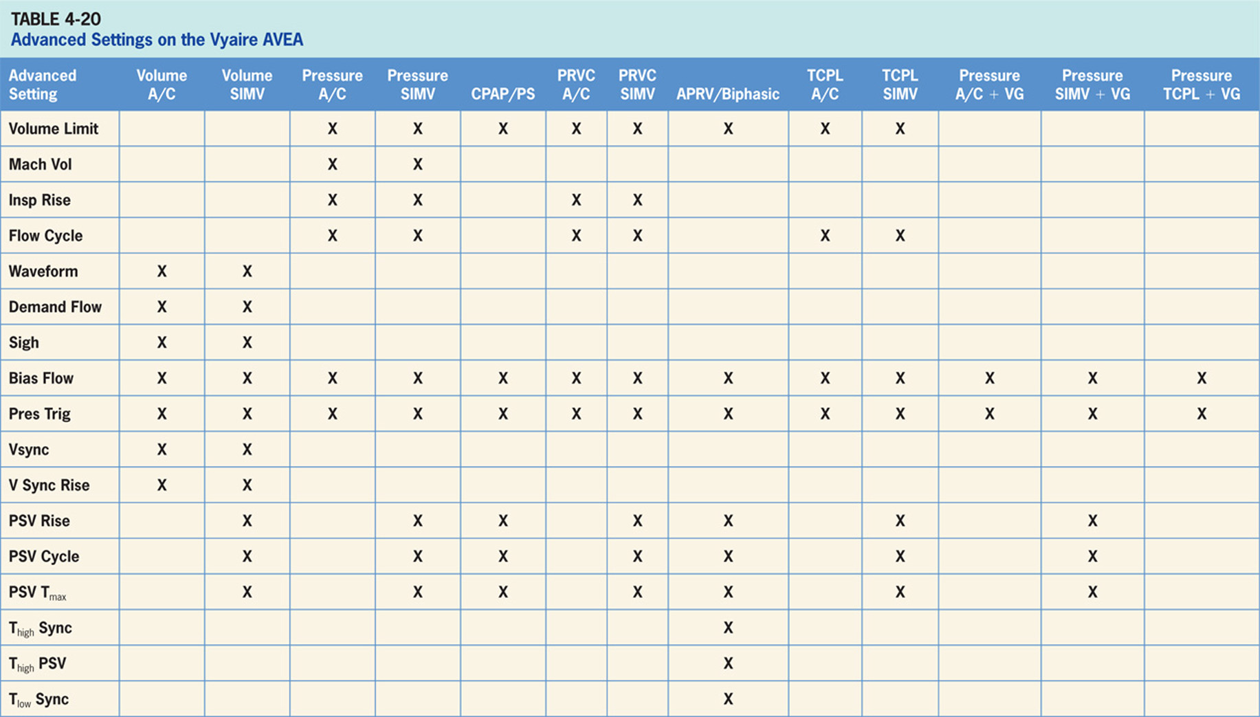

Slide 180
NPPV Leak Compensation
Adjusts bias flow to maintain the set PEEP level if there is a leak present in the system.
Can compensate up to 40 L/min.¹³

Slide 181
Maneuvers
The Vyaire Vela has a number of maneuvers available including: MIP/NIF, AutoPEEP detection, static compliance, circuit resistance and capnometry (optional).¹³

Slide 182
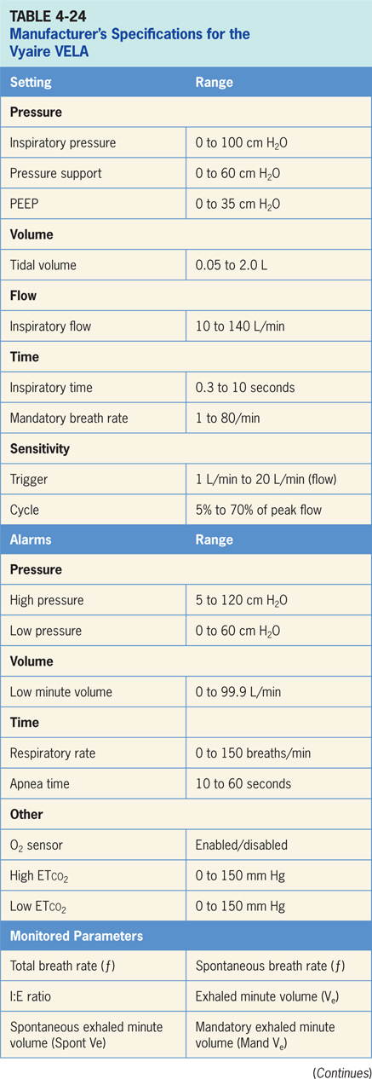

Slide 183
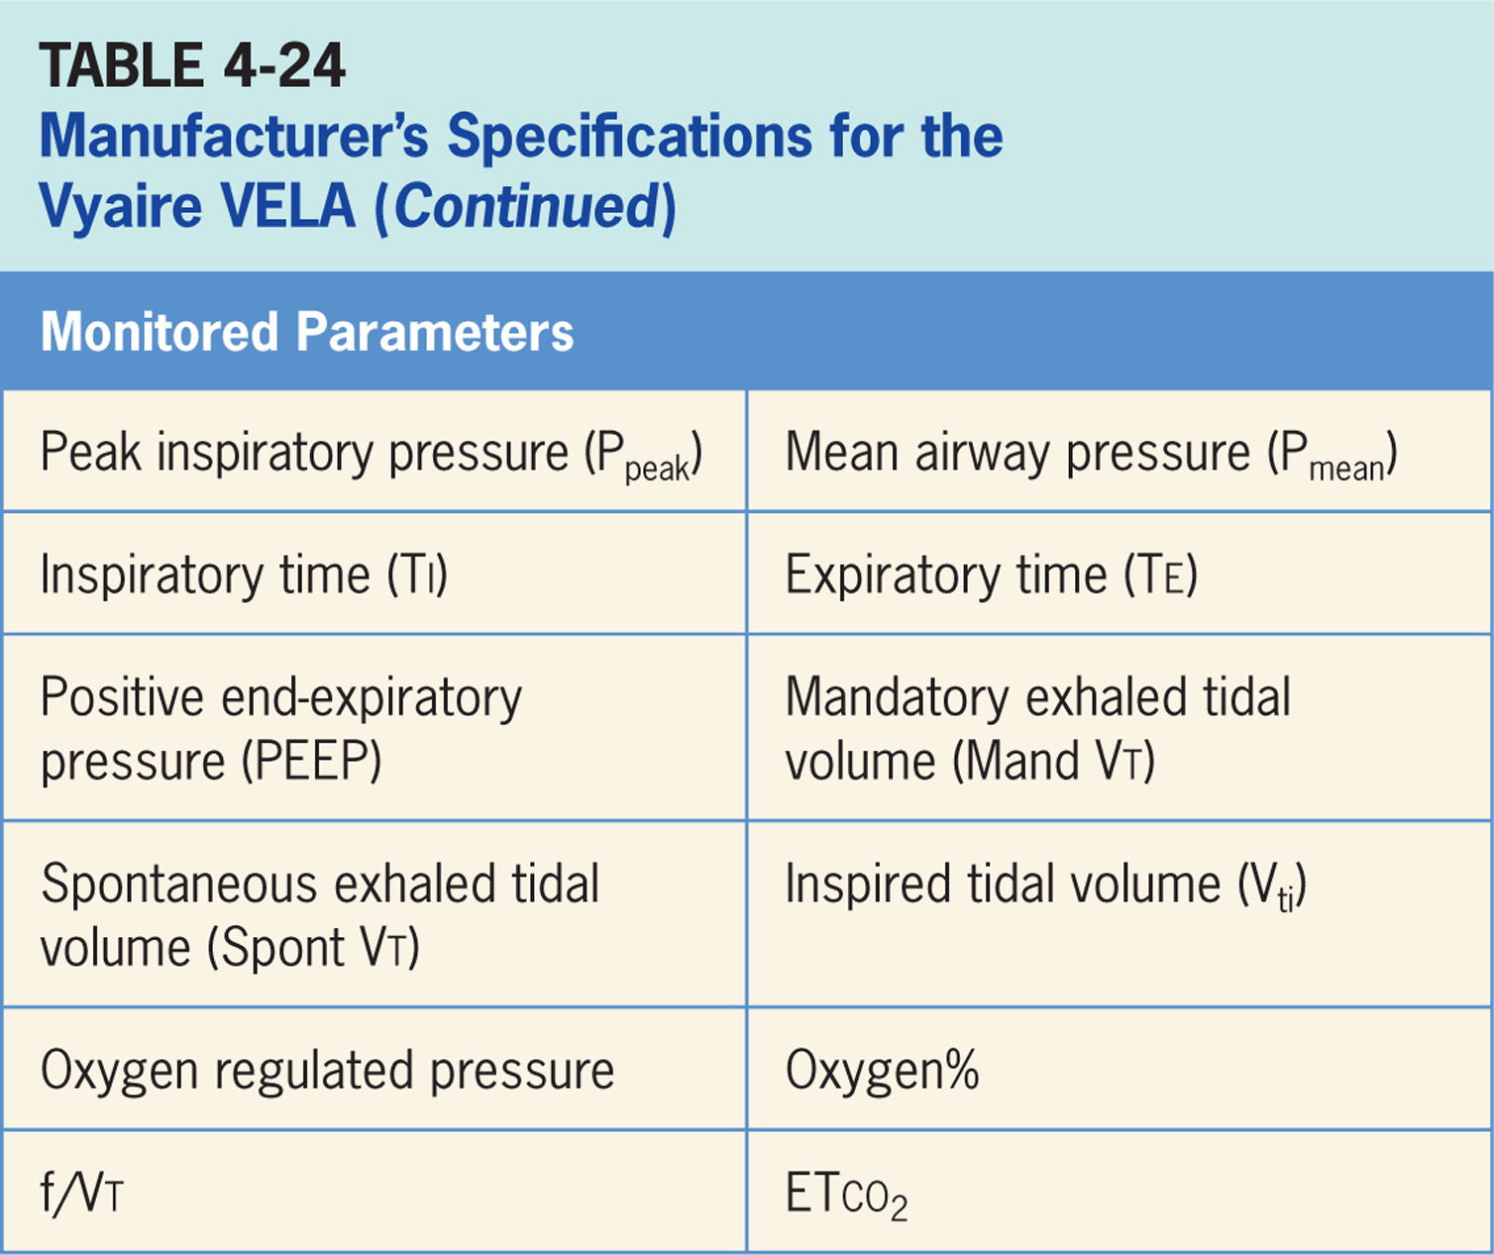

Slide 184
Accessories
VELA supplies blended gas to power a jet nebulizer (not provided) which is synchronized with inspiration.¹³
Volumetric capnometry is optional.¹³

Slide 185
Dräger Evita XL
The Dräger Evita XL ventilator is a critical care ventilator designed for use in adult, pediatric, and neonatal patients in both acute and subacute clinical locations.¹⁵
The Evita Infinity is electrically powered and controlled; designed to use in acute and subacute clinical settings and requires an external compressor if piped air is not available. (pictured in Figure 4-24)
Consists of a flat panel touch screen, buttons and a control dial to change and confirm settings. Settings are entered by pressing a button on the touch screen to select the parameter to be changed, then the control dial is turned to select the new value, and the control dial is pressed to confirm. (The Evita operator interface is depicted in Figure 4-25)

Slide 186
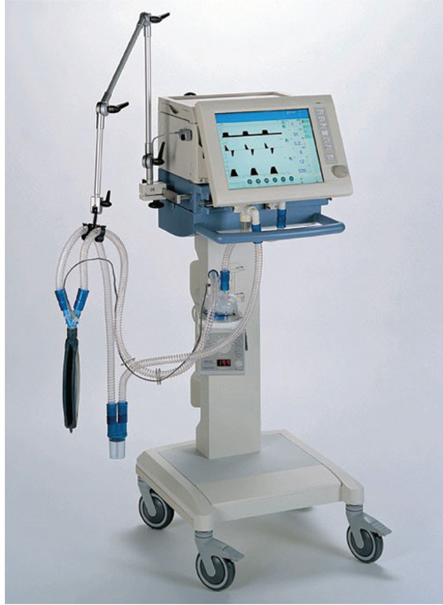
Figure 4.24

Slide 187
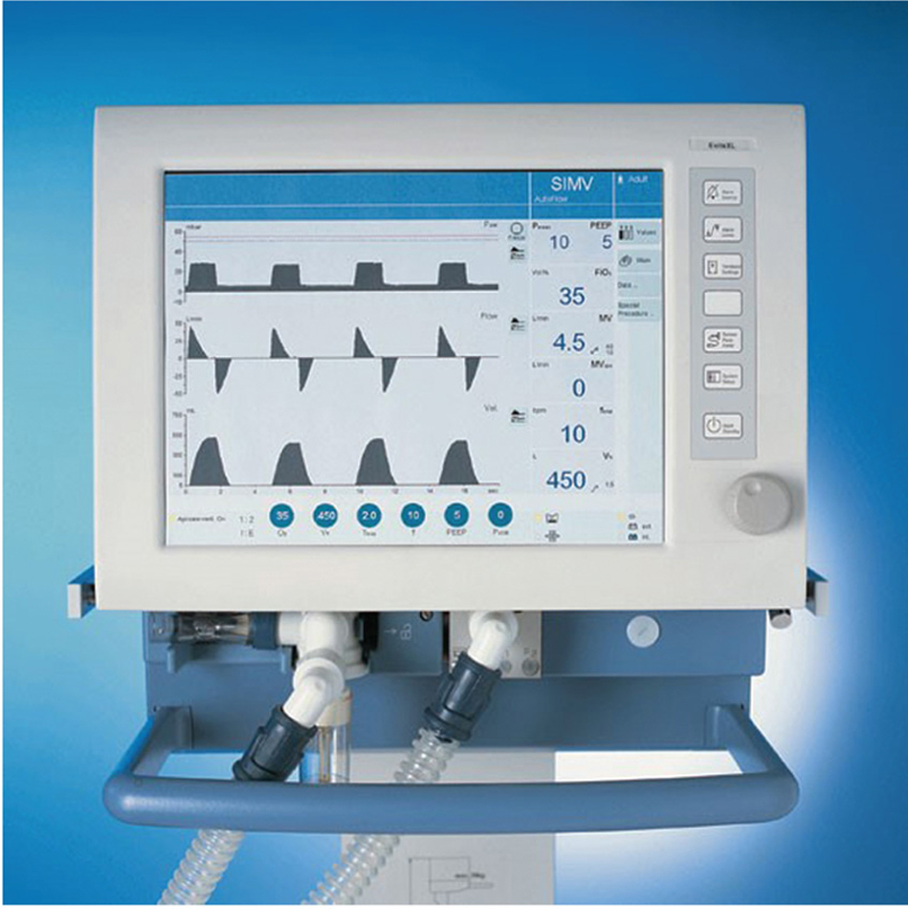
Figure 4.25

Slide 188
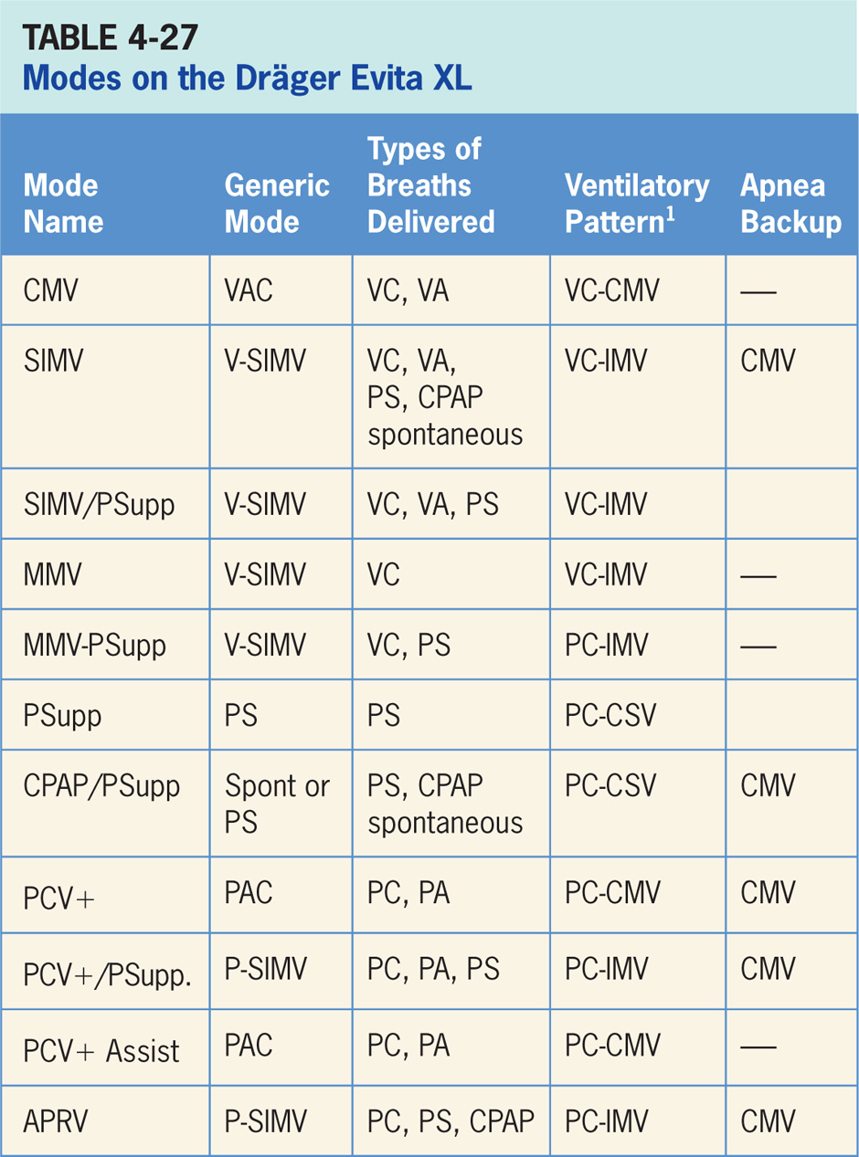

Slide 189
Continuous Mandatory Ventilation (CMV)
Volume-targeted mode of ventilation (VAC) allowing for mandatory, time-triggered breaths and patient-assisted breaths.¹⁵
Spontaneous breathing not allowed.
Breath cycles to exhalation once the tidal volume (Vt) has been delivered.

Slide 190
Main Operator Controls Include:
Fio₂
PEEP
Vt
Inspiratory flow
RR
Inspiratory time
The resulting pressure created is variable and depends on Vt, flow, and patient respiratory system mechanics.¹⁵

Slide 191
Synchronized, Intermittent Mandatory Ventilation
SIMV combines two breath types, VAC and spontaneous breathing, while on CPAP.¹⁵
Mandatory, time-triggered breaths, patient-assisted breaths, and spontaneous breaths are all provided.
Ventilator prevents “breath stacking” (a VAC breath compounded by a PS breath) through the use of a “timing window.”
If patient attempts to trigger a breath in timing window, then ventilator will deliver a VAC breath.
If patient attempts to trigger a breath outside the window, then a spontaneous breath will occur.

Slide 192
Main Operator Controls Include:
Fio₂
PEEP
Vt
Flow
SIMV rate
Inspiratory time
During VAC breaths, resulting pressure created is variable and depends on Vt, flow, and patient mechanics.¹⁵
During CPAP spontaneous breaths, volume will be variable and depend on patient effort, and patient respiratory system mechanics.¹⁵

Slide 193
Synchronized, Intermittent Mandatory Ventilation/Pressure Support (SIMV/PSupp)
SIMV/PSupp combines two breath types, VAC and PS or spontaneous breathing, while on CPAP.¹⁵
Mandatory, time-triggered breaths, patient-assisted breaths, and spontaneous breaths are all provided.
The ventilator prevents “breath stacking” (a VAC breath compounded by a PS breath) through use of a “timing window.”
If the patient attempts to trigger a breath in this timing window, then ventilator will deliver a VAC breath.
If the patient attempts to trigger a breath outside window, then a spontaneous breath will occur.

Slide 194
Main Operator Controls Include:
Fio₂
PEEP
Vt
Flow
SIMV rate
Inspiratory time
Pressure support level
Cycle sensitivity
During VAC breaths, the resulting pressure created is variable and depends on Vt, flow, and patient mechanics.¹⁵
During PS breaths, the volume will be variable and depend on the PS level, patient effort, and patient respiratory system mechanics.¹⁵

Slide 195
Mandatory Minute Volume Ventilation (MMV)
MMV guarantees the patient always receives at least the set minute volume MV.¹⁵
Patient can always breathe spontaneously at PEEP level (with or without pressure support).
If spontaneous breathing of patient is insufficient to achieve the set minute ventilation, VAC breaths are applied.
These mandatory breaths are synchronized with patient’s own breathing attempts.

Slide 196
Main Operator Controls Include:
Fio₂
PEEP
Vt
Inspiratory flow
RR
Inspiratory time
PS level
Cycle sensitivity
During VAC breaths, resulting pressure created is variable and depends on Vt, flow, and patient mechanics.¹⁵
During PS breaths, volume will be variable and depend on the PS level, patient effort, and patient respiratory system.¹⁵

Slide 197
Pressure Control Ventilation+ (PCV+)
PCV+ is a pressure-targeted mode of ventilation that delivers mandatory, time-triggered breaths only. ¹⁵
Spontaneous breathing is permitted during whole breathing cycle.
The mandatory breaths cycle to exhalation once inspiratory time has been reached.

Slide 198
Pressure-controlled Ventilation+/Pressure-supported Spontaneous Breathing (PCV+/PSUPP)
Pressure-targeted mode of ventilation that delivers mandatory, time-triggered breaths and pressure support breaths.¹⁵
Spontaneous breathing is permitted during whole breathing cycle.
The mandatory breaths cycle to exhalation once the inspiratory time has been reached.

Slide 199
Main Operator Controls Include:
Fio₂
PEEP
Inspiratory pressure level
Inspiratory time
RR
PS level
Cycle sensitivity
During PAC breaths, resulting Vt created is variable and depends on inspiratory pressure level, patient effort, and patient respiratory system mechanics.¹⁵
During PS breaths, the volume will be variable and depend on the PS level, patient effort, and patient respiratory system mechanics.¹⁵ Inspiratory pressure level is not automatically adjusted for PEEP and an increase in PEEP will decrease delta P (ΔP) and tidal volume, if pressure control is not also adjusted.

Slide 200
Pressure Controlled Ventilation+ (PCV+ Assist)
Pressure-targeted mode of ventilation that delivers mandatory, time-triggered patient-assisted breaths.¹⁵
Spontaneous breathing is permitted during whole breathing cycle.
Mandatory breaths cycle to exhalation once inspiratory time has been reached.
Inspiratory breaths are equivalent to those of PCV+, the switch from P_{insp} to PEEP is not synchronized with patient expiration.

Slide 201
Main Operator Controls Include:
Fio₂
PEEP
Inspiratory pressure level
Inspiratory time
RR
Pressure will be consistently delivered from breath to breath; Vt and flow are variable and will depend on the inspiratory pressure level, patient effort, and patient respiratory system mechanics.¹⁵ Inspiratory pressure level is not automatically adjusted for PEEP and an increase in PEEP will decrease delta P (ΔP) and tidal volume, if pressure control is not also adjusted.

Slide 202
Airway Pressure Release Ventilation
Mode of ventilation allowing for spontaneous breathing at two different clinician-set pressure levels.¹⁵
Ventilator switches between two different clinician-set pressure levels (the lower of which can be CPAP).
These pressure levels are referred to as P_{high} and P_{low}. T_{high} is length of time at P_{high} and T_{low} is the length of time spent at P_{low}. APRV is mainly used in an inverse I:E ratio.
An important difference from pressure-targeted modes is the P_{high} level is now referenced to atmosphere as to the P_{low}.
Important: increases in P_{low} will decrease the distending pressure.

Slide 203
Apnea Ventilation Special Features
Ventilator engages apnea ventilation when no breath has been delivered by the time the apnea interval elapses.¹⁵
When apnea ventilation has been triggered the ventilator switches over to CMV and ventilates with the set respiratory rate and Vt.
As in SIMV, patient can breathe spontaneously during apnea ventilation and mandatory breaths will be synchronized with patient's spontaneous breathing.
Apnea respiratory rate remains constant.

Slide 204
Autoflow
AutoFlow is a supplemental function that controls inspiratory flow during mandatory breaths in volume-controlled ventilation modes CMV, SIMV, and MMV.¹⁵
Breaths become pressure-targeted with a volume guarantee.
The ventilator determines what pressure to use in order to achieve the set tidal volume.
In neonatal population AutoFlow is automatically activated in all volume-controlled modes.
A neonatal flow sensor is required.

Slide 205
Automatic Tube Compensation
When Automatic Tube Compensation is activated ; ventilator calculates pressure drop from the proximal to the distal end of the ETT and ventilation pressure in the breathing circuit is increased during inspiration or decreased during expiration.¹⁵
Airway pressure is adjusted to the tracheal level if 100 % compensation of the tube resistance has been selected.
Clinician has to input ETT diameter and length.

Slide 206
Low-flow PV Loop
Low-flow PV Loop measuring procedure records a static pressure-volume curve, which can be used to assess the mechanical properties of the lungs.¹⁵

Slide 207
Nebulizer
The Evita XL employs a pneumatic nebulizer for delivery of medication.¹⁵
In adult patient category nebulization is available in all modes.
The nebulizer synchronizes with inspiratory phase and adds no additional flow while keeping the Fio₂ is constant.
In Neonatal and Pediatric patient categories, medication nebulization is only possible in volume controlled ventilation modes.

Slide 208
Noninvasive Ventilation
NIV is activated when Mask Ventilation application mode is selected.¹⁵
All ventilation modes can be used.
Patients with spontaneous breathing are supported with noninvasive ventilation therapies via a nasal or facial mask.

Slide 209
Neonatal Ventilation
Ventilation of neonates is accomplished through the use of NeoFlow option which offers flow measurement at wye.¹⁵

Slide 210
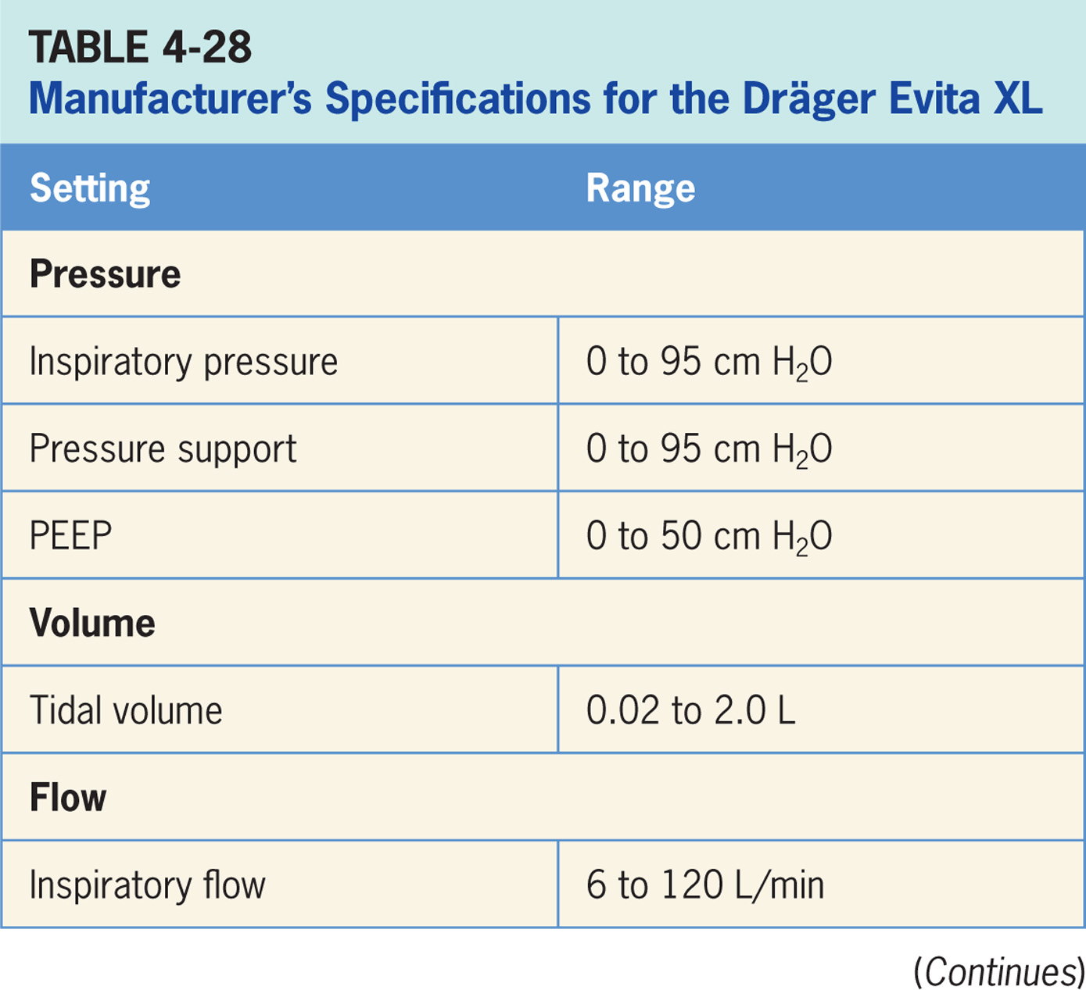

Slide 211
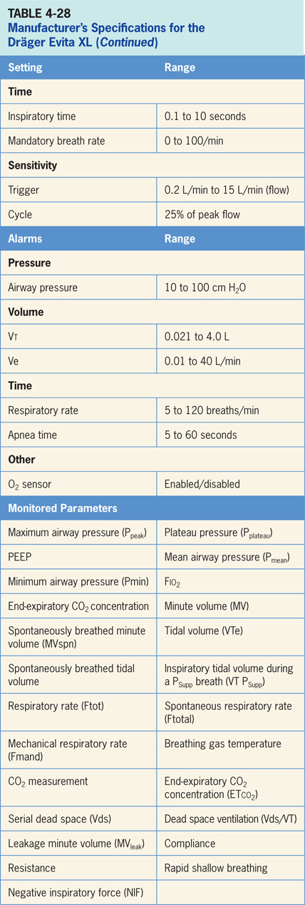

Slide 212
Accessories
Accessories include: optional CO₂ monitoring with the CapnoPlus.¹⁵
In neonatal mode, a neonatal sensor provides flow measurement at the wye.¹⁵
SmartCare offers an optional weaning mode that gradually reduces the PS level based on inputs from ETco₂, RR, and Vt.¹⁵

Slide 213
GE Healthcare CARESCAPE R860
CARESCAPE R860 ventilator is a critical care ventilator designed to provide mechanical ventilation or support to neonatal, pediatric, and adult patients weighing 0.25 kg and above.¹⁶
Microprocessor based, electronically controlled, pneumatically driven and be used for intrahospital transport as well.
The operator interface on the GE CARESCAPE R860 employs a combination of a touch screen, buttons (real and virtual) and a trim knob (Figure 4-27).

Slide 214
GE Healthcare CARESCAPE R860 (cont’d)
It is a three-step process to make a change to a setting, clinician first touches a virtual button on the touch screen. Second, the trim knob is used to change the value of the setting. Last, the trim knob must be pressed to confirm. Screen displays change depending on the operation being carried out. For instance, the alarm screen looks different than the monitoring screen and so forth. There are a number of different screens.

Slide 215
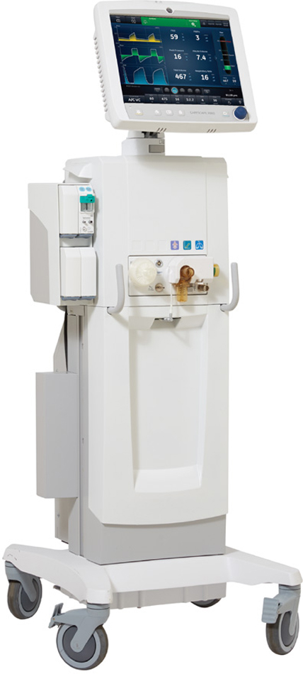
Figure 4.26

Slide 216
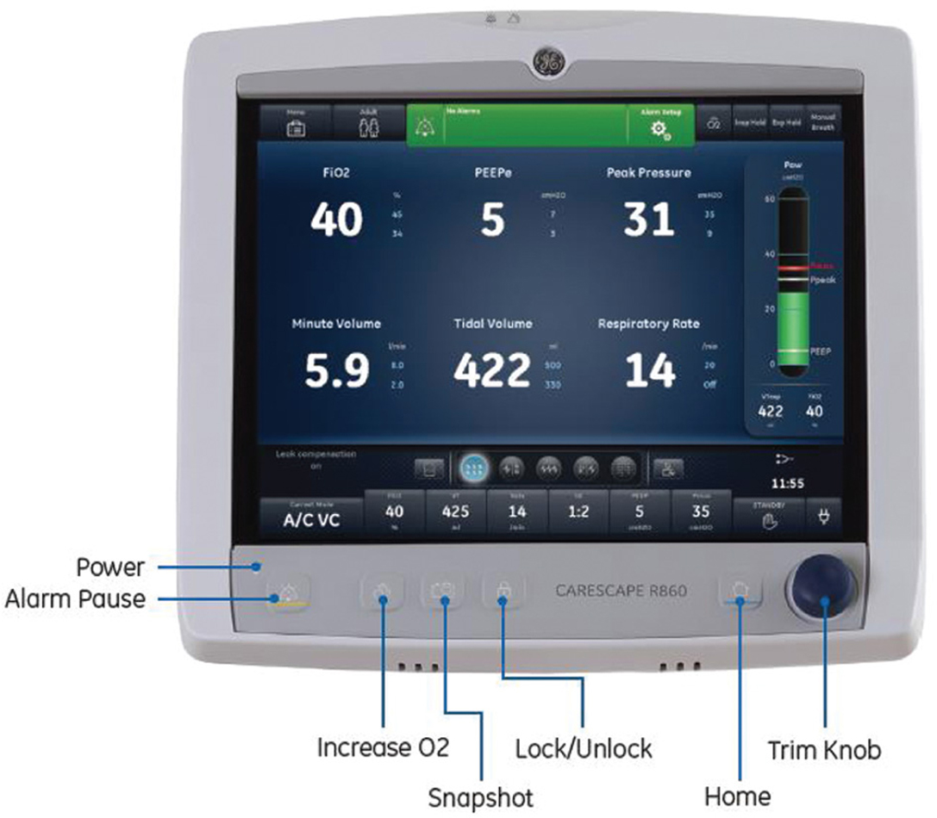
Figure 4.27

Slide 217
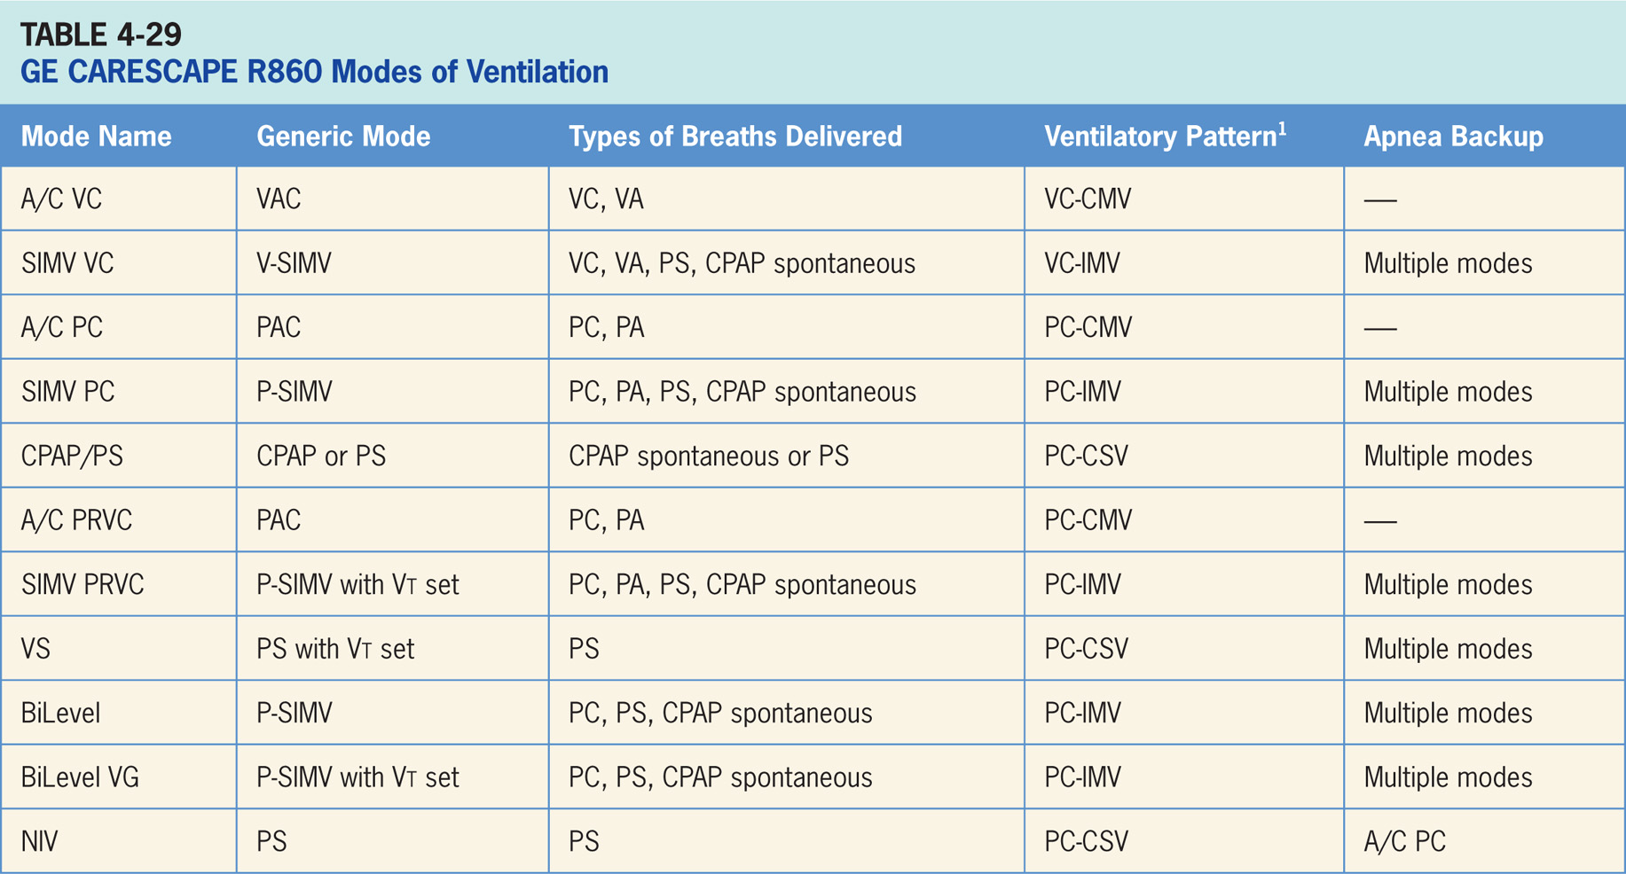

Slide 218
A/C Volume Control (A/C VC)
Volume-targeted mode of ventilation (VAC) allowing for mandatory, time-triggered breaths or patient-assisted breaths.¹⁶
Spontaneous breathing not allowed.
The breath cycles to exhalation once the tidal volume (Vt) has been delivered.

Slide 219
Main Operator Controls Include:
Fio₂
PEEP
Vt
Inspiratory flow
RR
Inspiratory time (T_{insp}) or I:E
The resulting pressure created is variable and depends on Vt, flow, and patient respiratory system mechanics.¹⁶

Slide 220
Synchronized, Intermittent Mandatory Ventilation Volume Control SIMV VC
Combines two breath types, VAC and PS or spontaneous breathing, while on CPAP.¹⁶
Mandatory, time-triggered breaths, patient-assisted breaths, and spontaneous breaths are all provided.
The ventilator prevents “breath stacking” (a VAC breath compounded by a PS breath) through the use of a “timing window.”
If patient attempts to trigger a breath in timing window, then ventilator will deliver a VAC breath.
If the patient attempts to trigger a breath outside window, then a spontaneous breath will occur.

Slide 221
Main Operator Controls Include:
Fio₂
PEEP
Vt
Inspiratory flow
SIMV rate
T_{insp}
Pressure support level
Cycle sensitivity
During VAC breaths, resulting pressure created is variable and depends on Vt, flow, and patient mechanics.¹⁶
During PS breaths, volume will be variable and depend on the PS level, patient effort, and patient respiratory system mechanics.¹⁶

Slide 222
A/C Pressure Control (A/C PC)
Pressure-targeted mode of ventilation allowing for mandatory, time-triggered breaths or patient-assisted breaths.¹⁶
Spontaneous breaths not allowed.
The breath cycles to exhalation once the inspiratory time has been reached or when the high-pressure alarm is tripped.

Slide 223
Main Operator Controls Include:
Fio₂
PEEP
Inspiratory pressure (P_{insp})
T_{insp} or I:E
RR
Pressure will be consistently delivered from breath to breath; Vt and flow are variable and will depend on the inspiratory pressure level, patient effort, and patient respiratory system mechanics.¹⁶

Slide 224
Synchronized, Intermittent Mandatory Ventilation Pressure Control (SIMV PC)
Similar to SIMV VC except the target is now pressure instead of volume.¹⁶
SIMV (Pressure Control) also combines two breath types, PAC and either PS or spontaneous breathing, while on CPAP.
Combination of mandatory, time-triggered breaths, patient-assisted breaths, and spontaneous breaths.
Ventilator prevents “breath stacking” (a PAC breath compounded by a PS breath) through the use of a “timing window.”
If patient attempts to trigger a breath in this timing window, then ventilator will deliver a PAC breath.
If patient attempts to trigger a breath outside window, then a spontaneous breath will occur.

Slide 225
Main Operator Controls Include:
Fio₂
PEEP
P_{insp}
T_{insp}
SIMV rate
Pressure support level
Cycle sensitivity
During PAC breaths, resulting Vt created is variable and depends on inspiratory pressure level, patient effort, and patient respiratory system mechanics.¹⁶
During PS breaths, the volume will be variable and depend on PS level, patient effort, and patient respiratory system mechanics.¹⁶

Slide 226
Continuous Positive Airway Pressure/Pressure Support (CPAP/PS)
During CPAP/PS the patient regulates the respiratory rate and Vt with support from ventilator.¹⁶
Patient triggers all breaths and will receive the clinician-set PS level (if PS is set to 0 the patient breathes spontaneously on CPAP).
If a pressure support level > 0 cm H₂O is set, the breath cycles to expiration when the inspiratory flow decreases below a preset percentage of the inspiratory peak flow.

Slide 227
A/C Pressure-regulated Volume Control (A/C PRVC)
Pressure-targeted (either PC or PA breaths) mode that uses pressure breaths to achieve a clinician-set Vt.¹⁶
The inspiratory pressure level, is now adjusted by ventilator instead of clinician.
Since the ventilator relies a previous breath sequence to deliver the ensuing breath the Vt tends to be somewhat variable, especially in patients with inconsistent efforts.
No spontaneous breaths.

Slide 228
Synchronized, Intermittent Mandatory Ventilation Pressure-regulated Volume Control (SIMV PRVC)
Combines two breath types, PAC (ventilator-controlled inspiratory pressure) and either PS or spontaneous breathing, while on CPAP.¹⁶
A combination of mandatory, time-triggered breaths, patient-assisted breaths, and spontaneous breaths.
Ventilator prevents “breath stacking” (a PAC breath compounded by a PS breath) through the use of “timing window.”
If patient attempts to trigger a breath in timing window, then ventilator will deliver a PAC breath.
If patient attempts to trigger a breath outside window, then a spontaneous breath will occur.

Slide 229
Volume Support (VS)
The ventilator delivers a variable (from breath to breath) PS level in order to reach a clinician-set Vt.¹⁶
The ventilator changes PS level as needed to reach Vt.
Ventilator drops the level of support as patient effort increases and conversely increases the PS level when patient effort is too low.

Slide 230
BiLevel Airway Pressure Ventilation
During BiLevel mode, ventilator alternates between the set PEEP level and the set inspiratory pressure level (P_{insp}) based on the set Rate and Tinsp.¹⁶
The patient can breathe spontaneously at either level.
Difference from the pressure-targeted modes is the P_{insp} level is now referenced to atmosphere as to the PEEP.
Important: increases in PEEP will decrease the distending pressure.
Additional ventilator support can also be added in form of PS at both pressure levels to augment the patient effort.

Slide 231
BiLevel Airway Pressure Ventilation Volume Guaranteed
In BiLevel VG ventilator alternates between a set PEEP and the minimum pressure to deliver the set tidal volume (VT) based on the set Rate and T_{insp}.¹⁶
The patient can breathe spontaneously at either level. Again the P_{insp} level is referenced to atmosphere as to the PEEP.
Important: increases in PEEP will decrease the distending pressure. Additional ventilator support can also be added in the form of PS at both pressure levels to augment the patient effort.

Slide 232
Noninvasive Ventilation
During NIV mode, patient draws spontaneous breaths as ventilator maintains the set PEEP level and provides PS breaths.¹⁶
Patients should have a reliable respiratory drive since all breaths are spontaneous.
Both flow and pressure triggers are applied simultaneously in NIV mode to help counterbalance the leak in the system.

Slide 233
Apnea Backup Ventilation Special Features
Backup mode is available upon activation of the apnea alarm or patient’s expired minute volume (MVexp) dropped below 50% of the set low MVexp alarm.¹⁶
All of CARESCPAPE R860’s modes with mandatory breaths can be used as the backup mode.

Slide 234
Tube Compensation
Designed to add additional pressure to compensate for difference between the lung pressure and breathing circuit pressure during the inspiratory phase of pressure-controlled and pressure-supported breaths.₁₆
Can be used to offset all or part of the resistance caused by endotracheal or tracheal tube.

Slide 235
Leak Compensation
Used to compensate for leaks in the circuit.¹⁶
CARESCAPE R860 uses increases in tidal volume to compensate in volume-targeted modes (A/C VC, A/C PRVC, SIMV VC, SIMV PRVC, BiLevel VG and VS).
Maximum tidal volume increase for adults is 25% of the set Vt. For pediatric and neonates the maximum increase is 100%.

Slide 236
Spontaneous Breathing Trial
Spontaneous breathing trial (SBT) mode can be used to evaluate readiness for liberation from the ventilator.¹⁶
Clinician sets the Fio₂, PEEP, PS level, and SBT duration.
There is an “SBT view” screen that allows clinician to examine the trial in more detail.

Slide 237
FRC Procedure
FRC procedure measures the patient's FRC using a nitrogen washout process.¹⁶
The nitrogen washout uses the changes in Fio₂ delivered to patient to measure FRC.

Slide 238
Metabolics (Indirect Calorimetry)
Indirect calorimetry calculates the energy expenditure (EE) and respiratory quotient (RQ) by measuring respiratory gas exchange, the consumption of oxygen and the production of carbon dioxide.¹⁶

Slide 239
SpiroDynamics
SpiroDynamics uses intratracheal pressure catheter connected to the Paux port to measure tracheal pressures and intrinsic PEEP.¹⁶
The idea is that the catheter bypasses the resistance created by the endotracheal tube to theoretically provide more accurate alveolar pressures.

Slide 240
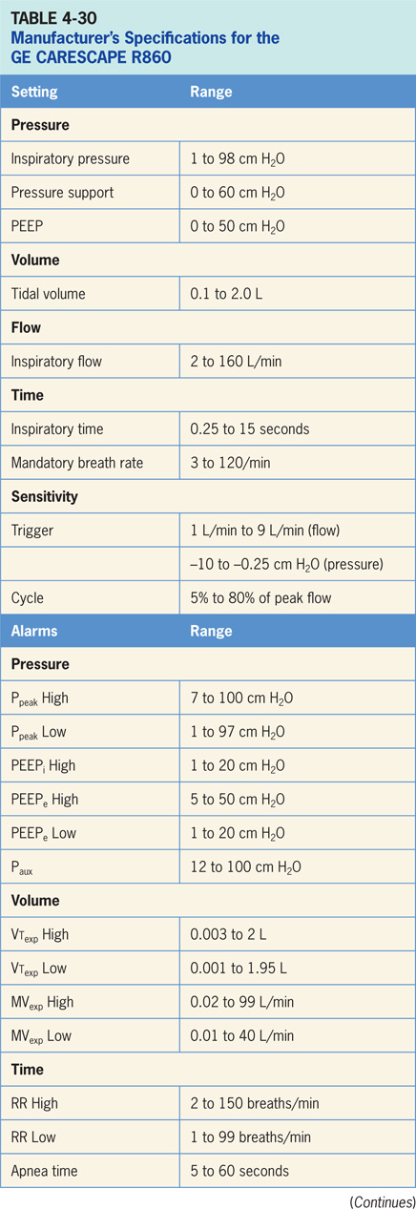

Slide 241
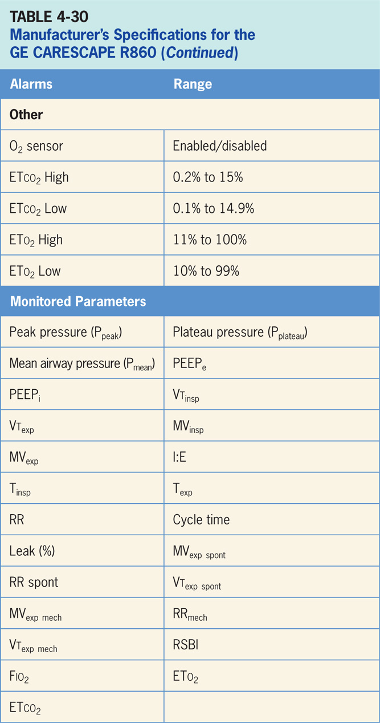

Slide 242
Accessories
Bilevel, APRV, and NIV are all optional modes on CARESCAPE R860.¹⁶
Neonatal ventilation is an option as well and neonates that weigh a minimum of 0.25 kg can be ventilated with the use of a proximal flow sensor.
All modes are available in neonatal ventilation as well as nasal CPAP (nCPAP).
The CARESCAPE R860 has the ability to deliver aerosolized medications through the use of an Aerogen Solo vibrating mesh nebulizer.
The nebulizer does not add flow to the circuit, so it does not interfere with ventilation.

