Slide 1
Chapter 6: Ventilator Initiation

Slide 2
Chapter Objectives
Describe the primary function of a mechanical ventilator
Identify the four major indications for mechanical ventilation
Describe the major goals of mechanical ventilation
Overview the historical development of negative pressure ventilation
Explain the advantages and disadvantages of negative pressure ventilation
Define term ‘trigger variable’ and compare time-triggered ventilation to patient-triggered ventilation

Slide 3
Chapter Objectives (cont’d)
Explain each of the following terms related to the trigger variable: flow-trigger, pressure trigger, and auto-trigger
Define each of the following commonly used terms: assist breath, control breath, assist-control, and controlled ventilation in terms of the trigger variable associated with each term.
Explain how each of the following cycle variables terminates the inspiratory phase: volume-cycled, pressure cycled, time cycled, and flow cycled.

Slide 4
Chapter Objectives (cont’d)
Compare volume-control (VC) and pressure-control ventilation (PC).
Compare pressure support ventilation (PSV) and pressure control ventilation (PCV).
Define each of the following: CMV, IMV, and CSV.
Explain the indications, contraindications, advantages and disadvantages of noninvasive ventilation (NIV).
Describe initial ventilator settings for NIV.

Slide 5
Chapter Objectives (cont’d)
Describe methods and steps to establish the airway for invasive mechanical ventilation.
Contrast endotracheal intubation and tracheostomy when used to provide invasive mechanical ventilation.
Summarize the factors that should be considered when choosing a mechanical ventilator.
Explain each of the following terms used to define the mode of ventilation employed: control variable, breath sequence, and targeting scheme.
Explain methods for providing full and partial ventilatory support and contrast advantages and disadvantages of each.

Slide 6
Chapter Objectives (cont’d)
Define each of the five major modes of ventilation and explain the advantages and disadvantages of each.
Explain the use of other modes of ventilation to include adaptive pressure control, (APC), mandatory minute ventilation (MMV), adaptive support ventilation (ASV), airway pressure release ventilation (APRV), proportional assist ventilation (PAV), automode, neutrally adjusted ventilatory assist (NAVA) and high-frequency ventilation (HFV).
Describe initial ventilator set up for adult patients to include mode, tidal volume, rate, inspiratory pressure, breath trigger, pressure rise time or slope, inspiratory time, expiratory time and I:E ratio, oxygen concentration, PEEP/ CPAP, alarms and limits, and humidification.

Slide 7
Chapter Overview
Introduction
Goals of Mechanical Ventilation
Methods of Ventilation
Establishment of the Airway
Choice of a Ventilator
Choice of Mode
Initial Ventilator Settings
Patient Assessment
Management of Specific Disease States and Conditions
Summary
Key Points

Slide 8
Introduction
The primary function of a mechanical ventilator is to augment or replace normal ventilation
Initiation of mechanical ventilation should be based on patient assessment, clinical judgement, and understanding appropriate use of the ventilator
Indications for ventilatory support include:
Apnea
Acute ventilatory failure (most common)
Impending ventilatory failure
Severe oxygenation problems/ refractory hypoxemia
Other possible indications may include administration of general anesthesia, airway protection in the absence of gag reflex, or use of deep sedation
Common diagnoses for requiring mechanical ventilation include acute exacerbations of COPD coma, multiple trauma, and neuromuscular disease

Slide 9
Introduction
Hazards/ complications to mechanical ventilation
Ventilator-associated lung injury (VALI)
Ventilator associated pneumonia (VAP)
Increased work of breathing (WOB)
Ventilatory muscle dysfunction
Barotrauma (e.g., pneumothorax, pneumomediastinum)
Airway problems (e.g., accidental bronchial intubation, airway occlusion)
Ventilator system failure

Slide 10
Goals of Mechanical Ventilation
Normalize alveolar ventilation and PaCO₂
Provide adequate alveolar ventilation
Ensure adequate tissue oxygenation
Restore and maintain acid-base homeostasis
Reduce the WOB

Slide 11
Methods of Ventilation
Methods of providing mechanical ventilatory support include:
Negative pressure ventilation
Positive pressure ventilation
Partial ventilatory support
Full ventilatory support
Volume control ventilation
Pressure control ventilation
Automated targeting schemes
Proportional assist ventilation (PAV)
Pressure-regulated volume control (PRVC)
Adaptive support ventilation (ASV)

Slide 12
Negative Pressure Ventilation
Negative pressure ventilators enclose the thorax within a chamber, shell, or body suit, to provide intermittent or continuous negative pressure on inspiration
“Iron Lung” used during polio epidemic to provide ventilatory support
Other types include Port-a-Lung, chest cuirass, and bodysuit
Does not require an artificial airway
Relatively easy to support patients with chronic ventilatory failure
Initial settings: Rate of 12-24 breaths/min, inspiratory pressure of -10 to -35 cm H₂O

Slide 13
Negative Pressure Ventilation (cont’d)
Advantages
Simplicity of the device
Maintenance of the airway, allowing the patient to eat and talk
Disadvantages
Machine is large and bulky
Assessing the patient for procedures, bathing, or turning may be challenging
Hazards/complications
Abdominal venous blood pooling
Reduced venous return
Acute hypotension
Upper airway soft tissue obstruction
Contraindication
Obstructive sleep apnea

Slide 14
Positive Pressure Ventilation
Positive pressure ventilation applies a positive pressure to the airway on inspiration, creating a pressure gradient between the upper airway and the alveoli
Can use with a mask, endotracheal tube, tracheostomy tube, or other interfaces
Peak inspiratory pressure (PIP): highest pressure reached during inspiration
Volume control ventilation: PIP occurs at the end of inspiration
Pressure control ventilation: PIP occurs early in inspiration and continues until expiration begins

Slide 15
Positive Pressure Ventilation (cont’d)
Plateau pressure (P_{plat}): when airway pressure (Paw) and alveolar pressure (Pa) have equilibrated
Monitoring PIP and P_{plat} during mechanical ventilation in the volume control mode provides valuable information used to detect important clinical changes as well as allowing for the calculation of the patient’s static total compliance (Cst) and airway resistance (Raw)
Hazards/complications: reduced venous return to the right heart, decreased cardiac output, and hypotension

Slide 16
Terminology
Trigger variable: begins inspiration
Time trigger: initiated by the ventilator, also known as “control breaths”
Patient trigger: initiated by the patient, also known as “assisted breaths”
Auto-triggering: unintentional initiation of a breath by the ventilator
Controlled ventilation: mode of ventilation with only time-triggered breaths
Cycle variable: the factor which cycles a breath from inspiration to expiration
Breaths may be cycled by volume, pressure, time, or flow
Breaths may be pressure limited and pressure cycled, pressure limited and time cycled, or pressure limited and flow cycled

Slide 17
Terminology (cont’d)
Targeting schemes: characteristics that distinguish the ventilatory pattern in use
Set-point targeting: all parameters are set
Adaptive targeting: ventilator automatically adjusts pressure between breaths to achieve an average tidal volume over several breaths
Dual targeting: ventilator automatically switches between volume control and pressure control during a single breath
Other schemes: servo, optimal, bio-variable, and intelligent targeting
Volume control (VC): delivered volume is set and airway pressure varies based on resistance and compliance

Slide 18
Terminology (cont’d)
Pressure control (PC): inspiratory airway pressure is set and tidal volume varies based on resistance, compliance, patient effort, driving pressure, inspiratory time, and presence/absence of PEEP; expiration to inspiration is time or patient triggered and inspiration to expiration is time cycled
Pressure support ventilation (PSV): spontaneous ventilation in which expiration to inspiration is patient triggered, inspiratory pressure rises to the set value, and inspiration to expiration is flow cycled
Mandatory breaths: ventilator delivers the same breath type with each cycle, regardless of patient effort; may be volume controlled or pressure controlled breaths

Slide 19
Terminology (cont’d)
Spontaneous breaths: beginning and end of inspiration is based entirely on patient effort; spontaneous breaths may or may not be pressure supported or have an elevated baseline pressure
Continuous spontaneous ventilation (CSV): all breaths are initiated and ended by the patient
Types: normal, spontaneous breathing, PSV, CPAP, automatic tube compensation (ATC), proportional assist ventilation (PAV), and neutrally adjusted ventilatory assist (NAVA)

Slide 20
Terminology (cont’d)
Continuous mandatory ventilation (CMV): all breaths are mandatory breaths, and can be patient or time triggered
Types: pressure control-continuous mandatory ventilation (PC-CMV), volume control-continuous mandatory ventilation (VC-CMV)
Intermittent mandatory ventilation (IMV): some breaths are mandatory and some breaths are spontaneous; the patient is able to spontaneously breathe in between mandatory breaths
Types: synchronized intermittent mandatory ventilation (SIMV) – breaths may be time or patient triggered, have an elevated baseline pressure, and spontaneous breaths may be pressure supported

Slide 21
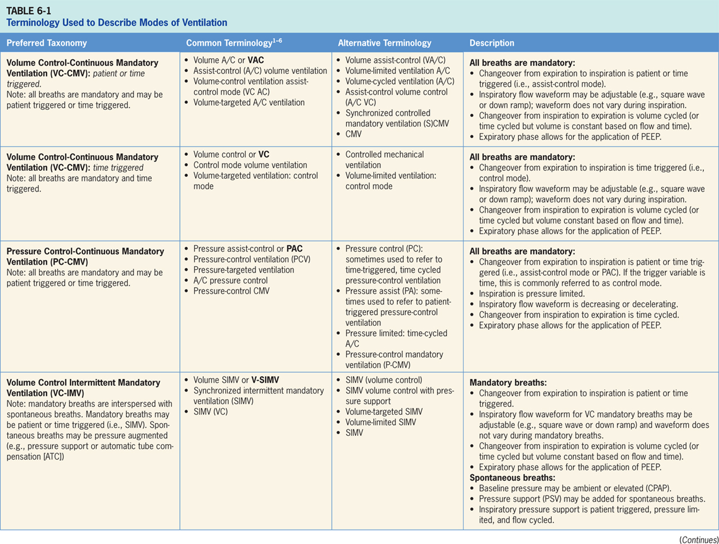

Slide 22
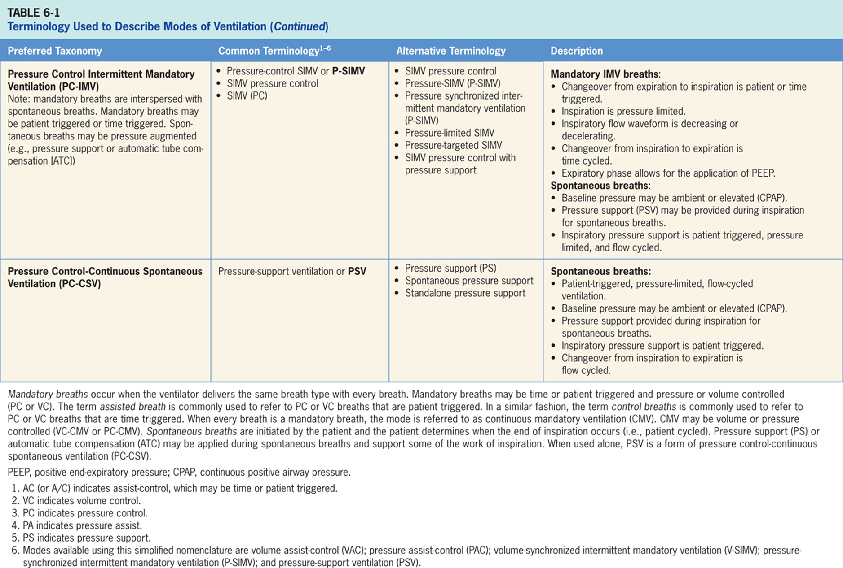

Slide 23
Noninvasive Ventilation (NIV)
Definition: A technique that does not require an artificial airway (e.g., endotracheal intubation or tracheostomy)
Types: NPVV, CPAP, BiPAP
Interfaces: nasal mask, oromask, nasal pillows, mouthpiece, helmet (most common: oronasal or full-face mask)
Indications: acute exacerbation of COPD, cardiogenic pulmonary edema, acute hypoxic respiratory failure, prevention of post-extubation respiratory failure, acute or impending respiratory failure, chronic hypoventilation

Slide 24
Noninvasive Ventilation (NIV) (cont’d)
Contraindications: cardiac or respiratory arrest, hemodynamic or cardiac instability, severely impaired consciousness, facial trauma, facial surgery, facial deformity, upper airway obstruction, inability to protect/clear the airway, high risk for aspiration
Hazards/ complications: discomfort, skin breakdown
Initial settings: IPAP 8-20 cm H₂O, EPAP 3-5 cm H₂O, backup rate 2-4 breaths/min below the spontaneous rate, Fio2 is titrated based on patient’s SpO₂, and volume goals should be 6-10 mL/kg

Slide 25
Invasive Ventilation
Invasive ventilation is a technique that requires an artificial airway (e.g., endotracheal intubation or tracheostomy)
Indications: Loss of protective airway reflexes, depressed mental status, hemodynamic instability, severe oxygenation disorders, need to suction excessive secretions
Advantages: secure and protected airway, allows for a more dependable form of ventilatory support

Slide 26
Establishment of the Airway
Nasopharyngeal or oropharyngeal airways are useful for patients with soft tissue obstruction
Extraglottic airways (supraglottic airways) are used during general anesthesia or for management of difficult and emergent airways
Example: Laryngeal mask airway (LMA)
Endotracheal intubation
Most patients (95%) are orally intubated
Nasal intubation is possible if the patient cannot be orally intubated
Tracheostomy
Required for extended invasive mechanical ventilation
Typically after 10-14 days of requiring mechanical ventilation

Slide 27
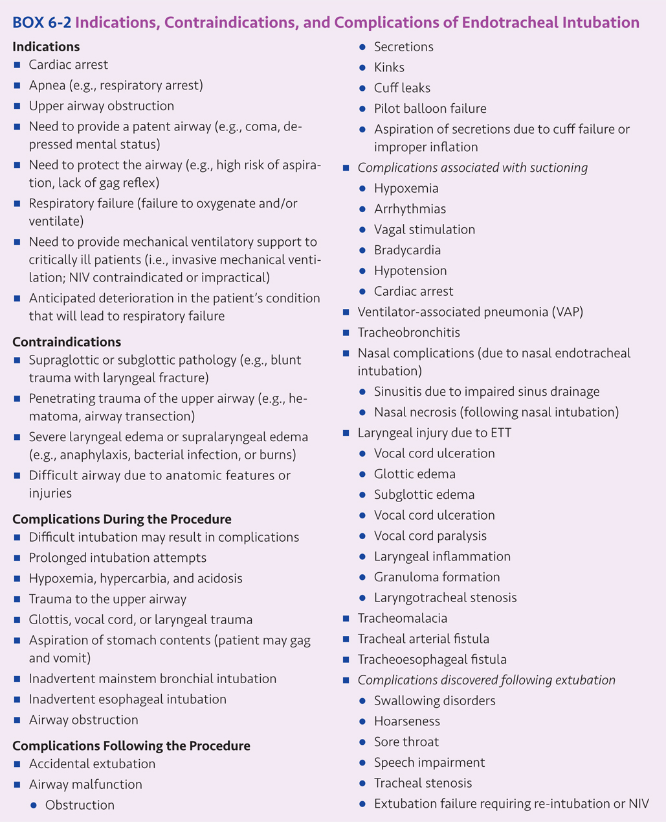

Slide 28
Rapid-sequence Intubation
Rapid-sequence intubation (RSI) – For emergency airway management
Indications for emergent intubation – Cardiac arrest, respiratory arrest, upper airway obstruction
Steps
Drug administration (induction agent and paralytic)
Equipment, supplies, and medications are gathered
Patient is prepared, positioned, and preoxygenated with 100% oxygen
Mouth is opened and laryngoscope is used to visualize the epiglottis and glottis

Slide 29
Rapid-sequence Intubation (cont’d)
Steps (cont’d)
Endotracheal tube (ETT) is inserted into the glottis and advanced past the vocal cords into the trachea
The endotracheal tube should be inserted at the appropriate depth (19-21 cm for females, 21-23 cm for males)
Equal and bilateral chest sounds as well as capnography color change should be present to confirm placement
Secure the tube and begin mechanical ventilation
Confirm proper placement with a chest x-ray
ETT should be located 2 – 5 cm above the carina

Slide 30
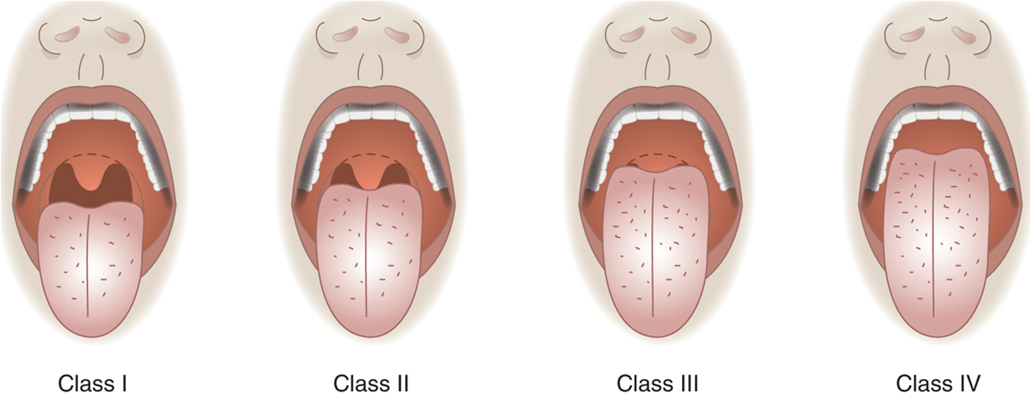
Figure 6.1

Slide 31
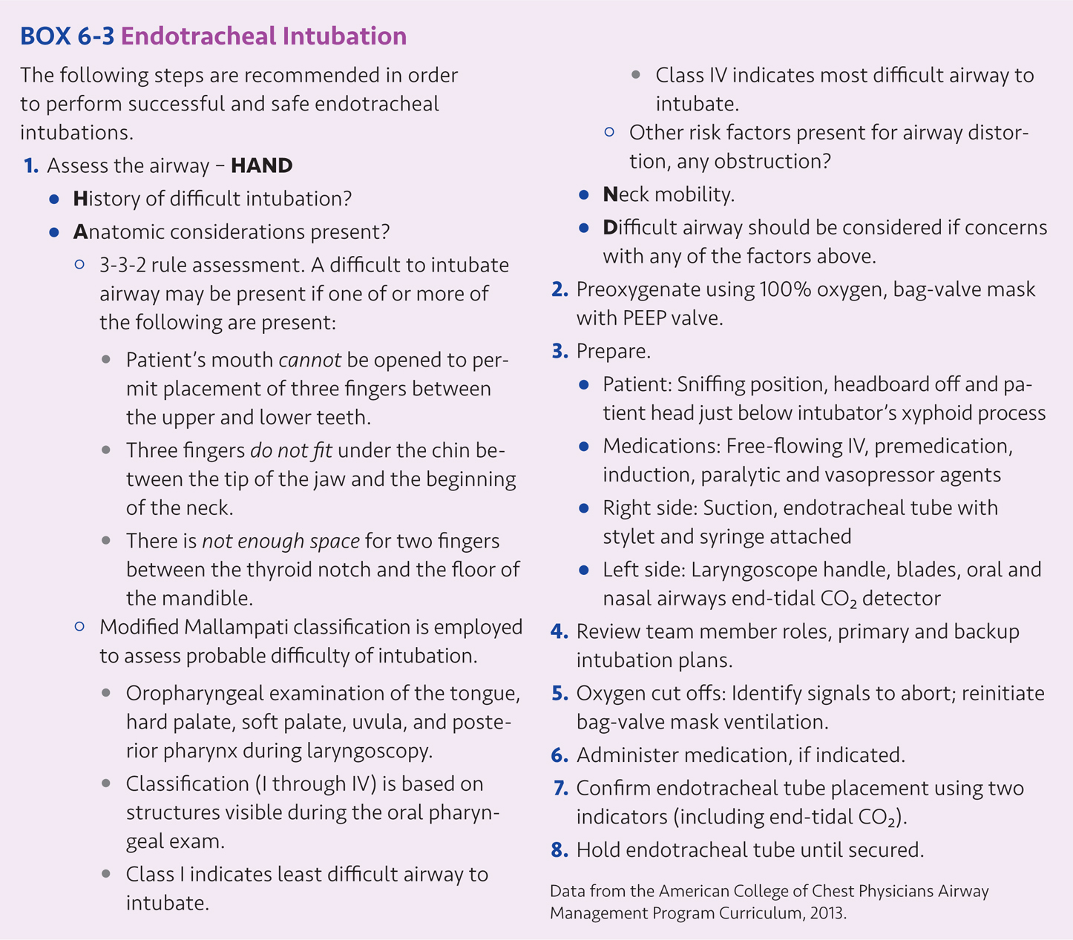

Slide 32
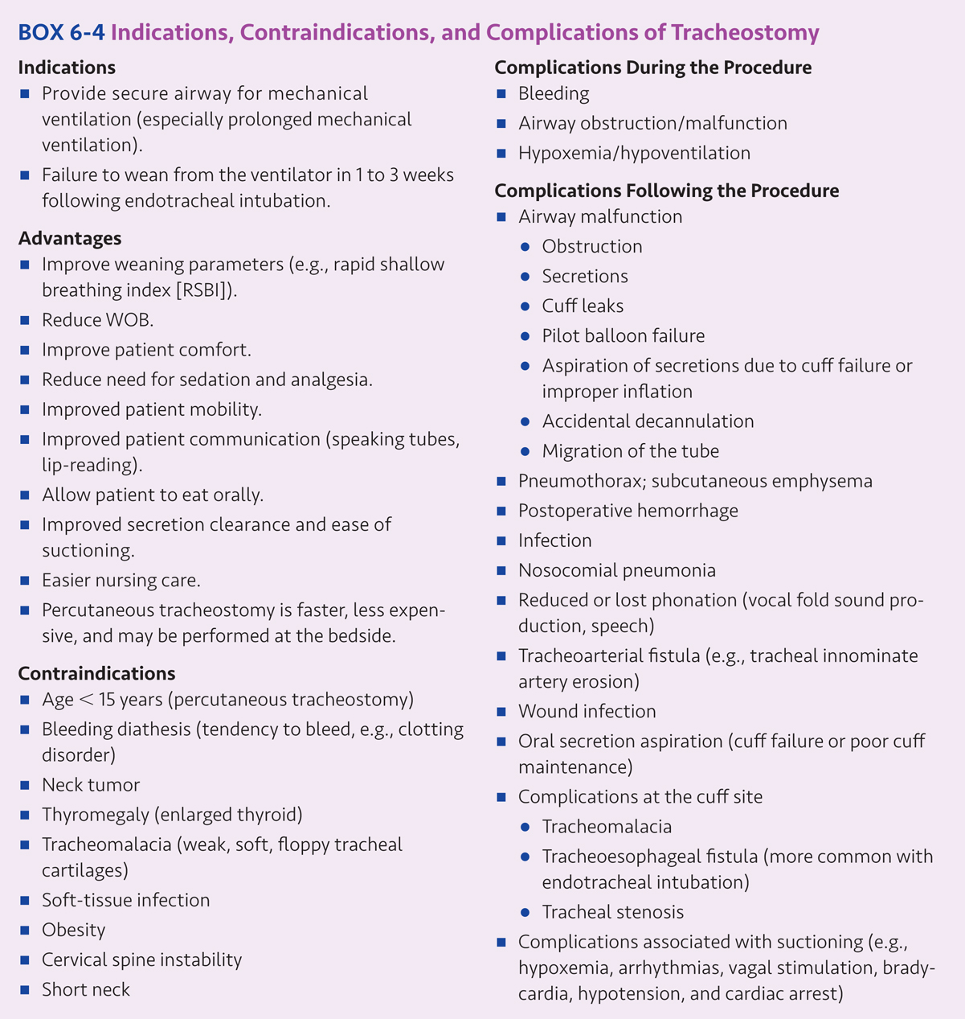

Slide 33
Choice of a Ventilator
Factors to consider
Patient’s needs
Goals to be achieved
Patient safety
Clinician’s familiarity with the ventilator
Reliability of the ventilator
Cost of the ventilator
Ventilator features

Slide 34
Choice of a Ventilator (cont’d)
Critical care ventilators available
Covidien Puritan Bennett (PB 840, PB 980)
Drager Evita (Evita XL, Evita Infinity, V500)
GE Healthcare CARESCAPE R860
Getinge Group Maquet Servo Ventilators (SERVO-s, SERVO-i, SERVO-u)
Hamilton Medical Ventilators (Hamilton G-5, Hamilton G-3)
Vyaire ventilators (AVEA, VELA)

Slide 35
Choice of a Ventilator (cont’d)
Other ventilators available
Comvidien Newport e360 Ventilator
Vyaire LTV 1200 and LTV 1150
Philips Respironics ventilators (V60, V200, BiPAP, Trilogy series)
Devilbiss ventilators (IntelliPAP, AutoBilevel, Bilevel S)
Vyaire 3100B Oscillator
Percussionaire VDR-4
Bunnell Life Pulse High Frequency Ventilator

Slide 36
Choice Of Mode
Mode is determined by the control variable (e.g., volume or pressure control), breath sequence (e.g., continuous or intermittent mandatory ventilation), and targeting scheme employed.
Within each mode, there are several variations that can be distinguished by their targeting schemes
The mode of ventilation can be further described by placing the targeting scheme subscripts after the basic mode description
For example: assist-control volume ventilation (aka volume control-continuous mandatory ventilation) with set-point breath targeting can be further described as VC-CMVs

Slide 37
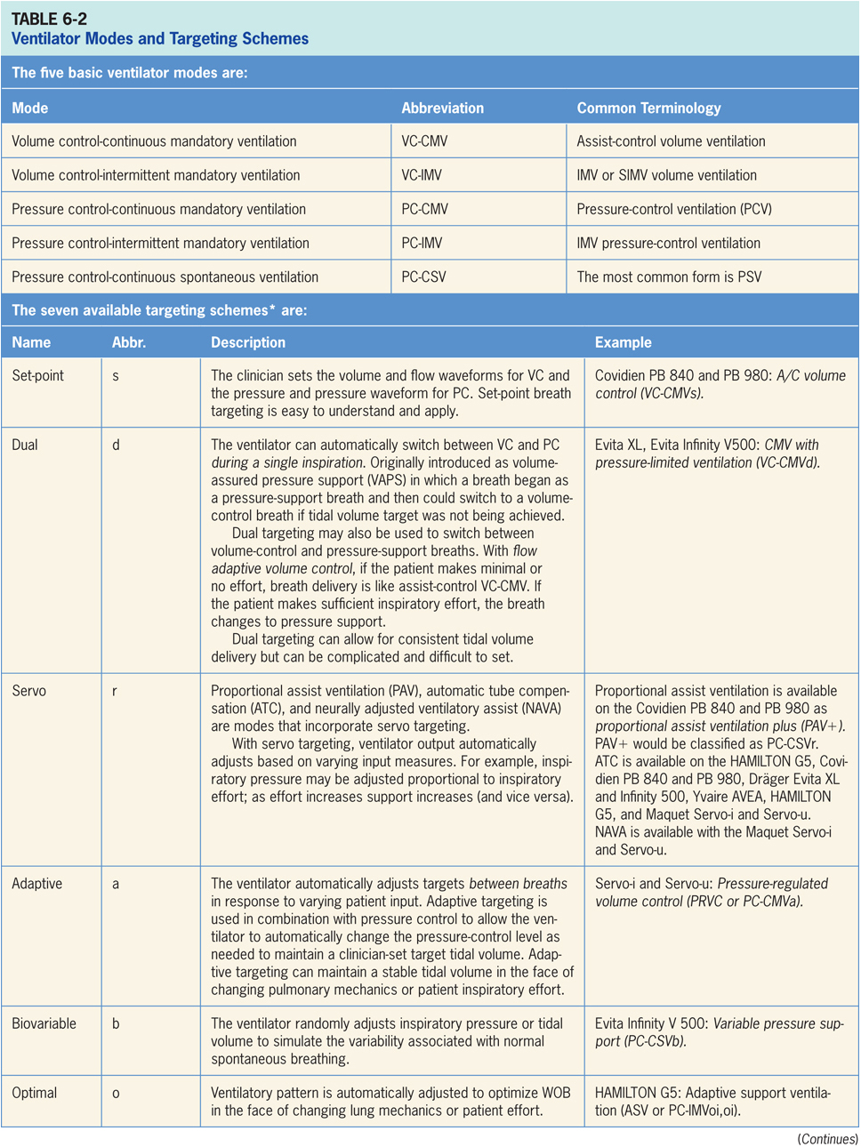

Slide 38
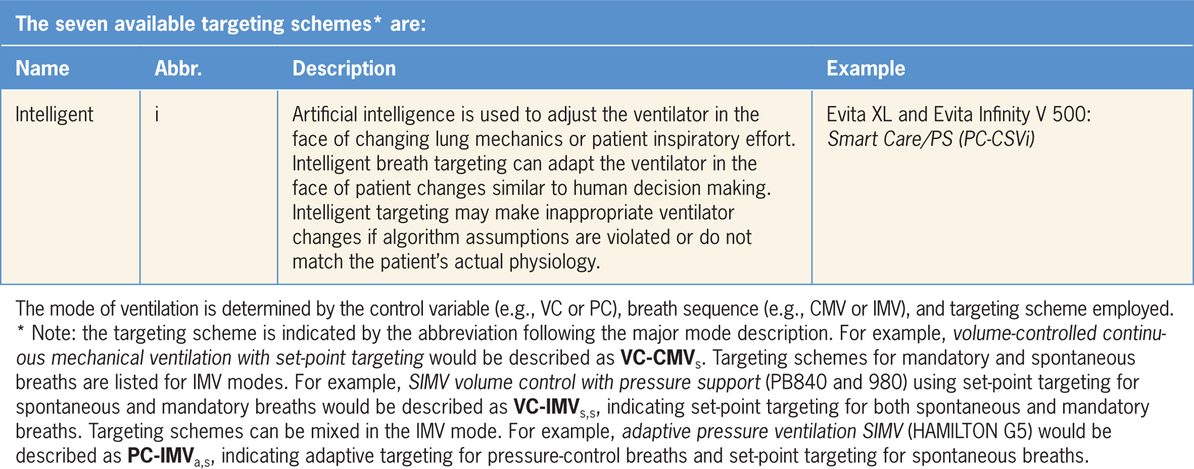

Slide 39
Full Ventilatory Support
Full ventilatory support provides 100% of the patient’s ventilatory needs
Available through volume or pressure controlled ventilation
Controlled ventilation refers to time-triggered continuous mandatory ventilation
Types: assist control volume ventilation, assist control pressure ventilation, volume SIMV, and pressure SIMV
Ventilator delivers adequate tidal volume, respiratory rate, and minute volume to minimize the amount of work required from the patient

Slide 40
Full Ventilatory Support (cont’d)
Spontaneously breathing patients in CMV mode are able to trigger the ventilator, and if the patient goes apneic, the ventilator will deliver a set tidal volume, respiratory rate, and minute volume
Indications: apnea, severe respiratory failure, increased WOB
Sedatives or neuromuscular blocking agents may be necessary for controlled ventilation
If paralytics are given, sedatives and analgesics should be given to ensure patient comfort
Common paralytics include: vercuronium, pancuronium, and cisatracurium

Slide 41
Partial Ventilatory Support
Partial ventilatory support requires the patient to continue to breathe spontaneously to maintain adequate alveolar ventilation but provides enough support required to maintain appropriate PaCO₂
Maintains ventilatory muscle function and reduces loss of ventilatory muscle strength
Advantages: Stabilization and recruitment of alveoli may occur, less sedation may be required, patient-ventilator synchrony may improve
Disadvantage: Adequate ventilatory muscle rest and recovery may not occur

Slide 42
Partial Ventilatory Support (cont’d)
Intermittent mandatory ventilation (IMV) / Synchronized intermittent mandatory ventilation (SIMV)
Setting mandatory respiratory rates < 8-10 breaths/min requires the patient to spontaneously breathe
Full ventilatory support may be provided if the mandatory rate, tidal volume, and minute ventilation meet the patient’s needs
Mandatory minute ventilation (MMV) and adaptive support ventilation (ASV) automatically adjust the level of ventilatory support based on the patient’s spontaneous minute ventilation
Other types: Pressure support ventilation (PSV), volume support (VS), proportional assist ventilation (PAV), and neutrally adjusted ventilatory assist (NAVA)

Slide 43
Major Modes of Ventilation
Volume control-continuous mandatory ventilation (VC-CMV)
Pressure control-continuous mandatory ventilation (PC-CMV)
Volume control-intermittent mandatory ventilation (VC-IMV)
Pressure control-intermittent mandatory ventilation (PC-IMV)
Pressure control-continuous spontaneous ventilation (PC-CSV)
VC-CMV and VC-IMV are the most frequently used forms of ventilation for adults.

Slide 44
Volume Control - Continuous Mandatory Ventilation
All breaths are mandatory; expiration to inspiration is patient or time triggered; inspiration to expiration is volume or time cycled
Clinician sets: desired tidal volume, minimum mandatory rate, inspiratory peak flow, inspiratory flow waveform, and trigger sensitivity
Other ventilators may set: desired tidal volume, mandatory rate, and inspiratory time or inspiratory percent time
Names vary by ventilator
A/C volume control: Covidien PB 840 and PB 980
VC-CMV: Dräger Evita XL and Evita Infinity V500
Synchronized CMV [(S)CMV]: Hamilton G5
VC: Maquet Servo-i and Servo-u

Slide 45
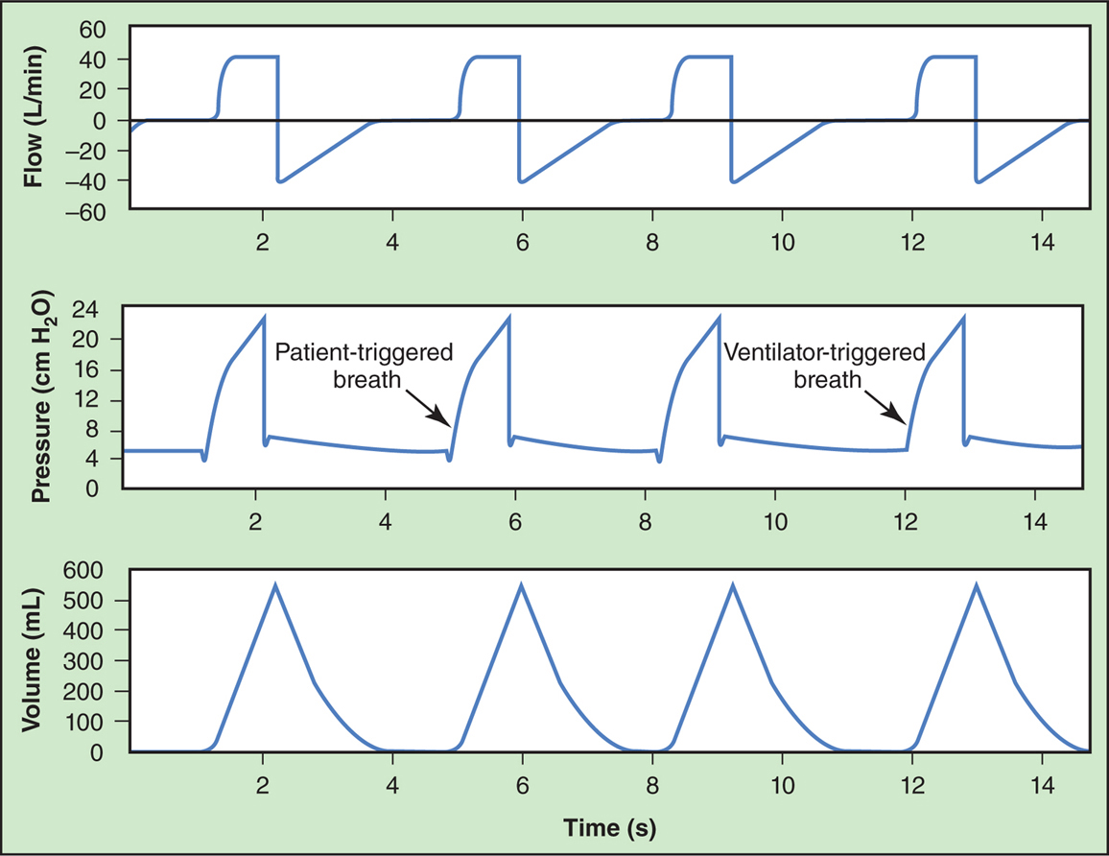
Figure 6.2

Slide 46
Volume Control - Continuous Mandatory Ventilation (cont’d)
Advantages
Tidal volume remains constant when changes in compliance and resistance are present
Guaranteed minimum minute ventilation delivered are based set on minimum frequency and tidal volume
Provides full ventilatory support
Minimizes or eliminates the patient’s WOB
Allows for ventilatory muscle rest and recovery from ventilatory muscle dysfunction
Flow waveform is adjustable on some ventilators
Mode is well suited for most patients

Slide 47
Volume Control - Continuous Mandatory Ventilation (cont’d)
Disadvantages
Unsafe PIPs may occur with reduced compliance or increased resistance as tidal volumes are maintained
Unsafe plateau pressures may occur with inappropriate tidal volume settings and or reduced lung compliance
Improper trigger sensitivity or inadequate ventilator flow rates may increase the patient’s WOB
Inspiratory flow rate is typically fixed and may result in patient-ventilator asynchrony
Inadequate expiratory times may result autoPEEP, particularly in patients with obstructive lung disease
Patient triggered breaths may result in increased WOB if the patient continues to actively inspire despite present ventilator support

Slide 48
Volume Control - Continuous Mandatory Ventilation (cont’d)
Disadvantages (cont’d)
High MAPs may reduce venous return and impede cardiac output in hemodynamically unstable patients
High pressures may result in barotrauma or ventilator-induced lung injury
Patients may trigger the ventilator at a rapid rate resulting in respiratory alkalosis, patient ventilator asynchrony, and increased peak and mean airway pressures
May be poorly tolerated in patients who are awake, anxious, or in pain
Ventilatory muscle weakness and atrophy is associated with controlled ventilation, or prolonged use of sedatives and neuromuscular blocking agents

Slide 49
Pressure Control - Continuous Mandatory Ventilation
All breaths are mandatory; expiration to inspiration is patient or time triggered; inspiration is pressure limited; inspiration to expiration is time cycled
Clinician sets: inspiratory pressure limit, minimum mandatory rate, inspiratory time (or inspiratory percent time), inspiratory rise time or ramp, and trigger sensitivity
As inspiratory time (T_{I}) increases, inspiratory flow to the patient decreases and tidal volume will generally increase until flow decreases to zero. When flow is zero, expiration will begin

Slide 50
Pressure Control - Continuous Mandatory Ventilation (cont’d)
Names vary by ventilator
A/C pressure control: Covidien PB 840 and PB 980
Pressure control ventilation plus assisted, CMV with autoflow and/or tube compensation: Dräger Evita XL
Pressure control assist-control, volume control assist-control with autoflow: Evita Infinity V500
Pressure control CMV with or without tube-resistance compensation, adaptive pressure ventilation CMV with or without tube-resistance compensation: Hamilton G5
Pressure control and pressure regulated volume control: Maquet Servo-i and Servo-u

Slide 51
Pressure Control - Continuous Mandatory Ventilation (cont’d)
Advantages
Inspiratory pressure remains constant when changes in compliance and resistance are present
Desired tidal volume can be achieved by adjusting pressure control level (PIP) or inspiratory time
Provides full ventilatory support
Minimizes or eliminates the patient’s WOB
Allows for ventilatory muscle rest and recovery from ventilatory muscle dysfunction

Slide 52
Pressure Control - Continuous Mandatory Ventilation (cont’d)
Advantages (cont’d)
Decreasing flow waveform varies based on patient’s inspiratory effort
Pressure control inverse ratio pressure control ventilation (PCIRV) has been suggested for severe hypoxemic respiratory failure where optimal PEEP and Fio₂ have been ineffective in providing adequate oxygenation
Mode is well suited for most patients

Slide 53
Pressure Control - Continuous Mandatory Ventilation (cont’d)
Disadvantages
Tidal volume varies when changes in patient effort, system compliance, or airway resistance are present
Increases in PEEP without increases in PIP will decrease ΔP and decrease delivered tidal volume
Increased PIP and P_{plat} may result in barotrauma or ventilator induced lung injury
No guaranteed minimum minute ventilation because tidal volume may vary
High MAPs may reduce venous return and impede cardiac output in hemodynamically unstable patients

Slide 54
Pressure Control - Continuous Mandatory Ventilation (cont’d)
Disadvantages (cont’d)
Improper trigger sensitivity or inadequate ventilator flow rates may increase the patient’s WOB
Excessive airway pressures may cause barotrauma or ventilator associated lung injury
Inadequate expiratory times may result in the development of autoPEEP and air trapping
May be poorly tolerated in patients who are awake, anxious, or in pain
Pressure control inverse ratio ventilation (PCIRV) will further increase mean airway pressure, may reduce venous return and cardiac output, and may reduce autoPEEP

Slide 55
Volume Control - Intermittent Mandatory Ventilation
Breaths can be mandatory; expiration to inspiration is patient or time triggered; inspiration to expiration is volume or time cycled
Breaths can be spontaneous; baseline pressure may be ambient or elevated (PEEP/CPAP); pressure support may be added; inspiratory pressure support is patient triggered, pressure limited, and flow cycled
Clinician sets: desired tidal volume, minimum mandatory rate, inspiratory peak flow, and trigger sensitivity for mandatory breaths and pressure support or automatic tube compensation for spontaneous breaths

Slide 56
Volume Control - Intermittent Mandatory Ventilation (cont’d)
Names vary by ventilator
SIMV volume control with pressure support or tube compensation: Covidien PB 840 and PB 980
SIMV with or without automatic tube compensation: Dr$\ddot{a}$ger Evita XL
Volume control SIMV: Evita Infinity V500, Maquet Servo-i and Servo-u
SIMV with or without tube resistance compensation: Hamilton G5
Automated modes providing VC IMV include:
Mandatory minute volume ventilation with or without automatic tube compensation
Mandatory minute volume ventilation with pressure-limited ventilation with or without automatic tube compensation

Slide 57
Volume Control - Intermittent Mandatory Ventilation (cont’d)
Advantages
Reduced mean airway pressures (may maintain cardiac output and blood pressure)
Maintenance of ventilatory muscle activity, strength, and coordination
Reduced need for sedation or paralytics
Improved patient-ventilator synchrony and patient tolerance
PSV or ATC may be added to overcome the WOB associated with endotracheal or tracheostomy tubes
Level of support ranges from full ventilatory support, to partial support, to no support
Development of auto PEEP may be less likely

Slide 58
Volume Control - Intermittent Mandatory Ventilation (cont’d)
Disadvantages
Increased WOB associated with endotracheal and tracheostomy tubes during spontaneous breathing
Spontaneous breathing with high ventilatory workloads may result in ventilatory muscle fatigue and dysfunction, prolonging need for ventilatory support
PSV or ATC will reduce WOB but increase MAP, which can reduce venous return and impair cardiac output
Ventilator weaning and discontinuance may be prolonged

Slide 59
Volume Control - Intermittent Mandatory Ventilation (cont’d)
Disadvantages (cont’d)
Hypoventilation or apnea may occur with partial ventilatory support, resulting in acute respiratory acidosis
Patients experiencing rapid shallow breathing may continue to make respiratory efforts during mandatory breaths, which will cause an increased WOB and patient-ventilator asynchrony
Some patients have difficulty adjusting to the ventilator and their spontaneous breathing patter may conflict with the ventilator settings

Slide 60
Pressure Control - Intermittent Mandatory Ventilation
Breaths can be mandatory or spontaneous; expiration to inspiration is patient or time triggered; inspiration is pressure limited, inspiration to expiration is time cycled
Breaths can be spontaneous; baseline pressure may be ambient or elevated (PEEP/CPAP); pressure support may be added; inspiratory pressure support is patient triggered, pressure limited, and flow cycled
Clinician sets: pressure control level, minimum mandatory rate, inspiratory time, inspiratory rise time, and trigger sensitivity for mandatory breaths and pressure support or automatic tube compensation for spontaneous breaths

Slide 61
Pressure Control - Intermittent Mandatory Ventilation (cont’d)
Names vary by ventilator
SIMV pressure control with pressure support or tube compensation: Covidien PB 840 and PB 980
PVC+ with pressure support of automatic tube compensation: Dr$\ddot{a}$ger Evita XL
Pressure control SIMV and pressure control SIMV+: Evita Infinity V500
Pressure control SIMV with pressure support of tube resistance compensation: Hamilton G5
Pressure control SIMV: Maquet Servo-i and Servo-u

Slide 62
Pressure Control - Intermittent Mandatory Ventilation (cont’d)
Advantages
Inspiratory pressure remains constant when changes in compliance and resistance are present
Desired tidal volume can be achieved by adjusting pressure control level (ΔP= PIP-PEEP), or inspiratory time
Decreasing flow waveform varies based on patient’s inspiratory effort, which may improve patient comfort and patient-ventilator synchrony

Slide 63
Pressure Control - Intermittent Mandatory Ventilation (cont’d)
Advantages (cont’d)
Square pressure waveform increases MAP and may improve distribution of inspired gases and oxygenation
MAP is typically lower with PC-IMV than PC-CMV
Provides full or partial ventilatory support, based on set mandatory rate
Spontaneous breathing maintains ventilatory muscle activity
Appropriately set pressure support minimizes or eliminates the patient’s WOB

Slide 64
Pressure Control - Intermittent Mandatory Ventilation (cont’d)
Disadvantages
PSV and ATC will increase MAP
High MAPs may reduce venous return and impede cardiac output in hemodynamically unstable patients
Too rapid rise times may result in a pressure spike in the beginning of inspiration
Tidal volume varies when changes in patient effort, system compliance, or airway resistance are present
Patients with rapid shallow breathing may have difficulty tolerating PC-IMV
Lower respiratory rates, sudden apnea, or hypoventilation may result in acute respiratory acidosis
May prolong the weaning process

Slide 65
Pressure Control - Continuous Spontaneous Ventilation
All breaths are spontaneous; patient triggered, pressure limited, flow cycled ventilation; baseline pressure may be ambient or elevated (CPAP), pressure support is provided during inspiration
All breaths are spontaneous; baseline pressure may be ambient or elevated (PEEP/CPAP); pressure support is added to inspiration to all breaths; breaths are patient triggered, pressure limited, and flow cycled
Types of PC-CMV include:
Pressure Support Ventilation (PSV)
Continuous Positive Airway Pressure (CPAP)

Slide 66
Pressure Support Ventilation (PSV)
Pressure augmentation is provided with each breath, allowing for variable respiratory rate, inspiratory flow, inspiratory time, and tidal volume
Automatic tube compensation (ATC): Overcomes the WOB caused by the endotracheal tube or tracheostomy tube during spontaneous breathing. Positive inspiratory pressure is automatically applied in proportion to the measured resistance of the artificial airway.
Can be used independently or in combination with CPAP during IMV and during spontaneous breathing trials (SBT)
Clinician sets: Trigger sensitivity, pressure support, inspiratory time, and flow termination

Slide 67
Pressure Support Ventilation (PSV) (cont’d)
Advantages
May improve patient-ventilatory synchrony and patient comfort
As pressure support increases, spontaneous tidal volume increases and WOB decreases
Often used during SBT to overcome WOB of the endotracheal tube or tracheostomy tube

Slide 68
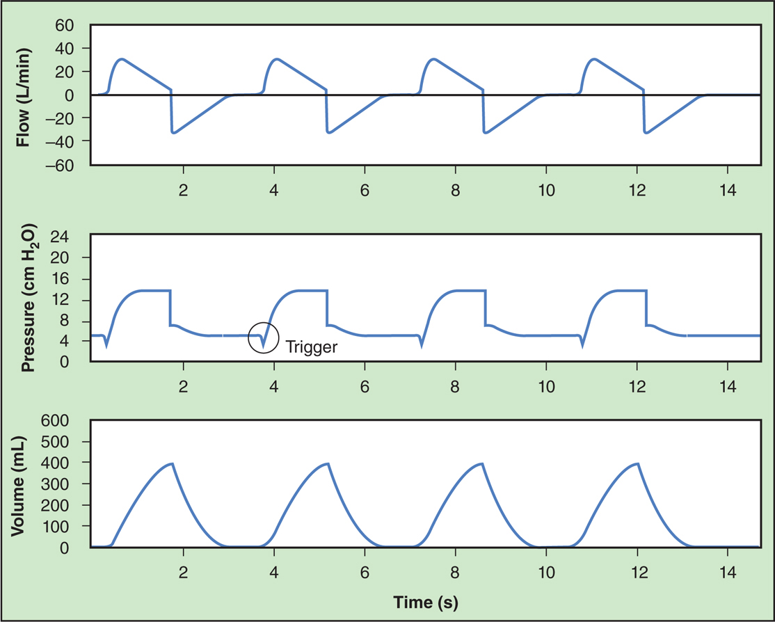
Figure 6.3

Slide 69
Continuous Positive Airway Pressure (CPAP)
Spontaneous breathing at a constant elevated pressure during inspiration and expiration
May be used during continuous spontaneous ventilation or in combination with IMV or PSV
CPAP can be provided through the ventilator or independently through a face mask with a high flow, blended and humidified gas source and a PEEP valve

Slide 70
Continuous Positive Airway Pressure (CPAP) (cont’d)
Advantages
May increase lung surface area for gas exchange, improve oxygenation, and help prevent alveolar collapse and atelectasis
Useful for maintaining alveolar recruitment for patients with acute restrictive lung disease
Often used for spontaneous breathing trials for evaluation of ventilator discontinuance and extubation
Can help maintain FRC in intubated patients
Disadvantages
CPAP increases MAP, mean intrathoracic pressure, and functional residual capacity (FRC)
Should be used cautiously in patients with obstructive lung disease or hemodynamic instability

Slide 71
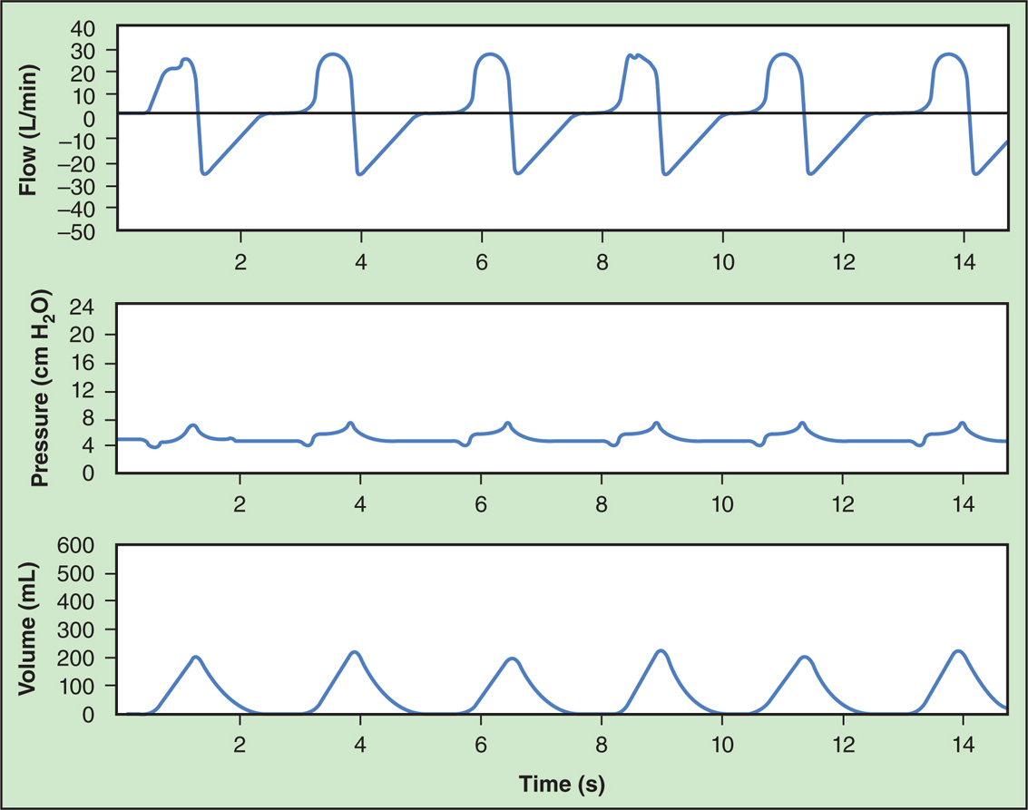
Figure 6.4

Slide 72
Other Modes of Ventilation
Adaptive Pressure Control
Pressure Regulated Volume Control
Volume Support
Mandatory Minute Ventilation
Adaptive Support Ventilation
Airway Pressure Release Ventilation
Proportional Assist Ventilation
Automode
Neurally Adjusted Ventilatory Assist
High Frequency Ventilation

Slide 73
Adaptive Pressure Control (APC)
Adaptive feedback mechanism for pressure control or pressure support
Clinician sets desired tidal volume, but the type of breath is pressure controlled or pressure supported
The ventilator automatically adjusts the pressure level breath-to-breath to achieve the target tidal volume
If the delivered tidal volume decreases, the ventilator will automatically increase the pressure provided
Names vary by ventilator
Pressure-regulated volume control (PRVC): Maquet Servo-i and Servo-u, AVEA
Autoflow: Dr$\ddot{a}$ger Evita XL and Evita Infinity V500
Volume control plus: Covidien PB 840 and PB 980
Adaptive pressure ventilation: Hamilton G5 and C3

Slide 74
Adaptive Pressure Control (APC) (cont’d)
Advantages
Tidal volume remains relatively constant when patient effort changes, or when changes in compliance or resistance are present
Many advantages of pressure control ventilation are applied, while maintaining a relatively stable tidal volume
Disadvantages
If patient demand and effort increases, producing larger than desired tidal volumes, the ventilator may provide inappropriate pressure control
PIPs and P_{plat} may increase as the ventilator attempts to automatically maintain a target tidal volume for changes in ventilatory mechanics or decreased patient effort
Increased patient effort may result in inappropriately decreased pressure support for patients in distress

Slide 75
Pressure Regulated Volume Control (PRVC)
Breaths are patient or time triggered
Form of APC which provides volume targeted pressure control breaths using an adaptive targeting scheme
Pressure is automatically adjusted in between breaths to reach the target tidal volume, based on varying compliance, resistance, or patient effort
Decreasing flow waveforms and square pressure waveforms are used
Clinician sets: desired target volume

Slide 76
Volume Support (VS)
All breaths are patient triggered, pressure limited, and flow cycled
Form of pressure control which provides volume targeted pressure control breaths using an adaptive targeting scheme
Pressure support is automatically adjusted breath-to-breath to achieve the desired tidal volume
Clinician sets desired tidal volume, but the type of breath is pressure controlled
Many advantages of pressure support ventilation are applied, while maintaining a relatively stable tidal volume

Slide 77
Mandatory Minute Ventilation (MMV)
Breaths are patient or time triggered
Older form of automated ventilation that compares the patient’s actual minute ventilation ($\dot{V}$e) to a targeted value and automatically increases or decreases the level of support provided
As the level of spontaneous ventilation increases, the ventilator reduces the amount of mandatory breaths delivered

Slide 78
Mandatory Minute Ventilation (MMV) (cont’d)
Advantages
Providing a more stable level of ventilation during IMV as the patient’s spontaneous breathing changes
Provides smooth, systematic, automated mode of weaning ventilatory support
Disadvantages
Patients may develop rapid shallow spontaneous breathing, which may result in a high minute ventilation but inadequate alveolar ventilation
Has not been shown to consistently improve ventilator weaning success as compared to newer techniques and has not been shown to improve other important patient outcomes

Slide 79
Adaptive Support Ventilation (ASV)
Breaths can be mandatory or spontaneous
Mandatory breaths: time triggered, pressure limited, and time cycled
Spontaneous breaths: patient triggered, pressure limited, and flow cycled
Closed-loop, automatic ventilation mode that combines pressure control IMV with pressure support to achieve a target minute ventilation
Target minute ventilation is calculated by the ventilator based on patient’s ideal body weight
Mandatory breaths: pressure control is automatically adjusted to achieve a specific tidal volume at a specific frequency

Slide 80
Adaptive Support Ventilation (ASV) (cont’d)
Spontaneous breaths: target tidal volume is based on respiratory system mechanics and target minute ventilation
Clinician sets: patient’s ideal body weight, high pressure limit, PEEP, Fio₂, rise time, flow cycle, percent of predicted minute ventilation, inspiratory pressure support level, and sensitivity
The ventilator automatically adjusts respiratory rate, pressure limit, and tidal volume to optimize the patient’s WOB to maintain the appropriate level of support based on calculated minute ventilation

Slide 81
Adaptive Support Ventilation (ASV) (cont’d)
Advantages
Can be effective for patients with acute respiratory failure
Provides a safe and effective method for automated ventilator weaning
Adjustments are made based on changing lung compliance and patient inspiratory effort
Disadvantages
Patients with conditions which extend expiratory time (e.g., COPD) may receive larger tidal volumes and lower frequencies as compared to patients with shorter expiratory time constants (e.g., ARDS)

Slide 82
Airway Pressure Release Ventilation (APRV)
Patients can spontaneously breath at two levels of pressure, which are time triggered and time cycled
High pressure promotes alveolar stabilization and alveolar recruitment for patients with hypoxemic respiratory failure
Low pressure aids in CO₂ removal, reduce mean airway pressures, and reduce the risk of cardiovascular compromise
Commonly used for patients with ARDS
Tidal volume provided by the ventilator is determined by the pressure gradient between the high pressure and low pressure settings, duration of high pressure, and patient’s pulmonary mechanics
P low → P high inflates the lungs
P high → P low allows the lungs to deflates

Slide 83
Airway Pressure Release Ventilation (APRV) (cont’d)
Clinician sets: high airway pressure, high pressure time, low airway pressure, and low pressure time
Names vary by ventilator
APRV: Dr$\ddot{a}$ger Evita XL, Evita Infinity V500
Bi-level: Covidien PB 840 and PB 980
APRV and DuoPAP: Hamilton G5
BiPhasic: Avea

Slide 84
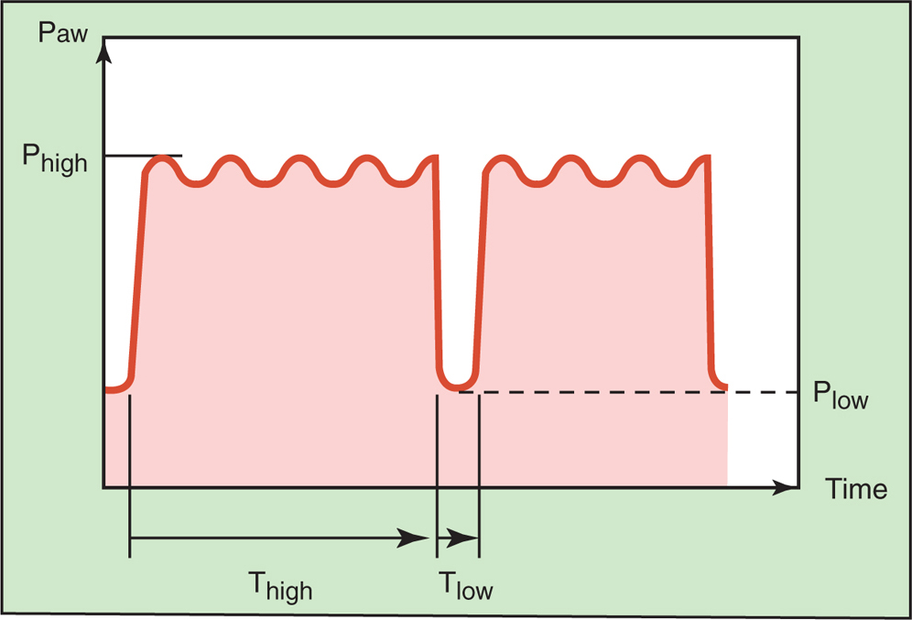
Figure 6.5

Slide 85
Airway Pressure Release Ventilation (cont’d)
Advantages
Decreases peak airway pressures, improves alveolar recruitment, oxygenation, and ventilation for ARDS patients
Spontaneous breathing may promote recruitment of dependent alveoli, improve gas change, and improve cardiac filling
Some evidence suggests APRV may decrease the need for sedation and paralytics, time on the ventilator, and length of ICU stay, compared to conventional approaches

Slide 86
Airway Pressure Release Ventilation (cont’d)
Disadvantages
Tidal volumes vary based on changing patient condition
Minimum minute ventilation is not guaranteed
Short expiratory times can result in auto PEEP
High MAPs may reduce venous return and impede cardiac output in hemodynamically unstable patients
Not indicated for use in patients with severe obstructive lung disease due to potential for air trapping and barotrauma
Has not been shown to improve mortality or other important outcomes as compared to other more conventional modes of ventilation

Slide 87
Proportional Assist Ventilation (PAV)
Automatically adjusts the level of ventilatory support based on estimated WOB and feedback measures associated with the neural output of the respiratory center
The ventilator calculates delivered volume and estimates resistance and compliance by applying a brief end-inspiratory pause and expiratory pause every few seconds
Inspiratory pressure is varied automatically depending on patient’s inspiratory effort, calculated WOB, and the clinician set percentage of support
Advantages: Patient-ventilator synchrony and patient comfort may be improved

Slide 88
Proportional Assist Ventilation (PAV) (cont’d)
Disadvantages: Automatic minimal support level is not provided, alarms and back up ventilation modes must be activated in the event of apnea, calculated WOB may not reflect patient effort, not useful in patients with weak ventilatory drive or weak respiratory muscles
Names vary by ventilator
Spontaneous proportional assist: Covidien PB 840 and PB 980
Spontaneous proportional pressure support: Dr$\ddot{a}$ger Evita V500
Proportional pressure support: Phillips Respironics V60

Slide 89
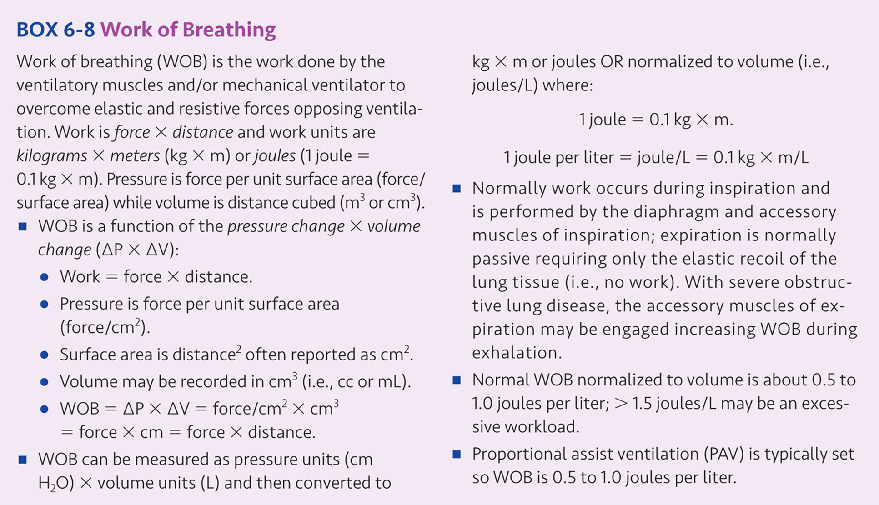

Slide 90
Automode
Form of IMV that incorporates a targeting scheme for both primary and secondary breaths based on the modes selected
IMV is used to synchronized mandatory and spontaneous breaths by automatically switching between two modes of ventilation based on specific feedback measures
The ventilator automatically titrates the level of support provided between control and support modes dependent on the patient’s level of spontaneous ventilation

Slide 91
Automode (cont’d)
Automode can be set to titrate the level of ventilation provided between the following modes:
Volume control (VC) and volume support (VS). Used in this fashion, automode can be classified as VC-IMVd,a using dual targeting for VC and adaptive targeting for VS.
Pressure Control (PC) and Pressure Support (PS). Used in this fashion, automode can be classified as PC-IMVs,s using set-point targeting for PC and PS.
Pressure-regulated Volume Control (PRVC) and Volume Support (VS). Used in this fashion, auto mode can be classified as PC-IMVa,a using adaptive targeting for both PRVC and VS

Slide 92
Neurally Adjusted Ventilatory Assist (NAVA)
An esophageal catheter with a multiple array electrode detects the electrical discharge from the diaphragm (Edi), which reflects the respiratory center’s neural output to the diaphragm
The diaphragmatic signal is used to trigger, adjust flow, and cycle the ventilator
Tidal volume varies breath to breath in proportion to the patient’s inspiratory demand
As NAVA level increases, inspiratory pressure and tidal volume will increase
If the catheter signal is lost, the ventilator will automatically switched to a conventional, patient-triggered pressure support mode
Clinician sets: NAVA level, inspiratory pressures should match the pressures from conventional ventilation

Slide 93
Neurally Adjusted Ventilatory Assist (cont’d)
Advantages
May improve patient-ventilator asynchrony
Neural-ventilatory coupling (time between the spontaneous breath and the delivery of a mechanical breath) should improve trigger synchrony and cycle synchrony
Useful for COPD patients
Disadvantages
Expensive
Esophageal catheter is invasive, uncomfortable, and may be displaced

Slide 94
Neurally Adjusted Ventilatory Assist (cont’d)
Contraindications
Patients unable to spontaneously breathe
Heavy sedation or respiratory center depression
Spinal cord injury or brain center damage
Absent phrenic nerve activity
Neuromuscular transmission problems or blockade
Lung transplant patients (may not have an intact vagal reflex)

Slide 95
High-frequency Ventilation (HFV)
Very small tidal volumes are delivered at very rapid respiratory rates ( > 60 - 3,000 breaths/min)
Used for neonatal, pediatric, and adults as a lung protective strategy
Primarily serves as a rescue mode in adults for patients with severe ARDS who have failed to respond to conventional ventilation

Slide 96
High-frequency Ventilation (HFV) (cont’d)
Suggested use for: bronchopleural fistula, tracheoesophageal fistula, neonatal respiratory distress syndrome (RDS), burns with inhalational injury, and head trauma with increased intracranial pressure (ICP).
Types
High-frequency positive pressure ventilation (HFPPV)
High-frequency percussive ventilation (HFPV)
High-frequency jet ventilation (HFJV)
High-frequency oscillatory ventilation (HFOV)

Slide 97
Types of High-frequency Ventilation
High-frequency positive pressure ventilation (HFPPV)
Used for adults
Tidal volumes: 100-200 mL
Frequency: 60-120 breaths/min
Can be accomplished with current conventional ventilators
Effective for patients with large air leaks

Slide 98
Types of High-frequency Ventilation (cont’d)
High-frequency percussive ventilation (HFPV)
Used for burn patients with inhalation injury to maintain lower peak airway pressures, facilitate clearance of soot and secretions, and for reinflation of collapsed alveoli
Small tidal volumes
Frequency: 200-900 beats per/min
May improve oxygenation and ventilation
Reduces risk of barotrauma and hemodynamic compromise
Promotes secretion clearance
May reduce incidence of pneumonia and ICPs in patients with head injuries

Slide 99
Types of High-frequency Ventilation (cont’d)
High-frequency jet ventilation (HFJV)
Commonly used for preterm neonates with RDS
Tidal volume is dependent on amplitude, jet driving pressure, jet orifice size, length of inspiratory jet time, and patient’s compliance and resistance
Frequencies: 240 - 660 cycles/min
Constant gas flow interrupters that are time cycled and pressure limited
Clinician sets: PIP, jet frequency, and inspiratory jet valve time
Used in conjunction with a conventional ventilator, which provides, Fio₂, PEEP, and 2-10 sigh breaths/min

Slide 100
Types of High-frequency Ventilation (cont’d)
High-frequency oscillatory ventilation (HFOV)
Used for preterm neonates in respiratory failure, as a rescue therapy in the case of high PIPs or MAPs, or for adults with ARDS who have refractory hypoxemia and have failed to respond to conventional mechanical ventilation
Very small tidal volumes: 50 - 250 mL
Very high frequencies: 180 - 900 cycles/min ( 3-15 Hz, where 1 Hz = 60 cycles/min)
Rapid oscillating bias flow is delivered to the patient
Relatively high mean alveolar pressures with minimal fluctuation
Most commonly used form of high-frequency ventilation for neonates and adults

Slide 101
Initial Ventilator Settings
Mechanical ventilatory support can be invasive or noninvasive
An appropriate ventilator must be available based on the patient’s needs, and the expertise and experience of the respiratory care clinician
The clinician must first choose the mode of ventilation
Next, the tidal volume, respiratory rate, breath trigger, inspiratory pressures, flows, time, PEEP, and Fio₂ should be appropriately set
Humidification, alarms, limits, and backup apnea ventilation should be selected

Slide 102
Mode
Initial mode for critically ill adult and pediatric patients should be volume-control continuous mandatory ventilation (VC-CMV)
An alternative mode to VC-CMV is pressure-control continuous mandatory ventilation (PC-CMV)
A third alternative for spontaneously breathing patients with an intact respiratory drive is pressure support ventilation (PSV)
SIMV may also be used to provide volume control-intermittent mandatory ventilation (VC-IMV) or pressure control-intermittent mandatory (PC-IMV) for patients with rapid spontaneous respiratory rates

Slide 103
Tidal Volume and Rate
Initial tidal volume (Vt) = 8 mL/kg IBW
Normal adult resting spontaneous Vt = 5-7 mL/kg of ideal body weight (IBW)
Tidal volume should be adjusted to maintain P_{plat} ≤ 28-30 cm H₂O
ARDS patients may require smaller tidal volumes to maintain appropriate plateau pressures
Neuromuscular disease patients may require larger tidal volumes to prevent atelectasis
Initial respiratory rate (f) = 12-16 breaths/min
Normal adult f = 12-18 breaths/min

Slide 104
Tidal Volume and Rate (cont’d)
Normal adult minute ventilation ($\dot{V}$e) is 5-10 L/min
Minute ventilation ($\dot{V}$e) = Vt × f
ARDSNet protocol for calculating IBW (or predicted body weight, PBW)
Males: IBW = 50 + 2.3 (height in inches - 60)
Females: IBW = 45.5 + 2.3 (height in inches - 60)

Slide 105
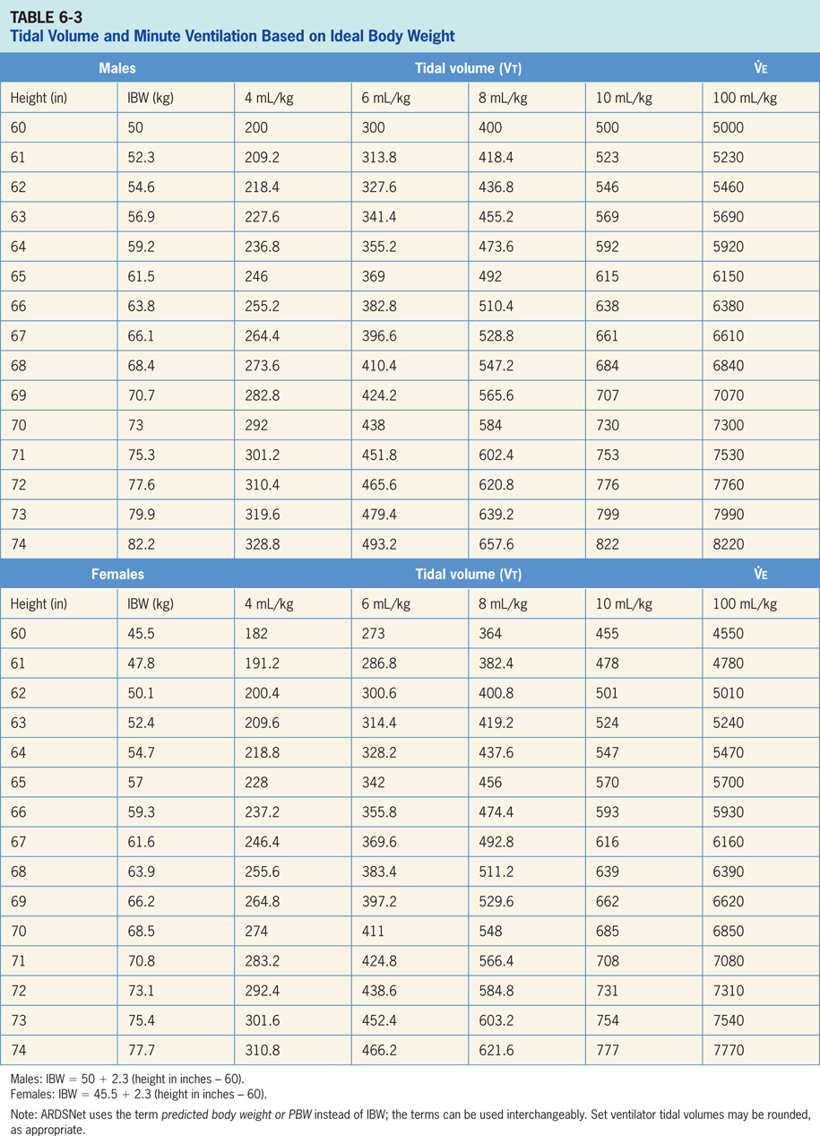

Slide 106
Pressure
Initial pressure control (PC) = 12-15 cm H₂O above PEEP
Observe resultant tidal volume and titrate pressure setting until adequate tidal volumes are achieved
Monitor and maintain P_{plat} ≤ 28-30 cm H₂O
Initial pressure support (PS) = 12-15 cm H₂O above PEEP
Observe resultant tidal volume and titrate pressure setting until adequate tidal volumes are achieved
Tidal volumes should be 4-8 mL/kg IBW, resulting in patient triggered respiratory rate of ≤ 25 breaths/min

Slide 107
Pressure (cont’d)
PIP should remain less than 40 cm H₂O
Reduce PIP by decreasing set tidal volume, peak inspiratory flow, and changing the inspiratory flow waveform from a square waveform to a decelerating ramp
P_{plat} should remain less than 28-30 cm H₂O
ARDS patients: reduce P_{plat} by decreasing set tidal volume
Neuromuscular disease patients: increase P_{plat} by tidal volumes to prevent atelectasis

Slide 108
Intermittent Sigh Breaths
Normal spontaneously breathing subjects take an intermittent deep breath or sigh every 6-10 minutes
Monotonous, shallow tidal breathing without an intermittent deep breath may cause progressive atelectasis and intermittent deep breaths will reverse this trend
Traditionally, sigh breaths were set at 1.5-2 times the tidal volume to be delivered every 6-10 minutes
Now, it is recommended that almost all patients receive a minimal level of PEEP to prevent atelectasis and eliminate the need for intermittent sigh breaths
Recruitment maneuvers are sometimes used for patients with ARDS and function similarly to an intermittent sigh

Slide 109
Breath Trigger
Patient triggered breaths may be (negative) pressure or flow triggered
Pressure trigger: patient inspiratory effort decreases the ventilator circuit pressure to a clinician selected level which triggers inspiration
Typically set between -0.5 and -1.5 cm H2O
Flow trigger: constant flow of gas during the expiratory phase is disrupted by the patient’s inspiratory effort which triggers inspiration
Typically set between 1 and 2 L/min below the baseline or bias flow
Trigger sensitivity should be adjusted to minimize trigger work while avoiding autotriggering
Trigger asynchrony occurs when the patient’s inspiratory effort becomes decoupled from the ventilator trigger
Inappropriate trigger sensitivity can increase WOB

Slide 110
Peep and CPAP
PEEP and CPAP restores FRC, improves and maintains lung volumes, and improves oxygenation
Should be considered in patients with inadequate arterial oxygen levels (Pao₂ < 60 mm Hg, Sao₂ < 0.90) on moderate to high oxygen concentrations (Fio₂ ≥ 0.40)
ARDS patients benefit from PEEP due to stabilization of lung units and the prevention of repetitive alveolar inflation and deflation
Useful in offsetting autoPEEP and reducing trigger work
Should be used cautiously in patients with obstructive lung disease
Approaches to using PEEP
Minimal PEEP
Optimal or best PEEP
Compliance titrated PEEP
Use of pressure-volume curves

Slide 112
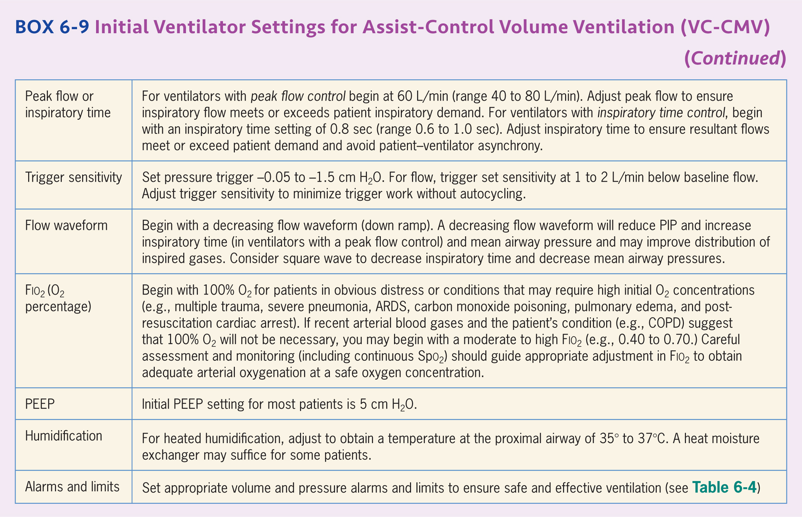

Slide 113
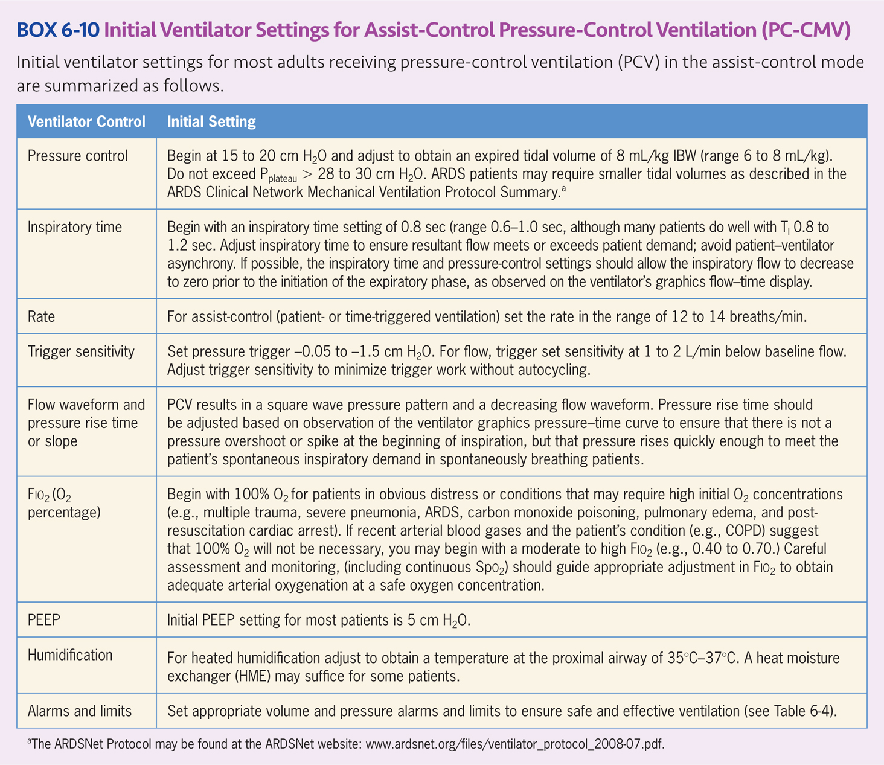

Slide 114
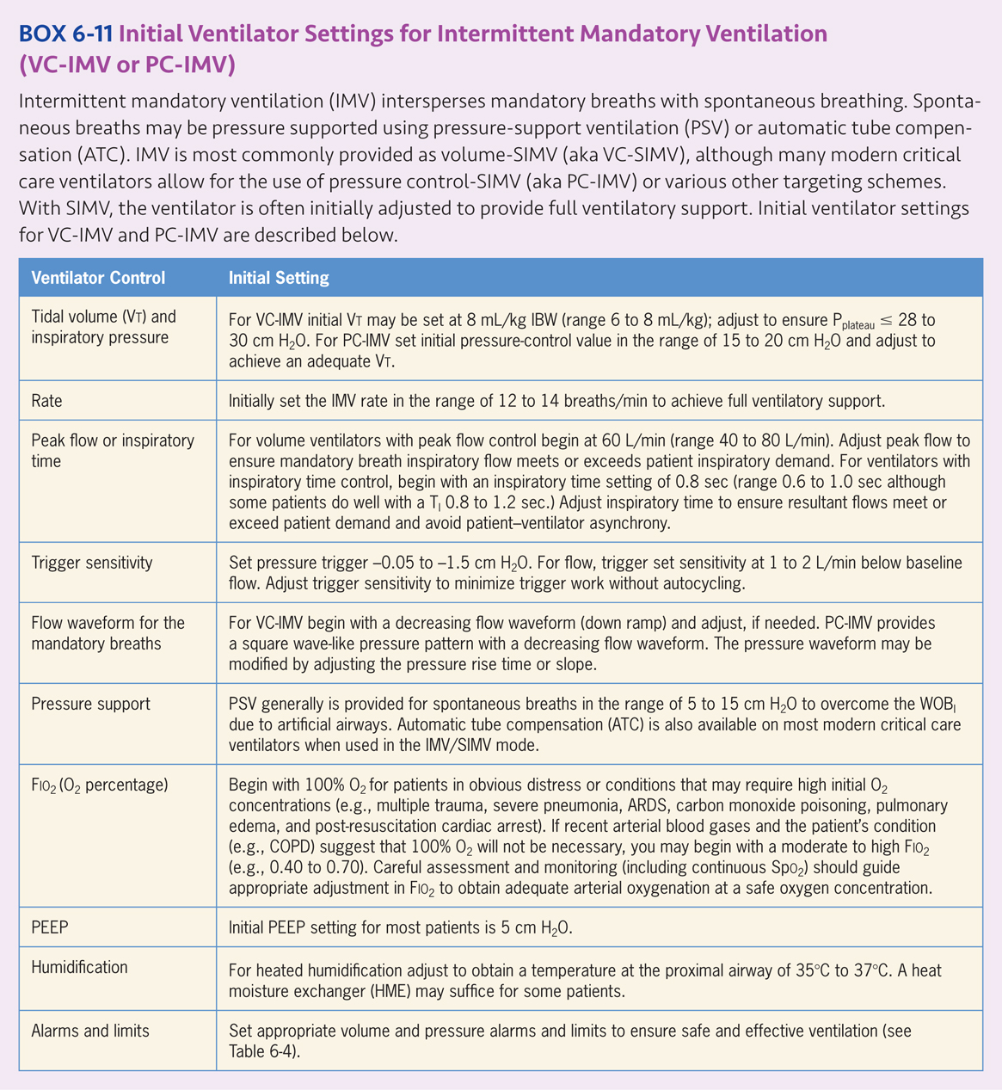

Slide 115
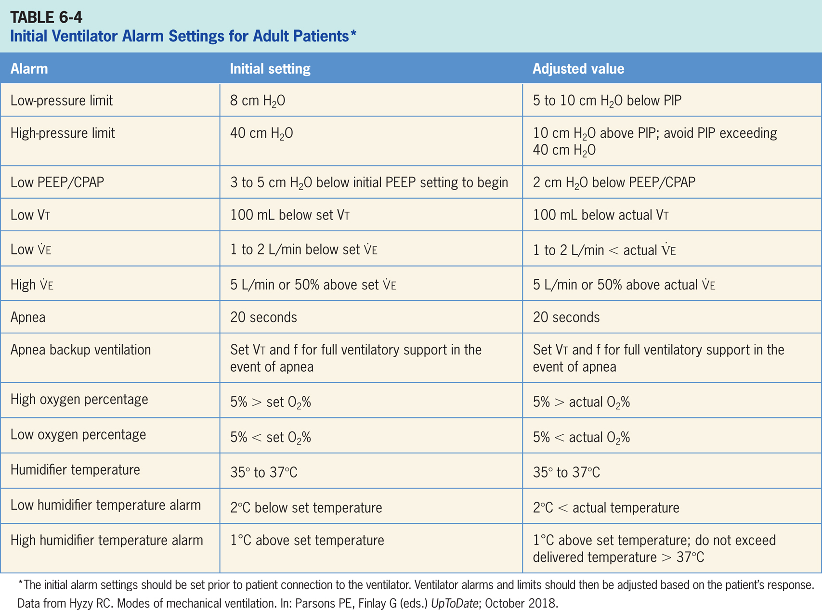

Slide 116
Humidification
Should be provided for all patients receiving invasive mechanical ventilatory support
Clinical practice guidelines suggest an inspired gas temperature of 35○C ± 2○ C to provide humidity of 33 to 44 mg H2O/L at the patient Y connection
Heat and moisture exchangers (HME) may be appropriate for some patients
HME’s should not be used for:
Patients receiving low tidal volumes, as they add additional mechanical dead space
Patients on noninvasive ventilation

Slide 117
Assessment
Following initiation of mechanical ventilation, the patient and patient-ventilator system should be carefully assessed
Patient assessment should include: physical assessment, breath sounds, oximetry, heart rate, blood pressure and observation of the cardiac monitor for cardiac rhythm.
Patient-ventilator assessment should include: assessment of ventilatory pressures, volumes, and flows
Arterial blood gases should be obtained following initial patient stabilization
Following assessment, appropriate ventilatory adjustments should be made to ensure patient safety, comfort, oxygenation, and ventilation

Slide 118
Management of Specific Disease States and Conditions
Asthma
Lower tidal volumes should be used to reduce airway pressures and avoid barotrauma
P_{plat} should be maintained ≤30 cm H₂O
Expiratory time should allow for complete exhalation in the presence of airway obstruction
Respiratory rate = 10-12 breaths/min and peak inspiratory flow= 60-80 L/min should be used
PEEP may be set at ≤ 5 cm H₂O or at 50-80% of measured autoPEEP, if present
Paralytics may be required to control ventilation and permissive hypercapnia

Slide 119
Management of Specific Disease States and Conditions (cont’d)
Acute Exacerbation of COPD
Noninvasive ventilation may be used in the presence of acute respiratory acidosis
Inspiratory pressure: 8-20 cm H₂O
End expiratory pressure: 3-5 cm H₂O
Patients who are unable to tolerate NIV may require mechanical ventilation
Initial settings: Assist-control volume ventilation, Vt = 6-8 mL/kg IBW, f = 10-12 breaths/min, inspiratory flow 60-80 L/min
Lower tidal volumes (6 mL/kg), lower rates (8-10) and higher initial peak flow (≥ 80 L/min or inspiratory time of 0.6-0.80 sec) may be necessary to allow for sufficient expiratory time

Slide 120
Management of Specific Disease States and Conditions (cont’d)
Patients who are unable to tolerate NIV may require mechanical ventilation (cont’d)
P_{plat} should be maintained ≤30 cm H₂O
Moderate Fio₂ (0.40-0.50) will often suffice
Patients who rapidly trigger the ventilator in the assist-control mode may do well with SIMV
SIMV settings: Vt, inspiratory peak flow, and Ti should be set at values similar to those used for assist-control volume ventilation, and pressure support (5-10 cm H₂O) and PEEP (3-5 cm H₂O) should be added

Slide 121
Management of Specific Disease States and Conditions (cont’d)
Severe Pneumonia
Mechanical ventilation may be necessary in pneumonia patients with severe respiratory failure to maintain oxygenation, ventilation, and acid-base balance
Assist-control volume ventilation or volume SIMV with pressure support will be effective for most patients
Initial settings: Vt = 8 mL/kg IBW, f = 14-16 breaths/min, peak inspiratory flow= 60 to 80 L/min, and inspiratory time= 0.6-0.8 sec
Begin Fio₂ at 1.0 and PEEP of 5 cm H₂O. Fio₂ and PEEP are then titrated to achieve an adequate arterial oxygenation at a safe Fio₂
P_{plat} should be maintained ≤30 cm H₂O

Slide 122
Management of Specific Disease States and Conditions (cont’d)
Acute Respiratory Distress Syndrome (ARDS)
Assist-control volume ventilation (aka VC-CMV) or assist-control pressure control ventilation (aka PC-CMV) generally is effective
Initial settings: Vt = 8 mL/kg IBW, respiratory rate is adjusted to achieve adequate minute ventilation
Tidal volume is progressively reduced to 7 mL/kg and then to 6 mL/kg over the next one to three hours.
As tidal volume is reduced, respiratory rate is increased to maintain minute ventilation. Respiratory rate may be adjusted up to 35 breaths/min

Slide 123
Management of Specific Disease States and Conditions (cont’d)
Acute Respiratory Distress Syndrome (ARDS) (cont’d)
Begin Fio₂ at 1.0 and PEEP at 5 to 8 cm H₂O
Fio₂ and PEEP are then titrated to achieve an adequate arterial oxygenation at a safe Fio₂
Other strategies to improve oxygenation include recruitment maneuvers, pressure control inverse ratio ventilation, and prone positioning
P_{plat} should be maintained ≤30 cm H₂O

Slide 124
Management of Specific Disease States and Conditions (cont’d)
Neuromuscular Disease
Mechanical ventilatory support is sometimes required in patients with neuromuscular disease
NIV can often be effective in these patients and should be considered
Assist-control volume ventilation or volume SIMV with pressure support will be effective for most patients
Initial settings: Vt = 8-10 mL/kg IBW, f = 12-16 breaths/min, peak inspiratory flow= 60 to 80 L/min, and inspiratory time= 0.6-0.8 sec, with a down ramp waveform

Slide 125
Management of Specific Disease States and Conditions (cont’d)
SIMV settings: Vt, inspiratory peak flow, and T_{I} should be set at values similar to those used for assist-control volume ventilation, and pressure support (5 cm H₂O) and PEEP (5 cm H₂O) should be added
Begin Fio₂ at 0.40-0.50
An Fio₂ of 1.0 may be necessary for a patient in distress or if oximetry or blood gases suggest the need for a high initial oxygen concentration

Slide 126
Summary
Indications for mechanical ventilation include apnea, acute ventilatory failure, impending ventilatory failure, and severe oxygenation problems.
Mechanical ventilatory support may be provided using NIV or invasive ventilation requiring endotracheal intubation or tracheostomy. Mechanical ventilation is usually initiated to provide full ventilatory support; partial ventilatory support modes may be appropriate in certain circumstances.
Conventional modes of ventilation include assist-control volume ventilation, also known as volume-control-continuous mandatory ventilation (VC-CMV); assist-control pressure control ventilation, also known as pressure control-continuous mandatory ventilation (PC-CMV) and intermittent mandatory ventilation (IMV/SIMV).

Slide 127
Summary (cont’d)
There are also a large number of alternative modes that have been used to safely and effectively provide ventilatory support to critically ill patients. While these newer modes may have theoretic advantages, none has been shown to consistently improve patient outcomes as compared to more conventional approaches.
Ventilator initiation requires important choices, including whether to provide invasive or noninvasive ventilation, type of airway or ventilator interface and whether to provide full or partial ventilatory support.

Slide 128
Summary (cont’d)
The respiratory care clinician must also select the mode of ventilation and specific ventilator to be employed and the initial ventilator settings. These include initial pressures, volumes, and flows provided, as well as oxygen concentration, PEEP/CPAP, humidification, and ventilator alarms and limits.
Careful patient observation, and assessment must follow ventilator initiation and appropriate adjustments should be made.
The goal is to ensure safe, comfortable, support that achieves adequate tissue oxygenation, alveolar ventilation, and acid-base homeostasis while minimizing the WOB.

Slide 129
Key Points
The primary function of a mechanical ventilator is to augment or replace normal ventilation.
The four major indications for mechanical ventilation are apnea, acute ventilatory failure, impending ventilatory failure, and severe oxygenation problems.
The major goals of mechanical ventilation are to provide adequate alveolar ventilation, ensure adequate tissue oxygenation, restore and maintain acid-base balance, and reduce the work of breathing.
The tank ventilator or iron lung was developed by Drinker, McCann, and Shaw at Harvard University in 1928 and saw widespread use as the Emerson iron lung during the polio epidemics in the 1940s and 50s.

Slide 130
Key Points (cont’d)
Negative pressure ventilators maintain the natural airway, which allows patients to talk and eat; however, it is difficult access the patient for procedures, bathing, or turning and are they are large, bulky and difficult to maneuver.
The most common trigger variables are time and patient effort (i.e., patient triggered).
The common types of patient triggers are flow-trigger and pressure-trigger.
Commonly used terms include assist breath, which is patient-triggered, control breath, which is time triggered and assist-control, which can be patient- or time-triggered.

Slide 131
Key Points (cont’d)
Controlled ventilation refers to time-triggered ventilation and requires apnea.
Cycle variables include volume, pressure, flow and time.
With volume control ventilation a constant tidal volume is delivered; however, inspiratory pressure varies with changes in the patient’s compliance and resistance.
With pressure control ventilation a constant inspiratory pressure is delivered; however, tidal volume varies with changes in the patient’s compliance, resistance, and inspiratory effort.

Slide 132
Key Points (cont’d)
Pressure support ventilation (PSV) is patient triggered, pressure limited, and flow cycled.
Pressure control ventilation (PCV) may be time or patient triggered and is pressure limited and time cycled.
With continuous mandatory ventilation (CMV), every breath is a mandatory breath.
With intermittent mandatory ventilation (IMV) mandatory breaths are interspersed with spontaneous breaths.
With continuous spontaneous ventilation (CSV) the patient initiates and terminates each breath; however, inspiratory pressure augmentation may be provided (e.g., PSV or automatic tube compensation [ATC]).

Slide 133
Key Points (cont’d)
Noninvasive ventilation (NIV) may indicated for patients with acute exacerbation of COPD with hypercapnic at acidosis, cardiogenic pulmonary edema, and acute hypoxemic respiratory failure.
NIV may also be useful to prevent post-extubation respiratory failure and in the support of patients with chronic hypoventilation due to neuromuscular or chest wall disease.
NIV should not be used in patients with cardiac or respiratory arrest, hemodynamic or cardiac instability, or severely impaired consciousness.

Slide 134
Key Points (cont’d)
Indications for endotracheal intubation include the inability to maintain a patent airway, inability to protect the airway against aspiration, failure to ventilate, failure to oxygenate, and anticipation of deterioration in the patient’s condition that will lead to respiratory failure.
Endotracheal intubation is the most common method to achieve invasive ventilatory support; however, tracheostomy should be considered in certain patients.
Factors that should be considered when choosing a ventilator include clinical goals, the patient’s needs, availability, reliability, ventilator features, alarms and monitoring capabilities, modes available, cost, and (most importantly) clinician’s familiarity with the ventilator.

Slide 135
Key Points (cont’d)
Explain each of the following terms used to define the mode of ventilation employed: control variable, breath sequence, and targeting scheme.
Explain methods for providing full and partial ventilatory support and contrast advantages and disadvantages of each.
Define each of the five major modes of ventilation and explain the advantages and disadvantages of each.
Explain the use of other modes of ventilation to include adaptive pressure control, (APC), mandatory minute ventilation (MMV), adaptive support ventilation (ASV), airway pressure release ventilation (APRV), proportional assist ventilation (PAV), automode, neutrally adjusted ventilatory assist (NAVA) and high-frequency ventilation.

Slide 136
Key Points (cont’d)
The mode of ventilation can be described by the control variable, breath sequence, and targeting scheme employed.
Common control variables are pressure control (PC) and volume control (VC) for the primary breath.
With full ventilatory support, adequate alveolar ventilation is achieved even if the patient makes no spontaneous breathing efforts.
Partial ventilatory support requires the patient to provide a portion of the work needed to maintain an acceptable PaCO₂.
High airway pressures may result in barotrauma or VILI.

Slide 137
Key Points (cont’d)
The five major modes of ventilation are VC-CMV, PC-CMV, VC-IMV, PC-IMV, and PC-CSV. These modes may be supplemented with PEEP or CPAP.
Advantages of VC-CMV include constant tidal volume delivery in the face of changes in compliance and resistance, provision of full ventilatory support, and reduced or eliminated work of breathing; however, unsafe airway pressures may result.
Advantages of PC-CMV include a constant inspiratory pressure in the face of changes in compliance and resistance, allowing for maintenance of a safe P_{plat} ≤ 28 to 30 cm H₂O.

Slide 138
Key Points (cont’d)
IMV incorporates spontaneous breathing, which maintains ventilatory muscle activity and may help maintain ventilatory muscle strength and coordination.
IMV may be used to provide full or partial ventilatory support; IMV may delay weaning as compared to spontaneous breathing trials (SBTs).
Pressure control inverse ratio ventilation (PCIRV) is a form of PC-CMV that may improve oxygenation in patients with acute, severe hypoxemia that is unresponsive to conventional ventilation.
Automatic tube compensation (ATC) is designed to overcome the imposed work of breathing due to an endotracheal or tracheostomy tube during spontaneous breathing.

Slide 139
Key Points (cont’d)
CPAP may help maintain FRC and improve oxygenation in spontaneously breathing patients.
Adaptive pressure control (APC) automatically adjusts pressure control or pressure support levels to achieve the desired tidal volume.
Pressure-regulated volume control (PRVC) and volume support (VS) are considered forms of APC.
Mandatory minute ventilation (MVV) automatically adjust the level of support provided to achieve a target minute ventilation.
Adaptive Support Ventilation (ASV) automatically adjusts respiratory rate and inspiratory pressure to deliver the desired minute ventilation and minimize the work of breathing.

Slide 140
Key Points (cont’d)
Airway pressure release ventilation (APRV) allows for two levels of CPAP that are time triggered and time cycled.
Proportional assist ventilation (PAV) automatically adjusts the level of ventilatory support based on the patient’s inspiratory effort, calculated work of breathing and clinician set percentage of support to be provided.
Auto mode is a form of IMV that incorporates a targeting scheme for both primary and secondary breaths based on the modes selected.

Slide 141
Key Points (cont’d)
Neurally adjusted ventilatory assist (NAVA) uses the electrical discharge from the diaphragm to trigger and cycle ventilator breaths.
High-frequency ventilation uses small tidal volumes and very high respiratory rates; possible indications include ARDS, bronchopleural fistula, and air leaks.
There are currently four major types of HFV: high-frequency positive pressure ventilation (HFPPV), high-frequency percussive ventilation (HFPV), high-frequency jet ventilation (HFJV) and high-frequency oscillatory ventilation (HFOV)

Slide 142
Key Points (cont’d)
Assist-control volume ventilation, also known as VC-CMV is a good initial mode choice for most patients.
An acceptable alternative to assist-control volume ventilation is assist-control pressure control ventilation (also known as PC-CMV); this mode requires careful attention to the delivered tidal volume.
Pressure support ventilation (PSV) can be used as the primary mode of ventilation when patients have a consistent, stable, spontaneous ventilatory pattern.

Slide 143
Key Points (cont’d)
Assist-control volume ventilation, also known as VC-CMV is a good initial mode choice for most patients.
An acceptable alternative to assist-control volume ventilation is assist-control pressure control ventilation (also known as PC-CMV); this mode requires careful attention to the delivered tidal volume.
Pressure support ventilation (PSV) can be used as the primary mode of ventilation when patients have a consistent, stable, spontaneous ventilatory pattern.

Slide 144
Key Points (cont’d)
SIMV is a serviceable option for initial ventilator setup, although it is used less commonly.
Initial tidal volume (adults) may be set in the range of Vt 6 to 8 mL/kg IBW with the rate of 12 to 16 breaths/min; smaller tidal volumes and faster rates may be required for some ARDS patients.
Tidal volume should be adjusted to ensure that P_{plateau} ≤ 28 to 30 cm H₂O with a peak inspiratory pressure (PIP) < 40 cm H₂O.
Intermittent sigh breaths have been used in the past to prevent development of atelectasis; routine use of PEEP may eliminate the need for an intermittent sigh.

Slide 145
Key Points (cont’d)
Patient-triggered breaths may be negative pressure or flow triggered; trigger sensitivity should be set to minimize trigger work while avoiding autotriggering.
Most modern ventilators allow for the adjustment of rise time and expiratory sensitivity during PSV.
An inspiratory pause allows for the measurement of the plateau pressure (P_{plateau}) and calculation of compliance and resistance.
I:E ratio should be 1:2 or lower for most patients.

Slide 146
Key Points (cont’d)
In general, the safest option for initial oxygen concentration is 100%.
PEEP/CPAP may improve and maintain lung volumes and improve oxygenation in patients with acute restrictive pulmonary disease.
Initial PEEP/CPAP of 5 cm H₂O is appropriate for most patients.

Slide 147
Key Points (cont’d)
Ventilator alarms and limits are to ensure patient safety and should be adjusted to alert ICU personnel that the patient-ventilator system should be assessed.
Heated humidification should be provided at 35○C ± 2○ C; heat and moisture exchangers (HME) may be appropriate for some patients.
A careful assessment should be done immediately following ventilator initiation and appropriate ventilator adjustments should be made to ensure patient safety, comfort and effective gas exchange.

