Slide 1
Chapter 4: Section V Neonatal Ventilators Dräger Babylog VN500 Smiths Medical Pneupac BabyPAC 100 Vyaire Infant Flow SiPAP

Slide 2
Dräger Babylog VN500 Neonatal Ventilators
Babylog VN500 ventilator (Figure 4-61) is intended for ventilation of neonatal patients from 0.4 kg (0.88 lbs) up to 10 kg (22 lbs) and pediatric patients from 5 kg (11 lbs) up to 20 kg (44 lbs) bodyweight.³⁸
Consists of a flat panel touch screen, buttons and a control dial to change and confirm settings and settings are entered by pressing a button on the touch screen to select the parameter to be changed, then the control dial is turned to select the new value, and then control dial is pressed to confirm. (depicted in Figure 4-62)

Slide 3
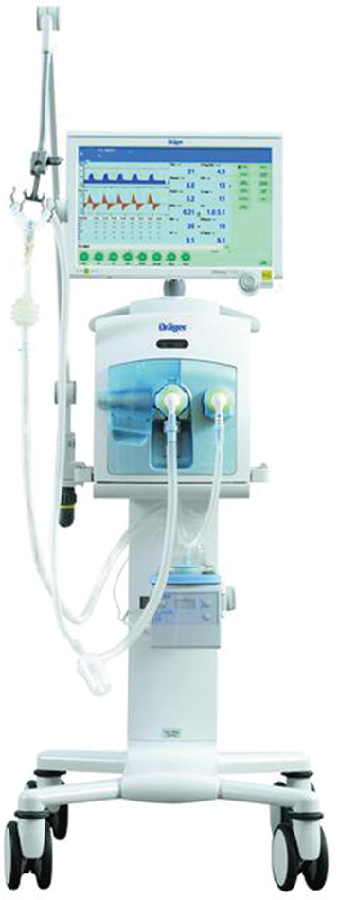
Figure 4.61

Slide 4
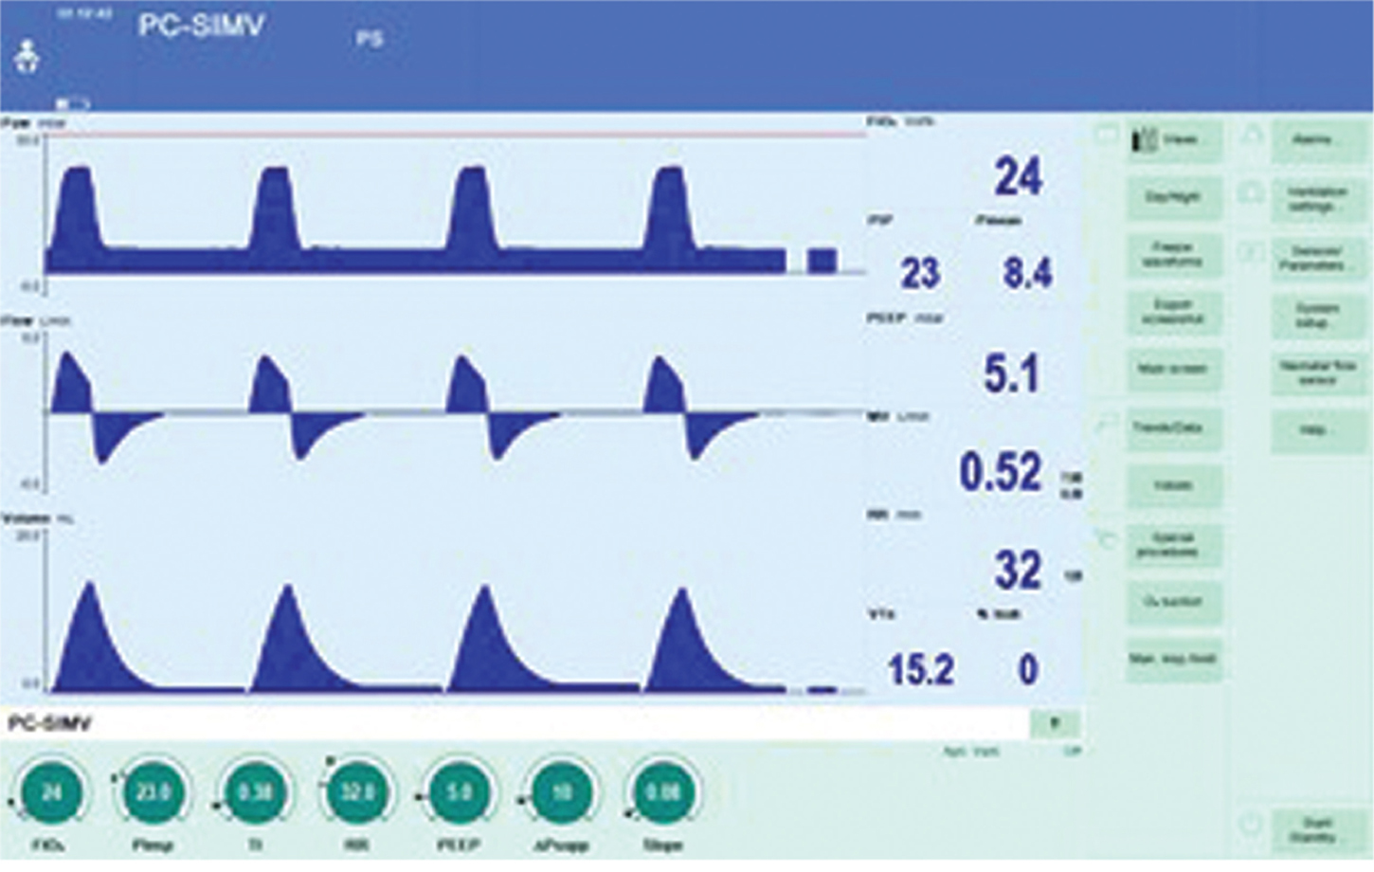
Figure 4.62

Slide 5
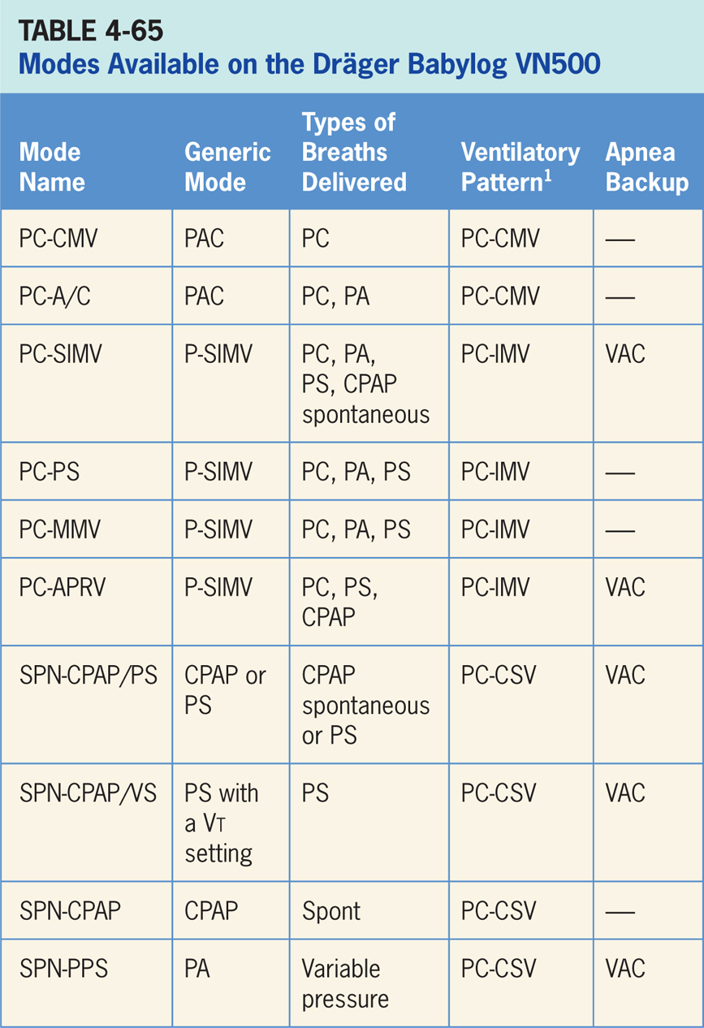

Slide 6
Pressure Control-continuous Mandatory Ventilation (PC-CMV)
Pressure-targeted mode of ventilation allowing for mandatory, time-triggered breaths only (patient-assisted breaths not allowed).³⁸
Spontaneous breathing is permitted during entire respiratory cycle through an “open” system.
Mandatory breaths cycle to exhalation once inspiratory time has been reached or when high-pressure alarm is tripped.

Slide 7
Main Operator Controls Include:
Fio₂
PEEP
Inspiratory pressure level (P_{insp})
Inspiratory time
RR
Vt – if volume guarantee is switched on
The pressure will be consistently delivered from breath to breath if the volume guarantee is switched off.³⁸ Vt and flow are variable and will depend on the inspiratory pressure level, patient effort, and patient respiratory system mechanics. If volume guarantee is turned on, Vt will be consistent while P_{insp} will vary to meet Vt target.

Slide 8
Pressure Control-A/C (PC-A/C)
Pressure-targeted mode of ventilation allowing for mandatory, time-triggered breaths or patient-assisted breaths.³⁸
Spontaneous breathing can occur during mandatory breaths.
Breath cycles to exhalation once inspiratory time has been reached or when the high-pressure alarm is tripped.

Slide 9
Main Operator Controls Include:
PEEP
Inspiratory pressure level (P_{insp})
Inspiratory time
RR
Vt – if volume guarantee is switched on
Pressure will be consistently delivered from breath to breath if volume guarantee is switched off.³⁸ Vt and flow are variable, and that will depend on inspiratory pressure level, patient effort, and patient respiratory system mechanics. If volume guarantee is turned on, Vt will be consistent while P_{insp} will vary to meet Vt target.

Slide 10
Pressure Control-synchronized, Intermittent Mandatory Ventilation (PC-SIMV)
Pressure-targeted mode that combines two breath types, PAC and either PS or spontaneous breathing, while on CPAP.³⁸
Combination of mandatory, time-triggered breaths, patient-assisted breaths, and spontaneous breaths.
Ventilator prevents “breath stacking” (a PAC breath compounded by a PS breath) through the use of a “timing window.”
If patient attempts to trigger a breath in timing window, then ventilator will deliver a PAC breath.
If patient attempts to trigger a breath outside window, then a spontaneous breath will occur. Spontaneous breathing allowed throughout entire respiratory cycle.

Slide 11
Main Operator Controls Include:
Fio₂
PEEP
Inspiratory pressure level (P_{insp})
Inspiratory time
SIMV rate
Vt – if the volume guarantee is switched on
Pressure support level
During PAC breaths, resulting Vt created is variable and depends on inspiratory pressure level, patient effort, and patient respiratory system mechanics.³⁸ If volume guarantee is turned on the Vt will be consistent while P_{insp} will vary to meet Vt target.
During PS breaths, volume will be variable and depend on PS level, patient effort, and patient respiratory system mechanics.

Slide 12
Pressure Control-pressure Support Ventilation (PC-PSV)
Pressure-targeted mode in which patient triggers all breaths and receives set pressure.³⁸
Breath cycles to expiration when inspiratory flow decreases below a preset percentage of inspiratory peak flow.

Slide 13
Main Operator Controls Include:
Fio₂
PEEP
Maximum inspiratory time
Pressure support level
Vt – if the volume guarantee is switched on
Vt will be variable and depend on PS level, patient effort, and patient respiratory system mechanics.³⁸ If the volume guarantee is turned on, Vt will be consistent while P_{insp} will vary to meet Vt target.

Slide 14
Pressure Control-mandatory Minute Volume Ventilation (PC-MMV)
Pressure-targeted mode guarantees the patient receives a set Vt during mandatory breaths and at least the set minute volume MV.³⁸
Patient can always breathe spontaneously at PEEP level (with or without pressure support).
If spontaneous breathing of patient is insufficient to achieve set minute ventilation, mandatory breaths are applied.
Mandatory breaths are synchronized with patient’s own breathing attempts.

Slide 15
Main Operator Controls Include:
Fio₂
PEEP
Vt
RR
Inspiratory time
PS level
Mandatory breaths should produce a consistent Vt while P_{insp} varies.³⁸ During PS breaths, volume will be variable and depend on PS level, patient effort, and patient respiratory system.

Slide 16
Pressure Control-airway Pressure Release Ventilation (PC-APRV)
Mode of ventilation allowing for spontaneous breathing at two different clinician-set pressure levels.³⁸
Ventilator switches between two different clinician-set pressure levels (the lower of which can be CPAP).
Pressure levels are referred to as P_{high} and P_{low}. T_{high} is length of time at P_{high} and T_{low} is the length of time spent at P_{low}. PC-APRV is mainly used in an inverse I:E ratio.
Important difference from pressure-targeted modes is the P_{high} level is now referenced to atmosphere as to the P_{low}.
Important: increases in P_{low} will decrease the distending pressure.

Slide 17
Main Operator Controls Include:
PEEP
Fio₂
P_{high}
P_{low}
T_{high}
T_{low}
Vt will be variable and depend on P_{high}, P_{low}, patient effort, and patient respiratory system mechanics.³⁸

Slide 18
Spontaneous-continuous Positive Pressure/Pressure Support (SPN-CPAP/PS)
Patient regulates the respiratory rate and Vt with support from ventilator.³⁸
Patient triggers all breaths and will receive clinician-set PS level. If a pressure support level > 0 cm H₂O is set, the breath cycles to expiration when the inspiratory flow decreases below a preset percentage of the inspiratory peak flow.

Slide 19
Main Operator Controls Include:
PEEP
Fio₂
Pressure support level
Vt will be variable and depend on PS level, patient effort, and patient respiratory system mechanics.³⁸ If PS level is set to 0, all breaths will be unsupported.

Slide 20
Spontaneous-continuous Positive Airway Pressure/Volume Support (SPN-CPAP/VS)
Ventilator delivers a variable (from breath to breath) PS level in order to reach a clinician-set Vt.³⁸
Ventilator changes PS level as needed to reach Vt.
Ventilator drops level of support as patient effort increases and conversely increases PS level when patient effort is too low.

Slide 21
Main Operator Controls Include:
PEEP
Fio₂
Vt target
Vt may not match operator setting due to the ventilator is using PS to target the Vt as to VAC and relies on the previous breaths to make the calculation.³⁸ Any change in patient effort from previous breath may result in a deviation from Vt setting.

Slide 22
Spontaneous-continuous Positive Airway Pressure (SPN-CPAP)
Only available in NIV and is designed only for neonatal population.³⁸
Patient regulates respiratory rate and Vt with support from ventila.

Slide 23
Main Operator Controls Include:
PEEP
Fio₂
T_{maninsp} (manual inspiration time)
P_{maninsp} (manual inspiration pressure)
Vt will be variable and depend on patient effort, and patient respiratory system mechanics.³⁸

Slide 24
Spontaneous-proportional Pressure Support (SPN-PPS)
Babylog VN500 supports patient's spontaneous breathing in proportion to the inspiratory effort.³⁸
If patient breathes strongly, the ventilator will support this effort with high-pressure support. If patient has shallow breathing, ventilator responds with low-pressure support.
Mechanical support is omitted altogether if there is no spontaneous breathing.

Slide 25
Main Operator Controls Include:
PEEP
Volume assist
Flow assist
Vt and pressure are variable and will depend on: vol. assist setting, flow assist setting, patient effort, and patient respiratory system mechanics.³⁸
Amount of pressure and flow delivered will be variable and depend on Vt setting, patient effort, and patient respiratory system.³⁸

Slide 26
Apnea Ventilation Special Features
Babylog VN500 detects an apnea when no expiratory flow is measured or insufficient inspiratory gas is delivered during set apnea alarm time (T_{apn}).³⁸
If apnea ventilation is activated, device starts volume-guaranteed SIMV with the RR and Vt set by the clinician.
Inspiratory time for apnea ventilation is determined from the set apnea respiratory rate and a fixed I:E ratio of 1:2.
Apnea ventilation is available in the following modes: PC-SIMV, PC-APRV, SPN-CPAP/PS, SPN-CPAP/VS and SPN-PPS.

Slide 27
Automatic Tube Compensation
When automatic tube compensation is activated, ventilator calculates the pressure drop from the proximal to the distal end of ETT and ventilation pressure in breathing circuit is increased during inspiration or decreased during expiration.³⁸
Airway pressure is adjusted to the tracheal level if 100 % compensation of tube resistance has been selected.
Clinician has to input ETT diameter and length.

Slide 28
Nebulizer
Babylog VN500 uses a gas mixture to drive medication nebulizer that is designed to minimize deviations from the set Fio₂.³⁸
Medication nebulizer nebulizes continuously.

Slide 29
Noninvasive Ventilation
For pediatric patients, NIV is available in every mode except SPN-CPAP.³⁸
For neonates, NIV is only available in SPN-CPAP and PC-CMV.

Slide 30
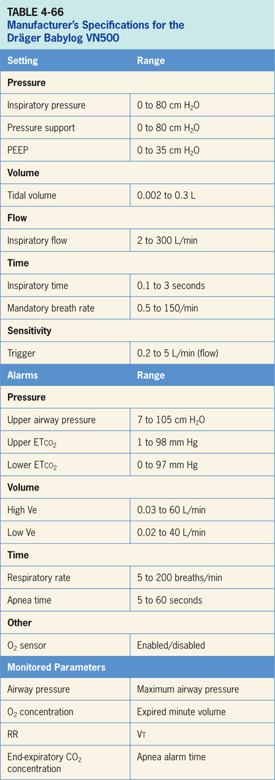

Slide 31
Smiths Medical Pneupac BabyPAC 100
BabyPAC 100 ventilator is a gas and battery powered, time cycled, pressure generator which depends solely on the pressure of supply gas for its operation (Figure 4-63).³⁹
Consists of a control module with a conventional Y patient circuit and ventilator has been rated MRI compatible up to 3 Tesla.
BabyPAC 100 portable ventilator is designed for use in and outside hospitals.
For ventilation during transportation and for resuscitation of neonates and infants up to a bodyweight of 20 kg. The operator interface (Figure 4-64) consists of a series of knobs and a pressure gauge.

Slide 32
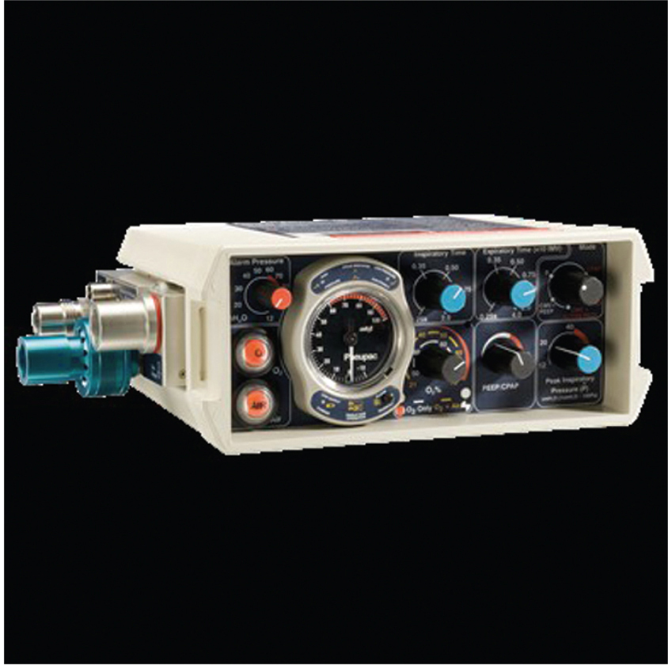
Figure 4.63

Slide 33
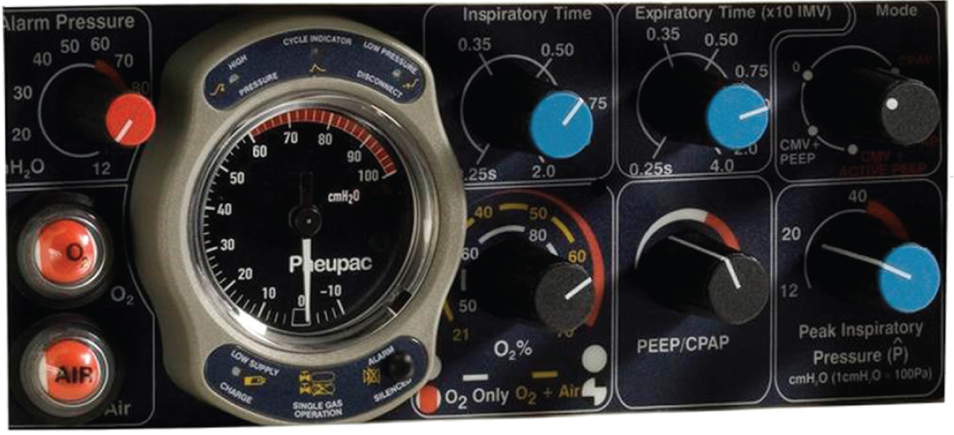
Figure 4.64

Slide 34
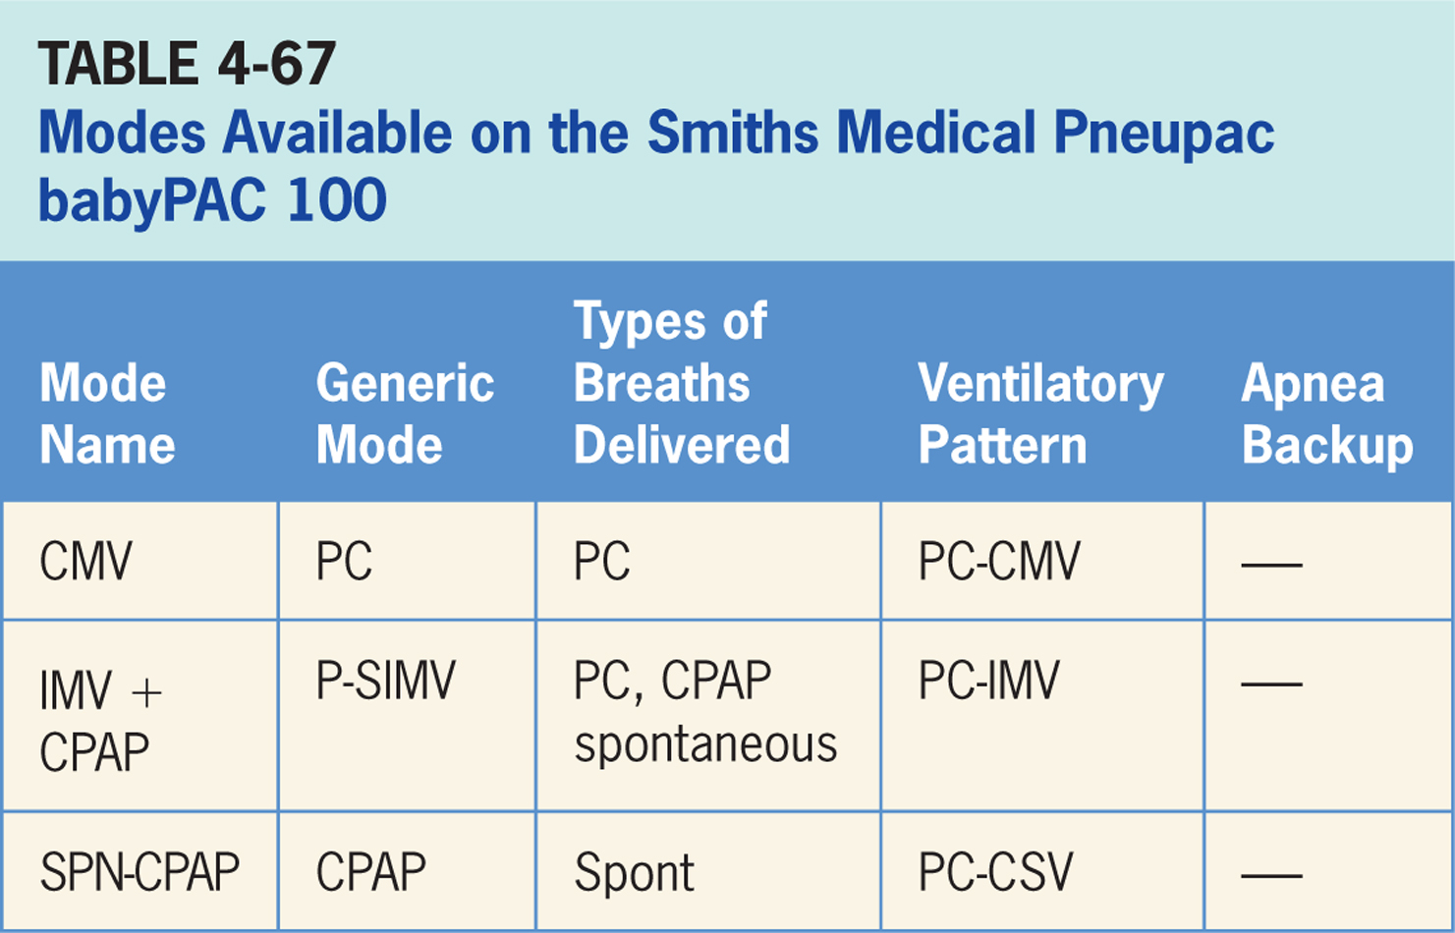

Slide 35
Controlled Mandatory Ventilation (CMV)
Pressure-targeted mode of ventilation allowing for mandatory, time-triggered breaths only (patient-assisted breaths are not allowed).³⁹
Mandatory breaths cycle to exhalation once inspiratory time has elapsed.

Slide 36
Main Operator Controls Include:
Fio₂
PEEP
Inspiratory pressure level
Inspiratory time (T_{insp})
Expiratory time (T_{exp})
Pressure will be consistently delivered from breath to breath; Vt and flow are variable and will depend on the inspiratory pressure level, patient effort, and patient respiratory system mechanics.³⁹
If CMV + active PEEP is selected a continuous flow is generated through circuit during exhalation and patient can draw a spontaneous breath from this flow.³⁹

Slide 37
Intermittent Mandatory Ventilation And Continuous Positive Airway Pressure (IMV + CPAP)
Pressure-targeted mode that combines two breath types, PAC and CPAP.³⁹
Continuous flow of 10 L/min in the circuit, and the patients can draw spontaneous breaths from this flow in between mandatory breaths.

Slide 38
Main Operator Controls Include:
During PAC breaths, resulting Vt created is variable and depends on inspiratory pressure level, patient effort, and patient respiratory system mechanics.³⁹
During CPAP period, Vt is also variable and depends on patient effort, and respiratory system mechanics.

Slide 39
Continuous Positive Airway Pressure
Constant baseline pressure is maintained by the ventilator through a 10 L/min continuous flow through the circuit and the patient regulates their respiratory rate and Vt.³⁹

Slide 40
Main Operator Controls Include:
CPAP
Fio₂
Vt will be variable and depend on patient effort and respiratory system mechanics.³⁹

Slide 41
Apnea Ventilation Special Features
There is no backup ventilation.³⁹

Slide 42
Oxygen
A gas mixing system enables selection of oxygen concentration by means of the calibrated rotary control.³⁹
There is a double calibration in order to be able to select concentration with two different gas supply possibilities.
If oxygen alone is available as a compressed supply gas, then a concentration range of 45% to 100% oxygen concentration is possible.
If both oxygen and air are connected as gas sources, then yellow scale becomes operative, and it is possible to select from 21% to 70% oxygen.
Clinician has to input ETT diameter and length.

Slide 43
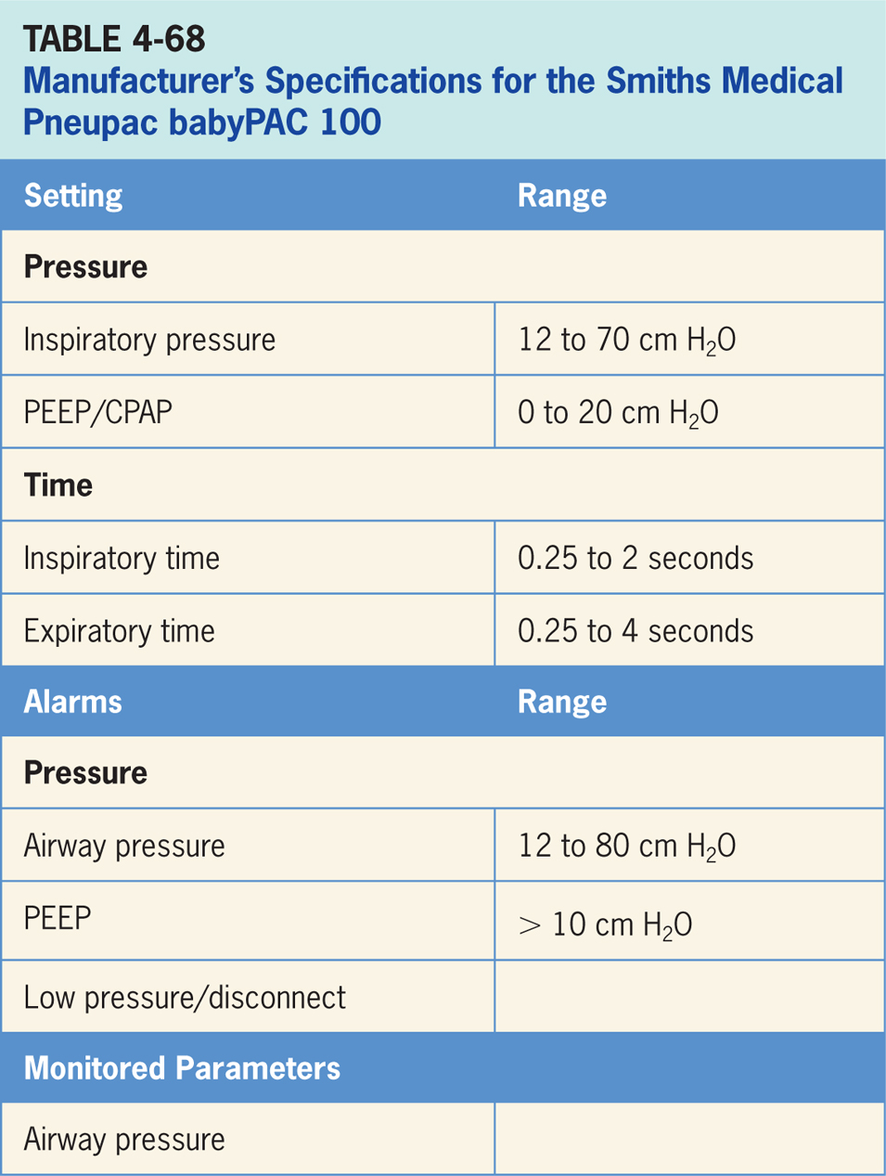

Slide 44
Vyaire Infant Flow SiPAP
Vyaire Infant Flo SiPAP (shown in Figure 4-65) designed to provide noninvasive ventilation for infants in hospital environments through either nasal prongs or a nasal mask.⁴⁰ It has a backup battery for patient transport.
Ventilator is available in two configurations: Plus or Comprehensive.
Difference between the two configurations is that Comprehensive provides an additional mode (BiPhasic tr, discussed in the Special Features section) and apnea backup breaths.
Infant Flow SiPAP operator interface (Figure 4-66) consists of an LCD touch screen display with keypad, pressure time waveform graphics, separate flowmeter controls for adjustment of NCPAP /P_{low} and P_{high} and a %O₂ blender control.

Slide 45
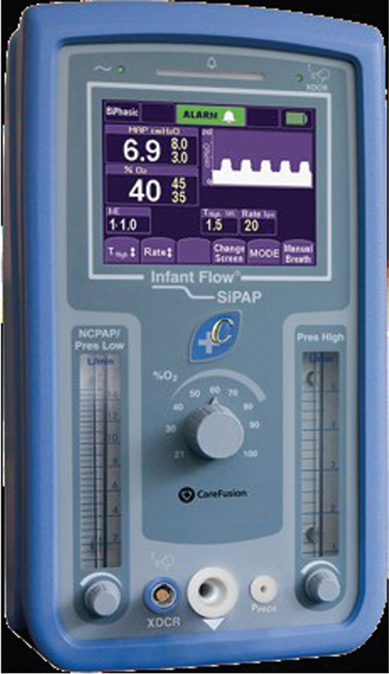
Figure 4.65

Slide 46
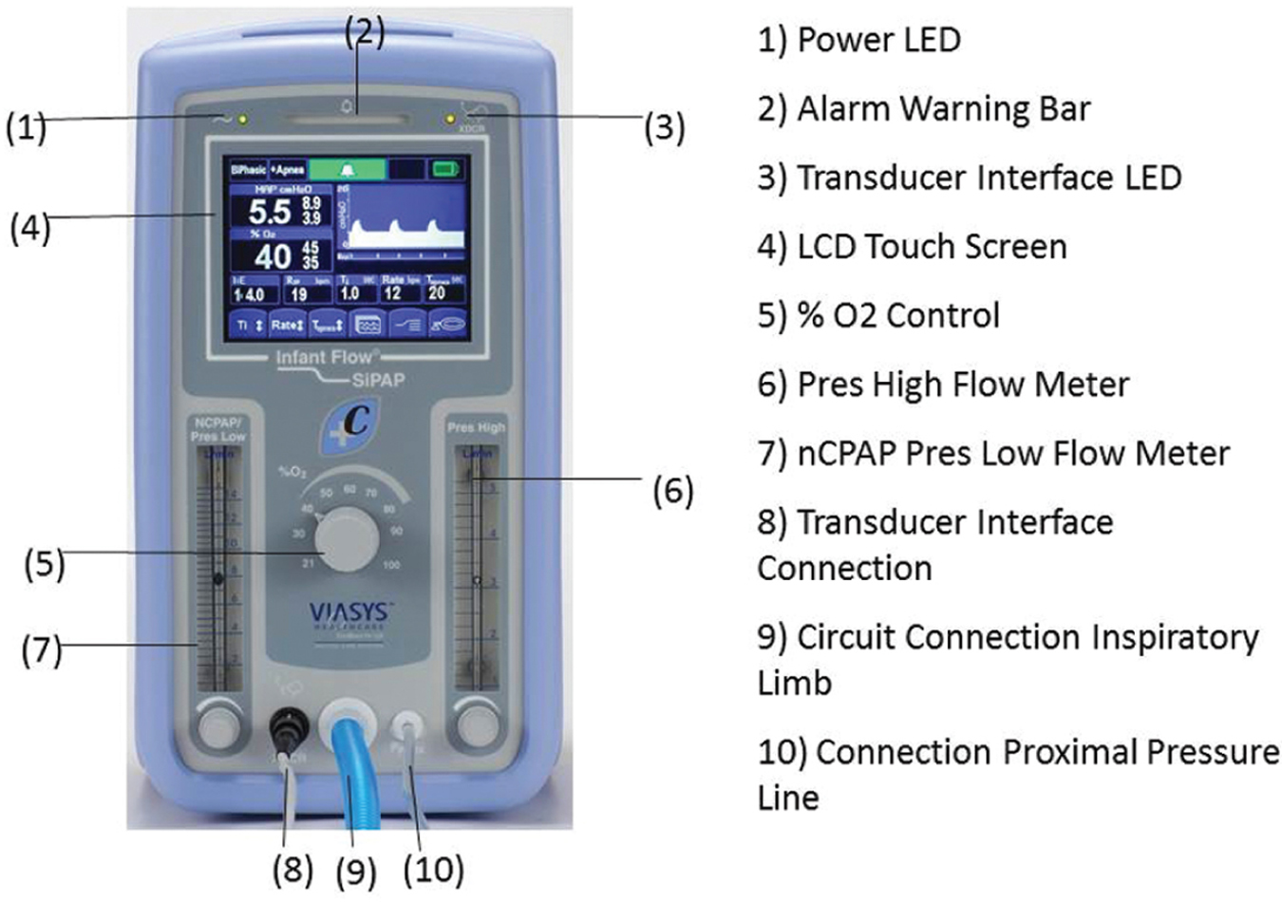
Figure 4.66

Slide 47
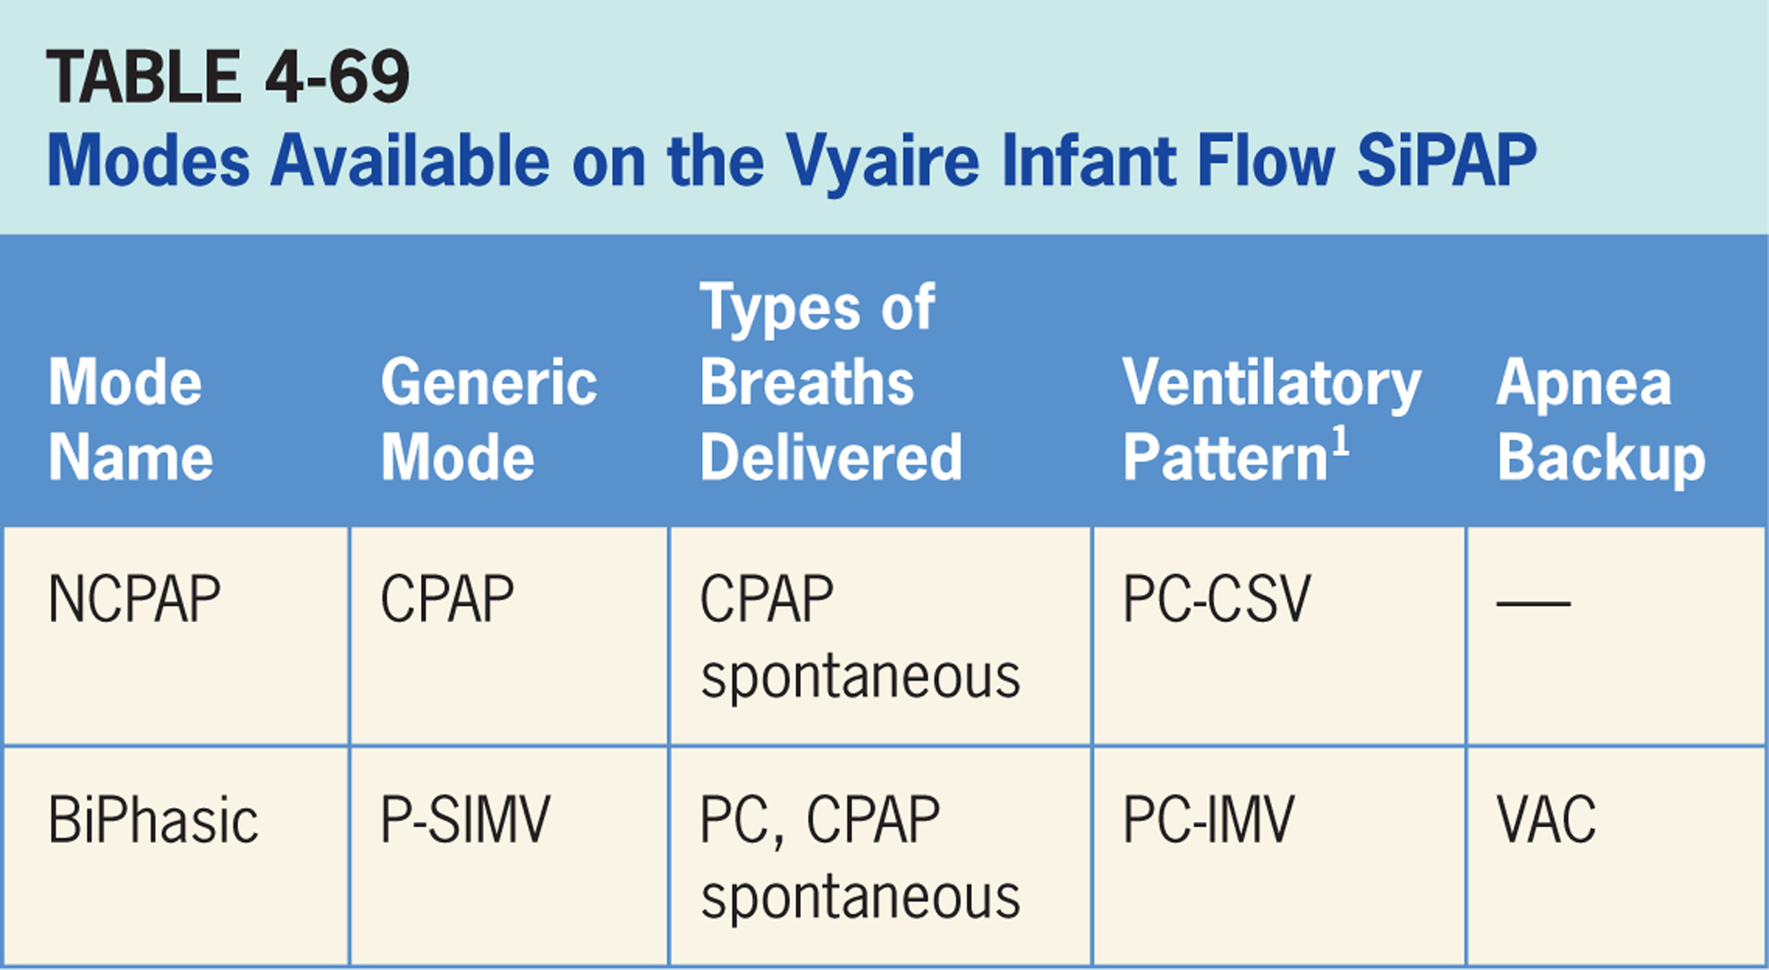

Slide 48
Nasal Continuous Positive Airway Pressure (NCPAP)
Pressure-targeted mode of ventilation allowing for spontaneous breathing from a fixed pressure baseline.⁴⁰
No additional support is provided during inspiration.

Slide 49
Main Operator Controls Include:
Fio₂
CPAP
Ventilator provides a baseline pressure and patient breathes spontaneously from baseline; Vt and flow are variable and will depend on patient effort, and patient respiratory system mechanics.⁴⁰

Slide 50
BiPhasic
BiPhasic mode is a pressure-targeted mode that delivers time-triggered pressure-assist breaths.⁴⁰
Patient can breathe spontaneously both between and during pressure breaths.

Slide 51
Main Operator Controls Include:
Fio₂
PEEP (P_{low} flowmeter)
Inspiratory pressure level (P_{high} flowmeter)
Inspiratory time (T_{high})
RR
During PAC breaths, resulting Vt created is variable and depends on inspiratory pressure level, patient effort, and patient respiratory system mechanics.⁴⁰
During CPAP period, Vt is also variable and depends on patient effort, and respiratory system mechanics.⁴⁰

Slide 52
Apnea Ventilation Special Features
There an apnea backup rate that can be set from 1 to 120 breaths per minute.⁴⁰
This becomes active after adjustable apnea timeout period has elapsed.
Breaths are pressure-targeted.

Slide 53
BiPhasic tr
BiPhasic tr requires the use of a special abdominal sensor for trigger signal.⁴⁰
Breaths delivered during BiPhasic tr are the same as BiPhasic mode.
BiPhasic tr is not presently available in the United States.

Slide 54
