Slide 1
Chapter 7: Patient Stabilization: Adjusting Ventilatory Support

Slide 2
Chapter Outline
Overview
Introduction
Patient ventilator interaction
Trigger Asynchrony
Flow Asynchrony
Cycle Asynchrony
Mode Asynchrony
Oxygenation
Fio₂
PEEP/CPAP
Recruitment Maneuvers
Prone Positioning
Bronchial Hygiene

Slide 3
Chapter Outline (cont’d)
Ventilation
Normal tidal volume, rate, and minute ventilation
Alveolar ventilation
PaCO₂ during mechanical ventilation
Assist-control volume ventilation
IMV/SIMV
PSV and PaCO₂
PCV and PaCO₂

Slide 4
Chapter Outline (cont’d)
Acid-base balance
Respiratory acidosis
Respiratory alkalosis
Metabolic acidosis
Metabolic alkalosis
Cardiac and Cardiovascular Support
Use of Sedation at Neuromuscular Blockade
Summary

Slide 5
Chapter Objectives
Describe items that should be assessed immediately following ventilator initiation.
List respiratory problems sometimes encountered following ventilator initiation.
Define the term patient – ventilator interaction and explain what is meant by patient – ventilator asynchrony.
Describe the adverse effects of patient – ventilator asynchrony.
Describe each of the types of trigger asynchrony and explain how to recognize and correct each.
Explain how to recognize and correct flow asynchrony.

Slide 6
Chapter Objectives (cont’d)
Explain the importance of correctly adjusting rise time and expiratory sensitivity when using PSV.
Explain what is meant by the term mode asynchrony and explain how NAVA and PAV may improve patient – ventilator interaction.
Explain each of the factors determine tissue oxygen delivery.
Describe the appropriate clinical goals for most patients for Pao₂, Sao₂ and Fio₂.
Describe methods to titrate Fio₂ down from 1.0 in ventilated patients.
Differentiate each of the following types of PEEP and explain how to apply each: minimum PEEP, compliance titrated PEEP, optimal PEEP for oxygen delivery, PEEP-Fio₂ tables, static pressure-volume curves, and slow flow pressure-volume curves.

Slide 7
Chapter Objectives (cont’d)
Explain how to perform a decremental PEEP trial to include appropriate use of a lung recruitment maneuver.
Explain causes, recognition and correction of auto PEEP.
Explain the purpose of prone positioning and describe its application.
Explain the purpose of lung recruitment maneuvers and describe the possible risks and benefits.
Describe bronchial hygiene techniques which may be beneficial in improving oxygenation.
Explain the relationships between tidal volume, dead space, respiratory rate, and alveolar ventilation.

Slide 8
Chapter Objectives (cont’d)
Describe the relationship between alveolar ventilation, CO₂ production, and PaCO₂.
Describe alterations in spontaneous breathing commonly seen in ICU patients.
Explain methods to alter ventilation and PaCO₂ during time – triggered controlled ventilation.
Describe factors that affect PaCO₂ when using each of the major modes of ventilation.
Explain the use of permissive hypercapnia.
Describe the purpose of intentional hyperventilation for patients with cerebral edema.

Slide 9
Chapter Objectives (cont’d)
Describe the relationship between alveolar ventilation, CO₂ production, and PaCO₂.
Describe alterations in spontaneous breathing commonly seen in ICU patients.
Explain methods to alter ventilation and PaCO₂ during time – triggered controlled ventilation.
Describe factors that affect PaCO₂ when using each of the major modes of ventilation.
Explain the use of permissive hypercapnia.
Describe the purpose of intentional hyperventilation for patients with cerebral edema.

Slide 10
Chapter Objectives (cont’d)
Explain the effects of PaCO₂ on acid-base balance during mechanical ventilation.
Describe causes of metabolic acidosis and alkalosis and explain expected respiratory compensation.
List normal values for arterial blood gases and hemodynamic measures often monitored in the intensive care unit.
Describe major cardiac and cardiovascular abnormalities which will reduce oxygen delivery to the tissues.
Summarize hemodynamic changes associated with ARDS, fluid overload, left ventricular failure, hypovolemic shock, septic shock, and cardiogenic shock.
Explain the importance of appropriate pain management and sedation protocols.
List possible indications for and hazards of neuromuscular blockade.

Slide 11
Overview
Assessment of the patient-ventilator system to assure appropriate ventilator function and patient-ventilator interaction
Support must ensure:
Oxygenation, for adequate alveolar ventilation & reduce the work of breathing
Patent comfort and safety, so must be adjusted for each individual
Minimization of harmful side effects
Promotion of patient liberation from the ventilator
Based on the clinician’s initial assessment, adjustments in ventilatory support may be necessary to reach these goals.

Slide 12
Overview (cont’d)
Most common modes of ventilation in use:
Assist-control volume ventilation (V-AC aka patient or time triggered VC-CMV with set point breath targeting)
Assist-control pressure control ventilation (PCV or P-AC – aka patient or time triggered PC-CMV with set point breath targeting)
Pressure support ventilation (PSV – aka PC-CSV)
Volume control synchronized intermittent mandatory ventilation (V-SIMV – aka VC-IMV with set point breath targeting)
Pressure control synchronized intermittent mandatory ventilation (P-SIMV – aka PC-IMV with set point breath targeting)

Slide 13
Introduction
1. Initiation of mechanical ventilation
2. Assessment of the patient and patient-ventilator system
Physical assessment
Ventilator settings
Patient-ventilator interaction
Cardiovascular assessment
Oximetry
Measurement of arterial blood gases
3. Check if ventilator adjustments are needed:
Criteria: meet oxygenation & ventilation goals, while maintaining optimal acid-base balance and minimizes harmful cardiovascular side effects

Slide 14
Introduction (cont’d)
4. Ventilation provided must be:
Safe and effective
Minimize work of breathing
Assure patient comfort
5. Initial Assessment should alert the respiratory care clinician to specific areas of concern. These may include:
Signs of hypoxemia or inadequate ventilation
Increased work of breathing
Respiratory distress
Diaphragmatic fatigue

Slide 15
Introduction (cont’d)
6. Findings during the initial assessment that are of concern that should be noted and recorded:
Heart failure
Fluid overload
Shock
Blood loss
Sepsis
Impaired CNS or neurologic function that include:
→depressed level of consciousness
→heavy sedation
→signs of neuromuscular disease or paralysis

Slide 16
Introduction (cont’d)
7. Respiratory mechanical problems that are encountered following ventilator initiation:
Inadvertent right mainstem intubation
Misplaced endotracheal tube (e.g., esophageal intubation)
Cuff leak or malfunction
Large air leak
Inappropriate ventilator settings
Ventilator malfunction or disconnect

Slide 17
Introduction (cont’d)
8. Problems effecting patients health that are encountered following ventilator initiation:
Bronchospasm
Mucosal edema
Secretions in a large airway
9. Monitor patient for worsening conditions that include:
Pulmonary edema
Consolidation
Pneumothorax
Pleural effusion
Atelectasis

Slide 18
Box 7-1 Initial Assessment Of The Patient
Based off of the initial assessment the clinician needs too:
Make appropriate ventilator adjustments to optimize oxygenation and ventilation
Maintain acid-base homeostasis
Reduce the work of breathing
Minimize harmful cardiovascular side effects
Assure patient safety and comfort
<Insert Box 7-1: Initial Assessment of the Patient>

Slide 19
Patient-ventilator Interaction
Positive patient-ventilator interaction:
Results in adequate oxygenation and ventilation, while decreasing the work of breathing and promoting patient comfort
Poor patient-ventilator interaction:
Results in patient-ventilator asynchrony, which may increase the work of breathing which causes patient discomfort and threatens effective oxygenation and ventilation.
Sustained increase in ventilator workload can lead to ventilator muscle fatigue and structural injury which cause ventilatory failure.

Slide 20
Patient-ventilator Interaction (cont’d)
Assist-control volume ventilation, assist-control pressure control ventilation, SIMV with pressure support, and standalone pressure support ventilation can reduce inspiratory effort without eliminating respiratory muscle activity.
Newer modes of ventilation include: proportional assist ventilation (PAV), neutrally adjusted ventilatory assist (NAVA).
Patient needs to be assessed for the presence of patient-ventilator asynchrony immediately following initiation of mechanical ventilation

Slide 21
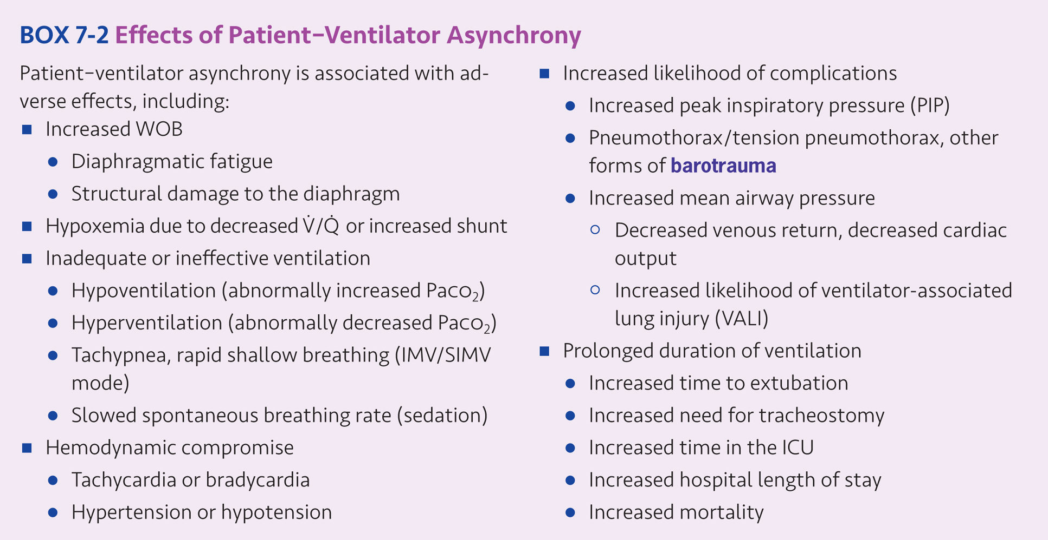

Slide 22
Trigger Asynchrony
Pressure triggering: the trigger is generally set at -0.5 to – 1.5 cm H₂O below the baseline expiratory pressure, although some circuits may require trigger sensitivity be set at -2.0 cm H₂O to avoid auto triggering
Flow triggering: the trigger sensitivity is generally set in the range of 1 to 2 L/min below the baseline or bias flow, although some systems may require flow triggers as high as 3 to 4 L/min below baseline (bias) flow to avoid auto triggering.

Slide 23
Trigger Asynchrony (cont’d)
No clinically important differences between the two when using current generation of critical care ventilators
Trigger asynchrony occurs when there is poor coordination between the patient’s inspiratory effort and the initiation of a ventilator supported breath.
RC insight: Trigger sensitivity should be adjusted so that trigger work is minimal without auto cycling.

Slide 24
Trigger Work
Trigger work refers to that portion of the work of breathing performed by the patient to trigger the ventilator to the inspiratory phase.
Inappropriate trigger sensitivity settings and auto-PEEP can increase trigger work.
Auto PEEP may also increase trigger work.
If patients are having trouble triggering the ventilator in the presence of auto PEEP extrinsic PEEP may be applied to reduce trigger work, usually at 50-80% of the measured auto PEEP level.
There are five types of trigger asynchrony: missed triggering, trigger delay, double triggering, reverse triggering and auto triggering

Slide 25
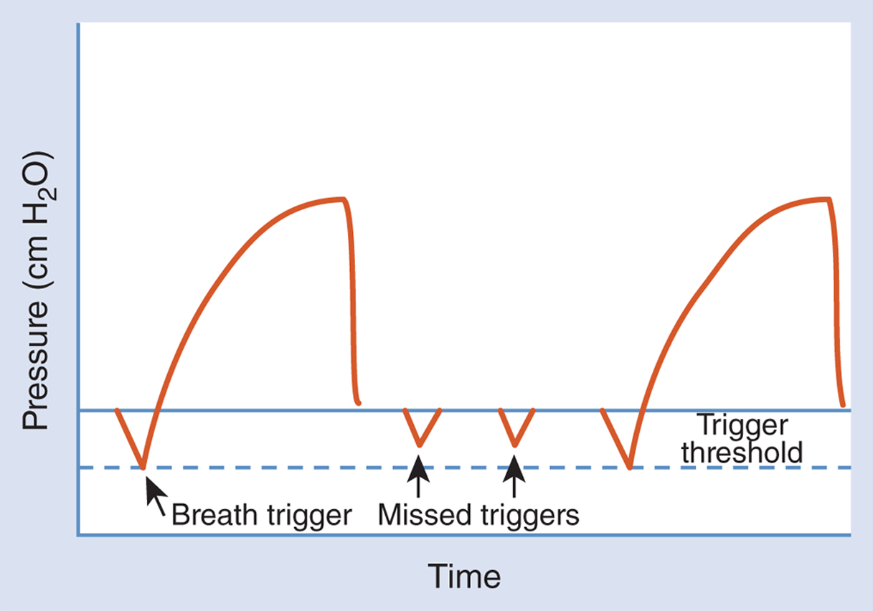
Missed Triggering
A patient inspiratory effort that does not trigger the ventilator is called missed triggering.
Figure 7.1

Slide 26
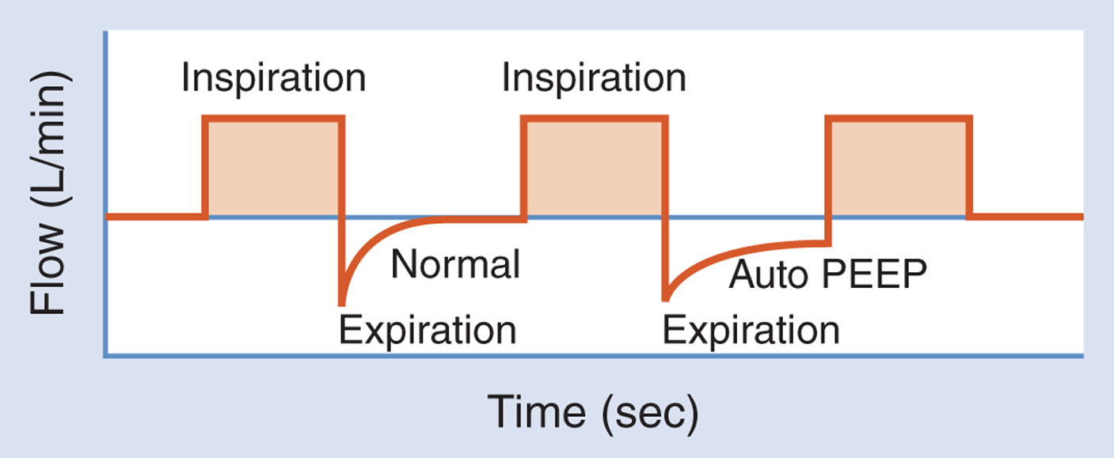
Missed Triggering (cont’d)
AutoPEEP as seen on a flow-time curve during mechanical ventilation.
Figure 7.2

Slide 27
Trigger Delay
Trigger delay occurs when there is an increased time interval between the neurologic inspiratory signal from the patient’s respiratory control center and the ventilator’s initiation of breath.
Trigger delay is most commonly caused by inappropriate sensitivity settings, and adjustment of trigger sensitivity can often correct trigger delay.

Slide 28
Double Triggering
Patients may try to breathe in longer or deeper than the ventilator is set to provide.
Ventilator may cycle to the expiratory phase while the patient continues to make an inspiratory effort, resulting in double triggering.
Double triggering may cause the patient to receive two consecutive tidal breaths from the ventilator before exhaling.
Double triggering may be corrected by increasing the inspiratory time to match the patient’s neuro-inspiratory time, increasing the tidal volume to better match the patient’s demand or considering a different mode of ventilation (e.g., pressure support or assist-control PCV).

Slide 29
Auto Triggering
Auto triggering occurs when the ventilator initiates inspiration without a corresponding patient effort due to inappropriate ventilator trigger sensitivity settings.
Auto triggering most often occurs when trigger sensitivity thresholds are such that even minor fluctuations in ventilator circuit pressure and flow result in a breath trigger.

Slide 30
Reverse Triggering
Reverse triggering may occur during controlled ventilation in which a time-triggered ventilator breath stimulates the diaphragm, resulting in diaphragmatic contraction which then triggers the next breath.

Slide 31
Flow Asynchrony
Flow asynchrony occurs when the inspiratory gas flow from the ventilator is unable to match the patient’s inspiratory flow demand.
With assist-control volume ventilation, this work may exceed that of spontaneous breathing
Pressure support ventilation (PSV) and Pressure control ventilation (PCV)
Figure 7-3 illustrates a fast rise time, slow rise time and appropriate rise time with pressure control ventilation.
<Insert Figure 7-3 Pressure Control Ventilation.>

Slide 32
Flow Asynchrony (cont’d)
RC Insight:
During volume ventilation peak flow should be adjusted to a value which meets or exceeds the patient’s inspiratory flow demand.

Slide 33
Cycle Asynchrony
Cycle asynchrony occurs when the patient’s respiratory center neurologic output and the ventilator do not match.
Cycle asynchrony is most common during pressure control ventilation (PCV), although it can occur in other modes.
Figure 7-4: illustrates a mismatch between the patient’s inspiratory time and the ventilator’s inspiratory time in which the patient begins exhalation early resulting in a pressure spike at end-inspiration in the pressure-time curve
<Insert Figure 7-4 Cycling Asynchrony.>

Slide 34
Flow Termination Criteria to Adjust PSV Expiratory Cycling: Figure 7-5
Expiratory sensitivity ([Esens], PB 840, PB 980; range 1-80% peak flow)
Expiratory trigger sensitivity ([ETS], Hamilton G5; range 5-70% peak flow)
End flow (GE CareStation; range 5-80% peak flow)
Expiratory termination (Drager Evita V500; range 1-80% peak flow)
Inspiratory cycle off % (Maquet Servo-i and Servo-u, range 1-80% peak flow)
<Insert Figure 7-5 Effect of Changing the Flow Termination Criteria During Pressure Support Ventilation. Note the effect on inspiratory time when a change in flow termination criteria as a percentage of peak flow is made.>

Slide 35
Mode Asynchrony
Following initiation of mechanical ventilatory support the patient should be immediately assessed for the quality of the patient – ventilator interaction by observing for trigger effort, accessory muscle use, patient–ventilator inspiratory time matching, respiratory rate, and signs of distress.

Slide 36
Oxygenation
Arterial oxygen content (CaO₂) is dependent on arterial oxygen tension (PaO₂), arterial oxygen saturation (SaO₂) and hemoglobin level (Hb) where:
CaO₂ = 1.34 x SaO₂ x Hb + .003 x PaO₂
Tissue oxygen delivery ($\dot{D}$O₂) is dependent on the arterial oxygen content (CaO₂) and cardiac output ($\dot{Q}$T) where:
$\dot{D}$O₂ = CaO₂ x $\dot{Q}$T
Cardiac output ($\dot{Q}$T) is dependent on stroke volume (SV) and heart rate (HR) where:
$\dot{Q}$T = SV x HR

Slide 37
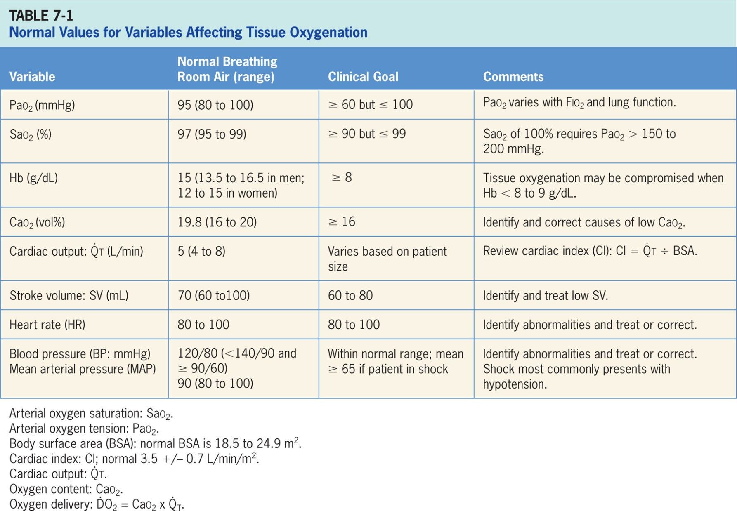
Oxygenation: Table 7-1

Slide 38
Fio2
Ventilator initiation often includes providing 100% oxygen (Fio₂ = 1.0) as a safeguard against development of severe hypoxemia
RC Insight: A clinical goal of PaO₂ 60-80 mm Hg and SaO₂ 90-95% at Fio₂ ≤ 0.50-0.60 is appropriate for most patients.
<Insert Table 7-2 Relationship between PaO₂ and SaO₂*>

Slide 39
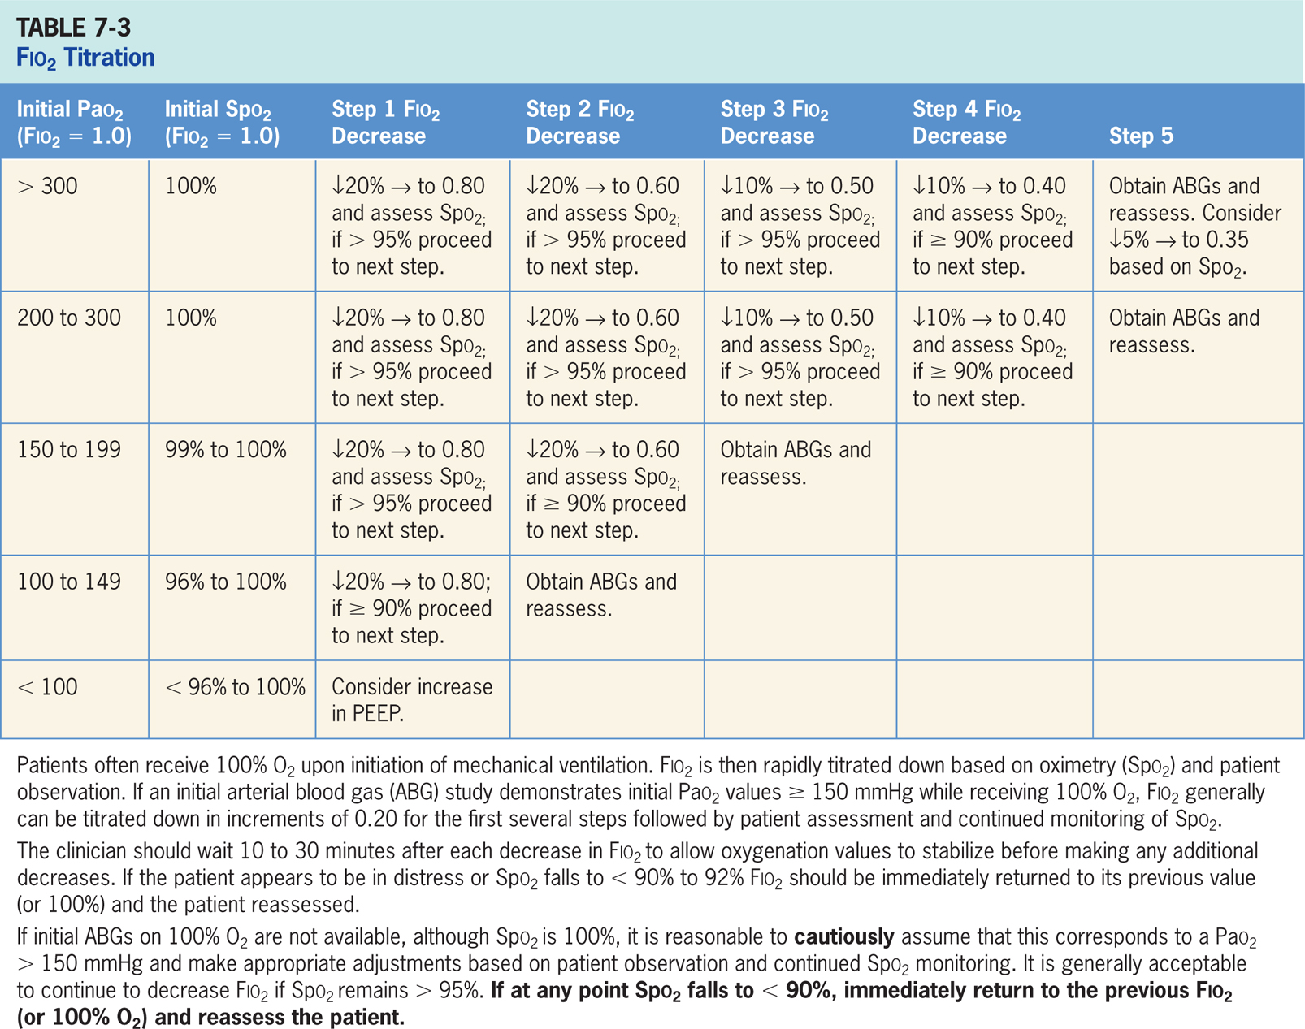
Fio₂ : TABLE 7-3 Fio₂ Titration

Slide 40
Clinical Focus 7-1 Oxygen Titration
Invasive mechanical ventilation is instituted for a patient in acute respiratory failure with the following settings:
Mode: assist-control volume ventilation (V-AC aka VC-CMV)
Tidal volume: 8 ml/kg IBW
Set rate: 14 breaths/minute
Fio₂: 1.0
PEEP: + 5 cm H₂O
Arterial blood gases are obtained shortly after initiation of mechanical ventilatory support:
pH: 7.36
PaCO₂; 35 mm Hg
PaO₂: 182 mm Hg
SaO₂: 100%

Slide 41
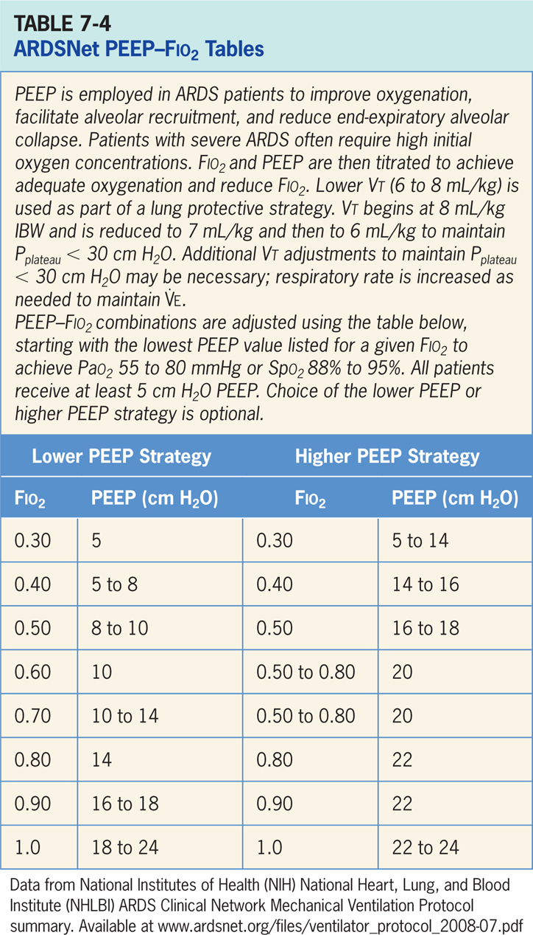
PEEP/CPAP
Mechanical ventilation often incorporates PEEP or CPAP to help restore or maintain lung volumes and prevent or treat atelectasis.
PEEP/CPAP can be highly effective in improving oxygenation in patients with acute hypoxemic respiratory failure (e.g., ARDS, severe pneumonia, pulmonary edema).
Methods: Minimum PEEP and Optimal PEEP for Oxygen Delivery

Slide 42
PEEP/CPAP: Clinical Focus 7-2 Compliance Titrated PEEP
Generally begins at a modest PEEP level (e.g., 5 cm H₂O) followed by measurement of static total compliance (CST) where:
CST = Vt ÷ (P_{plat} – PEEP)
A patient with acute hypoxemic respiratory failure is receiving mechanical ventilation in the assist-control volume ventilation mode. Initial ventilator settings include:
Mode: assist-control volume ventilation (aka VC-CMV)
Tidal volume: 8 ml/kg IBW
Set rate: 14 breaths/minute
Fio₂: 1.0
PEEP: + 5 cm H₂O

Slide 43
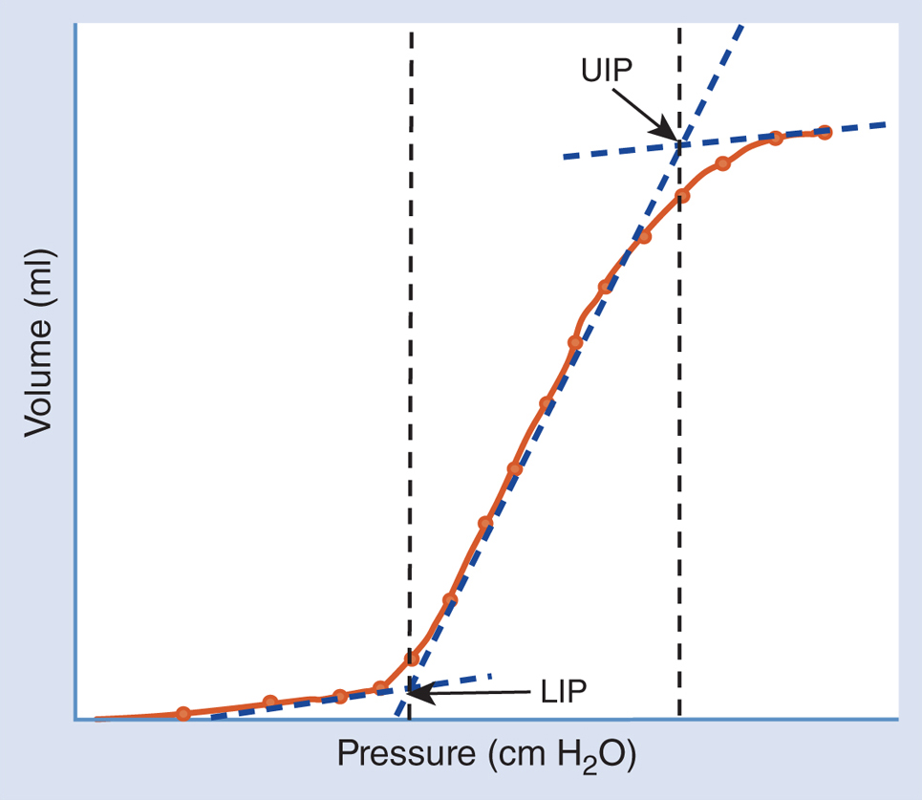
Pressure-volume Curves
Static pressure-volume curve with lower inflection point (LIP, aka p-flex) and upper inflection point (UIP)
Figure 7.6

Slide 44
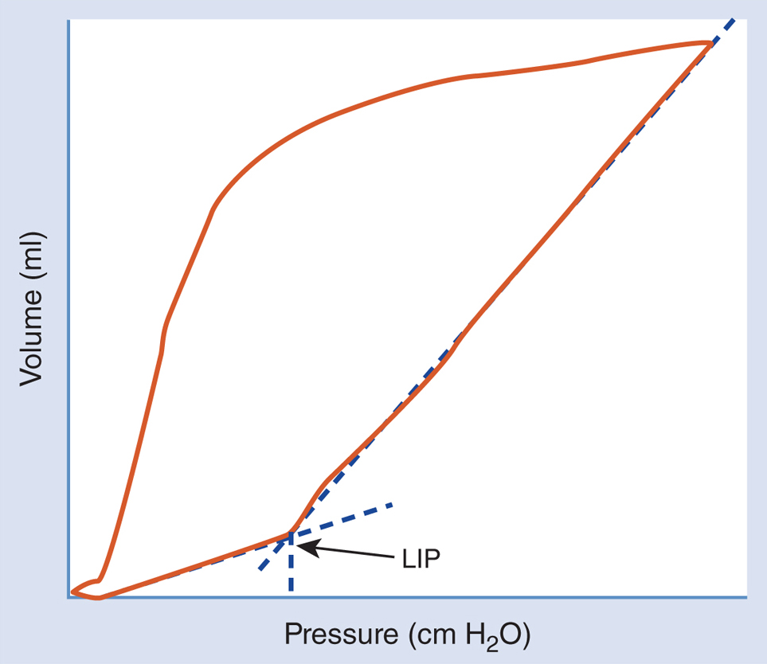
Pressure-volume Curves (cont’d)
Figure 7.7

Slide 45
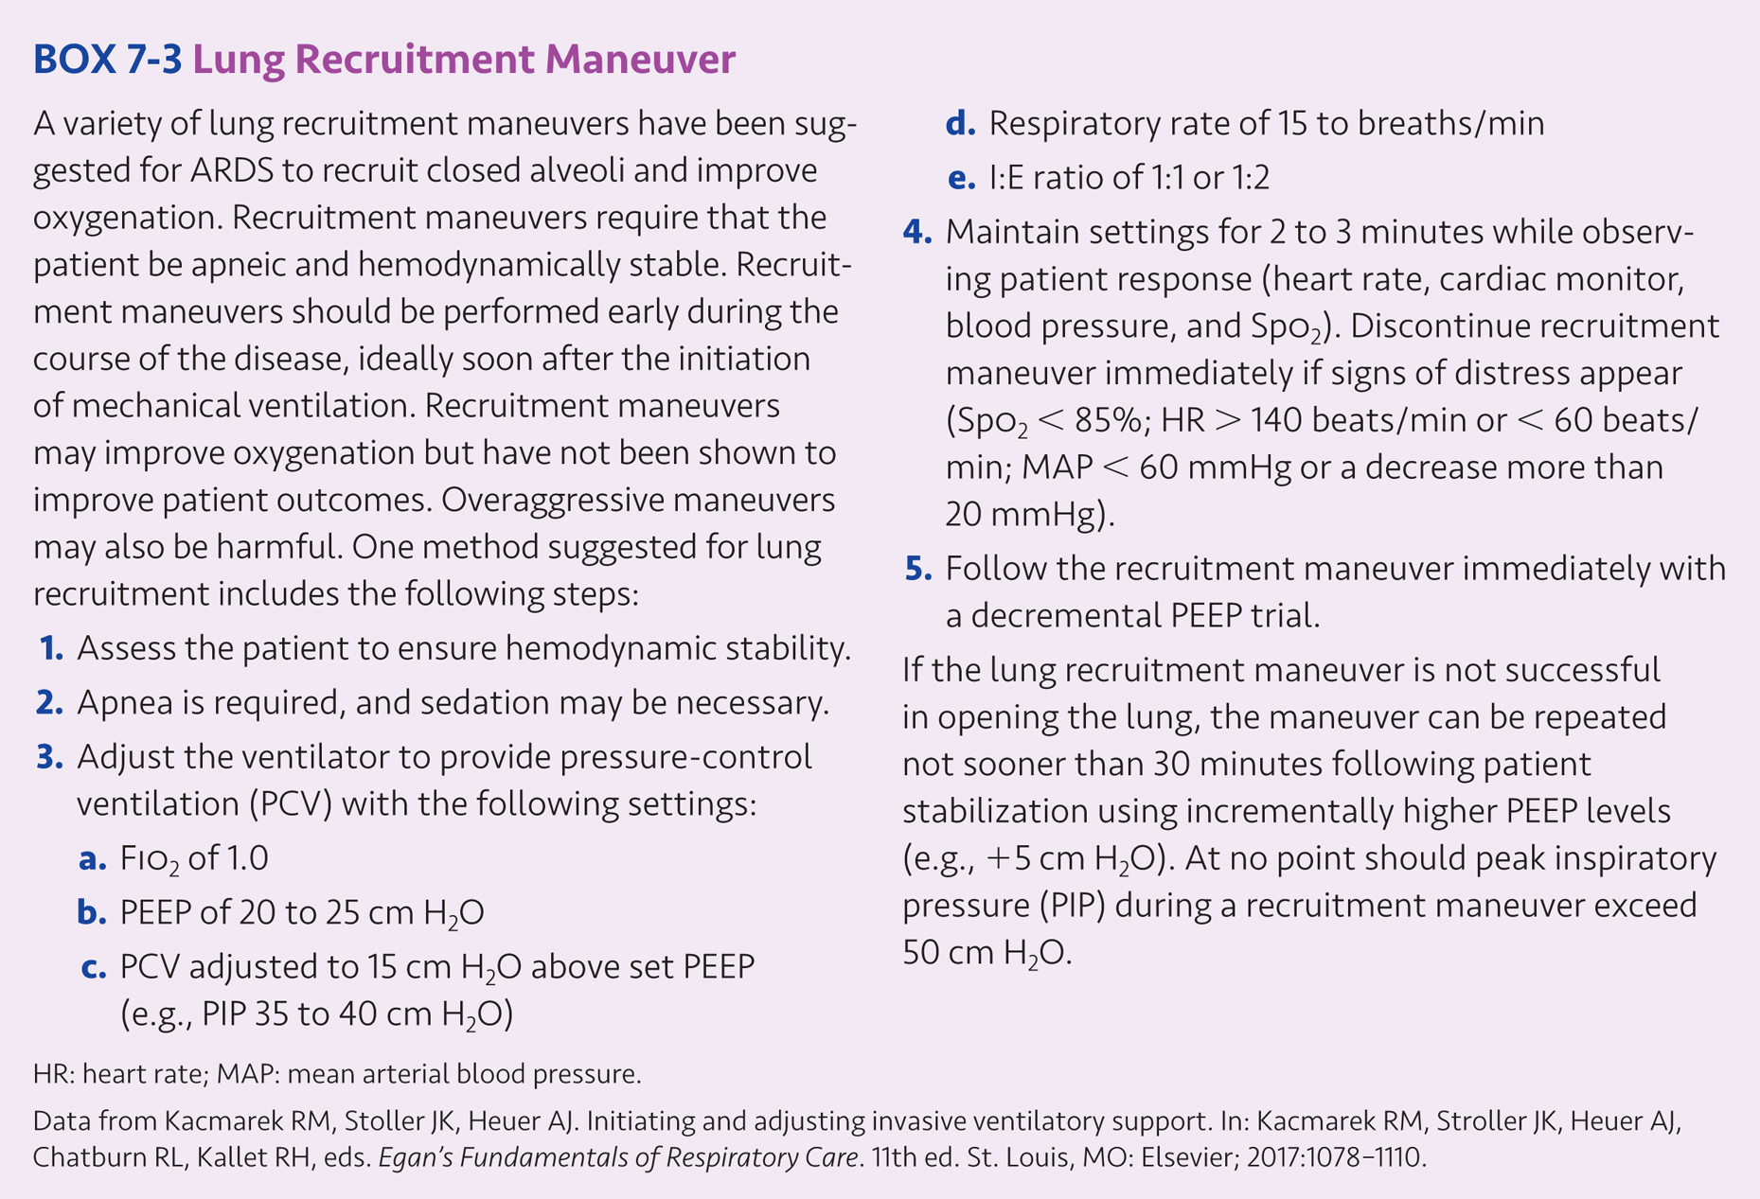
Decremental PEEP Trials

Slide 46
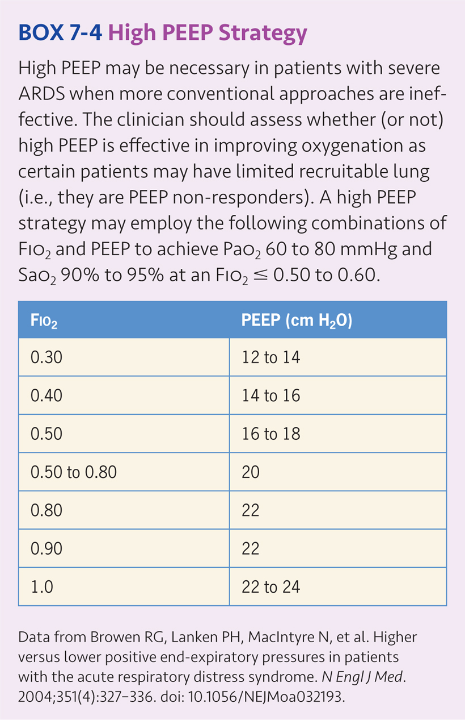
Application of PEEP
Minimum PEEP: most patients receive 5 cm H₂O of PEEP or CPAP to maintain lung volumes and prevent atelectasis
ARDS: The principal causes of ventilator associated lung injury (VALI) in ARDS are thought to be alveolar overdistention and cyclic atelectasis.

Slide 47
Recruitment Maneuvers
“30 for 30” or “40 for 40” : applies 30 cm H₂O of PEEP for 30 seconds or 40 cm H₂O of PEEP for 40 seconds
Another common method combines pressure control ventilation (PCV) with the peak pressures of 35-50 cm H₂O, inspiratory times of 1 to 2 seconds and PEEP set at 20-30 cm H₂O applied for a period of 1 to 3 minutes
RC Insights: When performing a recruitment maneuver carefully monitor the patient’s heart rate, blood pressure and cardiac monitor for development of arrhythmias.

Slide 48
Prone Positioning
Prone positioning will increase blood flow to the anterior portions of the lung which may be beneficial in improving oxygenation in ARDS patients.
Prone positioning may be considered for patients with severe ARDS (PaO₂/Fio₂ < 150 mmHg with Fio₂ ≥ 0.60 with PEEP ≥ 5 cm H₂O) and those with refractory hypoxemia (PaO₂/Fio₂ ≤ 100 mmHg and PaO₂ ≤ 60 mmHg with Fio₂ = 1.0) unresponsive to a more conventional ventilatory approach

Slide 49
Bronchial Hygiene
Methods used to improve oxygenation in ventilated patients include: adjustment of Fio₂, optimal PEEP techniques (e.g., minimum PEEP, compliance titrated PEEP; decremental PEEP; PEEP based on $\dot{D}$O₂); recruitment maneuvers and prone positioning.
Bronchial hygiene techniques which improve oxygenation include: bronchodilator and steroid medications, suctioning and airway care, attention to proper humidification, and bronchopulmonary hygiene.

Slide 50
Ventilation
Ventilation directly affects carbon dioxide removal, and measurement of the arterial carbon dioxide tension (PaCO₂) allows the respiratory care clinician to precisely assess the effectiveness of the ventilatory support provided and provides a guide for making needed, as well as ventilator adjustments.

Slide 51
Normal Tidal Volume, Rate, and Minute Ventilation
Normal adult values for each of these variables are:
f = 12 breath/min (normal range 12-20 breaths/min); f < 30 (but ≥ 10 breaths/min) is associated with adequate spontaneous breathing for adults in the ICU.
Vt = 500 mL (normal range 400-700 mL [about 7 mL/kg IBW]; Vt > 5 mL/kg associated with adequate spontaneous breathing.
$\dot{V}$E = 6 L/min (normal range 5-10 L/min [about 100 ml/kg IBW]); $\dot{V}$E < 10 L/min but ≥ 5 L/min associated with adequate spontaneous breathing; higher values associated with distress.

Slide 52
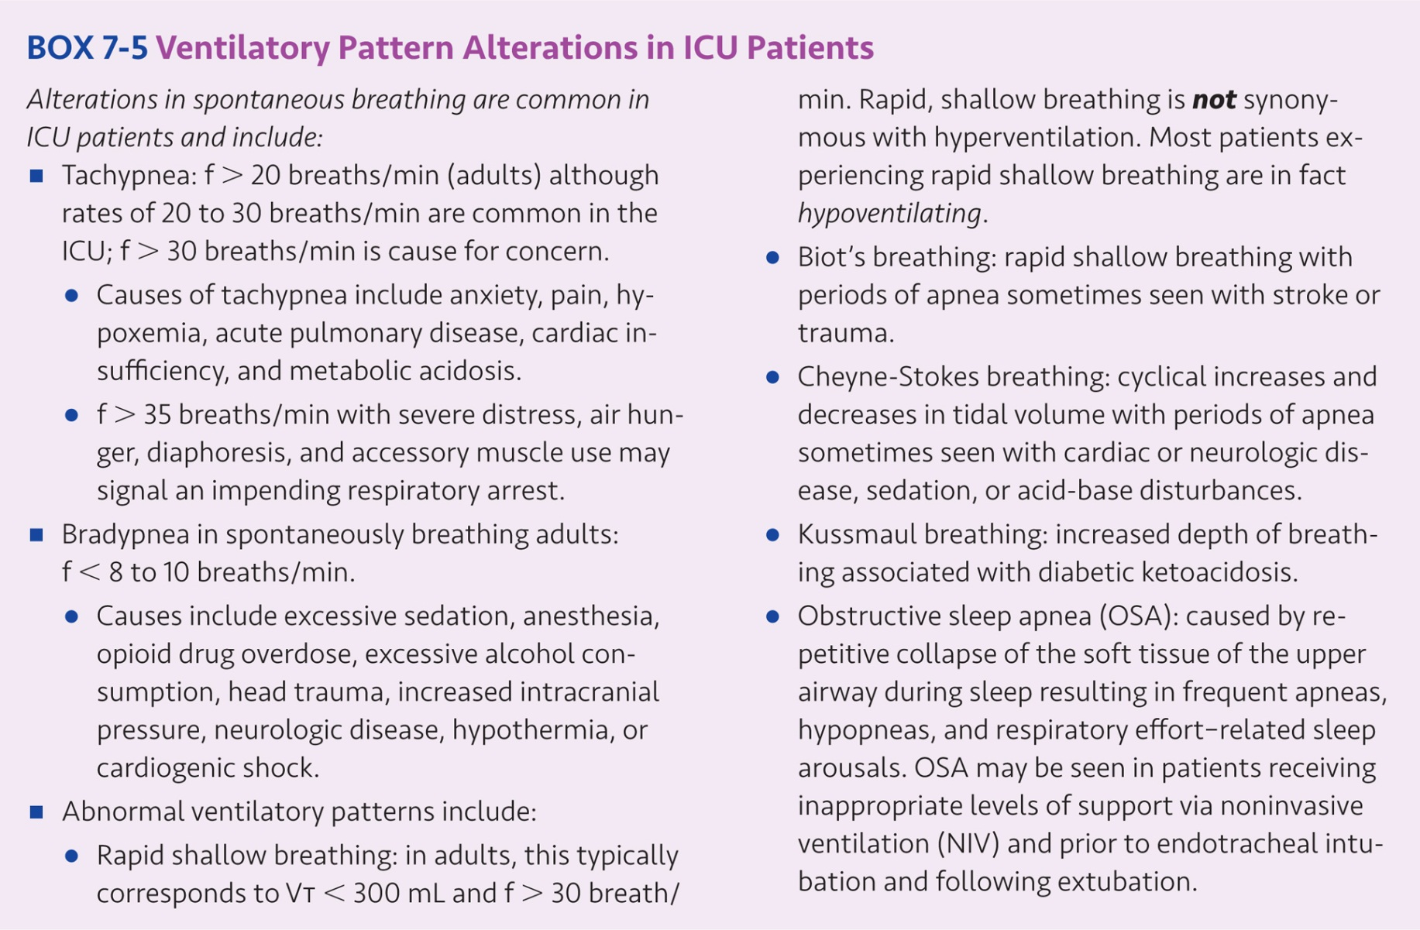
Normal Tidal Volume, Rate, and Minute Ventilation (cont’d)

Slide 53
Alveolar Ventilation
Alveolar ventilation ($\dot{V}$A) is:
$\dot{V}$A = (Vt - VD_{phys}) x f
Normal VD_{phys} can be estimated at approximately 1 ml/lb IBW or 2.2 ml/kg IBW. Normal VD_{phys} for a 150 lb (IBW) person would be about 150 ml. Thus, normal adult $\dot{V}$A is about 4.2 L/min (range: 4-5 L/min):
$\dot{V}$A = (Vt - VD_{phys}) x f = (500 ml – 150 ml) x 12 breaths/min = 4,200 ml/min = 4.2 L/min
Dead space to tidal volume ratio (VD/Vt) is sometimes measured at the bedside:
VD/Vt = (PaCO₂ - P$\overline{E}$CO₂) ÷ PaCO₂
Where PaCO₂ is arterial carbon dioxide tension (normally 40 mm Hg; range: 35-45 mm Hg) and P$\overline{E}$CO₂ is mean exhaled CO₂ tension (normally 28 mm Hg; range: 24-32 mm Hg).

Slide 54
PaCO₂ During Mechanical Ventilation
For most patients, the goal is to normalize PaCO₂ in the range of 35-45 mmHg.
In the absence of a metabolic acid-base disorder, a normal PaCO₂ should result in a normal arterial pH of 7.35 to 7.45.
Intentional Hyperventilation: Low arterial carbon dioxide tension produces cerebral vasoconstriction and reduces intracranial pressure (ICP).
Permissive Hypercapnia: ventilatory strategy which decreases Vt and associated delivery pressures to reduce alveolar pressures and minimize alveolar over distention. With permissive hypercapnia, PaCO₂ rises and pH falls resulting in a respiratory acidosis

Slide 55
PaCO₂ During Mechanical Ventilation (cont’d)
Ventilator Adjustments to Alter PaCO₂
Changes in alveolar ventilation ($\dot{V}$A) required to obtain a desired PaCO₂ can easily be calculated:
Initial PaCO₂ x Initial $\dot{V}$A = Desired PaCO₂ x Desired $\dot{V}$A
This can be rearranged to calculate the alveolar ventilation required to make a desired change in PaCO2:
Desired $\dot{V}$A = (Initial PaCO₂ x Initial $\dot{V}$A) ÷ Desired PaCO₂

Slide 56
PaCO₂ During Mechanical Ventilation (cont’d)
Recall that alveolar ventilation is simply tidal volume minus dead space times respiratory rate:
$\dot{V}$A = (Vt - VD_{phys}) x f
Substituting tidal volume, dead space, and respiratory rate into our predictive equation, we have:
Desired $\dot{V}$A = (Initial PaCO₂ x Initial $\dot{V}$A) ÷ Desired PaCO₂
Desired ([Vt - VD_{phys}] x f) = Initial (PaCO₂ x ([Vt - VD_{phys}] x f) ÷ Desired PaCO₂

Slide 57
Tidal Volume and PaCO₂
Alterations in tidal volume will affect alveolar ventilation and PaCO₂. With apnea during time-triggered volume ventilation, the respiratory care clinic clinician can easily adjust Vt to obtain a desired PaCO₂ using a modification of our predictive equation:
Desired Vt = (Initial PaCO₂ x Initial Vt) ÷ Desired PaCO₂
Assuming respiratory rate and dead space remain constant, if an apneic patient receiving mechanical ventilation has a Vt of 400 ml resulting in a PaCO₂ of 50 mm Hg, the Vt needed to lower the patient’s PaCO₂ to 40 mm Hg would be 500 ml:
Desired Vt = (Initial PaCO₂ x Initial Vt) ÷ Desired PaCO₂ = (50 x 400) ÷ 40 = 500 ml

Slide 58
Assist-control Volume Ventilation
Assist-control ventilation may be employed as assist-control volume ventilation (VC-CMV) or assist-control pressure control ventilation (PC-CMV)
Traditional assist-control volume ventilation, the mandatory breath delivers a set tidal volume, and the clinician determines the peak flow, flow waveform and inspiratory time
Assist-control PCV, the clinician determines the inspiratory pressure and inspiratory time, while patient-effort (assuming appropriate trigger sensitivity) determines the respiratory rate. Tidal volume is determined by the inspiratory pressure, inspiratory time, and patient effort.

Slide 59
IMV/SIMV and PaCO₂
SIMV intersperses mandatory breaths and spontaneous breathing.
SIMV may be employed to deliver volume or pressure control mandatory breaths.
Spontaneous breaths may be provided with pressure augmentation (pressure support or automatic tube compensation [ATC]) and PEEP/CPAP may be added.
Volume SIMV (V-SIMV) tidal volume is typically initiated in the range of 6-8 ml/kg IBW with the mandatory respiratory rate sufficient to provide full ventilatory support (e.g., 12-14 breath/min).
Care is taken to ensure P_{plat} < 28-30 cm H₂O. PEEP/CPAP is initially set at 5 cm H₂O and adjusted in combination with Fio₂ to meet oxygenation goals.

Slide 60
PSV and PaCO₂
Assuming a patient with an intact and properly functioning respiratory control center, problems associated with PSV are primarily related to inappropriate ventilator settings.
Slow rise times or inappropriate expiratory cycle criteria can result in increased work of breathing and patient-ventilator asynchrony.
If PSV is employed as the primary mode of ventilatory support, care should be taken to ensure that appropriate backup apnea ventilation mode has been set.

Slide 61
Acid-base Balance
Patients in respiratory failure often experience acid-base disorders and the patient’s ventilatory status can have a significant impact on acid-base balance as described by the simplified form of the Henderson-Hasselbalch equation; pH = pKa + log [HCO3-]
[H₂CO₃]
and
pH = pK_{a} + log __[HCO₃⁻]__
PCO₂ x 0.03

Slide 62
Acid-base Balance (cont’d)
Where pK_{a} is the –log (K_{a}) = 6.1; [HCO₃⁻] is the bicarbonate ion concentration (mEq/L); [H₂CO₃] is the carbonic acid concentration; PCO₂ is the partial pressure of carbon dioxide in mm Hg; and 0.03 is the solubility constant for CO₂ in plasma (H₂CO₃ = PCO₂ x 0.03).
Normal arterial blood pH is 7.40 with a range of 7.35 to 7.45, while normal PaCO₂ is 40 mm Hg (range 35-45 mm Hg) and normal bicarbonate concentration ([HCO3⁻]) is 24 mEq/L (range 22-28 mEq/L).

Slide 63
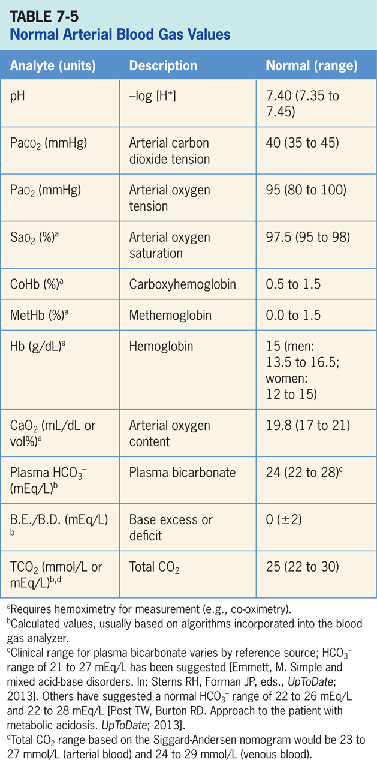
Acid-base Balance (cont’d)
RC Insight: For acute increases in PaCO₂ every 1 mm Hg increase in PaCO₂ will decrease pH by 0.008; for acute decreases in PaCO₂ every 1 mm Hg decrease in PaCO₂ will increase in pH by 0.008.

Slide 64
Respiratory Acidosis
Patients respiratory drive may be decreased due to respiratory or metabolic alkalosis, CNS depressants (sedatives, tranquilizers, opioids), neurologic disease, electrolyte disorders, decreased metabolic rate or pain.
Chronic elevations in PaCO₂ as seen with chronic CO₂ retention may depress the respiratory drive to breathe.

Slide 65
Respiratory Alkalosis (cont’d)
Causes of increased respiratory drive include hypoxemia, metabolic acidosis, increased CO₂ production, lung receptor stimulation, pain, anxiety, and decreased blood pressure.
Increased respiratory drive may cause patients receiving assist – control ventilation (e.g., PC-CMV or VC-CMV) to trigger the ventilator at excessively high rates resulting in an inappropriate respiratory alkalosis.
Any issues that causes an increase in respiratory drive need to be identified and addressed promptly.

Slide 66
Metabolic Acidosis
Metabolic acidosis seen in the ICU include lactic acidosis, ketoacidosis, and kidney failure. Other causes of metabolic acidosis include ingestion of acids, diarrhea, pancreatic fistula, and intravenous alimentation.
A normal physiologic response that results from metabolic acidosis is hyperventilation. Hyperventilation decreases PaCO₂ and raises pH. Normal respiratory compensation for metabolic acidosis will decrease PaCO₂ about 1.2 mm Hg for each 1 mEq/L decrease in HCO₃-.

Slide 67
Metabolic Alkalosis (cont’d)
Metabolic alkalosis is commonly caused by vomiting, NG tube suction, renal loss of hydrogen ions, hypokalemia, hypovolemia, and sodium bicarbonate administration.
Normal respiratory compensation for metabolic alkalosis typically results in an increase in PaCO₂ of about 0.7 mm Hg for each 1 mEq/L increase in HCO₃.
For ventilated patients, metabolic alkalosis will decrease the patients respiratory drive which may result in hipventilation.

Slide 68
Cardiac and Cardiovascular Support
Adequate cardiac output, blood pressure, and tissue perfusion are all factors that oxygen delivery is dependent on.
Treatment of heart failure is dependent on the cause and may include diuretics to treat fluid retention and the use of pharmacologic agents to improve cardiac function.
There are three broad types of acute coronary syndromes and myocardial infarction (MI) based on ECG findings: ST segment elevation MI (STEMI), non- ST segment elevation MI (NSTEMI), and unstable angina.

Slide 69
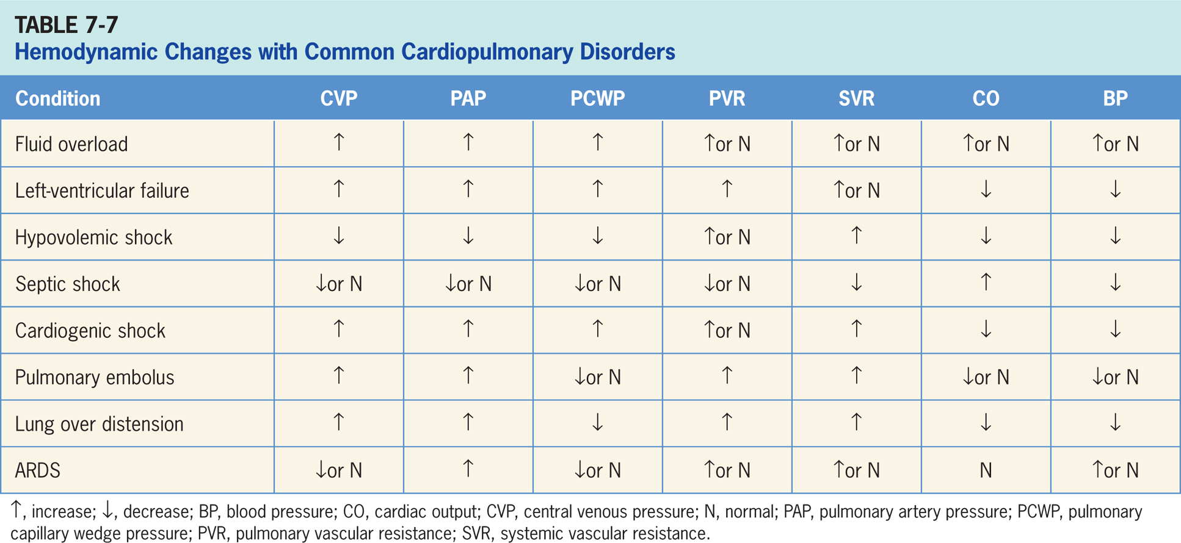
Cardiac and Cardiovascular Support (cont’d)

Slide 70
Use Of Sedation at Neuromuscular Blockade
Proper sedation and pain management can improve patient–ventilator synchrony and comfort and reduce oxygen consumption.
Sedation protocols and the use of sedation scales (e.g., Richmond Agitation – Sedation Scale) should be employed, including routinely waking patients each day.
Neuromuscular blockade can eliminate patient ventilator asynchrony, and some have speculated that it may benefit patients with ARDS.
Neuromuscular blocking agents have no sedative or analgesic properties and must be used in combination with appropriate sedation and treatment of pain.

Slide 71
Key Points
An immediate assessment should be completed following initiation of mechanical ventilation.
Initial assessment should include: physical assessment of the patient, assessment of ventilator settings and patient-ventilator interaction, cardiovascular assessment, oximetry, and measurement of arterial blood gases.
Initiation of mechanical ventilation may lead to respiratory problems which may include right mainstem intubation, misplaced endotracheal tube, cuff leak or malfunction, large air leak, inappropriate ventilator settings, or ventilator malfunction or disconnect.

Slide 72
Key Points (cont’d)
During assist – control volume ventilation, inspiratory peak flow should meet or exceed the patient’s ventilatory needs. Inadequate flow will increase the work of breathing while excessive flow may result in immediate and persistent tachypnea.
Patient-ventilator interaction refers to patient-ventilator synchrony, comfort and work of breathing during ventilator assisted breaths.
A sustained increase in ventilatory workload can lead to ventilatory muscle fatigue and structural injury. Muscle fatigue requires a minimum of 24 hours for recovery.
When set appropriately, ventilator mode and settings should reduce WOB while avoiding ventilatory muscle atrophy.

Slide 73
Key Points (cont’d)
Several modes may be selected to reduce inspiratory effort without minimizing respiratory muscle use.
Patient-ventilator asynchrony occurs when the patient’s respiratory efforts do not coordinate with the ventilator’s set respiratory efforts. Asynchrony may be detected through physical assessment and observation of ventilator graphics.
Patient-ventilator asynchrony is associated with adverse outcomes including increased WOB, hypoxemia, inadequate or ineffective ventilation, hemodynamic compromise, increased risk of complications, and prolonged ventilator dependency.

Slide 74
Key Points (cont’d)
Patient triggered breaths may be pressure triggered or flow triggered. Trigger sensitivity should be adjusted so that trigger work is minimal without auto cycling.
The pressure trigger is typically set -0.5 to -1.5 cm H₂O below the baseline expiratory pressure; flow trigger is typically set 1 to 2 L/min below the baseline or bias flow.
Trigger asynchrony occurs when the patient’s inspiratory effort does not match the beginning of the ventilator supported breath.
Trigger work is the amount of patient’s WOB required to trigger the machine breath; inappropriate trigger sensitivity settings and auto-PEEP can increase trigger work.

Slide 75
Key Points (cont’d)
There are five types of trigger asynchrony: missed triggering, trigger delay, double triggering, reverse triggering and auto triggering.
Missed triggering is when the patient’s inspiratory effort does not trigger the ventilator breath.
Trigger delay is when there is a delay between when the patient initiates inspiration and when the machine actually delivers the breath.
Double triggering occurs when the ventilator cycles into expiration while the patient is still making an inspiratory effort, resulting in double triggering and two consecutive breaths before the patient exhales.

Slide 76
Key Points (cont’d)
Auto triggering occurs when the ventilator initiates inspiration without a corresponding patient effort due to inappropriate trigger sensitivity settings.
Reverse triggering may occur during controlled ventilation in which a time-triggered ventilator breath stimulates the diaphragm, resulting in diaphragmatic contraction which then triggers the next breath.
Flow asynchrony occurs when the inspiratory gas flow from the ventilator does not match the patient’s inspiratory flow demand.
Cycle asynchrony occurs when there is poor coordination between the patient’s respiratory drive and the ventilator.

Slide 77
Key Points (cont’d)
Mode asynchrony occurs when the mode selected does not match the patient’s spontaneous ventilatory efforts.
Tissue oxygenation is determined by inspired oxygen concentration, alveolar ventilation, ventilation-perfusion relationships, diffusion across the alveolar-capillary membrane, arterial oxygen content, cardiac output, and peripheral perfusion.
Appropriate oxygenation values for most patients are PaO₂ 60-80 mmHg and SaO₂ 90-95% with Fio₂ ≤ 0.50-0.60.
Improved oxygenation can be achieved by adjusting Fio₂, PEEP, and CPAP. Other methods for improving oxygenation include recruitment techniques, open lung ventilation, and prone positioning.

Slide 78
Key Points (cont’d)
Fio₂ should be rapidly titrated down from 1.0 to avoid oxygen toxicity and related complications. Complications of high Fio₂ include absorption atelectasis, cellular injury, accentuation of hypercapnia, airway injury, parenchymal injury, potentiation by bleomycin, and retinopathy of prematurity in premature infants.
PEEP or CPAP are used to prevent or treat atelectasis by opening collapsed alveoli and reducing alveolar overdistention.
PEEP may help to reduce the incidence of ventilator associated pneumonia (VAP) and ventilator associated lung injury (VALI); PEEP may cause pulmonary barotrauma, reduced venous return, or negatively affect cardiac output and blood pressure.

Slide 79
Key Points (cont’d)
Methods for PEEP application include minimum PEEP, optimal PEEP, and compliance titrated PEEP.
Minimum PEEP is the least PEEP needed to achieve adequate arterial oxygenation at a safe oxygen concentration.
Optimal or Best PEEP can be defined as the PEEP which maximizes oxygen delivery to the tissues.
Compliance titrated PEEP is the best PEEP based on static total compliance (CST).
A decremental PEEP trial is a method used to identify optimal PEEP for patients with ARDS following a lung recruitment maneuver.

Slide 80
Key Points (cont’d)
Intrinsic PEEP or auto PEEP occurs when gas is not completely exhaled before beginning the next inspiratory phase.
Static auto PEEP is calculated by subtracting the extrinsic PEEP from the observed end-expiratory pressure observed during the expiratory pause.
Dynamic auto PEEP can be measured in spontaneously breathing patients by observing the flow-time curve.
High PEEP can be effective in improving oxygenation in patients with severe ARDS with recruitable lung but harmful to patients with mild ARDS who have little recruitable lung.

Slide 81
Key Points (cont’d)
Various recruitment maneuvers have been suggested to improve oxygenation in patients with ARDS or those with reduced functional residual capacity (FRC), which include a “30 for 30” or “40 for 40” maneuver, sigh breaths, or a variation of pressure control ventilation.
It is important to monitor the patient’s heart rate, blood pressure and cardiac monitor while performing a recruitment maneuver.
Prone positioning improves oxygenation for patients with severe ARDS.
Contraindications to prone positioning include shock, hemorrhage, multiple fractures or trauma, spinal instability, pregnancy, increased intracranial pressure, or recent tracheal surgery or sternotomy.

Slide 82
Key Points (cont’d)
Bronchial hygiene techniques may improve oxygenation for ventilated patients. Techniques include suctioning and airway care, provision of adequate humidification, and administration of bronchodilators and inhaled anti-inflammatory agents.
Early mobilization of ventilated patient may improve oxygenation and decreasing consequences of ICU acquired weakness.
PaCO₂ is the single best clinical indicator of alveolar ventilation and allows for accurate evaluation of ventilator success.
Arterial blood gases are typically drawn 20-30 minutes following a parameter change to confirm appropriate settings.

Slide 83
Key Points (cont’d)
Patients with dangerously elevated intracranial pressure (ICP) may be hyperventilated for a short period of time to lower PaCO₂ and ICP.
Permissive hypercapnia is a ventilatory strategy which reduces delivered volumes and pressures to reduce alveolar pressure and over distension. This strategy may be useful for patients with severe ARDS, and severe bronchospasm with acute asthma exacerbation, or exacerbation of COPD.
A decrease in PaCO₂ may be achieved by increasing tidal volume, frequency, or decreasing mechanical dead space.

Slide 84
Key Points (cont’d)
An increase in PaCO₂ may be achieved by decreasing tidal volume, frequency, or increasing mechanical dead space.
Tidal volume is initially set to 6-8 ml/kg IBW and titrated up or down to ensure P_{plat} < 28-30 cm H₂O.
Patients in respiratory failure often experience acid-base disorders and the patient’s ventilatory status can have a significant impact on acid-base balance.
Acute increases in PaCO₂ will cause a corresponding decrease in pH while acute decreases in PaCO₂ will increase pH.

Slide 85
Key Points (cont’d)
Each time there is an acute change and PaCO₂ increases by 1 mmHg, pH will decrease by 0.008, and each time there is an acute change and PaCO₂ decreases by 1 mmHg, pH will increase by 0.008.
Appropriate pain management and sedation protocols should be employed in ventilated patients.
Cardiac and cardiovascular problems may impair tissue oxygen delivery.
Neuromuscular blockade should be reserved for patients with persistent ventilatory asynchrony or severe oxygenation problems and for relatively short periods of time.
Ventilator failure or accidental disconnection can be catastrophic in patients undergoing neuromuscular blockade.

