Slide 1
Chapter 4: Section IV

Slide 2
Portable, Transport, and Non-invasive Ventilators
HAMILTON-T1
HAMILTON-MR1
Airon pNeuton
pNeuton mini
pNeuton A and S
Bio-Med Devices Crossvent 4+
Vyaire ReVel
Vyaire LTV 1200
Dräger CarinaDräger Oxylog 3000 Plus
Medtronic Newport HT 70 Plus
ZOLL Eagle II
Philips Respironics Trilogy Ventilator
DeVilbiss IntelliPAP Bilevel S
DeVilbiss IntelliPAP AutoBilevel
ResMed Lumis Tx
ResMed Astral 100/150

Slide 3
Portable Ventilators HAMILTON-T1
Intended to provide positive pressure ventilatory support to adults and pediatrics, and optionally infants and neonates.²¹ It is pictured in (Figure 4-38). It is meant to be used in the ICU, intermediate care, emergency room, long-term acute care hospital or during transport.
An electronically controlled pneumatic ventilator with an integrated air compressing system.
It runs on AC or direct current (DC) power with battery backup.

Slide 4
Portable Ventilators HAMILTON-T1 (cont’d)
Pneumatics deliver gas, and its electrical systems control pneumatics, monitor alarms, and distribute power. It employs a proximal flow sensor to monitor and deliver gas.
T1 operator interface utilizes a combination of numerics and real time waveforms and is depicted in (Figure 4-39).
It consists of a touch screen, some keys and a turn-and-press knob. Turning the knob changes the values of the parameter chosen and pressing the knob confirms the selection.

Slide 5
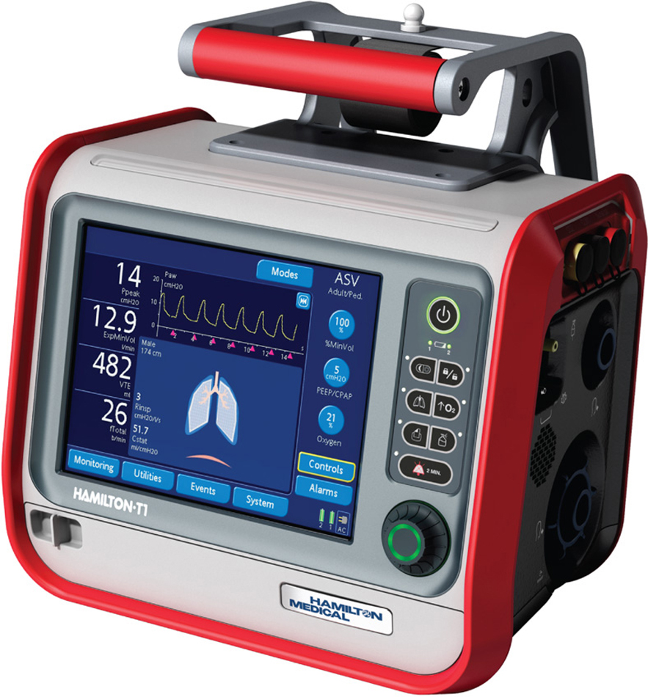
Figure 4.38

Slide 6
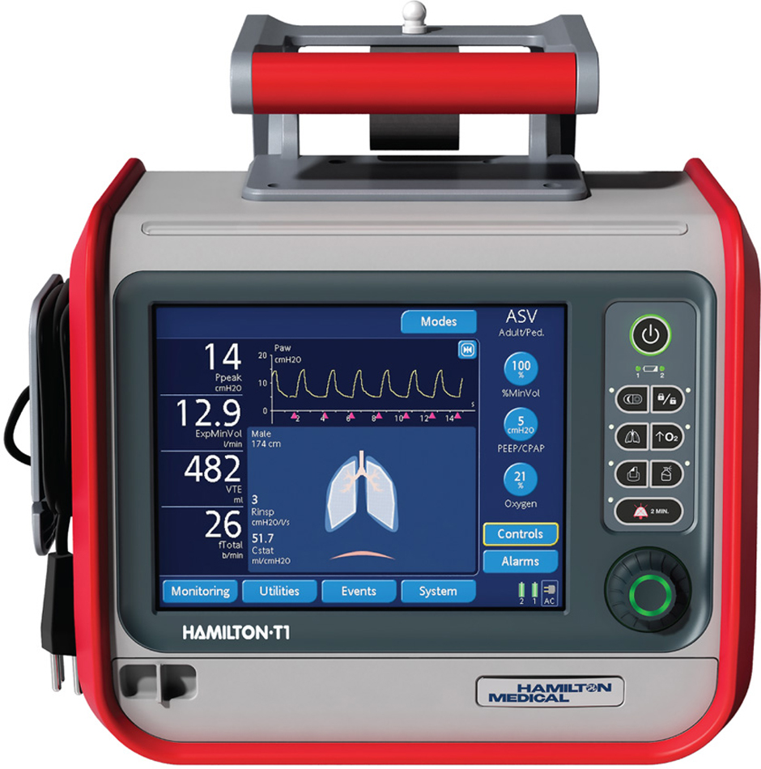
Figure 4.39

Slide 7
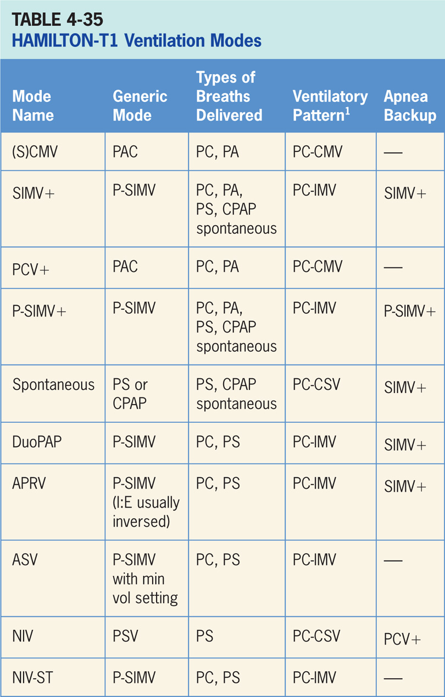

Slide 8
Synchronized Controlled Mandatory Ventilation Plus [(S)CMV+]
Vt targeted, pressure-regulated mode. ²¹
Clinician sets the Vt and the ventilator uses varying levels of pressure to achieve the target.
The ventilator relies on calculations from previous breaths to deliver what it calculates the inspiratory pressure level needs to be to achieve the desired Vt.

Slide 9
Main Operator Controls Include:
Vt target
PEEP
Fio₂
I:E
Vt may not match the operator setting due to the ventilator is using inspiratory pressure to target the Vt as to VAC and relies on the previous breaths to make the calculation.²¹ Any change in patient effort from the previous breath may result in a deviation from the Vt setting.

Slide 10
Synchronized, Intermittent Mandatory Ventilation Plus (SIMV+)
SIMV+ combines a Vt targeted PAC breath (see SCMV+ above) with spontaneous PS breaths in between.²¹
There exists mandatory, time-triggered breaths, patient-assisted breaths, and spontaneous breaths.
Ventilator prevents “breath stacking” (a SCMV+ breath compounded by a PS breath) through the use of “timing window.”
If patient attempts to trigger a breath in timing window, then ventilator will deliver a SCMV+ breath.
If patient attempts to trigger a breath outside the window, then a spontaneous PS breath will occur.

Slide 11
Main Operator Controls Include:
Vt target
PEEP
Fio₂
Inspiratory time
PS level
Vt may not match operator setting for the SCMV+ breaths due to the ventilator is using inspiratory pressure to target the Vt as to VAC and relies on the previous breaths to make the calculation.²¹ Any change in patient effort from the previous breath may result in a deviation from the Vt setting.
During the SCMV+ breaths, the resulting pressure created is variable and depends on Vt, flow, and patient mechanics.
During PS breaths, the Vt will be variable and depend on the PS level, patient effort, and patient respiratory system mechanics.

Slide 12
Pressure Controlled Ventilation+ (PCV+)
Pressure-targeted mode of ventilation that allows for mandatory, time-triggered breaths or patient-assisted breaths.²¹
Breath cycles to exhalation once the inspiratory time has been reached or when the high-pressure alarm is tripped.
Free breathing is allowed at both PEEP and inspiratory pressure levels.

Slide 13
Main Operator Controls Include:
Inspiratory pressure level
I:E ratio
RR
PEEP
Fio₂
Pressure will be consistently delivered from breath to breath; Vt and flow are variable and will depend on the inspiratory pressure level, patient effort, and patient respiratory system mechanics.²¹

Slide 14
Pressure Synchronized, Intermittent Mandatory Ventilation+ (PSIMV+)
Similar to SIMV+ except the target is now pressure instead of volume and that inspiratory pressure is now set by the clinician.
P-SIMV+ also combines two breath types, PAC (PCV+) and PS or spontaneous breathing, while on CPAP.²¹
Combination of mandatory, time-triggered breaths, patient-assisted breaths, and spontaneous breaths.
Ventilator prevents “breath stacking” (a PAC breath compounded by a PS breath) through the use of a “timing window.”
If the patient attempts to trigger a breath in this timing window, then ventilator will deliver a PAC breath.
If the patient attempts to trigger a breath outside window, then a spontaneous breath will occur.

Slide 15
Main Operator Controls Include:
Inspiratory pressure level
Inspiratory time
RR
PEEP
Fio₂
Pressure support level
Cycle sensitivity for the PS breaths
During PAC breaths, resulting Vt created is variable and depends on inspiratory pressure level, patient effort, and patient respiratory system mechanics.²¹
During PS breaths, the volume will be variable and depend on the PS level, patient effort, and patient respiratory system mechanics.²¹

Slide 16
Spontaneous (SPONT)
Patient triggers all breaths and will receive either PS or CPAP (if the PS is set at 0).²¹
If PS is set at 0, then the patient must contribute all of the work of breathing.
Sometimes used for a spontaneous breathing trial to assess the potential for liberation from the ventilator.
During PS, patient regulates the respiratory rate and the Vt with support from the ventilator.
Patient triggers all breaths and will receive the clinician-set PS level.
Breath cycles to expiration when the inspiratory flow decreases below a preset percentage of the inspiratory peak flow.

Slide 17
Duo Positive Pressure Ventilation (DuoPAP)
Pressure-targeted mode of ventilation allowing for spontaneous breathing at two different pressure levels.²¹
Ventilator switches between two different clinician-set pressure levels (the lower of which can be CPAP).
Pressure levels are referred to as P_{high} and PEEP. T_{high} is the length of time at P_{high} and T_{low} is the length of time spent at T_{low}.
Important difference from pressure-targeted modes is P_{high} level is now referenced to atmosphere as opposed to the PEEP level.
Important: increases in P_{low} will decrease the distending pressure. Additional ventilator support can also be added in the form of PS at both pressure levels to augment the patient effort.

Slide 18
Airway Pressure Release Ventilation (APRV)
Mode of ventilation similar to DuoPAP in allowing for spontaneous breathing at two different pressure levels.²¹
The ventilator switches between two different clinician-set pressure levels (the lower of which can be CPAP).
These pressure levels are referred to as P_{high} and P_{low}. T_{high} is length of time at P_{high} and T_{low} is length of time spent at T_{low}.
Unlike DuoPAP, APRV generally is used in an inverse ratio fashion. Most of time spent at P_{high} with brief, periodic releases to P_{low}.
Important difference from pressure-targeted modes is that the P_{high} level is now referenced to atmosphere as to the PEEP level.
Important: increases in P_{low} will decrease distending pressure. Additional ventilator support can also be added in the form of PS at both pressure levels to augment the patient effort.

Slide 19
Adaptive Support Ventilation (ASV)
“Feedback” mode that adjusts inspiratory pressure and RR to meet a minimum minute volume set by clinician.²¹
Results in a variable form of P-SIMV; machine-timed breaths are PAC while the spontaneously generated breaths are PS.
Amount of breathing that patient does determines how many machine-generated breaths will be delivered.
Algorithm for ASV is centered around lung protection.

Slide 20
Noninvasive Ventilation
Patient triggers all breaths and will receive PS.²¹
NIV is designed for use with a mask or other noninvasive patient interface

Slide 21
Spontaneous/Timed Noninvasive Ventilation (NIV-ST)
NIV-ST is also designed for use with a mask or other noninvasive patient interface.²¹
Essentially P-SIMV without an endotracheal tube. NIV-ST combines two breath types, PAC and either PS or spontaneous breathing, while on CPAP.
Combination of mandatory, time-triggered breaths, patient-assisted breaths, and spontaneous breaths.
If patient triggers regularly, all breaths are patient-triggered spontaneous breaths, i.e., no time-triggered mandatory breaths. Only when the patient trigger is not detected during defined breath cycle time (or total breath time), the ventilator delivers time-triggered mandatory breath.

Slide 22
Spontaneous/Timed Noninvasive Ventilation (NIV-ST) (cont’d)
Ventilator prevents “breath stacking” (a PAC breath compounded by a PS breath) through use of a “timing window.”
If patient attempts to trigger a breath in this timing window, then ventilator will deliver a PAC breath.
If the patient attempts to trigger a breath outside window, then a spontaneous breath will occur.

Slide 23
Oxygen Special Features
High-pressure oxygen can be provided by a central gas supply or a gas cylinder (41 87 psi).²¹
Low-pressure oxygen can be provided by a concentrator or liquid cylinder (flow ≤ 15 L/min, ≤ 87 psi).

Slide 24
Apnea Backup Ventilation
Ventilator will go into apnea backup ventilation if no breaths are detected in clinician-set interval.²¹
Mode of apnea backup ventilation depends on mode that patient is in (Table 4-51).

Slide 25
Nebulizer
A pneumatic nebulization function powers a standard inline nebulizer for delivery of prescribed medications in ventilator circuit.²¹
When nebulization is active, nebulizer flow is synchronized with the inspiratory phase of each breath for 30 minutes.
Nebulization can be activated in all modes of ventilation.

Slide 26
CO₂ Monitoring
An optional CO₂ sensor is available to allow monitoring of end tidal and volumetric expired CO₂.²¹

Slide 27
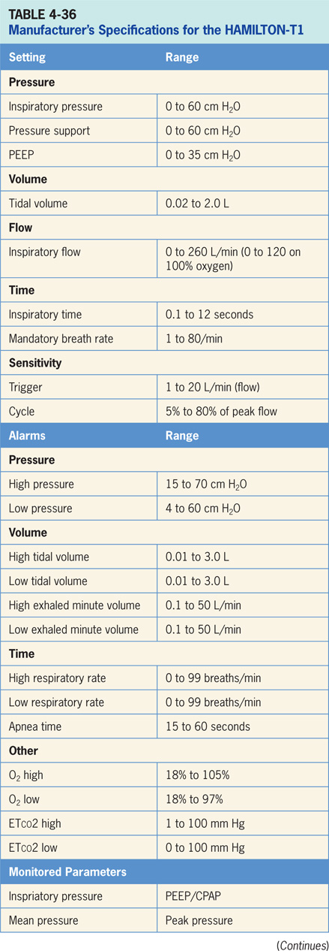

Slide 28
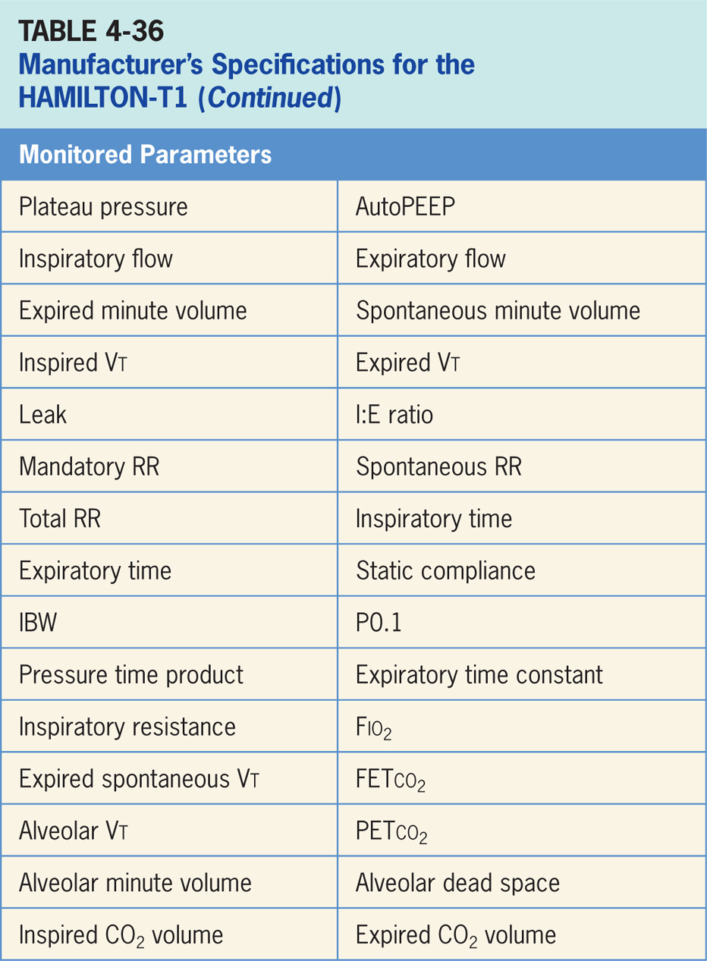

Slide 29
HAMILTON–MR1
HAMILTON-MR1 ventilator is intended to provide positive pressure ventilatory support to adults and pediatrics, and optionally infants and neonates.²² (pictured in Figure 4-40)
Intended for use in: the MRI department, the intensive care ward, intermediate care ward, emergency ward, long term acute care hospital or in the recovery room. MR1 can also be used as a transport ventilator.
Ventilator is classified as MR Conditional with the use of 1.5 Tesla and 3.0 Tesla static magnetic field scanners and is electronically controlled pneumatic ventilation system with an integrated air compressing system.

Slide 30
HAMILTON–MR1 (cont’d)
It uses an external power supply connected to AC mains with battery backup. The ventilator’s pneumatics deliver gas, and its electrical systems control pneumatics, monitor alarms, and distribute power.
The user provides inputs to the microprocessor system through a touch screen, keys, and a press-and-turn knob then ventilator receives inputs from the proximal flow sensor and other sensors within the ventilator. (operator interface of the MR1 is pictured in Figure 4-41)

Slide 31
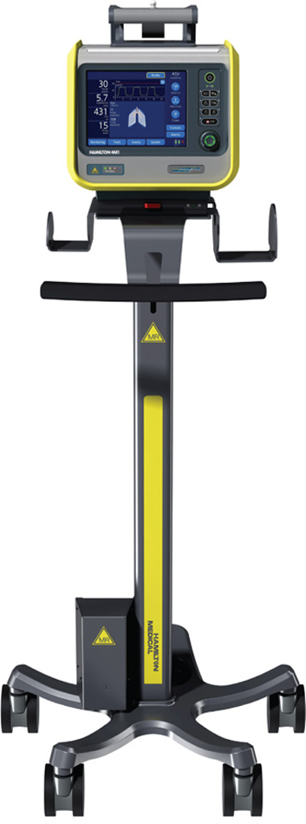
Figure 4.40

Slide 32
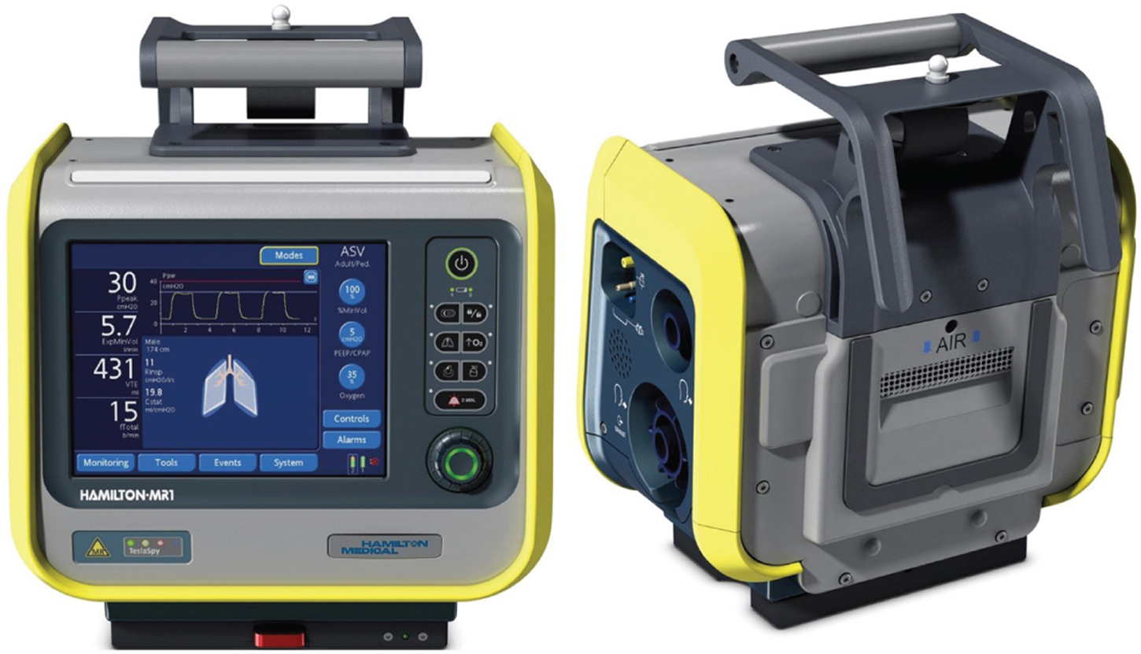
Figure 4.41

Slide 33
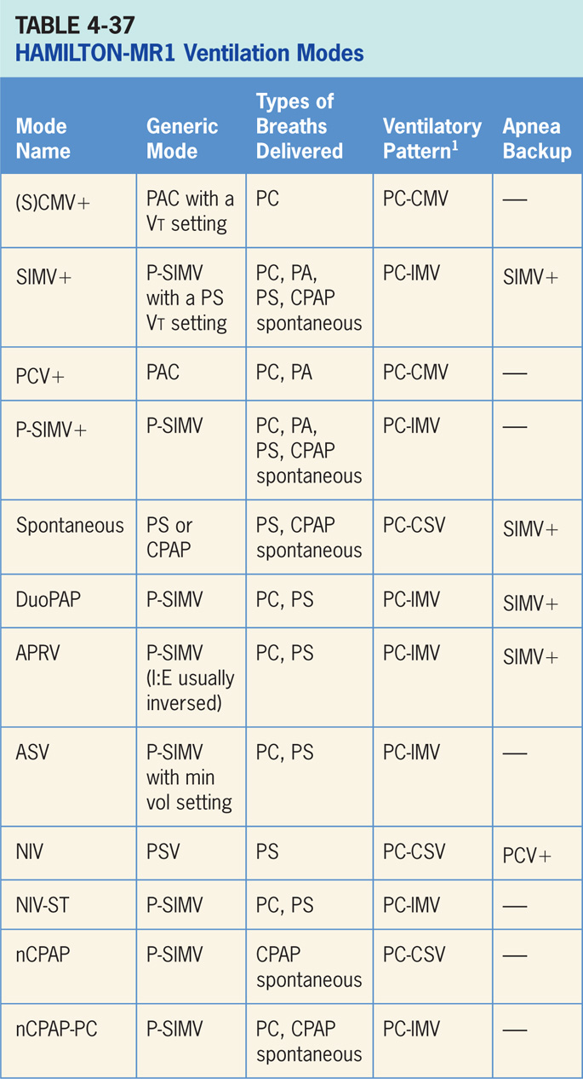

Slide 34
Synchronized Controlled Mandatory Ventilation Plus ((S)CMV+)
Vt targeted, pressure-regulated mode.²²
Clinician sets the Vt that want and ventilator uses varying levels of PAC to achieve the target.
Ventilator relies on calculations from previous breaths to deliver what it calculates the inspiratory pressure level needs to be to achieve the Vt.
In this mode, ventilator has the potential to drop inspiratory pressure level as patient effort increases and conversely may increase inspiratory pressure level when patient effort is too low.

Slide 35
Main Operator Controls Include:
Fio₂
PEEP
Vt target
I:E
RR
Vt may not match the operator setting due to the ventilator is using inspiratory pressure to target the Vt as to VAC and relies on the previous breaths to make the calculation.²² Any change in patient effort from previous breath may result in a deviation from the Vt setting.

Slide 36
Synchronized, Intermittent Mandatory Ventilation Plus (SIMV+)
SIMV+ combines a Vt targeted PAC breath with spontaneous PS breaths in between.²²
The type of breaths delivered are the same as P-SIMV; difference is the inspiratory pressure level is controlled by ventilator (variable) in SIMV+.

Slide 37
Main Operator Controls Include:
Fio₂
PEEP
Vt target
Inspiratory time
RR
PS level
Cycle sensitivity
Vt may not match operator setting for PAC breaths due to the ventilator is using inspiratory pressure to target the Vt as to VAC and relies on the previous breaths to make the calculation.²² Any change in patient effort from the previous breath may result in a deviation from Vt setting. During PS breaths, Vt will be variable and depend on PS level, patient effort, and patient respiratory system mechanics.

Slide 38
Pressure Controlled Ventilation+ PCV+
Pressure-targeted mode of ventilation allowing for mandatory, time-triggered breaths or patient-assisted breaths.²²
Spontaneous breaths not allowed.
Breath cycles to exhalation once the inspiratory time has been reached.

Slide 39
Main Operator Controls Include:
Fio₂
PEEP
Inspiratory pressure level
I:E
RR
Pressure will be consistently delivered from breath to breath; Vt and flow are variable and will depend on the inspiratory pressure level, patient effort, and patient respiratory system mechanics.²²

Slide 40
Pressure Synchronized, Intermittent Mandatory Ventilation+ (PSIMV+)
Similar to SIMV except the target is now pressure instead of volume.²²
P-SIMV also combines two breath types, PAC and either PS or spontaneous breathing, while on CPAP.
Combination of mandatory, time-triggered breaths, patient-assisted breaths, and spontaneous breaths.
Ventilator prevents “breath stacking” (a PAC breath compounded by a PS breath) through the use of “timing window.”
If patient attempts to trigger a breath in timing window, then ventilator will deliver a PAC breath.
If patient attempts to trigger a breath outside window, then a spontaneous breath will occur.

Slide 41
Main Operator Controls Include:
Fio₂
PEEP
Inspiratory pressure level
Inspiratory time
RR
Pressure support level
Cycle sensitivity
During PAC breaths, resulting Vt created is variable and depends on inspiratory pressure level, patient effort, and patient respiratory system mechanics.²²
During PS breaths, volume will be variable and depend on PS level, patient effort, and patient respiratory system mechanics.²²

Slide 42
Spontaneous Mode
Patient triggers all breaths and will receive either PS or CPAP (if the PS is set at 0).²²
If PS is set at 0 then patient must contribute all of the work of breathing.
Sometimes used for a spontaneous breathing trial to assess the potential for liberation from ventilator.
During Pressure Support, patient regulates the respiratory rate and Vt with support from ventilator.
Patient triggers all breaths and will receive clinician-set PS level.
Breath cycles to expiration when inspiratory flow decreases below a preset percentage of the inspiratory peak flow.

Slide 43
Duo Positive Airway Pressure (DuoPAP)
Pressure-targeted mode of ventilation allowing for spontaneous breathing at two different pressure levels.²²
The ventilator switches between two different clinician-set pressure levels (the lower of which can be CPAP).
These pressure levels are referred to as P_{high} and P_{low}. T_{high} is length of time at P_{high} and T_{low} is length of time spent at T_{low}.
Important difference from pressure-targeted modes is the P_{high} level is now referenced to atmosphere as to PEEP level.
Important: increases in P_{low} will decrease the distending pressure. Additional ventilator support can also be added in the form of PS at both pressure levels to augment the patient effort.

Slide 44
Airway Pressure Release Ventilation (APRV)
Mode of ventilation similar to DuoPAP in allowing for spontaneous breathing at two different pressure levels.²²
Ventilator switches between two different clinician-set pressure levels (the lower of which can be CPAP).
Pressure levels are referred to as P_{high} and P_{low}. T_{high} is length of time at P_{high} and T_{low} is length of time spent at T_{low} Different from DuoPAP - APRV generally is used in an inverse ratio fashion.
Most of time is spent at P_{high} with brief, periodic releases to P_{low}.
Important difference from pressure-targeted modes is that P_{high} level is now referenced to atmosphere as to the PEEP level.
Important: increases in P_{low} will decrease the distending pressure. Additional ventilator support can also be added in the form of PS at both pressure levels to augment the patient effort.

Slide 45
Adaptive Support Ventilation (ASV)
“Feedback” mode that adjusts the inspiratory pressure and RR to meet a minimum minute volume set by the clinician.²²
This results in variable form of P-SIMV. The machine-timed breaths are PAC while the spontaneously generated breaths are PS.
Amount of breathing that patient does determines how many machine-generated breaths will be delivered.
Algorithm for ASV is centered around lung protection.

Slide 46
Noninvasive Ventilation
In NIV mode, patient triggers all breaths and will receive either PS.²²
NIV is designed for use with a mask or other noninvasive patient interface.

Slide 47
Spontaneous/Timed Noninvasive Ventilation (NIV-ST)
Designed for use with a mask or other noninvasive patient interface.²² It is essentially P-SIMV without an endotracheal tube which combines two breath types, PAC and either PS or spontaneous breathing, while on CPAP.
Combination of mandatory, time-triggered breaths, patient-assisted breaths, and spontaneous breaths.
If patient triggers regularly, all breaths are patient-triggered spontaneous breaths, i.e., no time-triggered mandatory breath, only when patient trigger is not detected during the defined breath cycle time (or total breath time), ventilator delivers time-triggered mandatory breaths.

Slide 48
Spontaneous/Timed Noninvasive Ventilation (NIV-ST) (cont’d)
Ventilator prevents “breath stacking” (a PAC breath compounded by a PS breath) through the use of a “timing window.”
If patient attempts to trigger a breath in this timing window, then ventilator will deliver a PAC breath.
If patient attempts to trigger a breath outside window, then a spontaneous breath will occur.

Slide 49
Main Operator Controls Include:
Fio₂
PEEP
Inspiratory pressure level
Inspiratory time
RR
Pressure support level
Cycle sensitivity
During PAC breaths, resulting Vt created is variable and depends on inspiratory pressure level, patient effort, and patient respiratory system mechanics.²²
During PS breaths, volume will be variable and depend on the PS level, patient effort, and patient respiratory system mechanics.²²

Slide 50
Nasal Continuous Positive Airway Pressure (nCPAP)
Available only in neonatal mode and is designed for use with a noninvasive interface.²²
Purely spontaneous mode with CPAP as the baseline pressure with no additional pressure added on inspiration.

Slide 51
Main Operator Controls Include:
Fio₂
CPAP
RR
Vt created will be variable and depend on: patient effort, and patient respiratory system mechanics.²²

Slide 52
Nasal Continuous Positive Airway Pressure-pressure Control (nCPAP-PC)
Noninvasive pressure-targeted mode of ventilation allowing for mandatory, time-triggered breaths or patient-assisted breaths.²²
Breath cycles to exhalation once the inspiratory time has been reached

Slide 53
Main Operator Controls Include:
Fio₂
PEEP
Inspiratory pressure level
Inspiratory time
RR
Pressure will be consistently delivered from breath to breath; Vt and flow are variable and will depend on the inspiratory pressure level, patient effort, and patient respiratory system mechanics.²²

Slide 54
Apnea Backup Ventilation Special Features
Ventilator will go into apnea backup ventilation if no breaths are detected in the clinician-set interval.²²
Mode of apnea backup ventilation depends on the mode that patient is in (table 4-37)

Slide 55
Nebulizer
Pneumatic nebulization function powers a standard inline nebulizer for delivery of prescribed medications in ventilator circuit.²²
When nebulization is active, nebulizer flow is synchronized with the inspiratory phase of each breath for 30 minutes.
Nebulization can be activated in all modes of ventilation.

Slide 56
Dynamic Lung Panel
Dynamic lung panel visualizes tidal volume, lung compliance, patient triggering, and resistance in real time.²²
Lungs expand and contract in synchrony with actual breaths. Numeric values for resistance (R_{insp}) and compliance (C_{stat}) are displayed.
Shape of lungs and the bronchial tree are also related to compliance and resistance values.
If all values are in a normal range, the panel is framed in green.

Slide 57
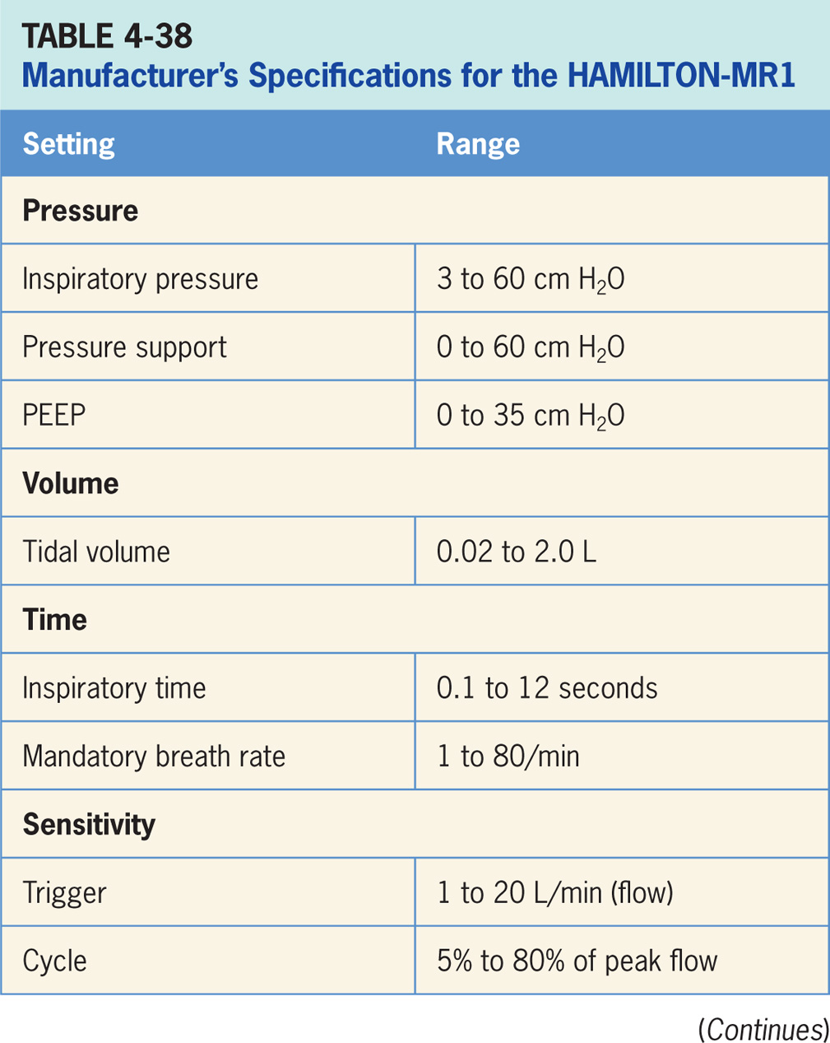

Slide 58
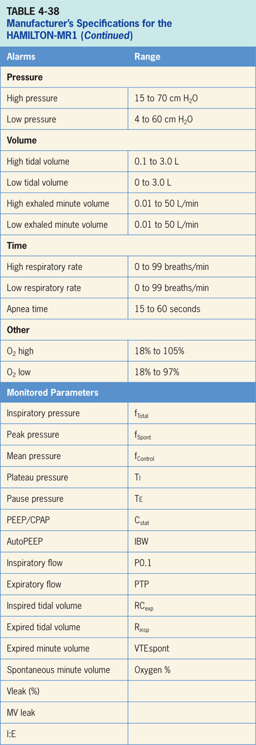

Slide 59
Accessories
HAMILTON-MR1 has an integrated vibrating mesh Aerogen® nebulizer for aerosolized medication delivery.²²

Slide 60
Airon pNeuton
Ventilators are small (< 15 pounds), pneumatically powered, pneumatically controlled and MRI compatible. The operator interfaces consist of a series of control knobs and a pressure gauge.
Being pneumatically driven they can provide ventilation while on transport or in the MRI suite.
pNeuton Mini is designed to ventilate neonatal, infant and pediatric patients.
pNeuton A and S models are designed to ventilate pediatric and adult patients. (The family of pNeuton ventilators are depicted in Figure 4-42)

Slide 61
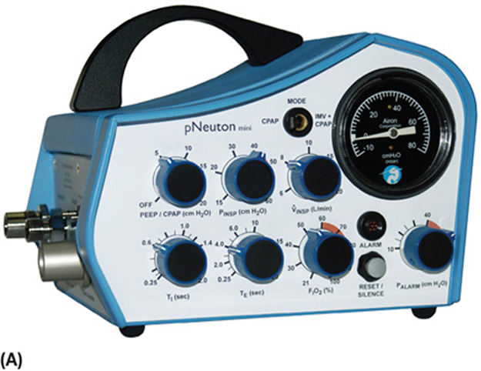
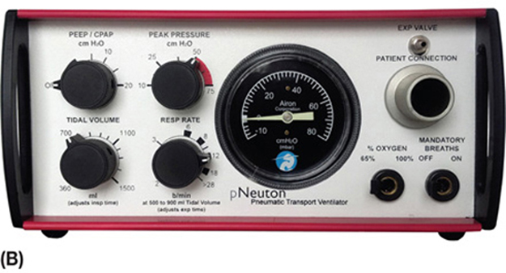
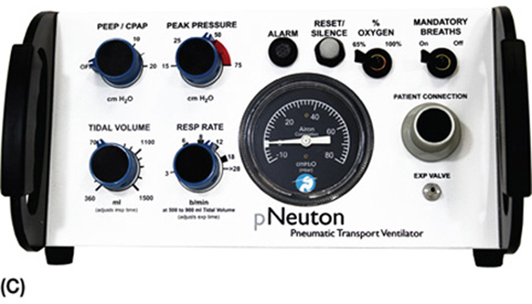
A. pNeuton Mini (neonatal/infant/pediatric)
B) pNeuton S (pediatric/adult)
C) pNeuton B (pediatric/adult)
Figure 4.42 A-C

Slide 63
Continuous Positive Airway Pressure (CPAP) pNeuton Mini
Purely spontaneous mode of ventilation.²³
No mandatory breaths are delivered.
Throughout breath cycle, clinician-set pressure is provided.
Breaths are supported only with demand flow.

Slide 64
Main Operator Controls Include:
Fio₂
CPAP
Vt will be variable and depend on patient effort, and patient respiratory system mechanics.²³

Slide 65
Intermittent Mandatory Ventilation (IMV) + CPAP
IMV delivers a set number of pressure-targeted (P_{insp}) breaths in which inspiratory time is directly controlled by the clinician while the respiratory rate is controlled by expiratory time setting.²³
In between these IMV breaths, patient can breathe spontaneously from baseline pressure setting (CPAP spontaneous).

Slide 66
Main Operator Controls Include:
Fio₂
PEEP
Inspiratory pressure level
Inspiratory time
Expiratory time
Flow (V_{insp})

Slide 67
Continuous Positive Airway Pressure pNeuton A and S
CPAP is a purely spontaneous mode of ventilation.^{24,25}
No mandatory breaths are delivered.
Throughout the breath cycle the clinician-set pressure is provided.
Breaths are supported only with demand flow.

Slide 68
Main Operator Controls Include:
Fio₂
CPAP
Vt will be variable and depend on patient effort, and patient respiratory system mechanics.²³

Slide 69
Intermittent Mandatory Ventilation (IMV) + CPAP
IMV delivers a set number of pressure-targeted (P_{insp}) breaths in which inspiratory time is directly controlled by clinician while respiratory rate is controlled by the expiratory time setting.²³
In between these IMV breaths, the patient can breathe spontaneously from baseline pressure setting (CPAP spontaneous).

Slide 70
Main Operator Controls Include:
Fio₂
PEEP
Inspiratory pressure level
Inspiratory time
Expiratory time
Flow (V_{insp})

Slide 71
Continuous Positive Airway Pressure pNeuton A and S
CPAP is a purely spontaneous mode of ventilation.^{24,25}
No mandatory breaths are delivered.
Throughout the breath cycle the clinician-set pressure is provided.
Breaths are supported only with demand flow.

Slide 72
Main Operator Controls Include:
Fio₂
CPAP
Vt will be variable and depend on patient effort, and patient respiratory system mechanics.²³

Slide 73
Intermittent Mandatory Ventilation (IMV) + CPAP with Pressure Limit
IMV delivers a set number of volume-targeted breaths in which the pressure limit is clinician-set.^{24,25}
Inspiratory time and respiratory rate are directly controlled by the clinician.
Breath terminates either when the set tidal volume is delivered (volume target) or the pressure limit is met (pressure target).
Between these IMV breaths, patient can breathe spontaneously from the baseline pressure setting (CPAP spontaneous).

Slide 74
Main Operator Controls Include:
Fio₂
PEEP
Tidal volume
Peak pressure
Inspiratory time
Respiratory rate

Slide 75
Special Features
Fio₂ is reset at either 65% or 100%.^{24,25}
All three ventilators can provide noninvasive ventilation.²³⁻²⁵
All three models are MRI compatible.²³⁻²⁵
Other
Ventilators are designed for patient transport.²³⁻²⁵
No leak compensation nor backup ventilation.²³⁻²⁵

Slide 76
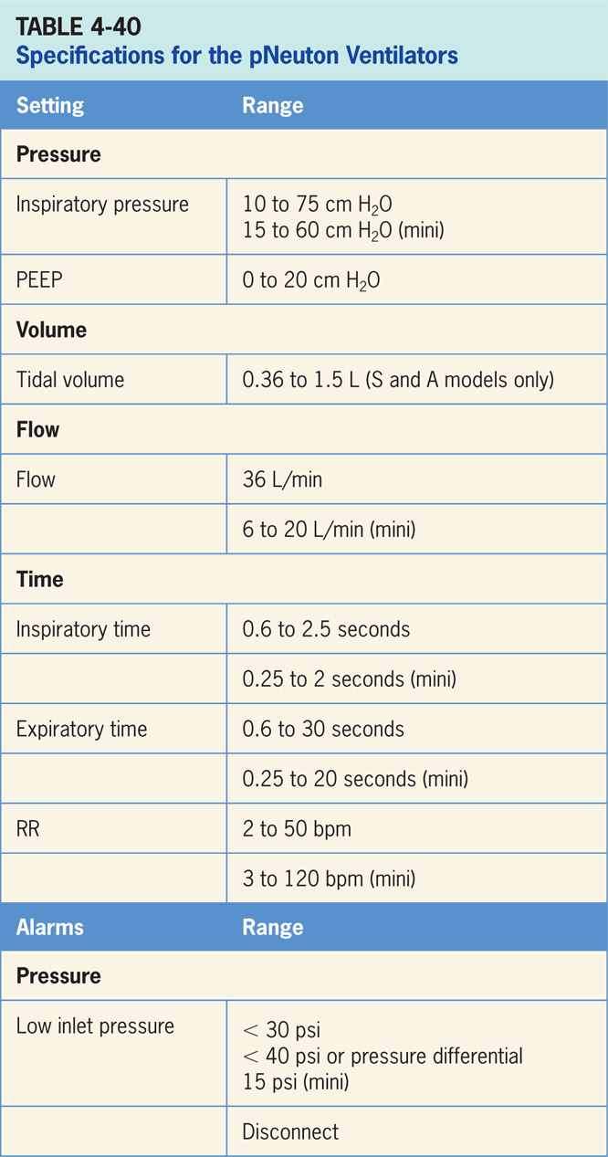

Slide 77
Bio-Med Devices Crossvent 4+
Bio-Med Devices actually provides a series of Crossvent ventilators: the CV 4+, CV 3+, CV 2+, and CV2i+.
CV 4+ is the most recent of the models and can ventilate all patient populations both invasively and noninvasively.
Ventilator is compact small (< 10 pounds), pneumatically powered, microprocessor controlled.
Operator interface consists three adjustment dials and a liquid crystal display. (The Bio-Med Crossvent 4+ ventilator is depicted in Figure 4-43)

Slide 78
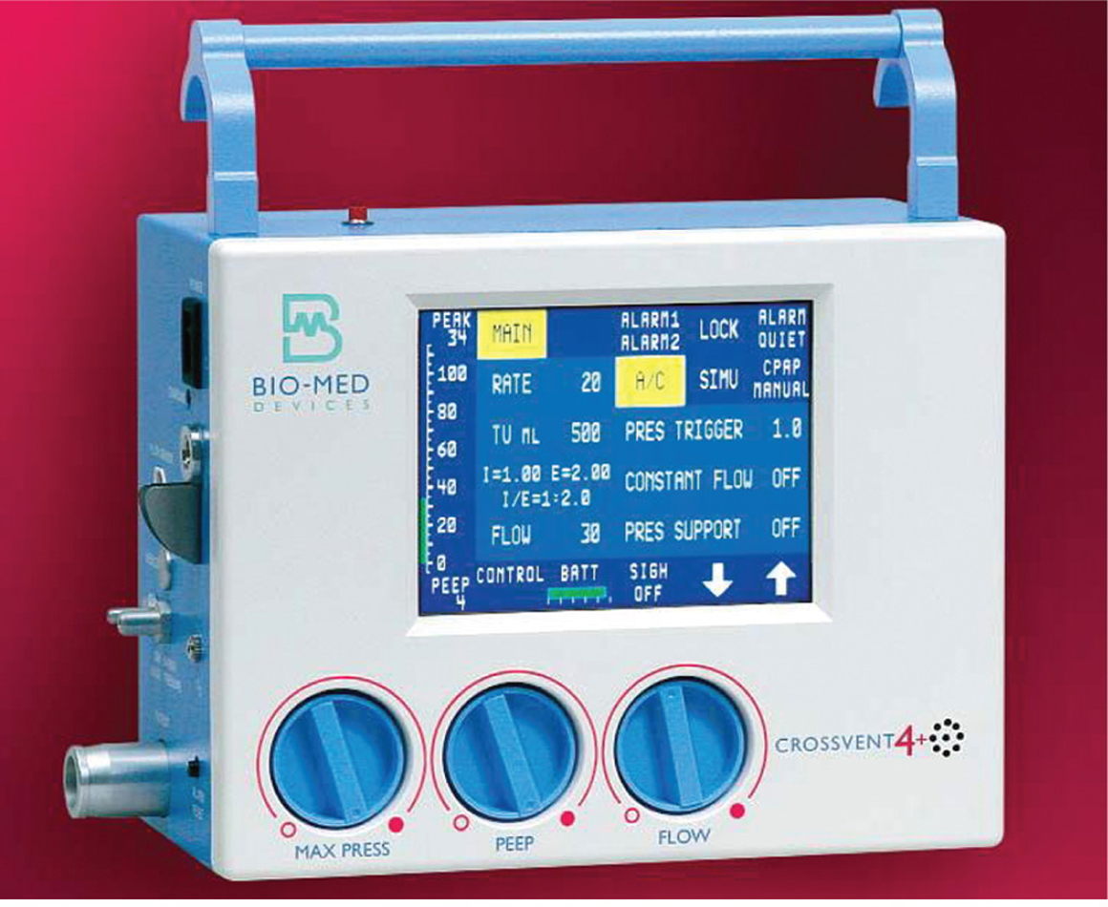
Figure 4.43

Slide 79
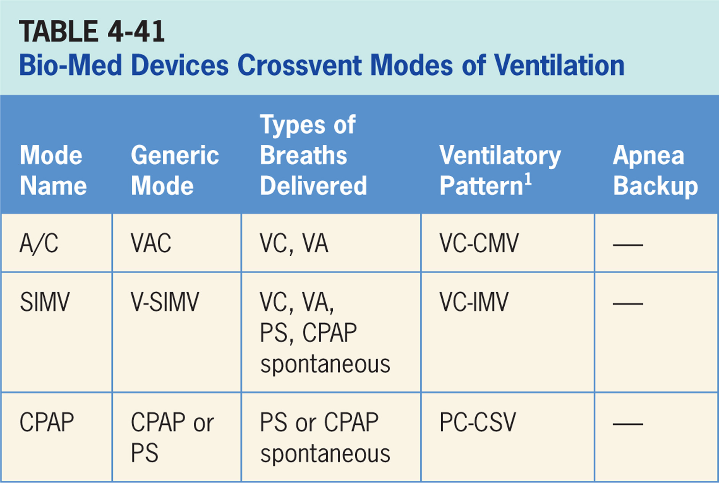

Slide 80
Assist/Control (A/C)
Volume-targeted mode of ventilation (VAC) allowing for mandatory, time-triggered breaths or patient-assisted breaths.²⁶
Spontaneous breathing not available.
Breath cycles to exhalation once the tidal volume (Vt) has been delivered or when the maximum inspiratory pressure has been reached.

Slide 81
Main Operator Controls Include:
PEEP
Vt
Inspiratory flow
RR
Max press
The resulting pressure created is variable and depends on Vt, flow, and patient respiratory system mechanics.²⁶

Slide 82
Synchronized, Intermittent Mandatory Ventilation (SIMV)
Combines two breath types, VAC and either PS or spontaneous breathing, while on CPAP.²⁶
There exists mandatory, time-triggered breaths, patient-assisted breaths, and spontaneous breaths will occur.

Slide 83
Main Operator Controls Include:
PEEP
Vt
Inspiratory flow
SIMV rate
Pressure support level
During VAC breaths, resulting pressure created is variable and depends on Vt, flow, and patient mechanics.²⁶
During PS breaths, volume will be variable and depend on the PS level, patient effort, and patient respiratory system mechanics.²⁶

Slide 84
Continuous Positive Airway Pressure (CPAP)
Purely spontaneous mode of ventilation.²⁶ No mandatory breaths are delivered.
Throughout breath cycle, clinician-set pressure is provided. Pressure support can be added.
If a pressure support level > 0 cm H₂O is set, breath cycles to expiration when inspiratory flow decreases below a preset percentage of the inspiratory peak flow.

Slide 85
Main Operator Controls Include:
PEEP (CPAP)
Pressure support level
Vt will be variable and depend on the PS level, patient effort, and patient respiratory system mechanics.²⁶ If the PS level is set to 0, all breaths will be unsupported.

Slide 86
Special Features
Fio₂ can be set at 50% or 100% with optional Air Entrainment Model, external blender can also be added.²⁶
NIV is available but the mode(s) not specified.²⁶
A backup rate can be set in CPAP in the event that apnea occurs.²⁶
Other
Ventilators are designed for patient transport.²⁶
No leak compensation nor nebulizer available.²⁶

Slide 87
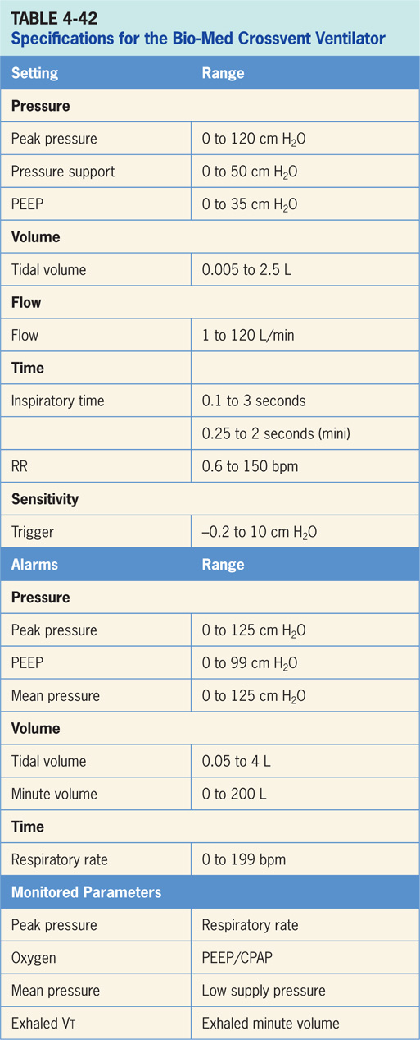

Slide 88
Vyaire ReVel
The Vyaire ReVel ventilator is designed for pediatric (> 5 kg) and adult patients during transport or in subacute care situations.²⁷ It is pneumatically driven and electronically controlled. (pictured in Figure 4-44)
Operator interface consists of a series of knobs and LED readouts (depicted in Figure 4-45)
The ventilator comes with a docking station which can interface with a graphics monitor and nurse call system.

Slide 89
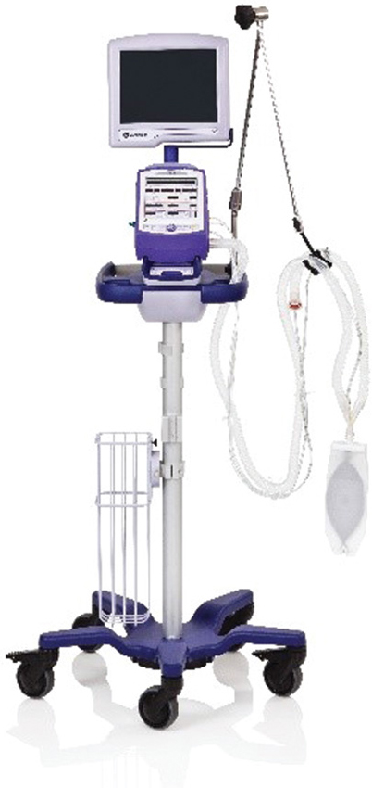
Figure 4.44

Slide 90
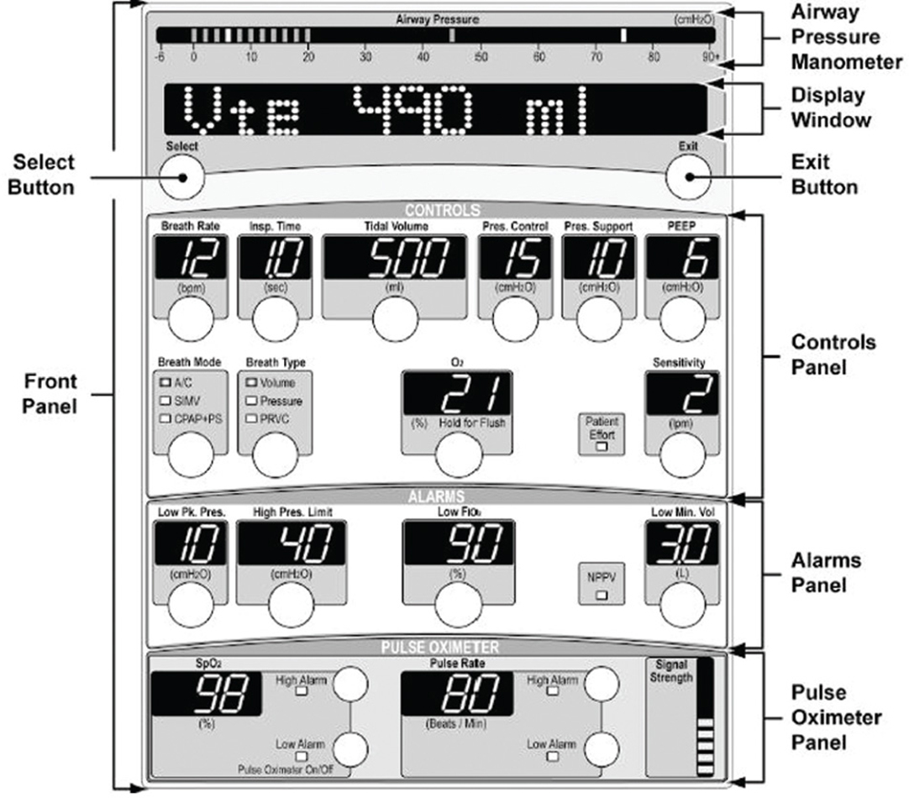
Figure 4.45

Slide 91
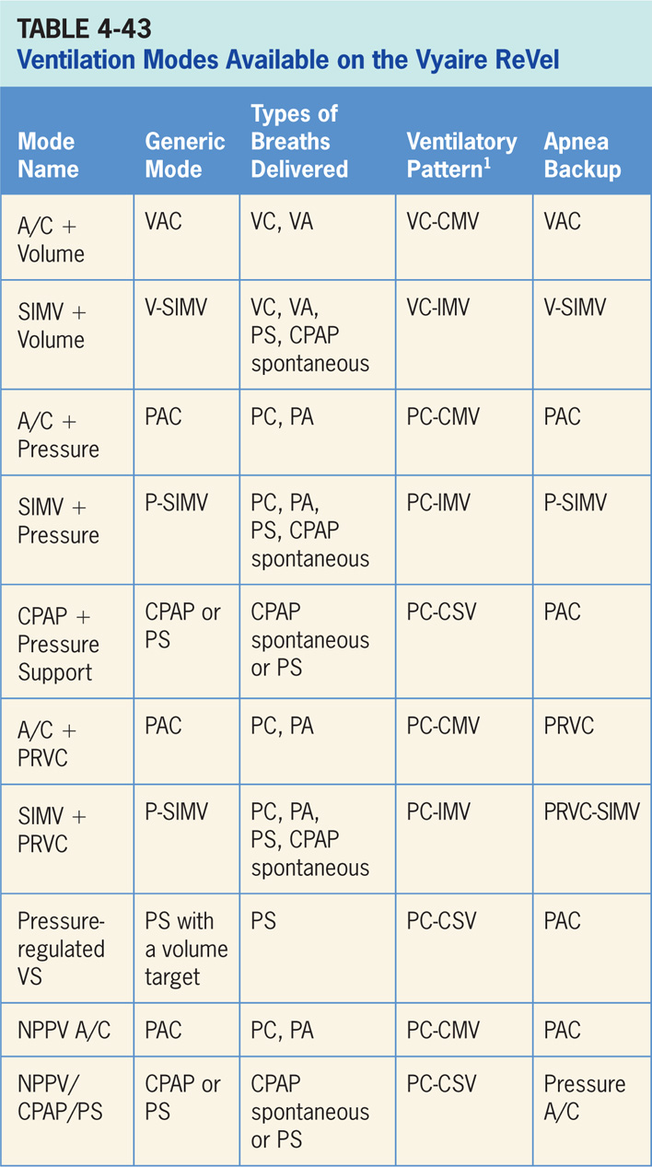

Slide 92
A/C + Volume
Volume-targeted mode of ventilation (VAC) allowing for mandatory, time-triggered breaths or patient-assisted breaths.²⁷
Spontaneous breathing not allowed.
Breath cycles to exhalation once the tidal volume (Vt) has been delivered.

Slide 93
Main Operator Controls Include:
Fio₂
PEEP
Vt
Inspiratory flow
RR
Resulting pressure created is variable and depends on Vt, flow, and patient respiratory system mechanics.²⁷

Slide 94
Synchronized, Intermittent Mandatory Ventilation + Volume - SIMV + Volume
Combines two breath types, VAC and either PS or spontaneous breathing, while on CPAP.²⁷
Mandatory, time-triggered breaths, patient-assisted breaths, and spontaneous breaths are all provided.
The ventilator prevents “breath stacking” (a VAC breath compounded by a PS breath) through use of “timing window.”
If patient attempts to trigger a breath in timing window, then ventilator will deliver a VAC breath.
If patient attempts to trigger a breath outside window, then a spontaneous breath will occur.

Slide 95
Main Operator Controls Include:
Fio₂
PEEP
Vt
Flow
SIMV rate
Pressure support level
Cycle sensitivity
During VAC breaths, resulting pressure created is variable and depends on Vt, flow, and patient mechanics.²⁷
During PS breaths, volume will be variable and depend on the PS level, patient effort, and patient respiratory system mechanics.²⁷

Slide 96
A/C + Pressure
Pressure-targeted mode of ventilation allowing for mandatory, time-triggered breaths or patient-assisted breaths.²⁷
Spontaneous breaths not allowed.
Breath cycles to exhalation once the inspiratory time has been reached or when the high-pressure alarm is tripped.

Slide 97
Main Operator Controls Include:
Fio₂
PEEP
Inspiratory pressure level
Inspiratory time
RR
Pressure will be consistently delivered from breath to breath; Vt and flow are variable and will depend on the inspiratory pressure level, patient effort, and patient respiratory system mechanics.²⁷

Slide 98
SIMV + Pressure
Similar to SIMV + Volume except the target is now pressure instead of volume.²⁷
Combines two breath types, PAC and either PS or spontaneous breathing, while on CPAP.
Combination of mandatory, time-triggered breaths, patient-assisted breaths, and spontaneous breaths.
Ventilator prevents “breath stacking” (a PAC breath compounded by a PS breath) through use of a “timing window.”
If patient attempts to trigger a breath in this timing window, then ventilator will deliver a PAC breath.
If patient attempts to trigger a breath outside window, then a spontaneous breath will occur.

Slide 99
Main Operator Controls Include:
Fio₂
PEEP
Inspiratory pressure level
Inspiratory time
SIMV rate
Pressure support level
Cycle sensitivity
During PAC breaths, resulting Vt created is variable and depends on inspiratory pressure level, patient effort, and patient respiratory system mechanics.²⁷
During PS breaths, volume will be variable and depend on the PS level, patient effort, and patient respiratory system mechanics.²⁷

Slide 100
CPAP + Pressure Support (CPAP + PSV)
Patient regulates respiratory rate and Vt with support from the ventilator.²⁷
Patient triggers all breaths and will receive the clinician-set PS level.
If a pressure support level > 0 cm H₂O is set, the breath cycles to expiration when the inspiratory flow decreases below a preset percentage of the inspiratory peak flow.

Slide 101
Main Operator Controls Include:
Fio₂
PEEP
Pressure support level
Cycle sensitivity
Vt will be variable and depend on the PS level, patient effort, and patient respiratory system mechanics.²⁷ If the PS level is set to 0, all breaths will be unsupported.

Slide 102
A/C + Pressure-regulated Volume Control (A/C + PRVC)
Pressure-targeted (either PC or PA breaths) mode that uses pressure breaths to achieve a clinician-set Vt.²⁷
The inspiratory pressure level; however, is now adjusted by the ventilator instead of the clinician.
Ventilator relies a previous breath sequence to deliver the ensuing breath the Vt tends to be somewhat variable, especially in patients with inconsistent efforts.
No spontaneous breaths.

Slide 103
Main Operator Controls Include:
Fio₂
PEEP
RR
Vt target
Inspiratory time
Amount of pressure and flow delivered will be variable and depend on the Vt setting, patient effort, and patient respiratory system mechanics.²⁷

Slide 104
SIMV + PRVC
Combines two breath types, PAC (ventilator-controlled inspiratory pressure) and either PS or spontaneous breathing, while on CPAP.²⁷
Combination of mandatory, time-triggered breaths, patient-assisted breaths, and spontaneous breaths.
Ventilator prevents “breath stacking” (a PAC breath compounded by a PS breath) through use of a “timing window.”
If patient attempts to trigger a breath in this timing window, then ventilator will deliver a PAC breath.
If patient attempts to trigger a breath outside window, then a spontaneous breath will occur.

Slide 105
Main Operator Controls Include:
Fio₂
PEEP
SIMV rate
Vt
Inspiratory time
Pressure support level
Cycle sensitivity
During control breath amount of pressure and flow delivered will be variable and depend on the Vt setting, patient effort, and patient respiratory system.²⁷ During PS breath flow, the Vt will be variable and depend on the PS level, patient effort, and patient respiratory system mechanics. If CPAP is used, the spontaneous breath Vt will be variable and depend on patient effort, and patient respiratory system mechanics.

Slide 106
Pressure-regulated Volume Support (VS)
Ventilator delivers a variable (from breath to breath) PS level in order to reach a clinician-set Vt.²⁷
Ventilator changes PS level as needed to reach Vt.
Ventilator drops the level of support as patient effort increases and conversely increases PS level when patient effort is too low.

Slide 107
Main Operator Controls Include:
Fio₂
PEEP
Vt target
Cycle sensitivity
Vt may not match operator setting due to the ventilator is using PS to target the Vt as to VAC and relies on previous breaths to make calculation.²⁷ Any change in patient effort from previous breath may result in a deviation from Vt setting.

Slide 108
Noninvasive Positive Pressure Ventilation A/C (NPPV A/C)
A/C + Pressure (see above) delivered through a mask instead of an endotracheal tube.²⁷
Pressure-targeted mode of ventilation allowing for mandatory, time-triggered breaths or patient-assisted breaths.
Spontaneous breaths not allowed.
Breath cycles to exhalation once the inspiratory time has been reached or when the high-pressure alarm is tripped.

Slide 109
Main Operator Controls Include:
Fio₂
PEEP
Inspiratory pressure level
Inspiratory time
RR
Pressure will be consistently delivered from breath to breath; Vt and flow are variable and will depend on the inspiratory pressure level, patient effort, and patient respiratory system mechanics.²⁷

Slide 110
Noninvasive Positive Pressure Ventilation/CPAP/Pressure Support (NPPV/CPAP/PS)
Is CPAP + PSV delivered through a mask instead of an endotracheal tube.²⁷
During NPPV/CPAP/PSV the patient regulates, respiratory rate and Vt with support from ventilator.
Patient triggers all breaths and will receive the clinician-set PS level.
If pressure support level > 0 cm H₂O is set, breath cycles to expiration when the inspiratory flow decreases below a preset percentage of the inspiratory peak flow.

Slide 111
Main Operator Controls Include:
Fio₂
PEEP
Pressure support level
Cycle sensitivity
Vt will be variable and depend on PS level, patient effort, and patient respiratory system mechanics.²⁷ If PS level is set to 0, all breaths will be unsupported.

Slide 112
Apnea Backup Ventilation Special Features
The ventilator engages apnea backup ventilation when no breath has been delivered by the time clinician-selected apnea interval elapses.²⁷
When in A/C or SIMV modes, apnea backup rate is determined by the operator-set mandatory breath rate or the apnea interval setting (whichever provides the highest respiratory rate).
In CPAP + PS apnea backup ventilation is provided in PAC.
When apnea interval setting (found in the alarm limits window) determines the backup rate, ventilator will continue to ventilate at this rate until the apnea has been resolved.
All other controls for apnea ventilation in A/C and SIMV are set when primary control values for these modes are selected.

Slide 113
Oxygen
When ventilator is attached to a high-pressure oxygen source of 40 psi to 88 psi the percentage of oxygen to be delivered through the ventilator’s oxygen blending system can be set directly.²⁷
When O₂% control is set to low-pressure source (LPS), oxygen can be supplied from a low-pressure, low-flow oxygen source of < 10 psi such as a flow meter.
Oxygen from low-pressure source is mixed with air inside the ventilator once connected to a low-pressure source, the estimated O₂ percent delivered to patient is determined by the O₂ inlet flow and the minute volume and is not regulated by ventilator.
A separate chart is provide to help estimate the delivered Fio₂.

Slide 114
Spontaneous Breathing Trial
During a spontaneous breathing trial, various parameters can be displayed.²⁷
These include SBT f/Vt, SBT respiratory rate, SBT Vt and SBT time remaining.

Slide 115
Nebulizer
Nebulization only available during Volume breaths in Assist/Control mode only.²⁷
When Nebulizer is activated, a six (6) L/min nominal flow is delivered to the nebulizer drive port.
This drives an aerosol nebulizer that doses medication into patient circuit.

Slide 116
Other
Optional pulse oximetry is available along with a separate graphics monitor.²⁷

Slide 117
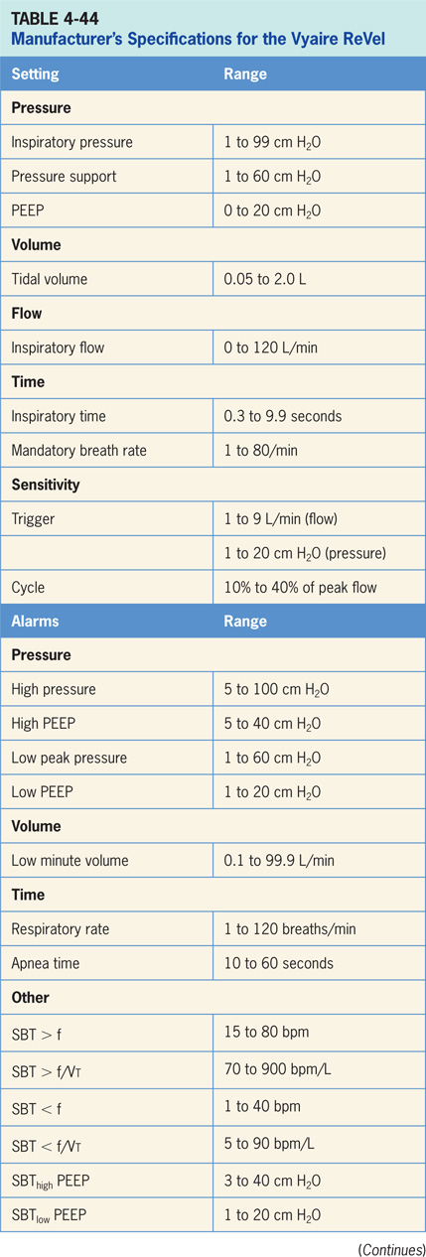

Slide 118
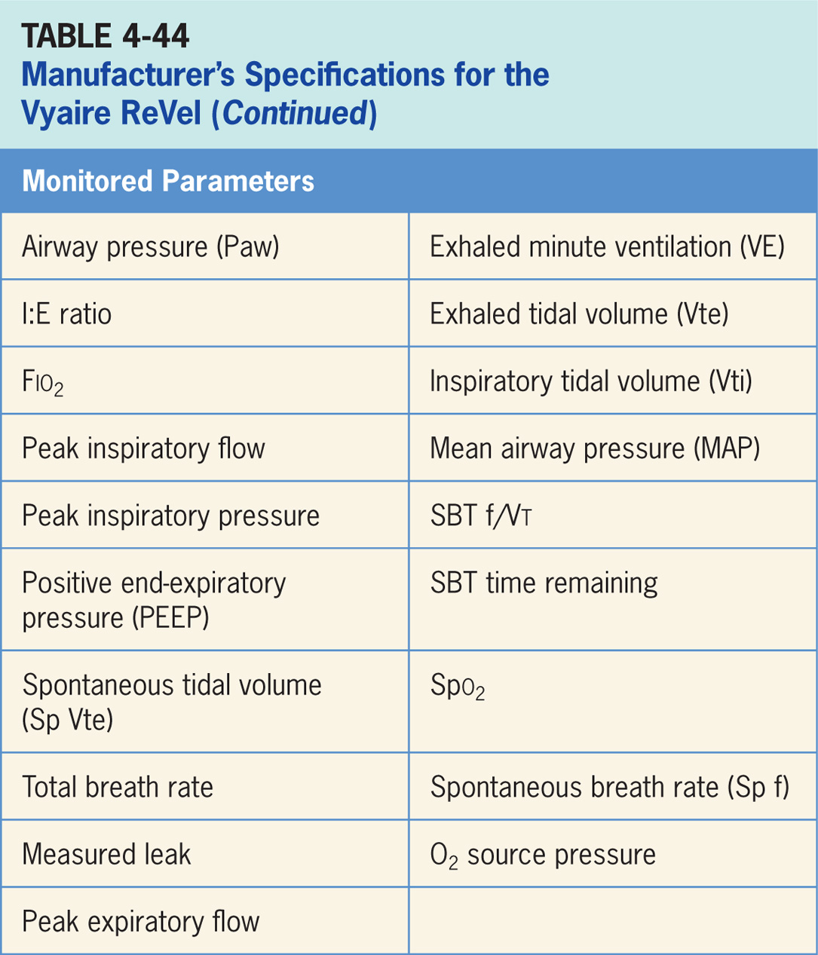

Slide 119
Vyaire LTV 1200
Designed for pediatric (> 11 lbs) and adult patients in institutional, home, and transport settings.²⁸
Blower driven and electronically controlled and can ventilate either invasively of noninvasively. (pictured in Figure 4-46)
The operator interface consists of a series of buttons, LED readouts, and an adjustable control knob (Figure 4-47).

Slide 120
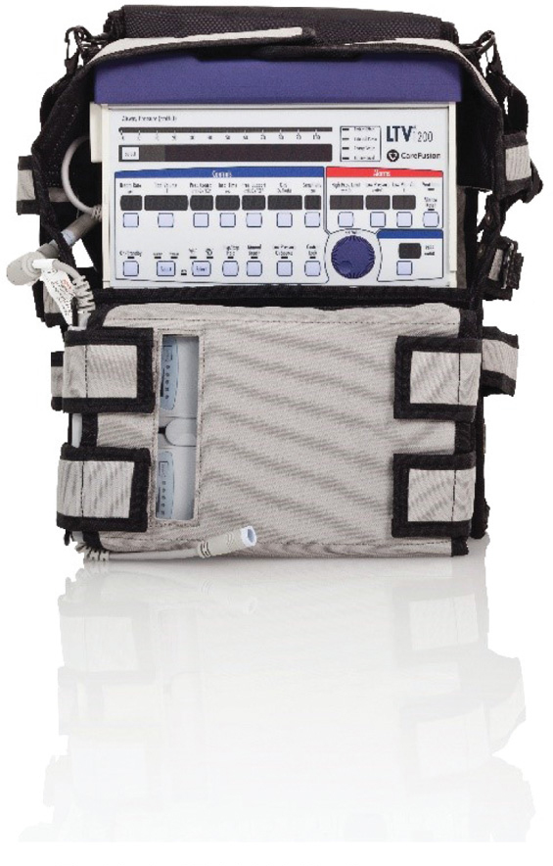
Figure 4.46

Slide 121
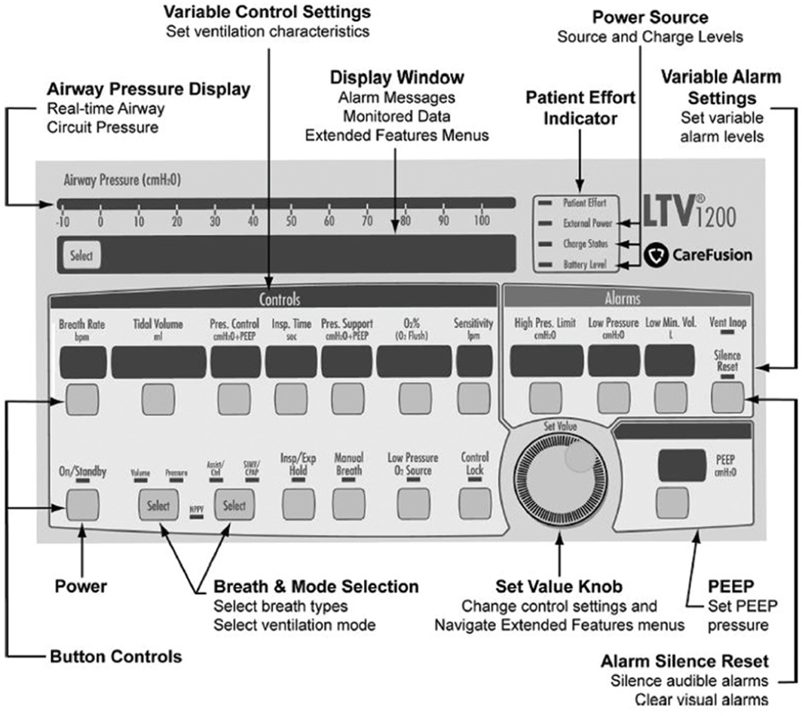
Figure 4.47

Slide 122
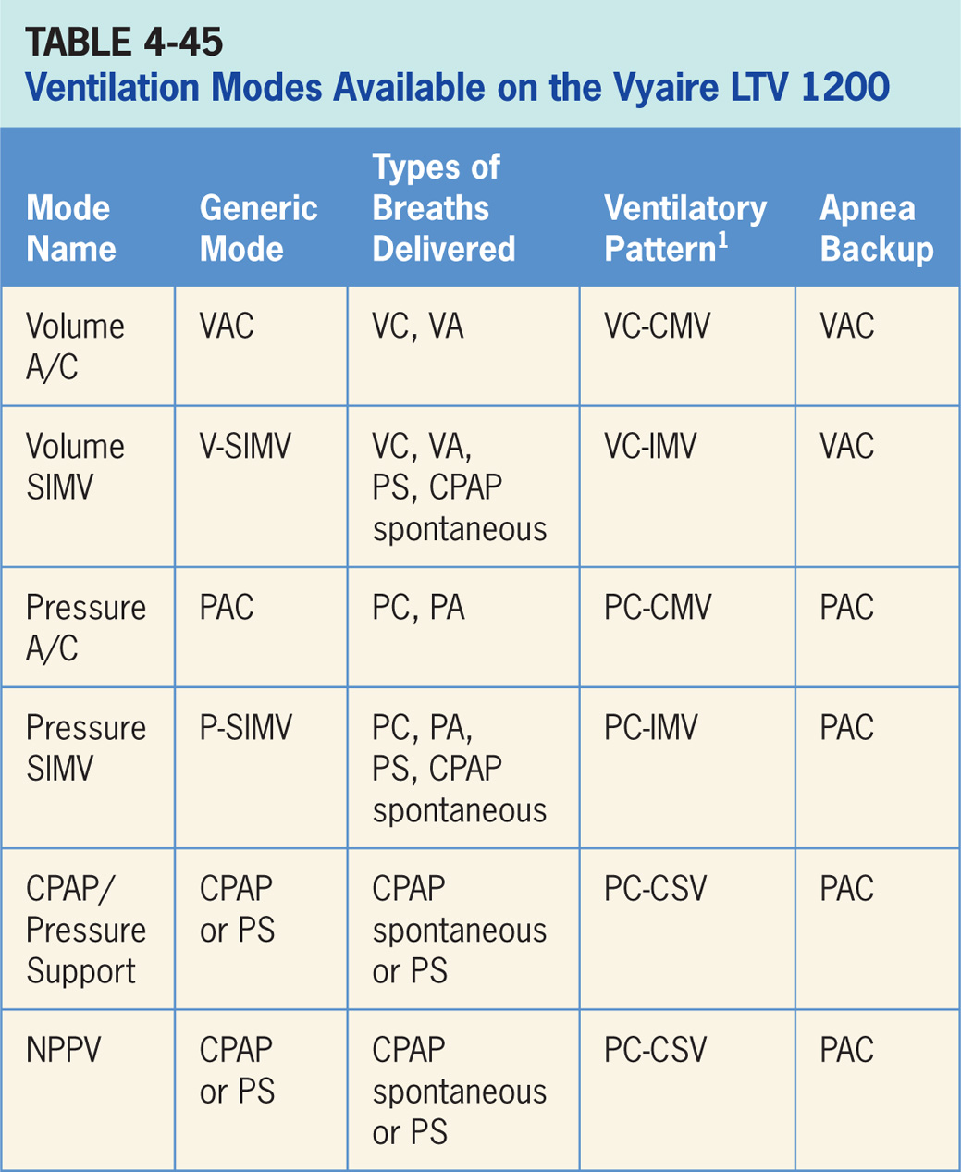

Slide 123
Volume A/C
Volume-targeted mode of ventilation (VAC) allowing for mandatory, time-triggered breaths or patient-assisted breaths.²⁸
Spontaneous breathing not allowed.
Breath cycles to exhalation once the tidal volume (Vt) has been delivered.

Slide 124
Main Operator Controls Include:
Fio₂
PEEP
Vt
Inspiratory flow
RR
Resulting pressure created is variable and depends on Vt, flow, and patient respiratory system mechanics.²⁸

Slide 125
Volume SIMV
Volume SIMV combines two breath types, VAC and either PS or spontaneous breathing, while on CPAP.²⁸
Mandatory, time-triggered breaths, patient-assisted breaths, and spontaneous breaths are all provided.
Ventilator prevents “breath stacking” (a VAC breath compounded by a PS breath) through the use of a “timing window.”
If patient attempts to trigger a breath in this timing window, then ventilator will deliver a VAC breath.
If patient attempts to trigger a breath outside window, then a spontaneous breath will occur.

Slide 126
Main Operator Controls Include:
Fio₂
PEEP
Vt
Flow
SIMV rate
Pressure support level
Cycle sensitivity for the PS breaths
During VAC breaths, resulting pressure created is variable and depends on Vt, flow, and patient mechanics.²⁸
During PS breaths, volume will be variable and depend on PS level, patient effort, and patient respiratory system mechanics.²⁸

Slide 127
Pressure A/C
Pressure-targeted mode of ventilation allowing for mandatory, time-triggered breaths or patient-assisted breaths.²⁸
Spontaneous breaths not allowed.
Breath cycles to exhalation once the inspiratory time has been reached or when the high-pressure alarm is tripped.

Slide 128
Main Operator Controls Include:
Fio₂
PEEP
Inspiratory pressure level
Inspiratory time
RR
Pressure will be consistently delivered from breath to breath; Vt and flow are variable and will depend on the inspiratory pressure level, patient effort, and patient respiratory system mechanics.²⁸

Slide 129
Pressure SIMV
Similar to Volume SIMV except the target is now pressure instead of volume.²⁸ P-SIMV also combines two breath types, PAC and either PS or spontaneous breathing, while on CPAP.
Combination of mandatory, time-triggered breaths, patient-assisted breaths, and spontaneous breaths.
Ventilator prevents “breath stacking” (a PAC breath compounded by a PS breath) through use of a “timing window.”
If patient attempts to trigger a breath in timing window, then ventilator will deliver a PAC breath.
If patient attempts to trigger a breath outside window, then a spontaneous breath will occur.

Slide 130
Main Operator Controls Include:
Fio₂
PEEP
Inspiratory pressure level
Inspiratory time
SIMV rate
Pressure support level
Cycle sensitivity for the PS breaths
During PAC breaths, resulting Vt created is variable and depends on inspiratory pressure level, patient effort, and patient respiratory system mechanics.²⁸
During PS breaths, volume will be variable and depend on PS level, patient effort, and patient respiratory system mechanics.²⁸

Slide 131
CPAP/Pressure Support
Patient regulates respiratory rate and the Vt with support from ventilator.²⁸
Patient triggers all breaths and will receive the clinician-set PS level.
If a pressure support level > 0 cm H₂O is set, the breath cycles to expiration when the inspiratory flow decreases below a preset percentage of the inspiratory peak flow.

Slide 132
Main Operator Controls Include:
Fio₂
PEEP
Pressure support level
Cycle sensitivity
Vt will be variable and depend on the PS level, patient effort, and patient respiratory system mechanics.²⁸ If the PS level is set to 0, all breaths will be unsupported

Slide 133
Noninvasive Positive Pressure Ventilation
NPPV is PS delivered through a mask instead of an endotracheal tube.²⁸
Patient regulates the respiratory rate and the Vt with support from ventilator.
Patient triggers all breaths and will receive clinician-set PS level.
If a pressure support level > 0 cm H₂O is set, the breath cycles to expiration when the inspiratory flow decreases below a preset percentage of the inspiratory peak flow.

Slide 134
Main Operator Controls Include:
Fio₂
PEEP
Pressure support level
Cycle sensitivity
Vt will be variable and depend on the PS level, patient effort, and patient respiratory system mechanics.²⁸ If the PS level is set to 0, all breaths will be unsupported.

Slide 135
Apnea Backup Ventilation Special Features
Ventilator engages Apnea Backup Ventilation when no breath has been delivered by the time the clinician-selected apnea interval elapses.²⁸
Backup ventilation will occur in the assist/control mode related to current settings (Table 4-43).

Slide 136
Oxygen
Ventilator is attached to a high-pressure oxygen source of 40 psi to 80 psi.²⁸
Percentage of oxygen to be delivered through ventilator’s oxygen blending system can be set directly.
When O₂% control is set to low-pressure source (LPS), oxygen can be supplied from a low-pressure, low-flow oxygen source of < 35 psi such as a flow meter.
Oxygen from the low-pressure source is mixed with air inside the ventilator.
When connected to a low-pressure source, the estimated O₂ percent delivered to patient is determined by O₂ inlet flow and the minute volume and is not regulated by ventilator.
A separate chart is provide to help estimate delivered Fio₂.

Slide 137
Spontaneous Breathing Trial
During a spontaneous breathing trial various parameters can be displayed.²⁸
Including SBT f/Vt, SBT respiratory rate, SBT Vt and SBT time remaining.

Slide 138
Nebulizer
Only available during Volume breaths in Assist/Control mode only.²⁸
When Nebulizer is activated, a six (6) L/min nominal flow is delivered to the nebulizer drive port.
This drives an aerosol nebulizer that doses medication into patient circuit.

Slide 139
Other
There is no leak compensation nor nebulizer in the LTV 1200.²⁸

Slide 140
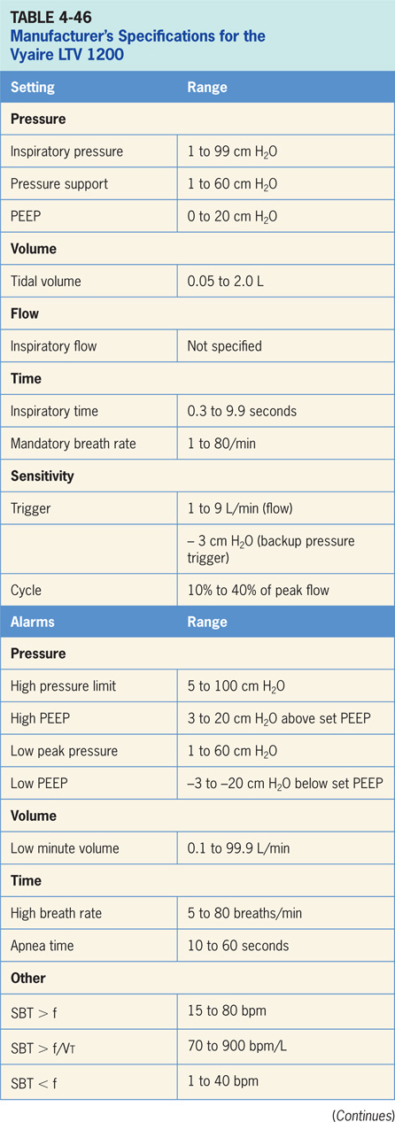

Slide 141
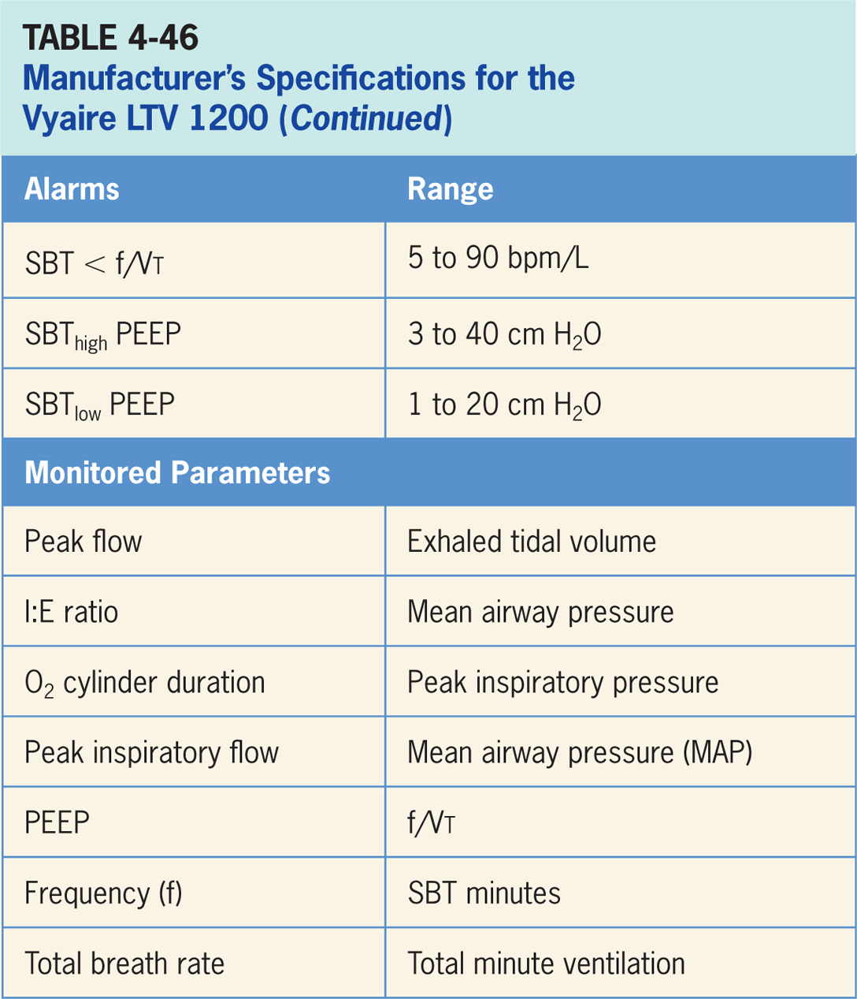

Slide 142
Dräger Carina
Designed for treatment of sub-acute care patients in hospitals or medical rooms and can be used for transport and in the hospital setting.²⁹
Lightweight ventilator (5.5 kg) that is pneumatically powered through blender technology and electrically driven.
Carina can deliver invasive or noninvasive ventilation and is (pictured in Figure 4-48)
Operator interface consists of an LCD screen with an array of buttons and a control knob.

Slide 143
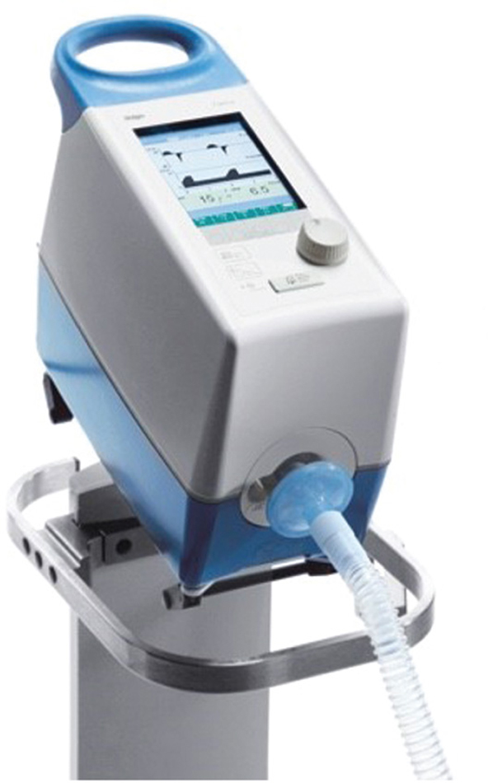
Figure 4.48

Slide 144
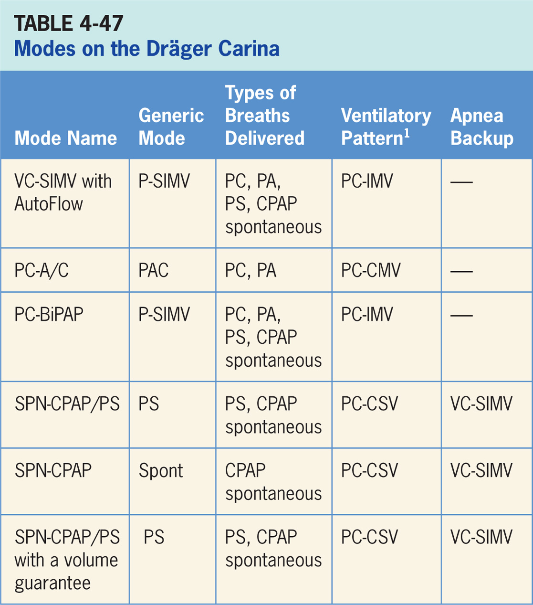

Slide 145
Volume Control Synchronized, Intermittent Mandatory Ventilation with Autoflow (VC-SIMV)
Combines two breath types, PAC (ventilator-controlled inspiratory pressure) and either PS or spontaneous breathing, while on CPAP.²⁹
Combination of mandatory, time-triggered breaths, patient-assisted breaths, and spontaneous breaths.
Ventilator prevents “breath stacking” (a PAC breath compounded by a PS breath) through use of a “timing window.”
If patient attempts to trigger a breath in this timing window, then ventilator will deliver a PAC breath.
If patient attempts to trigger a breath outside window, then a spontaneous breath will occur.

Slide 146
Main Operator Controls Include:
Fio₂
PEEP
SIMV rate
Vt
Inspiratory time or I:E
Pressure support level
During control breath amount of pressure and flow delivered will be variable and depend on the Vt setting, patient effort, and patient respiratory system mechanics.²⁹
During PS breath flow, Vt will be variable and depend on PS level, patient effort, and patient respiratory system mechanics. If CPAP is used, spontaneous breath Vt will be variable and depend on patient effort, and patient respiratory system mechanics.

Slide 147
Pressure Control-A/C (PC-A/C)
Pressure-targeted mode of ventilation allowing for mandatory, time-triggered breaths or patient-assisted breaths.²⁹
Spontaneous breaths not allowed.
Breath cycles to exhalation once inspiratory time has been reached or when the high-pressure alarm is tripped.

Slide 148
Main Operator Controls Include:
Fio₂
PEEP
Inspiratory pressure level
Inspiratory time or I:E
RR
Pressure will be consistently delivered from breath to breath; Vt and flow are variable and will depend on the inspiratory pressure level, patient effort, and patient respiratory system mechanics.²⁹

Slide 149
Pressure Control-biphasic Positive Airway Pressure (PC-BIPAP)
Form of pressure SIMV that combines two breath types, PAC and either PS or spontaneous breathing, while on CPAP.²⁹
Combination of mandatory, time-triggered breaths, patient-assisted breaths, and spontaneous breaths.
Spontaneous breathing allowed throughout entire breath cycle.

Slide 150
Main Operator Controls Include:
Fio₂
PEEP
Inspiratory pressure level
Inspiratory time or I:E
SIMV rate
Pressure support level
During PAC breaths, resulting Vt created is variable and depends on inspiratory pressure level, patient effort, and patient respiratory system mechanics.²⁹
During PS breaths, volume will be variable and depend on the PS level, patient effort, and patient respiratory system mechanics.

Slide 151
Spontaneous – Continuous Positive Airway Pressure/Pressure Support (SPN-CPAP/PS)
Patient regulates the respiratory rate and Vt with support from ventilator.²⁹
Patient triggers all breaths and will receive clinician-set PS level.
Breath cycles to expiration when inspiratory flow decreases below a preset percentage of inspiratory peak flow.

Slide 152
Main Operator Controls Include:
PEEP
Fio₂
Pressure support level
Vt will be variable and depend on PS level, patient effort, and patient respiratory system mechanics.²⁹

Slide 153
Spontaneous - Continuous Positive Airway Pressure (SPN-CPAP)
Ventilator maintains a baseline pressure level (CPAP) and patient breaths spontaneously.²⁹
Patient receives no additional support from ventilator.

Slide 154
Main Operator Controls Include:
Fio₂
CPAP
Vt may not match the operator setting due to the ventilator is using PS to target the Vt as to VAC and relies on previous breaths to make the calculation.²⁹ Any change in patient effort from the previous breath may result in a deviation from Vt setting.

Slide 155
Spontaneous–continuous Positive Airway Pressure/Pressure Support with Volume Guarantee (SPN-CPAP/PS)
Guarantee the ventilator delivers a variable (from breath to breath) PS level in order to reach a clinician-set Vt.²⁹
Ventilator changes the PS level as needed to reach Vt.
Ventilator drops the level of support as patient effort increases and conversely increases PS level when patient effort is too low.

Slide 156
Main Operator Controls Include:
Fio₂
PEEP
Vt target
Vt may not match the operator setting due to the ventilator is using PS to target the Vt as to VAC and relies on previous breaths to make the calculation.²⁹ Any change in patient effort from previous breath may result in a deviation from Vt setting.

Slide 157
Backup Ventilation Special Features
Available in SPN-CPAP, SPN-CPAP/PS and SPN-CPAP/PS with volume guarantee.²⁹
Ventilator will deliver VC-SIMV with AutoFlow breaths.

Slide 158
Oxygen
Oxygen levels of 21% to 100% are delivered when supplied with a high pressure of 40 to 87 psi.²⁹
Low-pressure (> 7 psi) oxygen delivery is also available.
Delivered Fio₂ will vary depending on the O₂ inlet flow and the minute volume.

Slide 159
Noninvasive Ventilation
Available in all available modes.²⁹
Ventilator will adjust the trigger level based on the leak when NIV is selected.

Slide 160
Other
Nebulizer and neonatal ventilation not available.²⁹

Slide 161
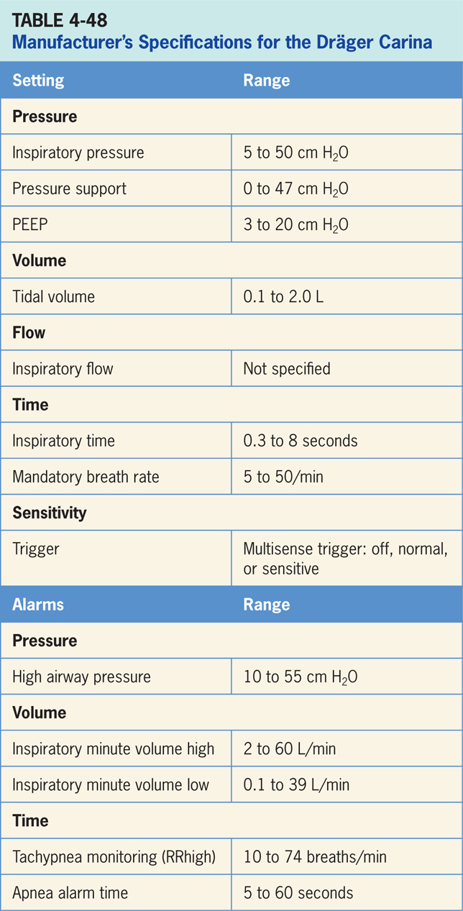

Slide 162
Dräger Oxylog 3000 Plus
Time-cycled, volume-controlled and pressure-controlled emergency and transport ventilator for patients requiring mandatory or assisted ventilation with a tidal volume from 50 mL upwards.³⁰
Oxylog 3000 Plus can deliver invasive or noninvasive ventilation (pictured in Figure 4-49)
Operator interface consists of an LCD screen with an array of buttons and a control knob. (pictured in Figure 4-50)

Slide 163
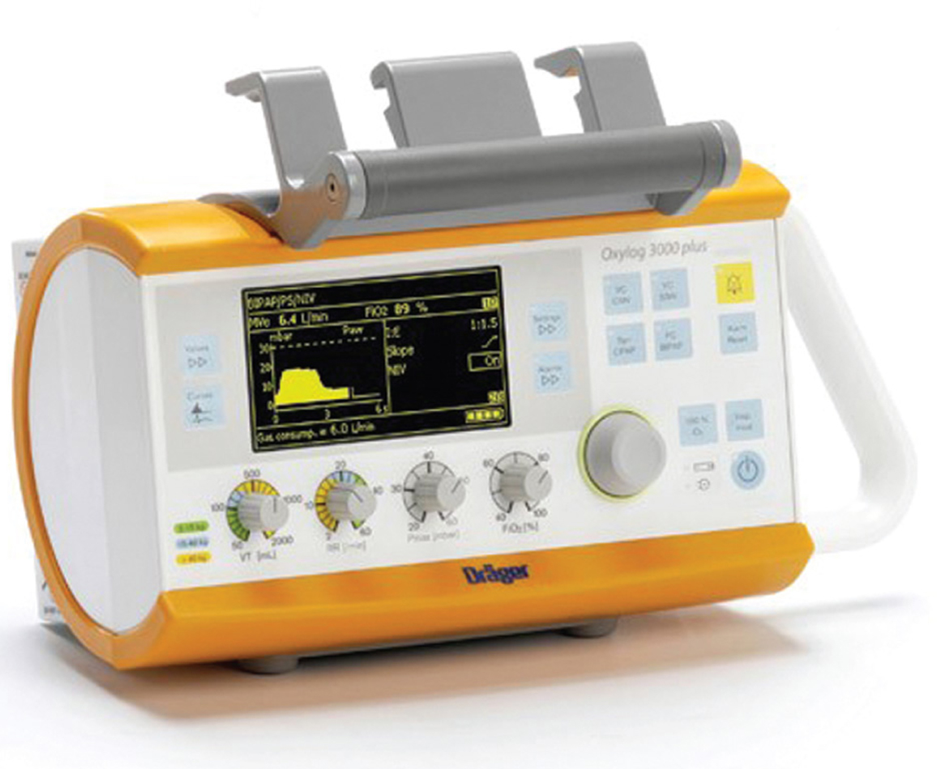
Figure 4.49

Slide 164
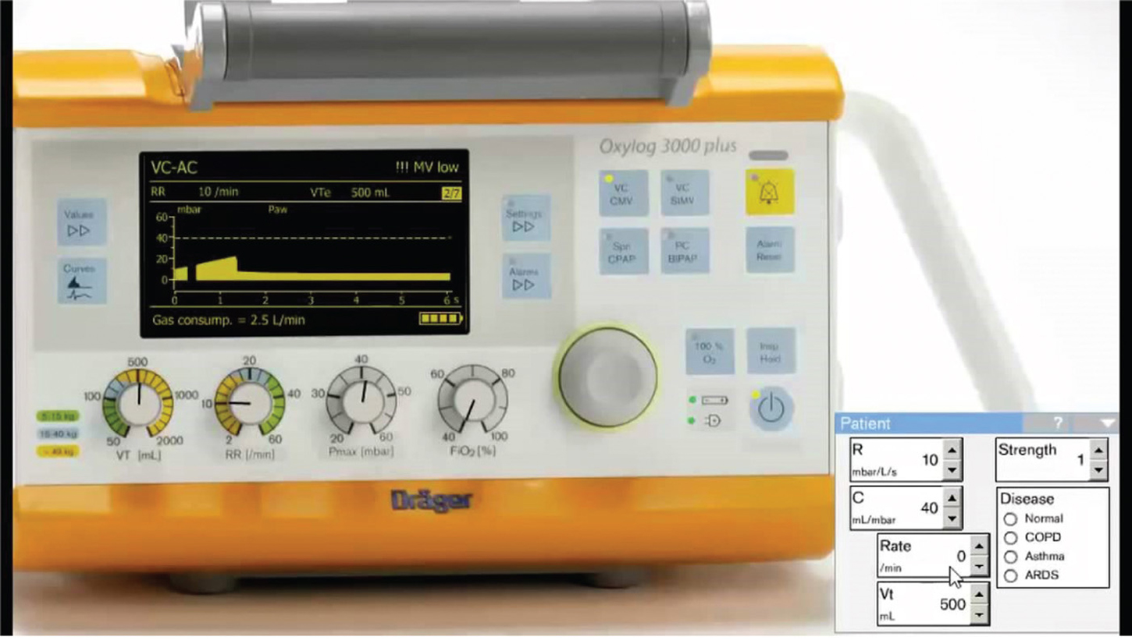
Figure 4.50

Slide 165
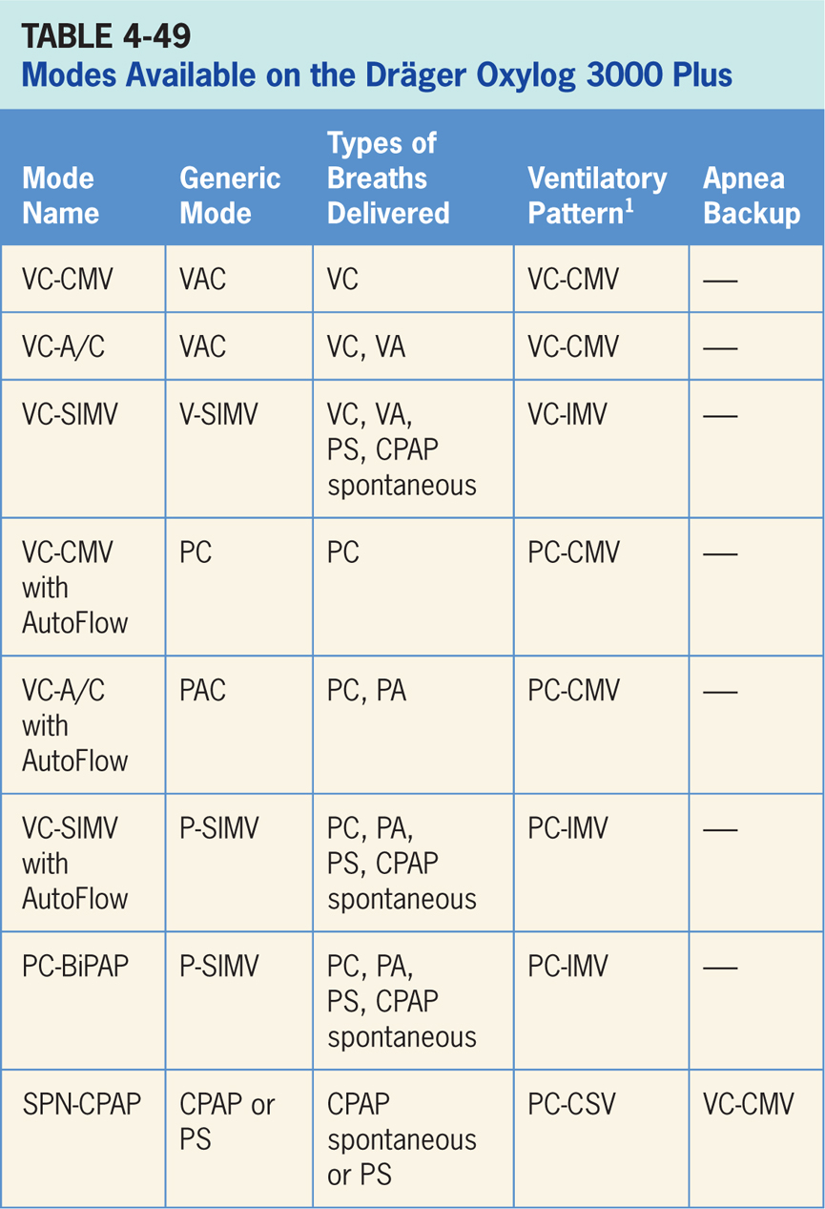

Slide 166
Volume Control–continuous Mandatory Ventilation (VC-CMV)
Volume-targeted mode of ventilation (VAC) allowing for mandatory, time-triggered breaths only.³⁰
Patient assisted breaths, and spontaneous breathing not allowed.
Breath cycles to exhalation once the tidal volume (Vt) has been delivered.

Slide 167
Main Operator Controls Include:
PEEP
Fio₂
Vt
Inspiratory flow
RR
Inspiratory time
Resulting pressure created is variable and depends on Vt, flow, and patient respiratory system mechanics.³⁰

Slide 168
Volume Control–A/C (VC–A/C)
Volume-targeted mode of ventilation (VAC) allowing for mandatory, time-triggered breaths or Patient assisted breaths.³⁰
Spontaneous breathing not allowed.
Breath cycles to exhalation once the tidal volume (Vt) has been delivered.

Slide 169
Main Operator Controls Include:
PEEP
Fio₂
Vt
Inspiratory flow
RR
Inspiratory time
Resulting pressure created is variable and depends on Vt, flow, and patient respiratory system mechanics.³⁰

Slide 170
Volume Control Synchronized, Intermittent Mandatory Ventilation (VC-SIMV)
Combines two breath types, VAC and either PS or spontaneous breathing, while on CPAP.³⁰
Mandatory, time-triggered breaths, patient-assisted breaths, and spontaneous breaths are all provided.
Ventilator prevents “breath stacking” (a VAC breath compounded by a PS breath) through use of a “timing window.”
If patient attempts to trigger a breath in this timing window, then ventilator will deliver a VAC breath.
If patient attempts to trigger a breath outside window, then a spontaneous breath will occur.

Slide 171
Main Operator Controls Include:
PEEP
Fio₂
Vt
Flow
SIMV rate
Inspiratory time
Pressure support level
Cycle sensitivity for the PS breaths
During VAC breaths, resulting pressure created is variable and depends on Vt, flow, and patient mechanics.³⁰
During PS breaths, volume will be variable and depend on the PS level, patient effort, and patient respiratory system mechanics.³⁰

Slide 172
Volume Control–continuous Mandatory Ventilation with Autoflow (VC-CMV)
Pressure-targeted (PC breaths) mode that uses pressure breaths to achieve a clinician-set Vt.³⁰
Inspiratory pressure level is now adjusted by the ventilator instead of clinician.
Ventilator relies a previous breath sequence to deliver ensuing breath the Vt tends to be somewhat variable, especially in patients with inconsistent efforts.
This mode delivers mandatory, time-triggered breaths only.
No spontaneous breaths allowed.
Volume-targeted mode of ventilation (VAC) allowing for mandatory, time-triggered breaths only. Patient assisted breaths, and spontaneous breathing not allowed.
Breath cycles to exhalation once the tidal volume (Vt) has been delivered.

Slide 173
Main Operator Controls Include:
PEEP
Fio₂
Vt target
Inspiratory flow
RR
Inspiratory time
Resulting pressure created is variable and depends on Vt, flow, and patient respiratory system mechanics.³⁰

Slide 174
Volume Control–A/C with Autoflow (VC-A/C)
Pressure-targeted (either PC or PA breaths) mode that uses pressure breaths to achieve a clinician-set Vt.³⁰
Inspiratory pressure level, is now adjusted by the ventilator instead of clinician.
Since ventilator relies a previous breath sequence to deliver the ensuing breath the Vt tends to be somewhat variable, especially in patients with inconsistent efforts.
No spontaneous breaths allowed.

Slide 175
Main Operator Controls Include:
Fio₂
PEEP
RR
Vt target
Inspiratory time
Amount of pressure and flow delivered will be variable and depend on the Vt setting, patient effort, and patient respiratory system mechanics.³⁰

Slide 176
Volume Control Synchronized, Intermittent Mandatory Ventilation with Autoflow (VC-SIMV)
Combines two breath types, PAC (ventilator-controlled inspiratory pressure) and either PS or spontaneous breathing, while on CPAP.³⁰
Combination of mandatory, time-triggered breaths, patient-assisted breaths, and spontaneous breaths.
Ventilator prevents “breath stacking” (a PAC breath compounded by a PS breath) through use of a “timing window.”
If patient attempts to trigger a breath in timing window, then ventilator will deliver a PAC breath.
If patient attempts to trigger a breath outside window, then a spontaneous breath will occur.

Slide 177
Main Operator Controls Include:
Fio₂
PEEP
SIMV rate
Vt
Inspiratory time
Pressure support level
During control breath, amount of pressure and flow delivered will be variable and depend on Vt setting, patient effort, and patient respiratory system mechanics.³⁰ During PS breath flow, the Vt will be variable and depend on the PS level, patient effort, and patient respiratory system mechanics. If CPAP is used, the spontaneous breath Vt will be variable and depend on patient effort, and patient respiratory system mechanics.

Slide 178
Pressure Control-biphasic Positive Airway Pressure (PC-BIPAP)
Form of pressure SIMV that combines two breath types, PAC and either PS or spontaneous breathing, while on CPAP.³⁰
Combination of mandatory, time-triggered breaths, patient-assisted breaths, and spontaneous breaths.
Spontaneous breathing allowed throughout entire breath cycle.

Slide 179
Main Operator Controls Include:
Fio₂
PEEP
Inspiratory pressure level
Inspiratory time
SIMV rate
Pressure support level
During PAC breaths, resulting Vt created is variable and depends on inspiratory pressure level, patient effort, and patient respiratory system mechanics.³⁰
During PS breaths, volume will be variable and depend on PS level, patient effort, and patient respiratory system mechanics.³⁰

Slide 180
Spontaneous-continuous Positive Pressure (SPN-CPAP)
Patient regulates the respiratory rate and Vt with support from ventilator.³⁰
Patient triggers all breaths and will receive clinician-set PS level or no additional support (CPAP).
If a pressure support level > 0 cm H₂O is set, the breath cycles to expiration when inspiratory flow decreases below a preset percentage of inspiratory peak flow.

Slide 181
Main Operator Controls Include:
PEEP
Fio₂
Pressure support level
Vt will be variable and depend on PS level, patient effort, and patient respiratory system mechanics.³⁰ If the PS level is set to 0, all breaths will be unsupported.

Slide 182
Backup Ventilation Special Features
Available in SPN-CPAP only.³⁰
Ventilator will deliver VC-CMV breaths.

Slide 183
Oxygen
40% to 100% when supplied with a high pressure of 39 to 87 psi through either a medical pipeline system or portable oxygen tank.³⁰
Actual Fio₂ may vary somewhat depending on inspiratory flowrate and mean airway pressure.

Slide 184
Noninvasive Ventilation
Available in SpnCPAP (/PS), PC-BIPAP, VC-CMV /AF, VC-A/C /AF and VC-SIMV/AF.³⁰
Ventilator will compensate for inherent leaks and the leakage alarm will be deactivated.

Slide 185
Other
An optional CO₂ sensor is available to allow for measurement of exhaled CO₂.³⁰
Nebulizer and neonatal ventilation not available.³⁰
Previous versions of this ventilator include the Oxylog 3000, Oxylog 2000 Plus and the Oxylog 1000.³⁰
Internal battery will operate for approximately 7.5 to 9.5 hours (depending on the parameter settings) on full charge.³⁰

Slide 186
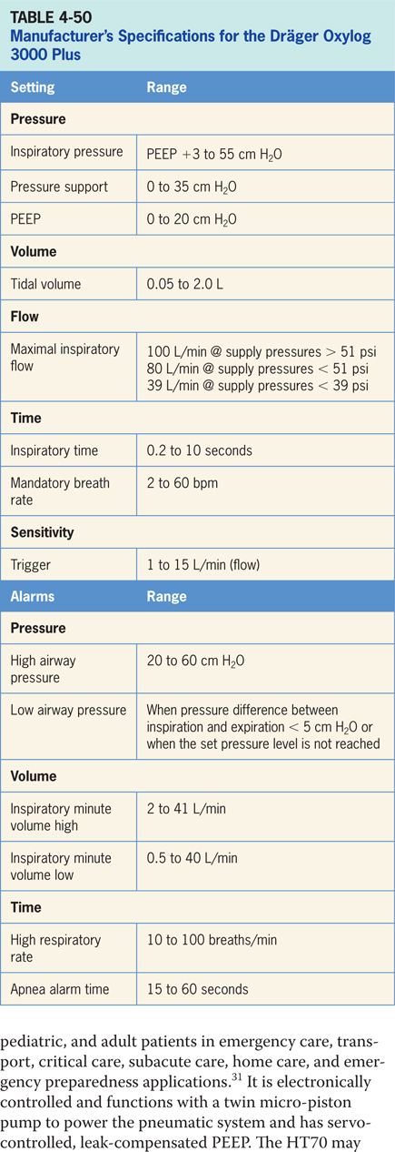

Slide 187
Medtronic Newport HT 70 Plus
Ventilator is designed to provide ventilatory support for infant, pediatric and adult patients in emergency care, transport, critical care, subacute care, home care and emergency preparedness applications.³¹
Electronically controlled and functions with a twin micro-piston pump to power the pneumatic system and has servo-controlled, leak-compensated PEEP.
HT70 may be used with an endotracheal tube, tracheal tube, facemask, nasal mask or prongs, or a mouthpiece. (pictured in Figure4-51)
Operator interface uses a color-coded LCD touch screen featuring an array of buttons along with a display screen. Settings are entered by selecting a parameter and then adjusting the value using the up/down arrow buttons. (pictured in Figure 4-52)

Slide 188
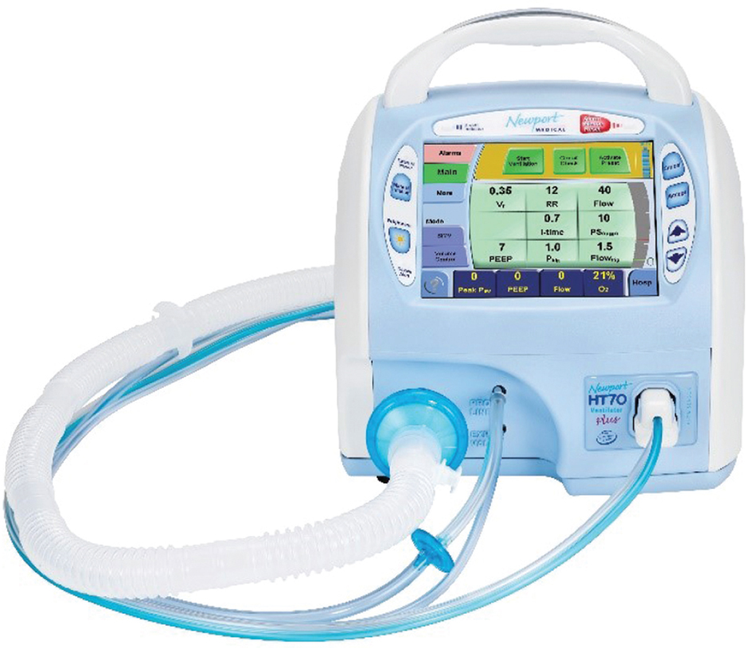
Figure 4.51

Slide 189
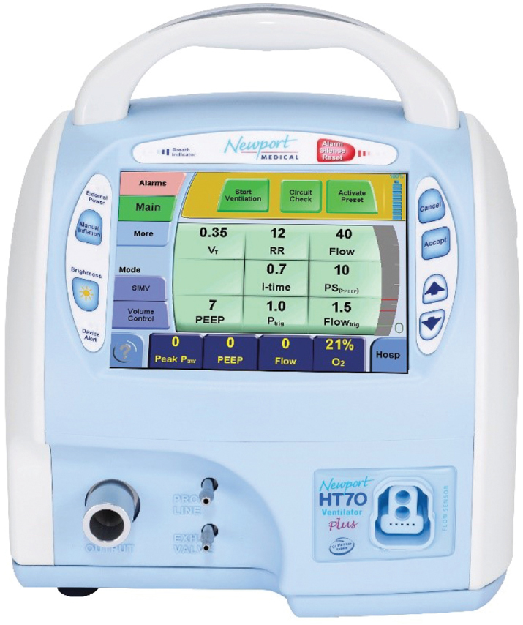
Figure 4.52

Slide 190
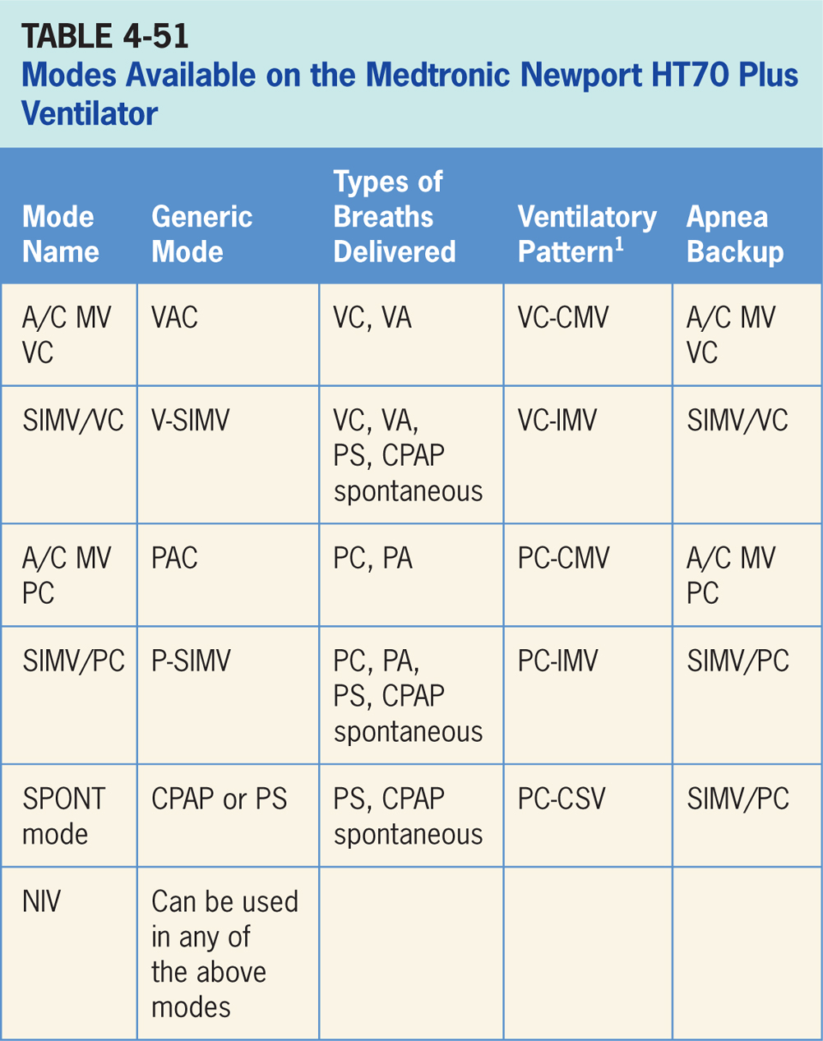

Slide 191
Assist/Control Mandatory Ventilation Volume Control (A/CMV VC)
Volume-targeted mode of ventilation (VAC) allowing for mandatory, time-triggered breaths or patient-assisted breaths.³¹
Spontaneous breathing not allowed.
Breath cycles to exhalation once the tidal volume (Vt) has been delivered.

Slide 192
Main Operator Controls Include:
Fio₂
PEEP
Vt
Inspiratory flow
Inspiratory time (T_{insp})
RR
Resulting pressure created is variable and depends on Vt, flow, and patient respiratory system mechanics.³¹

Slide 193
Synchronized, Intermittent Mandatory Ventilation Volume Control (SIMV VC)
Combines two breath types, VAC and either PS or spontaneous breathing, while on CPAP.³¹
Mandatory, time-triggered breaths, patient-assisted breaths, and spontaneous breaths are all provided.
Ventilator prevents “breath stacking” (a VAC breath compounded by a PS breath) through use of a “timing window.”
If patient attempts to trigger a breath in timing window, then ventilator will deliver a VAC breath.
If patient attempts to trigger a breath outside window, then a spontaneous breath will occur.

Slide 194
Main Operator Controls Include:
Fio₂
PEEP
Vt
Inspiratory flow
Inspiratory time
SIMV rate
Pressure support level
Cycle sensitivity
During VAC breaths, resulting pressure created is variable and depends on Vt, flow, and patient mechanics.³¹
During PS breaths, volume will be variable and depend on the PS level, patient effort, and patient respiratory system mechanics.³¹

Slide 195
Assist/Control Mandatory Ventilation Pressure Control (A/CMV PC)
Pressure-targeted mode of ventilation allowing for mandatory, time-triggered breaths or patient-assisted breaths.³¹
Spontaneous breaths not allowed.
Breath cycles to exhalation once the inspiratory time has been reached or when the high-pressure alarm is tripped.

Slide 196
Main Operator Controls Include:
Fio₂
PEEP
Inspiratory pressure level
Inspiratory time
RR
Pressure will be consistently delivered from breath to breath; Vt and flow are variable and will depend on the inspiratory pressure level, patient effort, and patient respiratory system mechanics.³¹

Slide 197
Synchronized, Intermittent Mandatory Ventilation Pressure Control (SIMV PC)
Similar to SIMV/VC except the target is now pressure instead of volume.³¹
SIMV/PC also combines two breath types, PAC and either PS or spontaneous breathing, while on CPAP.
Combination of mandatory, time-triggered breaths, patient-assisted breaths, and spontaneous breaths.
Ventilator prevents “breath stacking” (a PAC breath compounded by a PS breath) through the use of a “timing window.”
If patient attempts to trigger a breath in timing window, then ventilator will deliver a PAC breath.
If patient attempts to trigger a breath outside window, then a spontaneous breath will occur.

Slide 198
Main Operator Controls Include:
Fio₂
PEEP
Inspiratory pressure level
Inspiratory time
SIMV rate
Pressure support level
Cycle sensitivity for the PS breaths
During PAC breaths, resulting Vt created is variable and depends on inspiratory pressure level, patient effort, and patient respiratory system mechanics.³¹
During PS breaths, volume will be variable and depend on PS level, patient effort, and patient respiratory system mechanics.³¹

Slide 199
Spontaneous Ventilation (SPONT Mode)
Patient regulates respiratory rate and the Vt.³¹
Patient triggers all breaths and will receive either CPAP or a clinician-set PS level.
If a pressure support level > 0 cm H₂O is set, the breath cycles to expiration when the inspiratory flow decreases below a preset percentage of the inspiratory peak flow.

Slide 200
Main Operator Controls Include:
Fio₂
PEEP
Pressure support level
Cycle sensitivity
Vt will be variable and depend on the PS level, patient effort, and patient respiratory system mechanics.³¹ If the PS level is set to 0, all breaths will be unsupported.

Slide 201
Backup Ventilation Special Features
Occurs when either, low minute volume (MVI/MVE) or apnea alarm, or both, are activated.³¹
Available in all of ventilator modes.
If current mode is A/CMV or SIMV, current settings are used with a respiratory rate of 1.5 times the current setting.
If current mode is SPONT Mode, ventilator delivers SIMV PC breaths at a RR of 15, inspiratory pressure 15 cm H₂O above set PEEP and a 1.0 second inspiratory time.

Slide 202
Oxygen
HT 70 Plus can use a 35 to 65 psig source and can deliver an Fio₂ from 0.21 to 1.0.³¹

Slide 203
Battery Backup
Internal Dual Battery System consists of two internal independent but coordinated lithium ion batteries, one located on the back of the ventilator and the secondary backup battery inside the ventilator.³¹
Internal Dual Battery System can provide up to 10 hours of operation at standard settings when new and fully charged.

Slide 204
NIV
HT70 Plus can be used for noninvasive ventilation in all modes.³¹ It is activated switching the NIV toggle switch to on.
When NIV is activated the bias flow is increased to 10 L/min (and can be adjusted from 3-30 L/min), the low minute volume alarm can be turned off, the low-pressure alarm can be set closer to the base pressure (1 cm H₂O above baseline), and the high minute volume alarm range is expanded to 80 L/min.

Slide 205
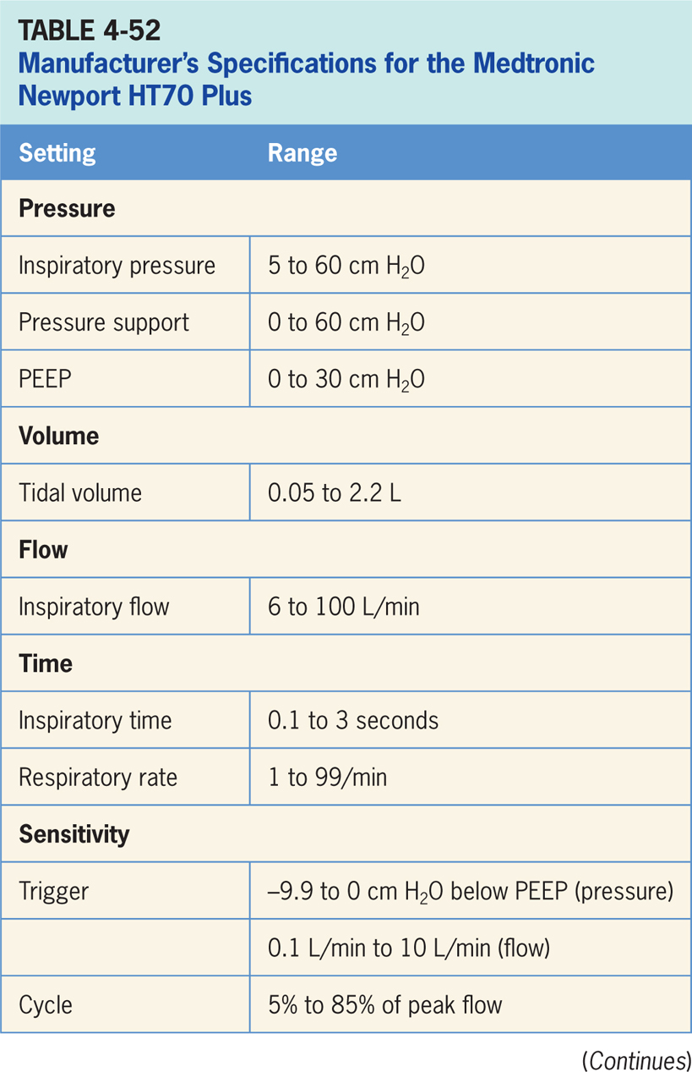

Slide 206
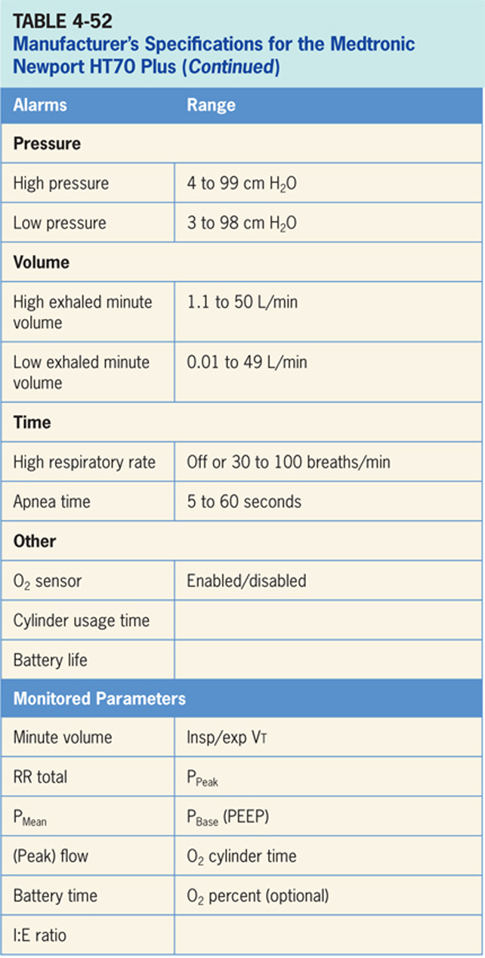

Slide 207
ZOLL Eagle II
A full-feature, portable, mechanical ventilator designed to operate in hospitals, during transport, and in severe environments, where it may be exposed to rain, dust, rough handling, and extremes in temperature and humidity (Figure 4-53).³²
With a third-party filter in place, ventilator may be operated in environments where chemical and/or biological toxins are present. When marked with an “MRI conditional” label, they are suitable for use in an MRI environment with appropriate precautions.
The Eagle II is a volume and pressure-targeted, time- or flow-cycled ventilator designed to use either oxygen from a 55 psig source or fresh air using its internal compressor to deliver a positive-pressure breath. When Fio₂ is set to 21%, clinicians can connect a low-flow oxygen source at the Fresh Gas/Emergency Air Intake using a reservoir.

Slide 208
ZOLL Eagle II (cont’d)
Operator interface (Figure 4-54) consists of a liquid crystal display (LCD) provides continuous display of control settings, operating conditions, power, and alarm status information. Most unit functions are controlled by pressing the parameter button associated with parameter you wish to change.
Pressing parameter button highlights the primary parameter; additional presses highlight secondary parameters moving in a clockwise direction.
When parameter you wish to change is highlighted, a knob called the rotary encoder is used to adjust parameter to the desired setting, and then it is confirmed by pressing confirm/select button.

Slide 209
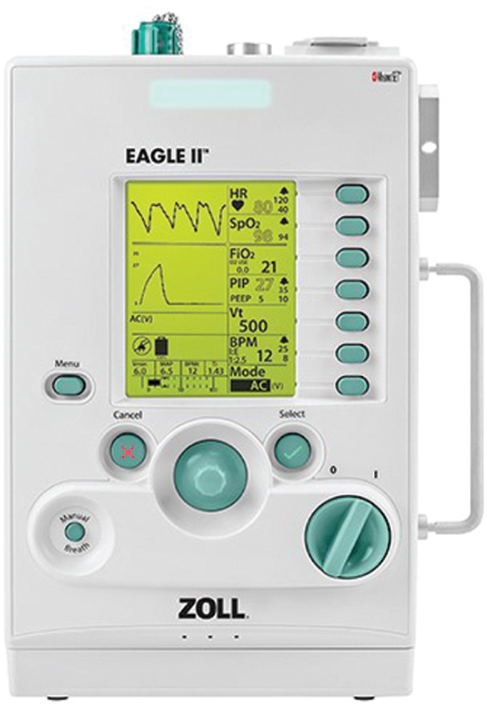
Figure 4.53

Slide 210
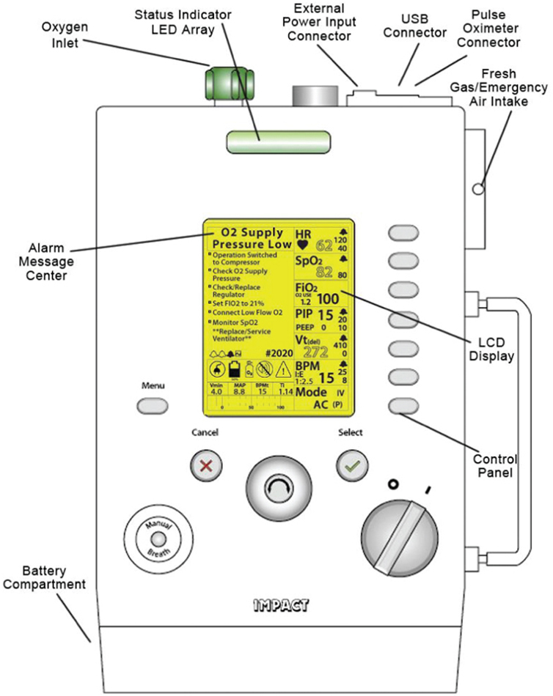
Figure 4.54

Slide 211
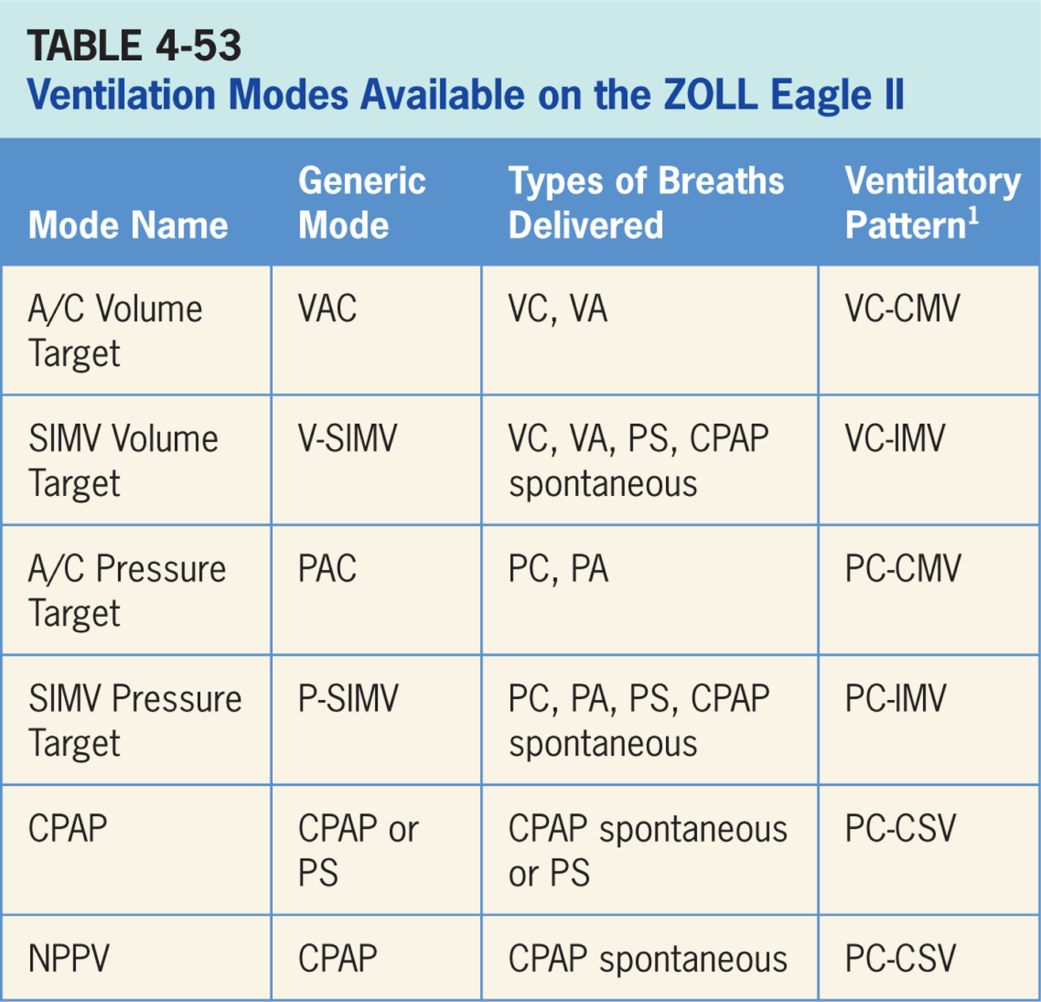

Slide 212
Assist/Control Volume Target
Volume-targeted mode of ventilation (VAC) allowing for mandatory, time-triggered breaths or patient-assisted breaths.³²
Spontaneous breathing not allowed.
Breath cycles to exhalation once the tidal volume (Vt) has been delivered. Inspiratory flow is preset to be a square waveform.

Slide 213
Main Operator Controls Include:
Fio₂
PEEP
Vt
I:E or inspiratory time
RR
Resulting pressure created is variable and depends on Vt, flow, and patient respiratory system mechanics.³²

Slide 214
Synchronized, Intermittent Mandatory Ventilation (SIMV) Volume Target
Combines two breath types, VAC and either PS or spontaneous breathing, while on CPAP.³²
Mandatory, time-triggered breaths, patient-assisted breaths, and spontaneous breaths are all provided.
Ventilator prevents “breath stacking” (a VAC breath compounded by a PS breath) through use of a “timing window.”
If patient attempts to trigger a breath in timing window, then ventilator will deliver a VAC breath.
If patient attempts to trigger a breath outside window, then a spontaneous breath will occur. Inspiratory flow is preset to be a square waveform.

Slide 215
Main Operator Controls Include:
Fio₂
PEEP
Vt
I:E or inspiratory time
SIMV rate
Pressure support level
Cycle sensitivity
During VAC breaths, resulting pressure created is variable and depends on Vt, flow, and patient mechanics.³²
During PS breaths, volume will be variable and depend on the PS level, patient effort, and patient respiratory system mechanics.³²

Slide 216
Assist/Control (A/C) Pressure Target
Pressure-targeted mode of ventilation allowing for mandatory, time-triggered breaths or patient-assisted breaths.³²
Spontaneous breaths not allowed.
Breath cycles to exhalation once the inspiratory time has been reached or when high-pressure alarm is tripped.

Slide 217
Main Operator Controls Include:
Fio₂
PEEP
Inspiratory pressure level
I:E or inspiratory time
RR
Pressure will be consistently delivered from breath to breath; Vt and flow are variable and will depend on inspiratory pressure level, patient effort, and patient respiratory system mechanics.³²

Slide 218
Synchronized, Intermittent Mandatory Ventilation (SIMV) Pressure Target
Similar to SIMV Volume Target described above except the target is now pressure instead of volume.³²
SIMV Pressure Target also combines two breath types, PAC and either PS or spontaneous breathing, while on CPAP.
Combination of mandatory, time-triggered breaths, patient-assisted breaths, and spontaneous breaths.
Ventilator prevents “breath stacking” (a PAC breath compounded by a PS breath) through use of a “timing window.”
If patient attempts to trigger a breath in this timing window, then ventilator will deliver a PAC breath.
If patient attempts to trigger a breath outside window, then a spontaneous breath will occur.

Slide 219
Main Operator Controls Include:
Fio₂
PEEP
Inspiratory pressure level
I:E or inspiratory time
SIMV rate
Pressure support level
Cycle sensitivity
During PAC breaths, resulting Vt created is variable and depends on inspiratory pressure level, patient effort, and patient respiratory system mechanics.³²
During PS breaths, volume will be variable and depend on PS level, patient effort, and patient respiratory system mechanics.³²

Slide 220
Continuous Positive Airway Pressure (CPAP)
Patient regulates respiratory rate and the Vt with support from ventilator.³²
Patient triggers all breaths and will receive either a purely spontaneous breath (demand flow only available) or the clinician-set PS.
If a pressure support level > 0 cm H₂O is set, breath cycles to expiration when the inspiratory flow decreases below a preset percentage of the inspiratory peak flow.

Slide 221
Main Operator Controls Include:
Fio₂
PEEP
Pressure support level
Cycle sensitivity

Slide 222
Noninvasive Positive Pressure Ventilation (NPPV)
Provides flow during expiratory phase to maintain baseline pressure (CPAP) in spontaneously breathing patients with a leaking airway or facemask.³²
Amount of leak compensation depends on leak flow rate during expiratory period and ranges from 0 to 15 liters/min and is automatically adjusted by the ventilator in order to maintain the CPAP target.
NPPV/CPAP/PS is CPAP/PS (see above) delivered through a mask instead of an endotracheal tube. During NPPV, patient regulates respiratory rate and Vt.

Slide 223
Main Operator Controls Include:
Fio₂
CPAP
Vt will be variable and depend on patient effort, and patient respiratory system mechanics.³²

Slide 224
Oxygen Special Features
The unit can use oxygen from low-flow sources, oxygen flow meters, and oxygen concentrators to provide supplemental oxygen to patients.³²
To do this, oxygen is delivered through Fresh Gas/Emergency Air Intake when unit’s internal compressor cycles to deliver a breath.

Slide 225
Backup Ventilation
Depending upon preexisting conditions at time of failure, backup ventilator will begin operation in one of two ways:
(1) If no preexisting alarm condition(s) exists, backup operation will continue using the current settings.
(2) If a preexisting alarm condition(s) exists, backup operation will revert to the startup default settings (Mode A/C (P), volume target, BPM 12, PIP 20 cm H₂O, Fio₂ 21%, PEEP 5 cm H₂O, I:E 1:2.5, PIP High Limit 35 cm H₂O).³²

Slide 226
Other
An optional pulse oximeter can be used.³²

Slide 227
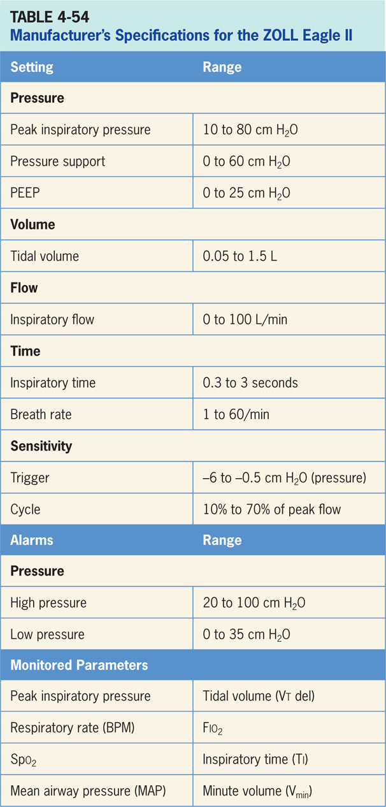

Slide 228
Philips Respironics Trilogy Ventilator
Respironics Trilogy 202 systems provides continuous or intermittent ventilatory support for the care of individuals who require mechanical ventilation with or without Fio₂ blending.³³ (pictured in Figure 4-55) and intended for pediatric through adult patients weighing at least 5 kg.
The ventilator is meant to be used in hospitals and institutions, and for portable applications such as wheelchairs and gurneys only when in an institutional setting and may be used for both invasive and noninvasive ventilation.
Not intended to be used as a transport ventilator.
The Trilogy 202 can be used with either a single-limb or double-limb circuit and operator interface consists of a central screen with some buttons to make parameter and setting adjustments and is (depicted in Figure 4-56)

Slide 229
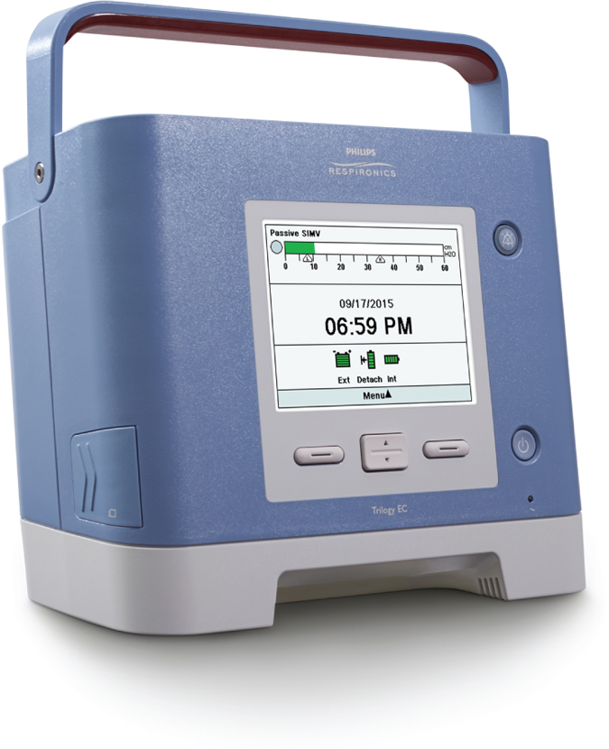
Figure 4.55

Slide 230
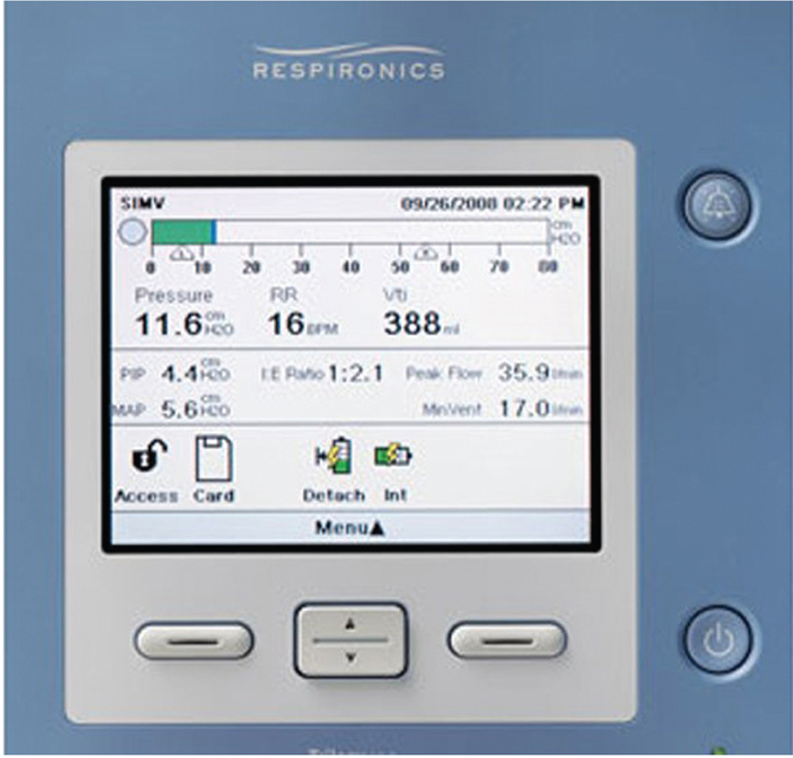
Figure 4.56

Slide 231
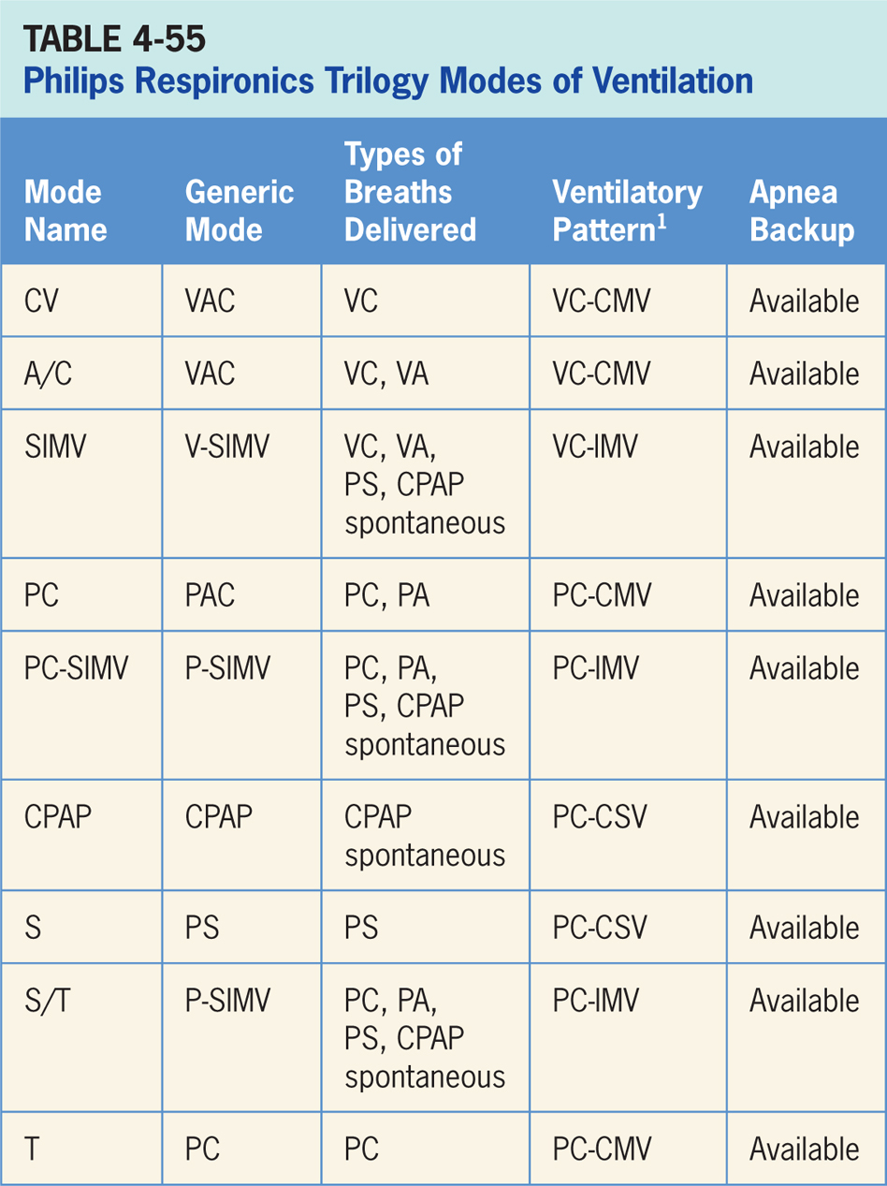

Slide 232
Control Ventilation (CV)
Volume-targeted mode of ventilation (VAC) allowing for mandatory, time-triggered breaths only.³³
Patient triggered breaths, and spontaneous breathing are not allowed.
Breath cycles to exhalation once tidal volume (Vt) has been delivered.

Slide 233
Main Operator Controls Include:
Fio₂
PEEP
Vt
Inspiratory time
RR
Resulting pressure created is variable and depends on Vt, flow, and patient respiratory system mechanics.³³

Slide 234
Assist/Control (A/C)
Volume-targeted mode of ventilation (VAC) allowing for mandatory, time-triggered breaths only or patient-assisted breaths.³³
Breath cycles to exhalation once the tidal volume (Vt) has been delivered.

Slide 235
Main Operator Controls Include:
Fio₂
PEEP
Vt
Inspiratory time
RR
Resulting pressure created is variable and depends on Vt, flow, and patient respiratory system mechanics.³³

Slide 236
Synchronized, Intermittent Mandatory Ventilation (SIMV)
Combines two breath types, VAC and either PS or spontaneous breathing, while on CPAP.³³
Mandatory, time-triggered breaths, patient-assisted breaths, and spontaneous breaths are all provided.
Ventilator prevents “breath stacking” (a VAC breath compounded by a PS breath) through use of a “timing window.”
If patient attempts to trigger a breath in timing window, then ventilator will deliver a VAC breath.
If patient attempts to trigger a breath outside window, then a spontaneous breath will occur.

Slide 237
Main Operator Controls Include:
Fio₂
PEEP
Vt
Inspiratory time
SIMV rate
Pressure support level
Cycle sensitivity
During VAC breaths, resulting pressure created is variable and depends on Vt, flow, and patient mechanics.³³
During PS breaths, volume will be variable and depend on PS level, patient effort, and patient respiratory system mechanics.³³

Slide 238
Pressure-control Mode (PC)
Pressure-targeted mode of ventilation allowing for mandatory, time-triggered breaths or patient-assisted breaths.³³
Spontaneous breaths not allowed.
Breath cycles to exhalation once the inspiratory time has been reached.

Slide 239
Main Operator Controls Include:
Fio₂
EPAP (expiratory positive airway pressure)
IPAP (inspiratory positive airway pressure)
I-Time
RR
Pressure will be consistently delivered from breath to breath; Vt and flow are variable and will depend on the IPAP, EPAP levels, patient effort, and patient respiratory system mechanics.³³

Slide 240
Pressure Control–synchronized, Intermittent Mandatory Ventilation (PC-SIMV)
Similar to SIMV except the target is now pressure instead of volume.³³
Combines two breath types, PAC and either PS or spontaneous breathing, while on CPAP.
Combination of mandatory, time-triggered breaths, patient-assisted breaths, and spontaneous breaths.
Ventilator prevents “breath stacking” (a PAC breath compounded by a PS breath) through the use of a “timing window.”
If patient attempts to trigger a breath in timing window, then ventilator will deliver a PAC breath.
If patient attempts to trigger a breath outside window, then a spontaneous breath will occur.

Slide 241
Main Operator Controls Include:
Fio₂
PEEP
Inspiratory pressure level
Inspiratory time
RR
Pressure support level
Cycle sensitivity
During PAC breaths, resulting Vt created is variable and depends on inspiratory pressure level, patient effort, and patient respiratory system mechanics.³³
During PS breaths, volume will be variable and depend on the PS level, patient effort, and patient respiratory system mechanics.³³

Slide 242
Continuous Positive Airway Pressure (CPAP)
Ventilator functions as a demand flow system, with the patient triggering all breaths and determining their timing, pressure, and size.³³

Slide 243
Main Operator Controls Include:
Fio₂
CPAP level
Vt will be variable and depend on patient effort, and patient respiratory system mechanics.³³

Slide 244
Spontaneous Mode
Delivers pressure-targeted breaths that are patient-triggered and flow-cycled.³³

Slide 245
Main Operator Controls Include:
Fio₂
IPAP
EPAP
Flow (expiratory) sensitivity
Vt will be variable and depend on IPAP, EPAP, patient effort, and patient respiratory system mechanics.³³

Slide 246
Spontaneous/Timed (S/T)
Delivers pressure-controlled, time-cycled mandatory and pressure supported spontaneous breaths.³³
If patient fails to trigger a breath within the interval determined by the rate setting, ventilator triggers a mandatory breath with the set I-Time.

Slide 247
Main Operator Controls Include:
Fio₂
EPAP
IPAP
I-Time
RR
Vt will be variable and depend on IPAP, EPAP, patient effort, and patient respiratory system mechanics.³³

Slide 248
Timed (T Mode)
Delivers pressure-controlled, time-cycled mandatory breaths only.³³
Patient-triggered and spontaneous breaths not allowed.

Slide 249
Main Operator Controls Include:
Fio₂
EPAP
IPAP
I-Time
RR
Vt will be variable and depend on IPAP, EPAP, patient effort, and patient respiratory system mechanics.³³

Slide 250
Auto-Trak Sensitivity
Trilogy automatically adjust its triggering and cycling algorithms to maintain optimum performance in presence of leaks.³³
Only available with “passive” circuit configuration.

Slide 251
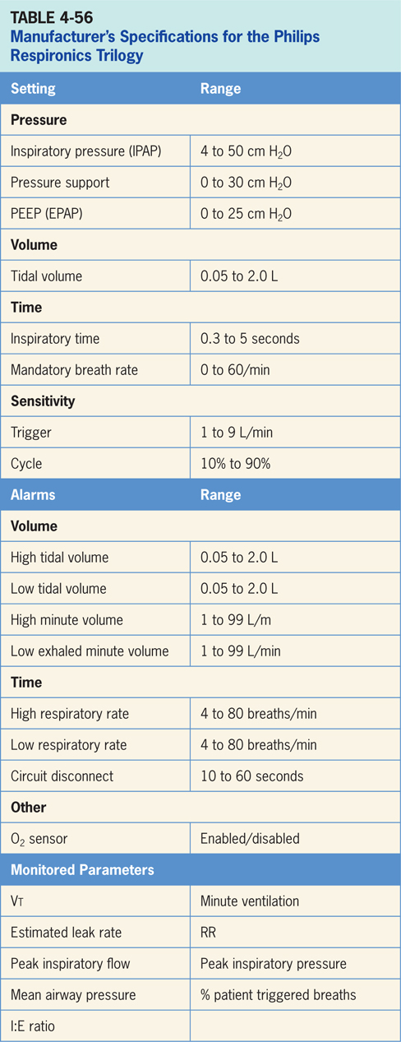

Slide 252
DeVilbiss IntelliPAP Bilevel S
Intended for use in treating OSA in spontaneously breathing patients 30 kg (66 lbs) and above by means of application of positive air pressure.³⁴
The device has automatic leak compensation and is intended to be used in home and clinical environments. (pictured in Figure 4-57)

Slide 253
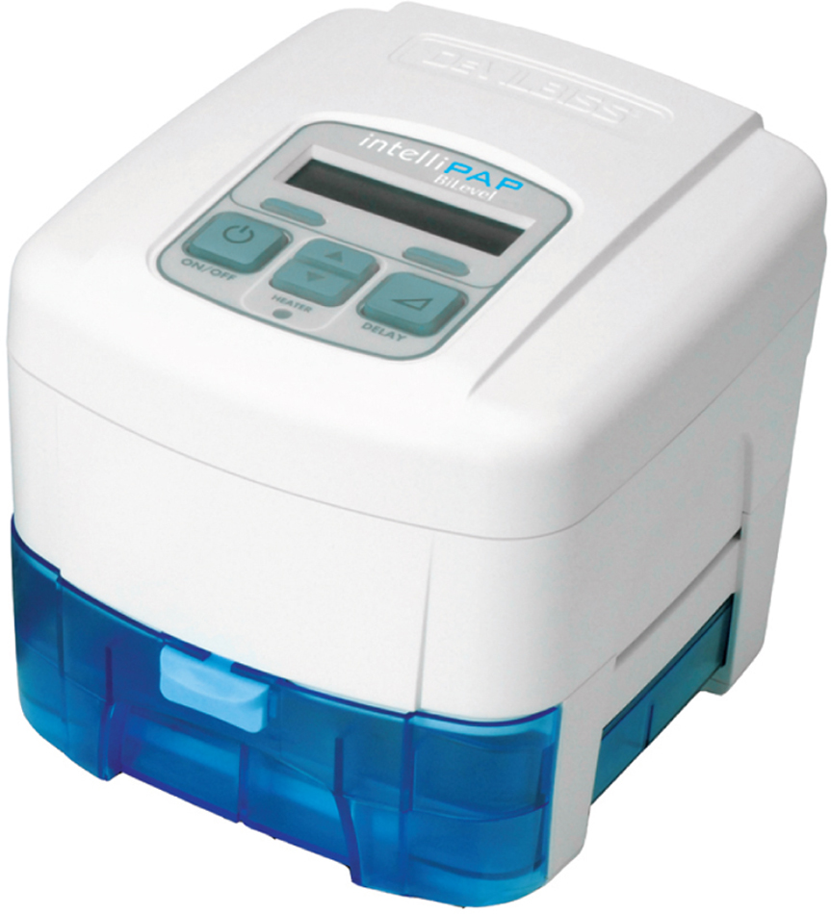
Figure 4.57

Slide 254
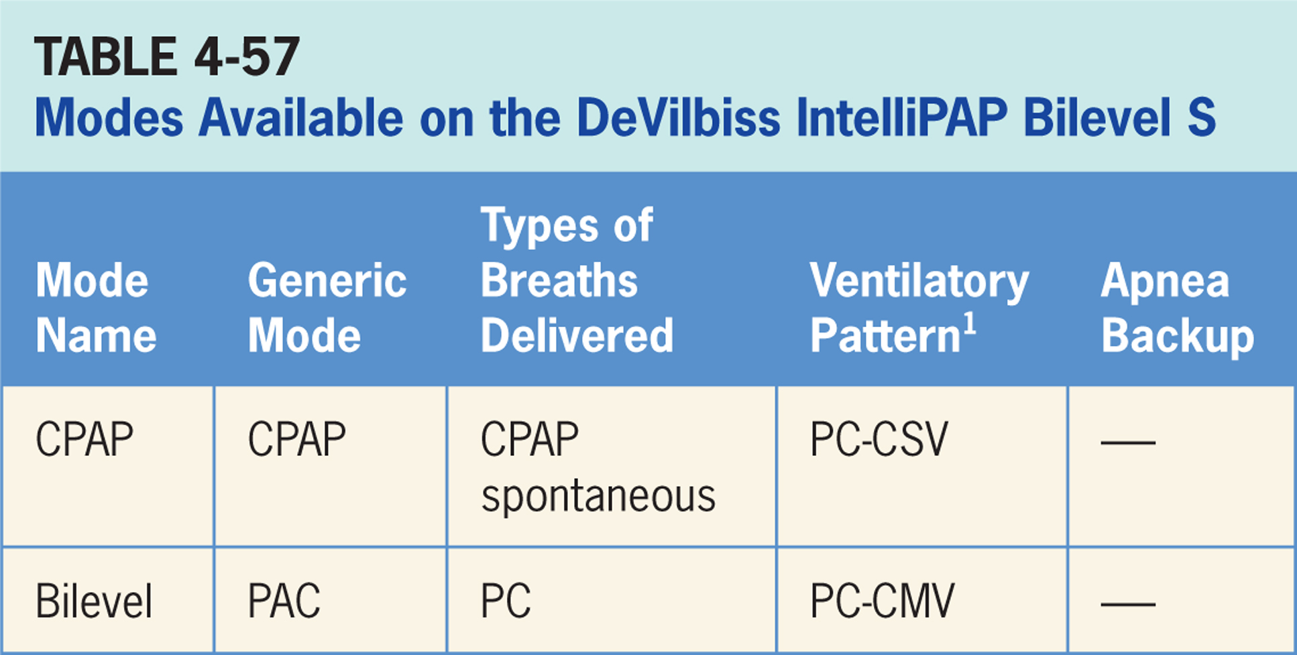

Slide 255
Continuous Positive Airway Pressure (CPAP)
Pressure-targeted mode of ventilation allowing for spontaneous breathing from a fixed pressure baseline.³⁴
No additional support is provided during inspiration.

Slide 256
Main Operator Controls Include:
CPAP
Ventilator provides a baseline pressure and the patient breaths spontaneously from that baseline; Vt and flow are variable and will depend on patient effort, and patient respiratory system mechanics.³⁴

Slide 257
Bilevel
Pressure-targeted mode that delivers patient triggered pressure assist breaths.³⁴

Slide 258
Main Operator Controls Include:
IPAP
EPAP
Vt created is variable and depends on inspiratory pressure level, patient effort, and patient respiratory system mechanics.³⁴

Slide 259
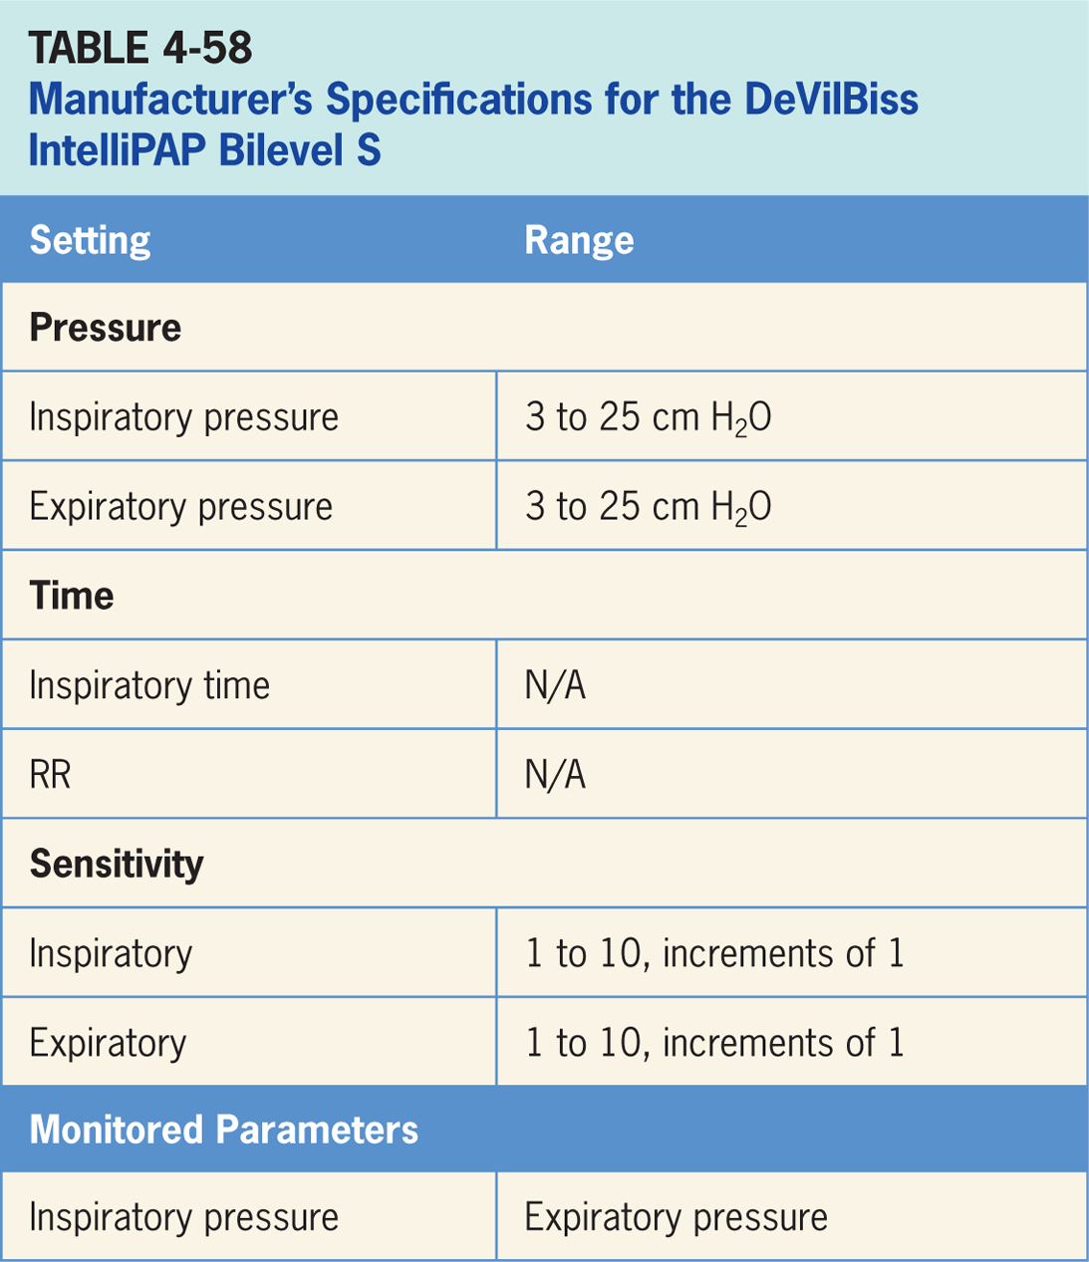

Slide 260
DeVilbiss IntelliPAP AutoBilevel
Intended for use in treating OSA in spontaneously breathing patients 30 kg (66 lbs) and above by means of application of positive air pressure.³⁵
Device has automatic leak compensation and is intended to be used in home and clinical environments. (pictured in Figure 4-58)
AutoBilevel is typically used for OSA patients with higher prescribed pressures.
During mode, ventilator automatically increases IPAP in response to clinical events such as hypopnea, apnea, and snoring.
EPAP level stays below the IPAP level by a constant amount.

Slide 261
Figure 4.58

Slide 263
Continuous Positive Airway Pressure (CPAP)
Pressure-targeted mode of ventilation allowing for spontaneous breathing from a fixed pressure baseline.³⁵
No additional support is provided during inspiration.

Slide 264
Main Operator Controls Include:
CPAP
Ventilator provides a baseline pressure and the patient breaths spontaneously from that baseline; Vt and flow are variable and will depend on patient effort, and patient respiratory system mechanics.³⁵

Slide 265
Bilevel
Pressure-targeted mode that delivers patient triggered pressure assist breaths.³⁵

Slide 266
Main Operator Controls Include:
IPAP
EPAP
Vt created is variable and depends on inspiratory pressure level, patient effort, and patient respiratory system mechanics.³⁵

Slide 268
ResMed Lumis Tx
A hospital ventilator designed for patients with sleep disordered breathing, central breathing disorders and respiratory insufficiency.³⁶
It is suitable for a variety of hospital environments.

Slide 269
Figure 4.59

Slide 271
CPAP Mode
Lumis delivers a constant baseline level of pressure during inspiration and expiration.³⁶
Patient receives no additional inspiratory pressure during inspiration.

Slide 272
Main Operator Controls Include:
Set pressure (CPAP)
Vt will be variable and depend on patient effort, and patient respiratory system mechanics.³⁶

Slide 273
ASV Mode
Pressure-targeted mode in which ventilator automatically adjusts pressure support level to meet a target minute ventilation.³⁶
Designed to consist of solely patient-initiated breaths, but a timed backup mandatory rate does exist that automatically calculates required breath rate to meet target minute ventilation.

Slide 274
Main Operator Controls Include:
EPAP
Max PS
Min PS
Vt and flow are variable and will depend on the delivered inspiratory pressure level, patient effort, and patient respiratory system mechanics.³⁶

Slide 275
ASVAuto Mode
ASVAuto mode automatically adjusts expiratory pressure in order to provide only the amount of EPAP required to maintain upper airway patency.³⁶
Designed to consist of solely patient initiated breaths but there does exist a timed backup mandatory rate that automatically calculates required breath rate to meet target minute ventilation.

Slide 276
Main Operator Controls Include:
Max EPAP
Min EPAP
Max PS
Min PS
Vt and flow are variable and will depend on delivered inspiratory pressure level, patient effort, and patient respiratory system mechanics.³⁶

Slide 277
Pressure A/C (PAC)
Pressure-targeted mode of ventilation mode that delivers pressure-controlled breaths.³⁶
Inspiration is initiated either by the ventilator at a set rate (time-triggered breath) or by the patient (spontaneous-triggered breath).
Ventilator cycles to expiration when the inspiratory time has been reached.

Slide 278
Main Operator Controls Include:
IPAP
EPAP
Inspiratory time
RR
Vt will be variable and depend on IPAP, patient effort, and patient respiratory system mechanics.³⁶

Slide 279
Spontaneous Mode
Bilevel pressure ventilation mode delivering pressure-supported spontaneous breaths.³⁶
Inspiration is initiated only by patient (spontaneous-triggered breath).
Breath cycles to expiration when inspiratory flow decreases below a preset percentage of the inspiratory peak flow.

Slide 280
Main Operator Controls Include:
EPAP
IPAP
Cycle
Vt will be variable and depend on IPAP, EPAP, patient effort, and patient respiratory system mechanics.³⁶

Slide 281
Spontaneous/Timed Mode (S/T)
A bilevel pressure ventilation mode delivering pressure-supported spontaneous breaths.³⁶
Inspiration is initiated either by the ventilator at a set rate (time-triggered breath) or by the patient (spontaneous-triggered breath).
Breath cycles to expiration when inspiratory flow decreases below a preset percentage of inspiratory peak flow.

Slide 282
Main Operator Controls Include:
EPAP
IPAP
RR
Cycle sensitivity
Vt will be variable and depend on IPAP, EPAP, patient effort, and patient respiratory system mechanics.³⁶

Slide 283
Timed (T) Mode
Bilevel pressure ventilation mode delivering pressure-targeted breaths.³⁶
Inspiration is initiated only by ventilator at a set rate (time-triggered breath).
Spontaneous breathing not allowed.
Breath cycles to expiration when inspiratory time has been reached.

Slide 284
Main Operator Controls Include:
EPAP
IPAP
RR
Ti
Vt will be variable and depend on IPAP, EPAP, patient effort, and patient respiratory system mechanics.³⁶

Slide 285
Intelligent Volume Assured Pressure Support (iVAPS)
Ventilator delivers a variable (from breath to breath) PS level in order to reach a clinician-set target alveolar ventilation.
Ventilator drops the level of support as patient effort increases and conversely increases the PS level when patient effort is too low. iVAPS also has a backup rate, if needed.

Slide 286
Main Operator Controls Include:
Target Va (L/min)
Target patient rate
Patient height
EPAP
Cycle sensitivity
Vt will be variable and depend on PS level, patient effort, and patient respiratory system mechanics.

Slide 288
ResMed Astral 100/150
Provides continuous or intermittent ventilatory support for patients weighing more than 11 lbs (5 kg) who require mechanical ventilation.³⁷
The Astral is intended to be used in home, institution/hospital and portable applications for both invasive and noninvasive ventilation and is suitable for a variety of hospital environments. (Figure 4-60)

Slide 289
Figure 4.60

Slide 291
(Assisted) Volume-controlled Ventilation (A)CV
Volume-targeted mode of ventilation (VAC) allowing for mandatory, time-triggered breaths or patient-assisted breaths.³⁷
Spontaneous breathing not allowed.
Breath cycles to exhalation once the tidal volume (Vt) has been delivered.

Slide 292
Main Operator Controls Include:
PEEP
Vt
Inspiratory flow
RR
Inspiratory time
Resulting pressure created is variable and depends on Vt, flow, and patient respiratory system mechanics.³⁷

Slide 293
Volume-synchronized, Intermittent Mandatory Ventilation (V-SIMV)
Combines two breath types, VAC and either PS or spontaneous breathing, while on CPAP.³⁷
Mandatory, time-triggered breaths, patient-assisted breaths, and spontaneous breaths are all provided.
Ventilator prevents “breath stacking” (a VAC breath compounded by a PS breath) through use of a “timing window.”
If patient attempts to trigger a breath in timing window, then ventilator will deliver a VAC breath.
If patient attempts to trigger a breath outside window, then a spontaneous breath will occur.

Slide 294
Main Operator Controls Include:
PEEP
Vt
Flow
SIMV rate
Inspiratory time
Pressure support level
Cycle sensitivity
During VAC breaths, resulting pressure created is variable and depends on Vt, flow, and patient mechanics.³⁷
During PS breaths, volume will be variable and depend on the PS level, patient effort, and patient respiratory system mechanics.³⁷

Slide 295
Assisted Pressure-controlled Ventilation P(A)CV
Pressure-targeted mode of ventilation allowing for mandatory, time-triggered breaths or patient-assisted breaths.³⁷
Spontaneous breaths not allowed.
Breath cycles to exhalation once the inspiratory time has been reached.

Slide 296
Main Operator Controls Include:
PEEP
Inspiratory pressure level
Inspiratory time
RR
Pressure will be consistently delivered from breath to breath; Vt and flow are variable and will depend on inspiratory pressure level, patient effort, and patient respiratory system mechanics.³⁷

Slide 297
Pressure-synchronized, Intermittent Mandatory Ventilation
Similar to V-SIMV except the target is now pressure instead of volume.³⁷
Combines two breath types, PAC and either PS or spontaneous breathing, while on CPAP.
Combination of mandatory, time-triggered breaths, patient-assisted breaths, and spontaneous breaths.
Ventilator prevents “breath stacking” (a PAC breath compounded by a PS breath) through the use of a “timing window.”
If patient attempts to trigger a breath in timing window, then ventilator will deliver a PAC breath.
If patient attempts to trigger a breath outside window, then a spontaneous breath will occur.

Slide 298
Main Operator Controls Include:
PEEP
Inspiratory pressure level
Inspiratory time
SIMV rate
Pressure support level
Cycle sensitivity
During PAC breaths, resulting Vt created is variable and depends on inspiratory pressure level, patient effort, and patient respiratory system mechanics.³⁷ During PS breaths, the volume will be variable and depend on the PS level, patient effort, and patient respiratory system mechanics.³⁷

Slide 299
Pressure Support (PS)
Pressure-targeted mode of ventilation allowing for mandatory, time-triggered breaths or patient-assisted breaths.³⁷
Breath cycles to expiration when inspiratory flow decreases below a preset percentage of the inspiratory peak flow.

Slide 300
Main Operator Controls Include:
PEEP
RR
Pressure support level
Cycle sensitivity
Vt will be variable and depend on PS level, patient effort, and patient respiratory system mechanics.³⁷

Slide 301
Continuous Positive Airway Pressure (CPAP)
A baseline pressure is maintained by the ventilator and then receives no additional support during the spontaneous breaths.³⁷
Other than baseline pressure, patient controls all other aspects of the breath.

Slide 302
Main Operator Controls Include:
CPAP
The Vt will be variable and depend on patient effort and patient respiratory system mechanics.³⁷

Slide 303
(Spontaneous) Timed (S/T) Mode (S)T
A bilevel pressure ventilation mode delivering pressure-supported spontaneous breaths.³⁷
Inspiration is initiated either by ventilator at a set rate (time-triggered breath) or by the patient (spontaneous-triggered breath).
Breath cycles to expiration when inspiratory flow decreases below a preset percentage of the inspiratory peak flow.

Slide 304
Main Operator Controls Include:
EPAP
IPAP
RR
Cycle sensitivity
Vt will be variable and depend on IPAP, EPAP, patient effort, and patient respiratory system mechanics.³⁷

Slide 305
Pressure (Assist) Control P(A)C
A bilevel pressure ventilation mode delivering pressure-targeted breaths.³⁷
Inspiration is initiated either by ventilator at a set rate (time-triggered breath) or the patient.
Breath cycles to expiration when the inspiratory time has been reached.

Slide 306
Main Operator Controls Include:
EPAP
IPAP
RR
Ti
Vt will be variable and depend on IPAP, EPAP, patient effort, and patient respiratory system mechanics.³⁷

Slide 307
Intelligent Volume-assured Pressure Support (iVAPS)
Ventilator delivers a variable (from breath to breath) PS level in order to reach a clinician-set target alveolar ventilation.³⁷
Ventilator drops the level of support as patient effort increases and conversely increases the PS level when patient effort is too low. iVAPS also has a backup rate, if needed.

Slide 308
Main Operator Controls Include:
Target Va (L/min)
Target patient rate
Patient height
EPAP
Cycle sensitivity
The Vt will be variable and depend on PS level, patient effort, and patient respiratory system mechanics.³⁷

